Slide 1
BIO00058M: Sequence Analysis Lecture 5 Genome browsers
Kanchon Dasmahapatra
kanchon.dasmahapatra@york.ac.uk
Room J101

Slide 2
L5: Learning objectives
Understand the main sequence databases used in biology
Understand what genome browsers are for

Slide 3
Sequence databases
Submitting raw sequence data to databases is a requirement of publication
There are many DNA/gene expression/protein databases.
The main providers of sequence database are:
The National Center for Biotechnology Information (NCBI), USA https://www.ncbi.nlm.nih.gov/guide/all/
DNA Data Bank of Japan (DDBJ), Japan https://www.ddbj.nig.ac.jp/index-e.html
European Nucleotide Archive, UK https://www.ebi.ac.uk/ena
The data in these three databases are synchronized every day

Slide 4
Sequence databases
There are many other sequence databases. Some prominent ones are:
For protein sequences (mostly inferred from DNA sequences of genes)
Uniprot https://www.uniprot.org/ (see also: https://en.wikipedia.org/wiki/UniProt)
PFAM https://pfam.xfam.org/
CATH http://www.cathdb.info/
SCOP http://scop2.mrc-lmb.cam.ac.uk/
Protein Data Bank (PDB) three-dimensional structural data http://www.wwpdb.org/
For gene expression data
Gene Expression Omnibus (GEO, at NCBI), https://www.ncbi.nlm.nih.gov/gds
ArrayExpress https://www.ebi.ac.uk/arrayexpress/

Slide 5
What are genome browsers for?
Vast amounts of information is associated with a genome
Genome browsers allow many layers of information to be displayed cleanly

Slide 6
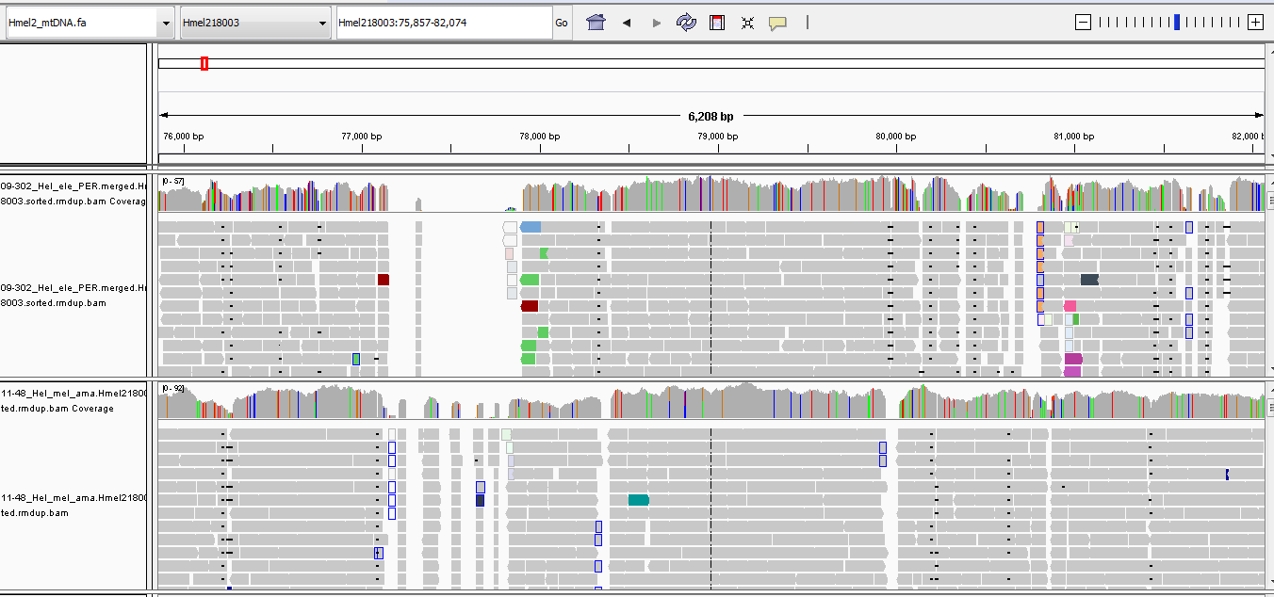
IGV: Integrated Genome Viewer
Good for viewing the quality of your alignments to a genome
http://software.broadinstitute.org/software/igv/home

Slide 7
Ensembl genome browser
Allows viewing of genomes together with
Annotations: genes, repeats, regulatory regions
Alternative splicing
Variants
Conserved regions
Gene trees
Upload and view your own bam and vcf files
And much more…

Slide 8
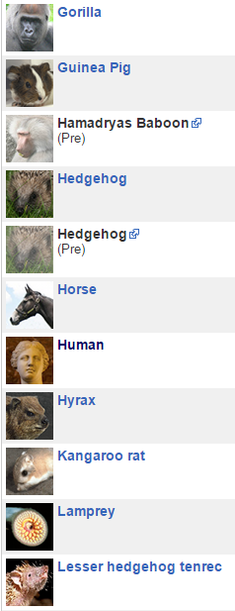
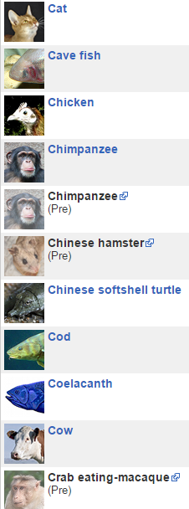
What genomes can be viewed?
Ensemble
244 vertebrates (plus Drosophila, C. elegans, yeast)

Slide 9
What genomes can be viewed?
Ensemble
244 vertebrates (plus Drosophila, C. elegans, yeast)
Ensemble Genomes
Ensembl Bacteria: over 44,048 genomes
Ensembl Fungi: 1014 genomes from 523 species
Ensembl Protists: 237 genomes
Ensembl plants: 67 genomes
Ensembl metazoan: 78 genomes
and counting….

Slide 10
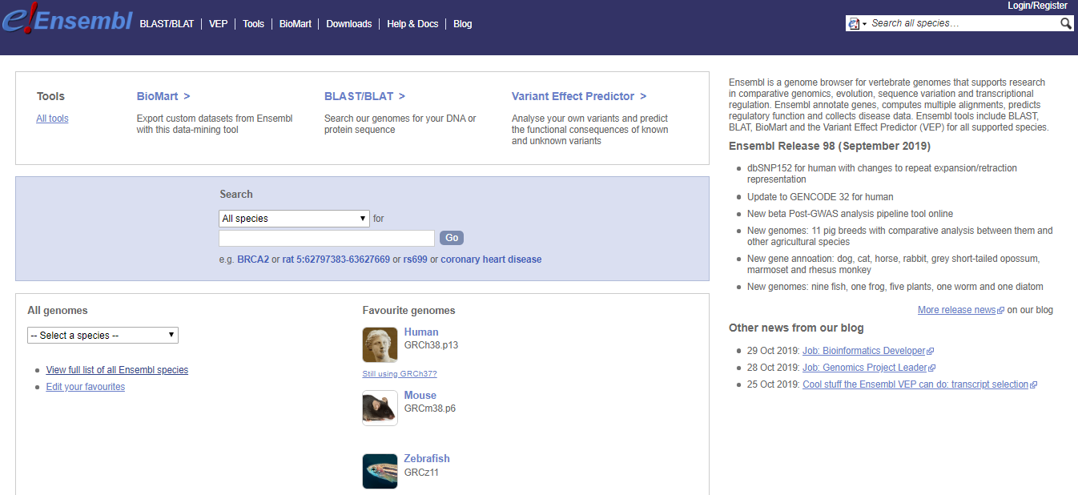
Ensemble: http://www.ensembl.org

Slide 11
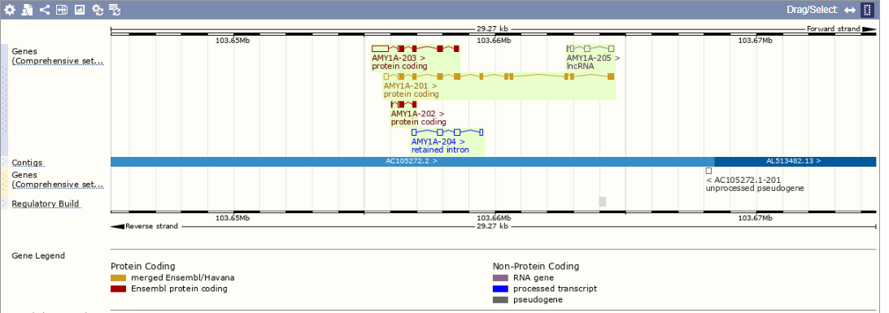

Slide 12
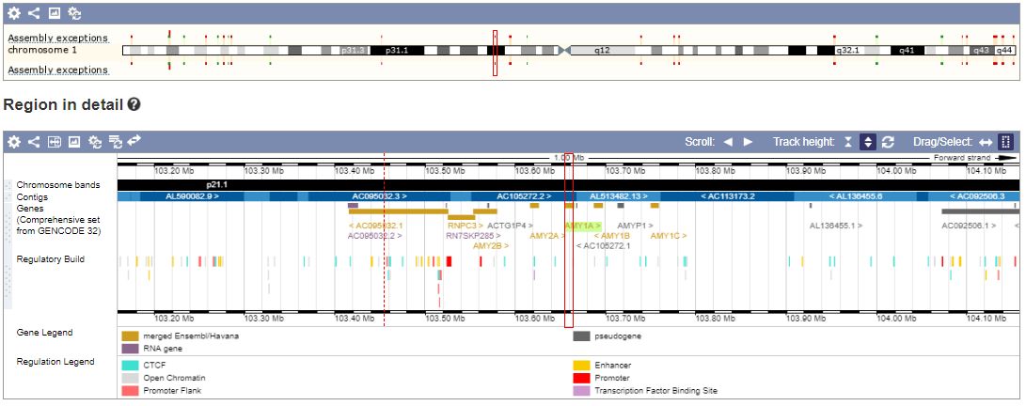
Region in detail

Slide 13
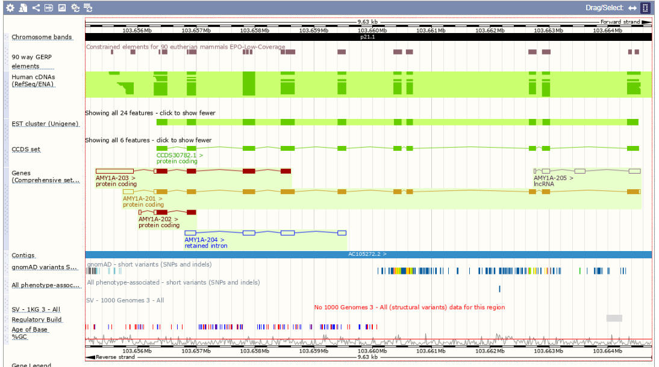
Region in detail

Slide 14
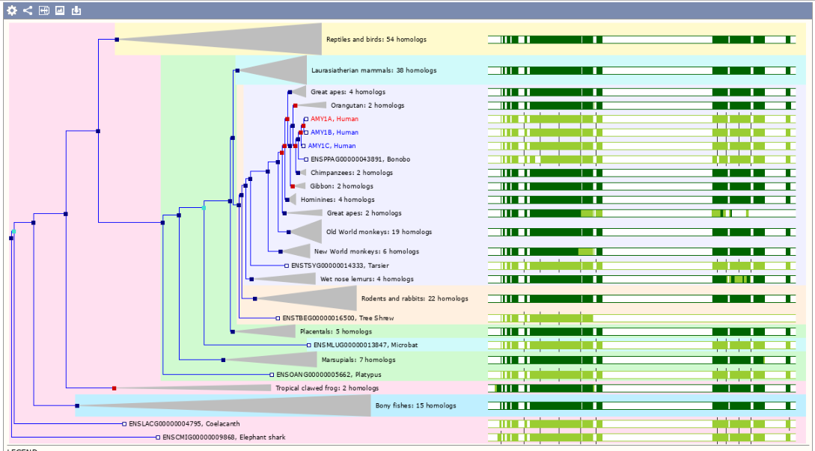
Gene trees

Slide 15
PomBase: an advanced browser
A database for the model yeast species Schizosaccharomyces pombe:
– genome browser
– gene information pages
– structural and functional annotation
– literature curation
– access to large-scale data sets
• Landing page: https://www.pombase.org
• Gene page: https://www.pombase.org/gene/SPAP8A3.13c
• Gene-based queries: https://www.pombase.org/query
• Community data submission: https://www.pombase.org/submit-data
• Data downloads: ftp://ftp.pombase.org/nightly_update/
• Community annotation: https://curation.pombase.org/pombe/

Slide 16
Using genome browsers
Getting started with the PomBase browser
https://www.pombase.org/documentation/JBrowse_quick_start
Using the ENSEMBLE genome browser
http://www.ebi.ac.uk/training/online/course/ensembl-browsing-chordate-genomes

Slide 17
Assessment
Population genomics of fission yeast
https://www.york.ac.uk/res/dasmahapatra/teaching/MBiol_sequence_analysis/pombe_projects_2019.html
L5 + W5: Project plans and help with projects
W6: Extra project help session (AEW004; 15 Nov 13:00-15:00)

