Slide 1
BIO00058M: Sequence Analysis Lecture 4 Population genomic analyses
Kanchon Dasmahapatra
kanchon.dasmahapatra@york.ac.uk
Room J101

Slide 2
Assessment
Population genomics of fission yeast
https://www.york.ac.uk/res/dasmahapatra/teaching/MBiol_sequence_analysis/pombe_projects_2019.html
L5 + W5: Project plans and help with projects
W6: Extra project help session

Slide 3
L4 + W4: Learning objectives
How to interpret principal component analysis of population structure
How to implement principal component analysis of population structure from a VCF file
Understand the population genomic parameters pi, Tajima’s D and Fst
How to estimate pi, Tajima’s D and Fst from a VCF file

Slide 4
40 billion bases….what do I do with them?
Clean/trim
sequences cutadapt, Reaper, Trimmotomatic
Check average
quality statistics
FastQC
Fastq files
(reads)
de novo assembly
SGA
Velvet, CLCbio, and many others
Compare to other sequences/genomes
BLAST, Cactus Genome-alignment
Annotate (locate and mark up the genes)
Augustus
Align to a
reference genome or
transcriptome
BWA
NextGenMap
Novoalign
Structural variant ‘calling’
Delly, GenomeSTRiP, Lumpy
Remove
PCR
Duplicates
Picardtools
Samtools
SNP and indel ‘calling’
GATK, Samtools, Freebayes
Make vcf files (variant call format)
VCF filtering
bcftools,
vcftools, GATK
Biological analysis
vcftools, Admixture
Many, many others

Slide 5
Variant calling and genotyping
Software
Freebayes
The Genome Analysis Took Kit (GATK)
Outputs a vcf file (variant call format)
REF
base
ALT
base
HE670865 400036 . A C 394.38 . AC=5;AF=0.250;AN=20;BaseQRankSum=3.199;DP=254;Dels=0.00;FS=25.982;HaplotypeScore=5.0148;InbreedingCoeff=0.7136;MLEAC=5;MLEAF=0.250;MQ=42.64;MQ0=0;MQRankSum=-4.172;QD=9.39;ReadPosRankSum=2.020 GT:AD:DP:GQ:PL 0/0:51,0:52:99:0,138,1750 1/1:0,6:6:12:131,12,0 0/1:18,6:25:61:61,0,526
https://software.broadinstitute.org/gatk/
https://github.com/ekg/freebayes

Slide 6
Population genomics
When people, animals, plants or microbes travel, they carry their DNA with them.
Every individual carries its history within its DNA
Because we know the ‘rules’ (mutation, drift, recombination) population movements can be modelled
Because populations can have small contributions from one/other populations, this can’t always be drawn on a phylogenetic tree.
Variants tend to remain within their original population

Slide 7
What is population genomics?
Population genetics is the study of genetic variation within species.
Population genomics expands the data to study variation within species using whole genome data.
Population genomics:
Is more challenging data to gather, more expensive, more challenging to analyse
Genome-scale data produces a more comprehensive picture
Demography (population size, migration, population structuring)
Natural selection (purifying, adaptive, balancing)
Demography, selection and quantitative genetics are intimately related.

Slide 8
Collecting population genomics data
Hypothesis/query
Sample collection and DNA extraction
Choose geographic/habitat region of interest
Gather hundreds to thousands of individuals (strains/subjects) from within a species (sometimes tens of thousands)
Extract genomic DNA from each individual
Genome sequencing
Aim: to obtain sequence data covering the entire genome 5x to 40x coverage
Coverage: how many reads per site
Sequence genome using ‘short read’ technology (usually Illumina)
Main issue: cost/base
Reads from one individual, aligned to a reference genome
2x coverage
4x coverage

Slide 9
Collecting population genomics data
Read mapping and ‘variant calling’
Locate genetic variants (sites the genome that differ between individuals, polymorphisms)
eg: SNPs, indels etc
By mapping (aligning) sequence reads to a reference genome, and identifying sites the genome that differ
Segregating genetic variants are (usually) the final data set
A list of positions that vary. Alleles/polymorphisms/variants.
Analysis:
Describing demography
Detecting selection
Quantitative genetics (like GWAS)
Some other strain/individual we are comparing to the reference genome
reference genome
Reads from one individual, aligned to a reference genome

Slide 10
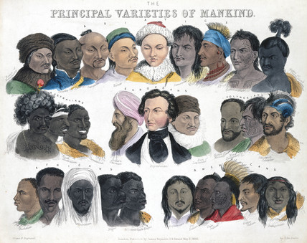

Slide 11
What affects population structure?
Genetic drift
Gene flow
Selection

Slide 12
PCA for measuring population structure
A way of describing variation in complex multidimensional datasets
Widely used method for visualising genetic distances and relatedness between populations.

Slide 13
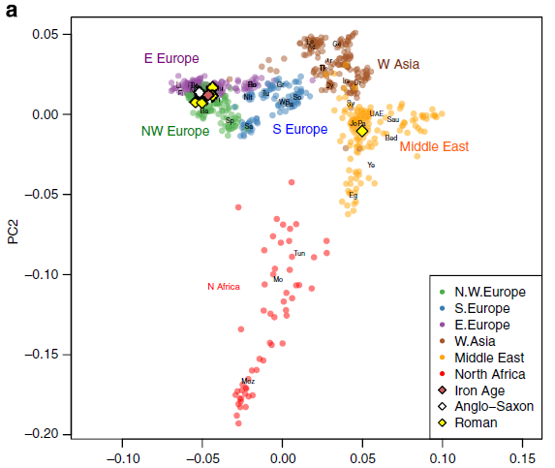
Ancient genomes compared to modern European and Middle Eastern genomes
Modern genomes
Martiniano et al (2015) Genomic signals of migration and continuity in Britain
before the Anglo-Saxons. Nature Communications 7:10326

Slide 14
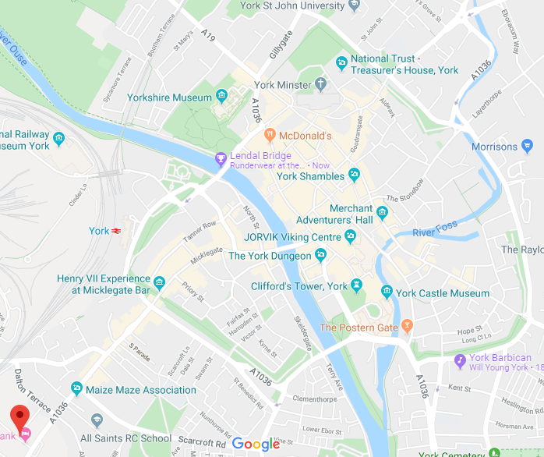
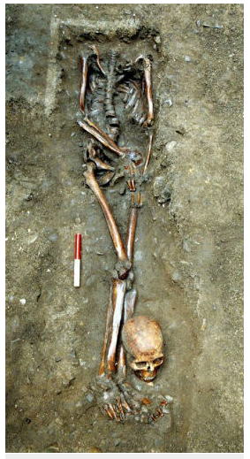
Ancient genomes from Northern Britain
9 ancient human genomes sequences
7 from Roman era cemetery in York (200-400 AD)
1 Iron Age (200BC – 40 AD)
1 Anglo Saxon (650-900 AD)
Martiniano et al (2015) Genomic signals of migration and continuity in Britain
before the Anglo-Saxons. Nature Communications 7:10326

Slide 15
Ancient genomes compared to modern European and Middle Eastern genomes
Modern genomes
Ancient genomes
Martiniano et al (2015) Genomic signals of migration and continuity in Britain
before the Anglo-Saxons. Nature Communications 7:10326

Slide 16
Concept: genetic diversity
Genetic diversity: the life of a SNP
Variants tend to remain within their original population
Most variants are rare
One population
Physically linked variants tend to travel together
Another population
Many signals can be found within polymorphism data.
The patterns of polymorphism data are complex.
Hence: summary statistics

Slide 17
Genetic divergence, Fst
A measure of genetic difference between populations
Fst ranges from 0 to 1
Populations that share many SNPs and have similar allele frequencies have low Fst (close to 0)
Populations with many SNP differences between them will have high Fst (close to 1)

Slide 18
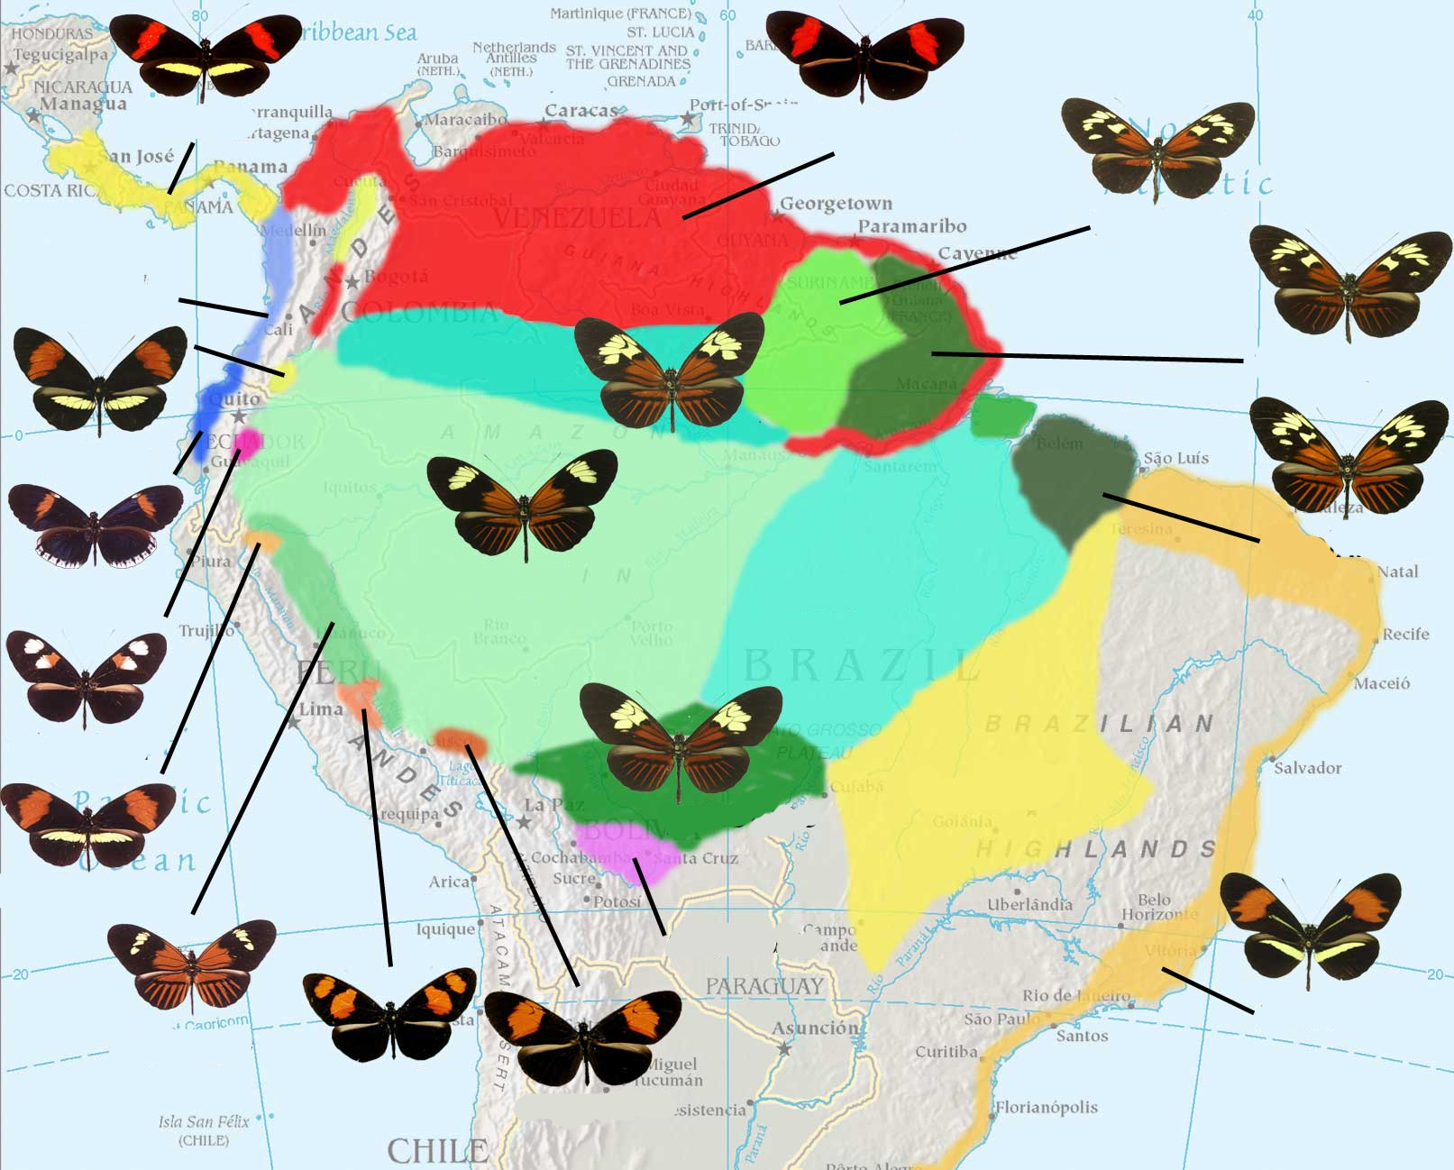

Heliconius
melpomene

Slide 19
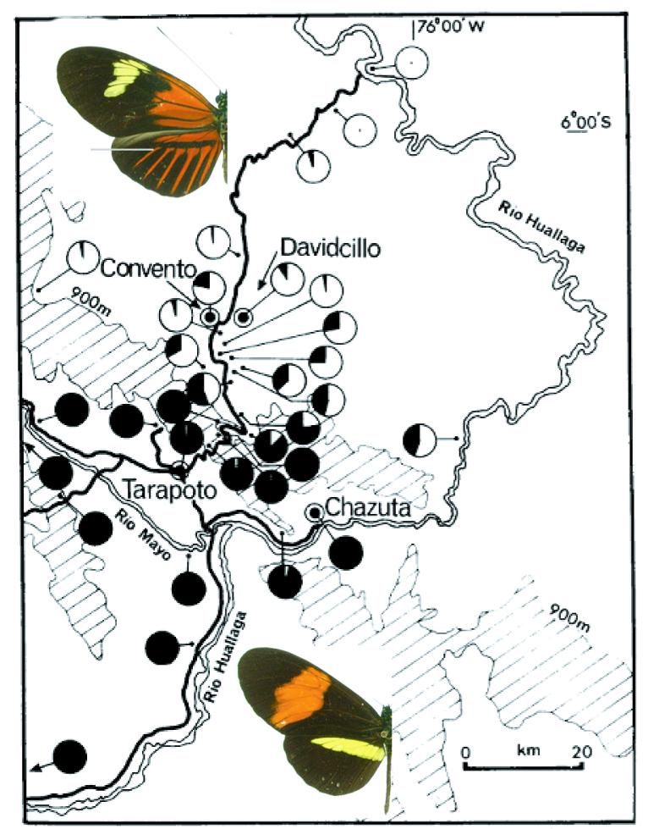
Subspecies of H. melpomene
H. melpomene
aglaope
B/D : red patterns
Yb: yellow patterns
H. melpomene
amaryllis

Slide 20
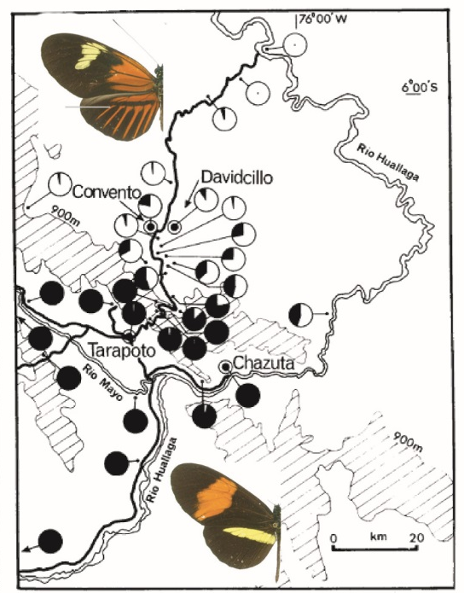
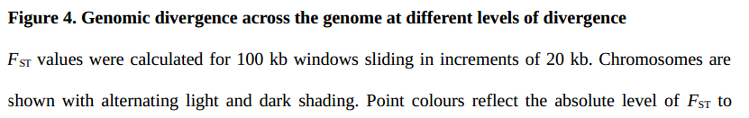
Divergence (F_{ST}) between subspecies of H. melpomene
H. melpomene
aglaope
H. melpomene
amaryllis
Martin et al (2014) Genome-wide evidence for speciation
with gene flow in Heliconius butterflies. Genome Research

Slide 21
Genetic diversity summary statistics
Average pairwise similarity (‘diversity’, π):
If we compare every sequence to every other, what is the average number of differences?
The number of segregating sites (S):
Allele frequencies:
Minor allele frequency (MAF)
Derived allele frequency (DAF)
Each of these statistics can be described as:
A histogram (a distribution)
Plots along chromosomes
A genomic site/gene
from many individuals within a species
ATCCCG-TAAATTTT AGCCCG-TAAATTTT AGCCCGTTAAATTTT AGCCCGTTAAATTTT
Ancestral state
See:
Nucleotide diversity (π) on Wikipedia: https://en.wikipedia.org/wiki/Nucleotide_diversity
Watterson estimator of 𝚯 on Wikipedia https://en.wikipedia.org/wiki/Watterson_estimator

Slide 22
Tajima’s D
Tajima’s D uses summary statistics to detect
selection or demography
The expected number of segregating sites, 𝚯 =
In a neutral site π = 𝚯
Fumio Tajima worked out that π ≠ 𝚯 in certain circumstances
Tajima’s D is approximately = π - 𝚯
When D is negative: excess of rare alleles
selective sweep or expanding population after bottleneck
When D is positive: lack of rare alleles
Balancing selection or shrinking population
S is the number of segregating sites
N is the number of sequences compared
For six sequences:
Sum of: 1 + 1/2 + 1/3 +1/4 +1/5
In theory, 𝚯 = π = 4Nμ
Where N = population size
μ = mutation rate
So π can give us an estimate of population size.
Tajima’s D on Wikipedia https://en.wikipedia.org/wiki/Tajima%27s_D
Excellent explanation of π, 𝚯 and Tajima’s D on Youtube: https://www.youtube.com/watch?v=wiyay4YMq2A

Slide 23
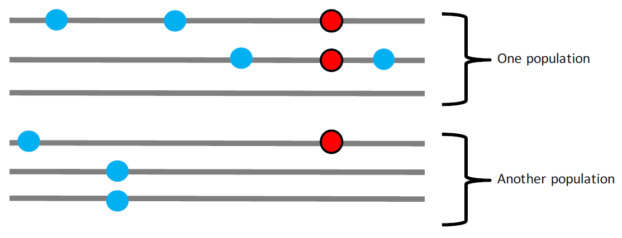
Tajima’s D
Concept: genome-wide summary statistics: Tajima’s D
Tajima’s D = 0
Neutrally evolving, stable population
When D is negative:
more rare alleles than expected
selective sweep
or expanding population
When D is positive:
Lack of rare common alleles
balancing selection
shrinking population
Tajima’s D on Wikipedia https://en.wikipedia.org/wiki/Tajima%27s_D
Excellent explanation of π, 𝚯 and Tajima’s D on Youtube: https://www.youtube.com/watch?v=wiyay4YMq2A

Slide 24
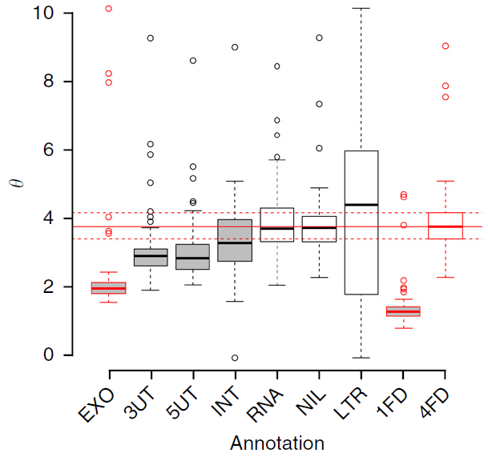
Concept: Purifying selection – expectations and observations
Purifying selection (negative selection)
Purifying is the loss of deleterious (harmful) variants
This process will
Reduce diversity in regions that are important
Increase the proportion of rare alleles
Cause negative Tajima’s D
Purifying selection is expected to be a common event
exons (EXO), 5′ and 3′ UTRs (5UT and 3UT), introns (INT), lncRNAs (RNA), unannotated regions (NIL), LTRs of Tf2 family transposons (LTR), and onefold-degenerate (1FD) and fourfold-degenerate (4FD) sites in exons. Protein-coding categories have red borders.

Slide 25
Positive selection (adaptive evolution)
Concept: Adaptive evolution – expectations and observations
Adaptive evolution is the the increase in frequency of an adaptive (helpful) variant
This process will
Reduce diversity around the beneficial allele
Increase rare alleles
Cause negative Tajima’s D
Strong adaptive evolution is expected to be a rare event

Slide 26
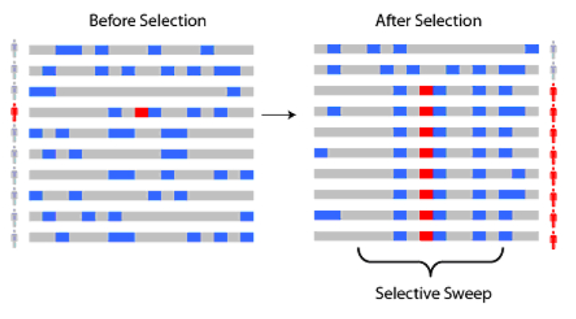
Linkage and selective sweeps
Concept: Linkage of alleles on chromosomes
When a strongly beneficial allele arises it will ‘sweep’ through the population.
This will cause strong genetic signatures in the genome:
loss of diversity around the sweep (asses by looking at π)
increase in linkage (look at linkage)
Alleles are referred to as ‘linked’ when they are often found together linkage is strongest for alleles that site close on the same chromosome
strong linkage
weaker linkage
See: https://en.wikipedia.org/wiki/Selective_sweep
unlinked alleles

Slide 27
Conclusions
Population genomics is the study of variation within species using whole genome data
Measure population structure using PCA
Can also measure genetic divergence using Fst
Changes in Fst, pi and Tajima’s D along a genome can be informative about variation in selection.

