Slide 1
BIO00058M: Sequence Analysis Lecture 3 High-throughput sequencing Part 2
Kanchon Dasmahapatra
kanchon.dasmahapatra@york.ac.uk
Room J101

Slide 2
L3 + W3: Learning objectives
Have a understanding of resequencing genomes
Aligning to a reference genome
PCR duplicates
SNP/indel calling
Have a basic understanding of de novo genome assembly
agp and gff files
Introduction to group projects

Slide 3
40 billion bases….what do I do with them?
Clean/trim
sequences cutadapt, Reaper, Trimmotomatic
Check average
quality statistics
FastQC
Fastq files
(reads)
de novo assembly
SGA
Velvet, CLCbio, and many others
Compare to other sequences/genomes
BLAST, Cactus Genome-alignment
Annotate (locate and mark up the genes)
Augustus
Align to a
reference genome or
transcriptome
BWA
NextGenMap
Novoalign
Structural variant ‘calling’
Delly, GenomeSTRiP, Lumpy
Remove
PCR
Duplicates
Picardtools
Samtools
SNP and indel ‘calling’
GATK, Samtools, Freebayes
Make vcf files (variant call format)
VCF filtering
bcftools,
vcftools, GATK
Biological analysis
vcftools, Admixture
Many, many others

Slide 4
Whole genome ‘resequencing’
Usually used to collect information about diversity within a species (other uses also possible)
Mapping/aligning to an existing reference genome
Computationally easier than de novo assembly
Much cheaper than de novo assembly
These projects can have impressive scales: The 100,000 Genomes Project has sequenced 100,000 genomes from around 70,000 people. Participants are NHS patients with a rare disease, plus their families, and patients with cancer. See: https://www.genomicsengland.co.uk/the-100000-genomes-project/
In workshops we will use some population sequencing data from the parasite Leishmania infantum.
In your projects you will be examining population sequencing data from the fission yeast, Schizosaccharomyces pombe

Slide 5
Aligning to a reference genome
Different aligners available
BWA: for less divergent sequences (fast)
NextGenMap: for more divergent sequences (slow)

Slide 6
ReadGroup information
bwa mem -t 2 \
-R '@RG\tID:S1\tSM:S1\tPL:Illumina' \
TriTrypDB-39_LdonovaniBPK282A1_Genome.fasta \
Sample1_R1.q20.fastq.gz \
Sample1_R2.q20.fastq.gz \
2> Sample1.bwamem.log \
> Sample1.q20.sam &
Each sample needs to have a unique ID and SM

Slide 7
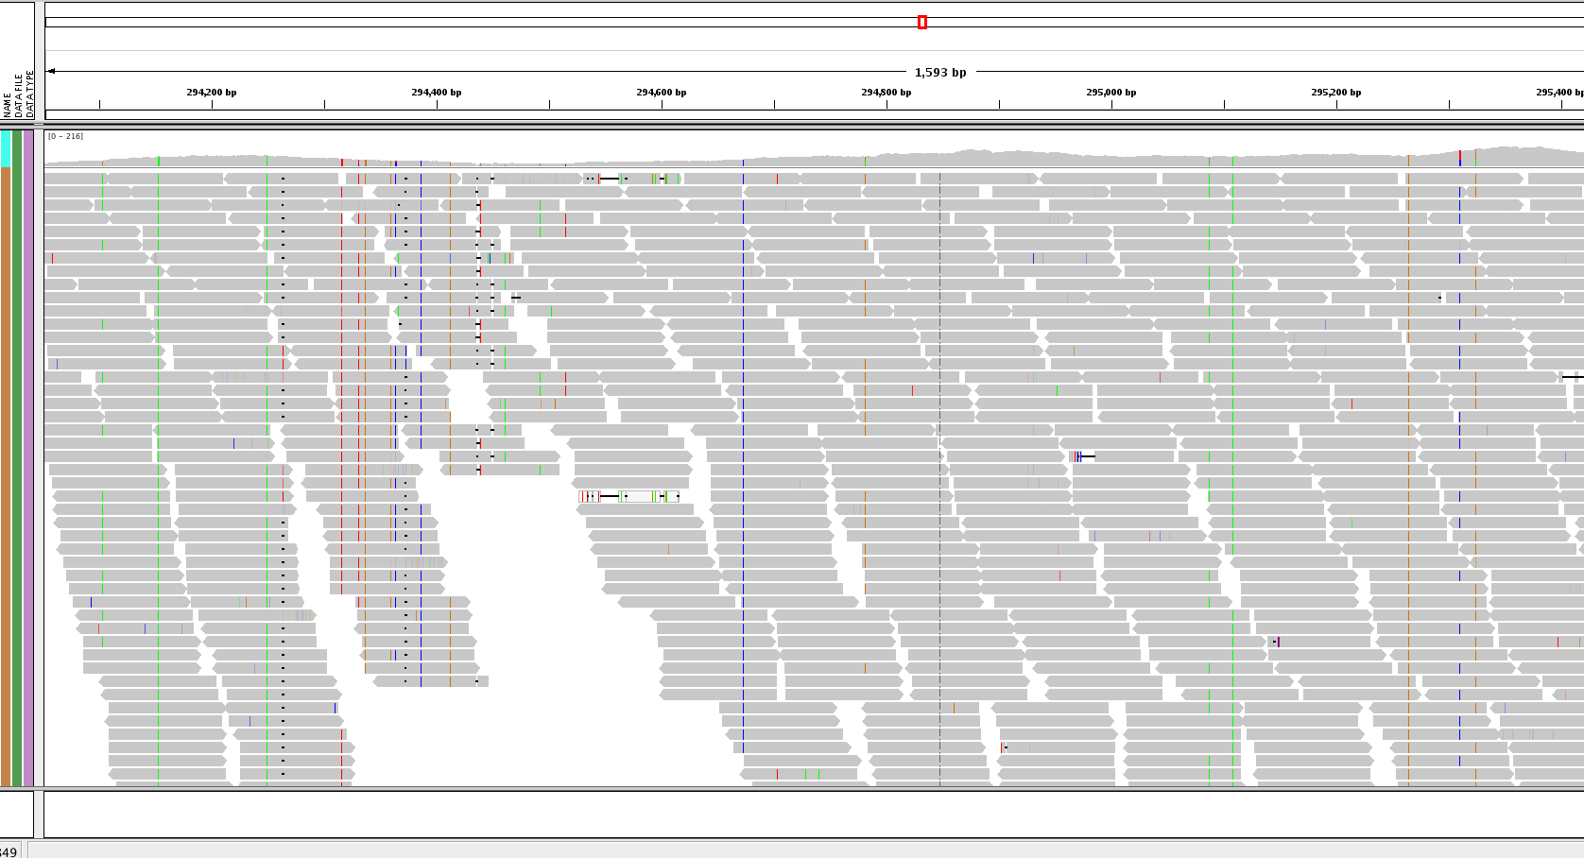
Whole-genome resequencing

Slide 8
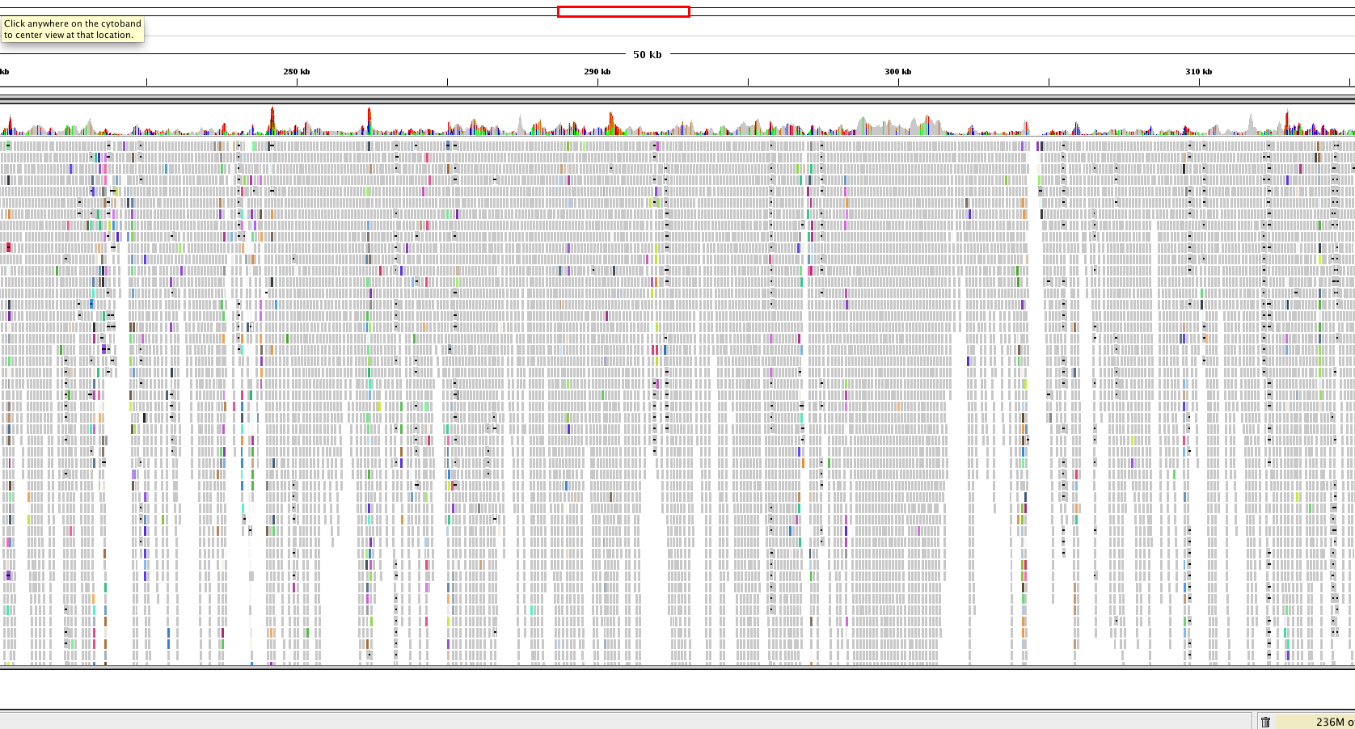
Whole-genome resequencing

Slide 9
Aligning to a reference genome
Different aligners available
BWA: for less divergent sequences (fast)
NextGenMap: for more divergent sequences (slow)
SAM: Sequence Alignment/Map format (https://samtools.github.io/hts-specs/SAMv1.pdf)
BAM is a compressed SAM file

Slide 10
@SQ SN:chr1 LN:278268
@SQ SN:chr2 LN:356299
@SQ SN:chr3 LN:389660
@SQ SN:chr4 LN:466506
@SQ SN:chr5 LN:467711
@SQ SN:chr6 LN:525234
@SQ SN:chr7 LN:592865
@SQ SN:chr8 LN:515744
@SQ SN:chr9 LN:581921
@SQ SN:chr10 LN:588571
@SQ SN:chr11 LN:568610
@SQ SN:chr12 LN:593479
@SQ SN:chr13 LN:659809
@SQ SN:chr14 LN:656122
@SQ SN:chr15 LN:650312
@SQ SN:chr16 LN:688194
@SQ SN:chr17 LN:690898
@SQ SN:chr18 LN:720421
@SQ SN:chr19 LN:706116
@SQ SN:chr20 LN:731246
@SQ SN:chr21 LN:764851
@SQ SN:chr22 LN:782138
@SQ SN:chr23 LN:786675
@SQ SN:chr24 LN:863800
@SQ SN:chr25 LN:895070
@SQ SN:chr26 LN:1055294
@SQ SN:chr27 LN:1175405
@SQ SN:chr28 LN:1205018
@SQ SN:chr29 LN:1272412
@SQ SN:chr30 LN:1353282
@SQ SN:chr31 LN:1529233
@SQ SN:chr32 LN:1544753
@SQ SN:chr33 LN:1532280
@SQ SN:chr34 LN:1852060
@SQ SN:chr35 LN:2019666
@SQ SN:chr36 LN:2743046
@RG ID:S3 SM: S3 PL:Illumina
@PG ID:bwa PN:bwa VN:0.7.17-r1188 CL:bwa mem -t 2 -R @RG\tID:S3\tSM: S3\tPL:Illumina LinJ_cbm_v1.fasta Sample3_R1_fastq.q20.gz Sample3_R2_fastq.q20.gz
J00125:7:HJ772BBXX:5:1101:3437:1332 83 chr31 361505 0 151M = 361476 -180 TCACCCACGACGCCACACCGCATCGCGTCCACTCGGTAGGAAGAGGGAGAGACGCAAGGGGGAGGGGGGAGGCGGCGAGGAAGGGAGGACACCGGGCGCAAGAGACGACGCAGAAGATAAGCCACAAACAAGAGGGAGAGAGGAGGAGNAG 7AJAF<FFFJJJFJJJ<JJJJJJJJJJJJFFAFJJFJJJJJJJJJFJJJJJJJJJJJJJJJJJJJJJJJJFJJJAFJJJAJJJJJJJJJAJJJJJJFF<JJJJJJJJJJJJJJJJJJJJJJJJJJJJJJJJJJJJJJJJFFF7JFJFF#AA NM:i:1 MD:Z:148G2 MC:Z:151M AS:i:149 XS:i:149 RG:Z:S3 XA:Z:chr31,-353856,151M,1;chr31,-369151,151M,1;
J00125:7:HJ772BBXX:5:1101:3437:1332 163 chr31 361476 0 151M = 361505 180 CTCGGCGTGATTGCGTTTGCTCCGTCCCTTCACCCACGACGCCACACCGCATCGCGTCCACTCGGTAGGAAGAGGGAGAGACGCAAGGGGGAGGGGGGAGGCGGCGAGGAAGGGAGGACACCGGGCGCAAGAGACGACGCAGAAGATAAGC AAFFFJ<AJJJJJJJJJJJJJJJJJJFJJJJJJJJJJJJJJJJJJJJJJJJJJJJJJJJJJJJJJJJJJJJFFJ-FJFFJJJFFJJJ7F<FAFAJF-<A<JFFAAAJJJJ<FJ<AA-AAJAAF--<-<JJJJ-F-AF7-7AAAFJJ<FJ-7 NM:i:0 MD:Z:151 MC:Z:151M AS:i:151 XS:i:151 RG:Z:S3 XA:Z:chr31,+353827,151M,0;chr31,+369122,151M,0;
J00125:7:HJ772BBXX:5:1101:5203:1332 99 chr22 572045 60 150M = 572202 307 AANCCGGAAGGCAGTGTATGGACGAAGCACCTGAGCTGTCGAGTAGGTACAGAGAAAGACAGACACACAGAGGGCGGAGGGAAGGGGGAGGCACGCGCGTGCTGTTGCTGATTATACCGCCTTTGTTTTCTGGCTTCTCTTATTCGCTTT AA#FFJJJJJJJJJJJJJJJJJJJJJJJJJJJJJJJJJJJJJJJJJJJJJJJJJJJJJJJJJJJJJJJJJJJJJJJFJJJJJJJJJFFJJJJJJFFJJJJJJJJJJJJJJJJJJJFJAAFFFFJJJJJJJJAAA7FJFFFFJFFA<F7<F NM:i:1 MD:Z:2G147 MC:Z:150M AS:i:148 XS:i:0 RG:Z:S3
J00125:7:HJ772BBXX:5:1101:5203:1332 147 chr22 572202 60 150M = 572045 -307 GTTGTTTGATGTGCGTGTGTGCTTGTGCGGCTCCCGGCATGTGCCACCGTGATAATGGTGGTGGTAGTGGTGGTACGTGCGAAGAGCAGCACCGACGAACGTGTACGGATGTCAAGAGGGCAAGAAAAGGGAAGCGATGGAGGGGATAGG 7JJJFAJA-)JFFAJFFA-<A-F-A-7))<AF<FJJFJFJJF<)))FFJAJJJJJJJJJJJFFJJJJJJJJJJJJJJJJJJJJJJJJJJ<JJJJJFJJJFJJJJJJJJJJJJJJJJJJJJFJJJJJJJJJJJJJJJJJJJJJJJJFFFAA NM:i:0 MD:Z:150 MC:Z:150M AS:i:150 XS:i:20 RG:Z:S3
J00125:7:HJ772BBXX:5:1101:30492:1332 99 chr10 189007 0 72M79S = 189006 75 GANCGGCCCGCTCGCGGATGCCGGGAAGCCGCAGATCAGCATCTTCGTGTCTGCCGCGCTGCAGGCCATCACATGAGATCGGAAGAGCACACGTCTGAACTCCAGTCACATTCAGAAATCTCGTATGCCGTCTTCTGCTTGAAAAAAAAAA <A#FFJAFJJJJAAJJF<JJJJJJJJJJJJJJJJFJJJJJF7FFAJJJJFAAJ<JJJJJJJFAJFFJ-<FAJ-AJJ<--FJJFAF7JJJJFJFJJFFF<F7<AAFFFFJJ<<JFJF<A-AAA<AFF<F-7)A)-77AJ--<F-7<A----< NM:i:1 MD:Z:2A69 MC:Z:75S76M AS:i:70 XS:i:70 RG:Z:S3 XA:Z:chr10,+182916,72M79S,1;chr10,+168748,72M79S,1;chr10,+174884,72M79S,1;chr10,+162463,64M87S,1;
J00125:7:HJ772BBXX:5:1101:30492:1332 147 chr10 189006 0 75S76M = 189007 -75 TTTTTTAATGATCCGGCGACCACCGAGATCTACACCCTATCCTACACTCTTTCCCTACACGACGCTCTTCCGATCTGAACGGCCCGCTCGCGGATGCCGGGAAGCCGCAGATCAGCATCTTCGTGTCTGCCGCGCTGCAGGCCATCACCTG JJFFA--JFA7))7-)A77FA)7A-7A<<--<7<FFA7-FAFA7--F7FFA<FAF7JA-A77JJFAJA<FAFJFFFFF-F7AJJJ7JJJJJJJAFJF<JJAFJJJJJAF<<FJJJJJJJFJJJJJ<JJJJJJJJJJJJJAJJFAF7-FAAA NM:i:0 MD:Z:76 MC:Z:72M79S AS:i:76 XS:i:76 RG:Z:S3 XA:Z:chr10,-182915,75S76M,0;chr10,-168747,75S76M,0;chr10,-174883,75S76M,0;chr10,-162462,75S76M,2;
J00125:7:HJ772BBXX:5:1101:1783:1349 83 chr36 331249 60 11S140M = 331249 -140 TCTTCCGATCTCAGCGCAGAAGTCTGCCAATGCACCAGGCACGGGAGGAGCTGGTGAAGCTCATTCGCGACAATCGCGTGGTGATCATTGTGGGTGAGACCGGATCGGGCAAGACGACGCAGCTGCTTCAGTATCTCTATGAGGAGGGCTT <FFAJF<<7<JA--AFJFAJJFFJAFJFF7)JFJJJJJJFJJJJJJJJAAFFFFFJJJJJJJFFJJJAFFFFJFAAJAJAJFAAJJJFJJJFJJJJ<A-JJJ<JJJJFJJJJA<<FFFFJAF<JJJJJJJFJFFJJ7JJJFJJJJAFFFAA NM:i:0 MD:Z:140 MC:Z:140M11S AS:i:140 XS:i:0 RG:Z:S3

Slide 11
@SQ SN:chr1 LN:278268
@SQ SN:chr2 LN:356299
@SQ SN:chr3 LN:389660
@SQ SN:chr4 LN:466506
@SQ SN:chr5 LN:467711
@SQ SN:chr6 LN:525234
@SQ SN:chr7 LN:592865
@SQ SN:chr8 LN:515744
@SQ SN:chr9 LN:581921
@SQ SN:chr10 LN:588571
@SQ SN:chr11 LN:568610
@SQ SN:chr12 LN:593479
@SQ SN:chr13 LN:659809
@SQ SN:chr14 LN:656122
@SQ SN:chr15 LN:650312
@SQ SN:chr16 LN:688194
@SQ SN:chr17 LN:690898
@SQ SN:chr18 LN:720421
@SQ SN:chr19 LN:706116
@SQ SN:chr20 LN:731246
@SQ SN:chr21 LN:764851
@SQ SN:chr22 LN:782138
@SQ SN:chr23 LN:786675
@SQ SN:chr24 LN:863800
@SQ SN:chr25 LN:895070
@SQ SN:chr26 LN:1055294
@SQ SN:chr27 LN:1175405
@SQ SN:chr28 LN:1205018
@SQ SN:chr29 LN:1272412
@SQ SN:chr30 LN:1353282
@SQ SN:chr31 LN:1529233
@SQ SN:chr32 LN:1544753
@SQ SN:chr33 LN:1532280
@SQ SN:chr34 LN:1852060
@SQ SN:chr35 LN:2019666
@SQ SN:chr36 LN:2743046
@RG ID:S3 SM: S3 PL:Illumina
@PG ID:bwa PN:bwa VN:0.7.17-r1188 CL:bwa mem -t 2 -R @RG\tID:S3\tSM: S3\tPL:Illumina LinJ_cbm_v1.fasta Sample3_R1_fastq.q20.gz Sample3_R2_fastq.q20.gz
J00125:7:HJ772BBXX:5:1101:3437:1332 83 chr31 361505 0 151M = 361476 -180 TCACCCACGACGCCACACCGCATCGCGTCCACTCGGTAGGAAGAGGGAGAGACGCAAGGGGGAGGGGGGAGGCGGCGAGGAAGGGAGGACACCGGGCGCAAGAGACGACGCAGAAGATAAGCCACAAACAAGAGGGAGAGAGGAGGAGNAG 7AJAF<FFFJJJFJJJ<JJJJJJJJJJJJFFAFJJFJJJJJJJJJFJJJJJJJJJJJJJJJJJJJJJJJJFJJJAFJJJAJJJJJJJJJAJJJJJJFF<JJJJJJJJJJJJJJJJJJJJJJJJJJJJJJJJJJJJJJJJFFF7JFJFF#AA NM:i:1 MD:Z:148G2 MC:Z:151M AS:i:149 XS:i:149 RG:Z:S3 XA:Z:chr31,-353856,151M,1;chr31,-369151,151M,1;
J00125:7:HJ772BBXX:5:1101:3437:1332 163 chr31 361476 0 151M = 361505 180 CTCGGCGTGATTGCGTTTGCTCCGTCCCTTCACCCACGACGCCACACCGCATCGCGTCCACTCGGTAGGAAGAGGGAGAGACGCAAGGGGGAGGGGGGAGGCGGCGAGGAAGGGAGGACACCGGGCGCAAGAGACGACGCAGAAGATAAGC AAFFFJ<AJJJJJJJJJJJJJJJJJJFJJJJJJJJJJJJJJJJJJJJJJJJJJJJJJJJJJJJJJJJJJJJFFJ-FJFFJJJFFJJJ7F<FAFAJF-<A<JFFAAAJJJJ<FJ<AA-AAJAAF--<-<JJJJ-F-AF7-7AAAFJJ<FJ-7 NM:i:0 MD:Z:151 MC:Z:151M AS:i:151 XS:i:151 RG:Z:S3 XA:Z:chr31,+353827,151M,0;chr31,+369122,151M,0;
J00125:7:HJ772BBXX:5:1101:5203:1332 99 chr22 572045 60 150M = 572202 307 AANCCGGAAGGCAGTGTATGGACGAAGCACCTGAGCTGTCGAGTAGGTACAGAGAAAGACAGACACACAGAGGGCGGAGGGAAGGGGGAGGCACGCGCGTGCTGTTGCTGATTATACCGCCTTTGTTTTCTGGCTTCTCTTATTCGCTTT AA#FFJJJJJJJJJJJJJJJJJJJJJJJJJJJJJJJJJJJJJJJJJJJJJJJJJJJJJJJJJJJJJJJJJJJJJJJFJJJJJJJJJFFJJJJJJFFJJJJJJJJJJJJJJJJJJJFJAAFFFFJJJJJJJJAAA7FJFFFFJFFA<F7<F NM:i:1 MD:Z:2G147 MC:Z:150M AS:i:148 XS:i:0 RG:Z:S3
J00125:7:HJ772BBXX:5:1101:5203:1332 147 chr22 572202 60 150M = 572045 -307 GTTGTTTGATGTGCGTGTGTGCTTGTGCGGCTCCCGGCATGTGCCACCGTGATAATGGTGGTGGTAGTGGTGGTACGTGCGAAGAGCAGCACCGACGAACGTGTACGGATGTCAAGAGGGCAAGAAAAGGGAAGCGATGGAGGGGATAGG 7JJJFAJA-)JFFAJFFA-<A-F-A-7))<AF<FJJFJFJJF<)))FFJAJJJJJJJJJJJFFJJJJJJJJJJJJJJJJJJJJJJJJJJ<JJJJJFJJJFJJJJJJJJJJJJJJJJJJJJFJJJJJJJJJJJJJJJJJJJJJJJJFFFAA NM:i:0 MD:Z:150 MC:Z:150M AS:i:150 XS:i:20 RG:Z:S3
J00125:7:HJ772BBXX:5:1101:30492:1332 99 chr10 189007 0 72M79S = 189006 75 GANCGGCCCGCTCGCGGATGCCGGGAAGCCGCAGATCAGCATCTTCGTGTCTGCCGCGCTGCAGGCCATCACATGAGATCGGAAGAGCACACGTCTGAACTCCAGTCACATTCAGAAATCTCGTATGCCGTCTTCTGCTTGAAAAAAAAAA <A#FFJAFJJJJAAJJF<JJJJJJJJJJJJJJJJFJJJJJF7FFAJJJJFAAJ<JJJJJJJFAJFFJ-<FAJ-AJJ<--FJJFAF7JJJJFJFJJFFF<F7<AAFFFFJJ<<JFJF<A-AAA<AFF<F-7)A)-77AJ--<F-7<A----< NM:i:1 MD:Z:2A69 MC:Z:75S76M AS:i:70 XS:i:70 RG:Z:S3 XA:Z:chr10,+182916,72M79S,1;chr10,+168748,72M79S,1;chr10,+174884,72M79S,1;chr10,+162463,64M87S,1;
J00125:7:HJ772BBXX:5:1101:30492:1332 147 chr10 189006 0 75S76M = 189007 -75 TTTTTTAATGATCCGGCGACCACCGAGATCTACACCCTATCCTACACTCTTTCCCTACACGACGCTCTTCCGATCTGAACGGCCCGCTCGCGGATGCCGGGAAGCCGCAGATCAGCATCTTCGTGTCTGCCGCGCTGCAGGCCATCACCTG JJFFA--JFA7))7-)A77FA)7A-7A<<--<7<FFA7-FAFA7--F7FFA<FAF7JA-A77JJFAJA<FAFJFFFFF-F7AJJJ7JJJJJJJAFJF<JJAFJJJJJAF<<FJJJJJJJFJJJJJ<JJJJJJJJJJJJJAJJFAF7-FAAA NM:i:0 MD:Z:76 MC:Z:72M79S AS:i:76 XS:i:76 RG:Z:S3 XA:Z:chr10,-182915,75S76M,0;chr10,-168747,75S76M,0;chr10,-174883,75S76M,0;chr10,-162462,75S76M,2;
J00125:7:HJ772BBXX:5:1101:1783:1349 83 chr36 331249 60 11S140M = 331249 -140 TCTTCCGATCTCAGCGCAGAAGTCTGCCAATGCACCAGGCACGGGAGGAGCTGGTGAAGCTCATTCGCGACAATCGCGTGGTGATCATTGTGGGTGAGACCGGATCGGGCAAGACGACGCAGCTGCTTCAGTATCTCTATGAGGAGGGCTT <FFAJF<<7<JA--AFJFAJJFFJAFJFF7)JFJJJJJJFJJJJJJJJAAFFFFFJJJJJJJFFJJJAFFFFJFAAJAJAJFAAJJJFJJJFJJJJ<A-JJJ<JJJJFJJJJA<<FFFFJAF<JJJJJJJFJFFJJ7JJJFJJJJAFFFAA NM:i:0 MD:Z:140 MC:Z:140M11S AS:i:140 XS:i:0 RG:Z:S3
General information about the mapping proceedure

Slide 12
@SQ SN:chr1 LN:278268
@SQ SN:chr2 LN:356299
@SQ SN:chr3 LN:389660
@SQ SN:chr4 LN:466506
@SQ SN:chr5 LN:467711
@SQ SN:chr6 LN:525234
@SQ SN:chr7 LN:592865
@SQ SN:chr8 LN:515744
@SQ SN:chr9 LN:581921
@SQ SN:chr10 LN:588571
@SQ SN:chr11 LN:568610
@SQ SN:chr12 LN:593479
@SQ SN:chr13 LN:659809
@SQ SN:chr14 LN:656122
@SQ SN:chr15 LN:650312
@SQ SN:chr16 LN:688194
@SQ SN:chr17 LN:690898
@SQ SN:chr18 LN:720421
@SQ SN:chr19 LN:706116
@SQ SN:chr20 LN:731246
@SQ SN:chr21 LN:764851
@SQ SN:chr22 LN:782138
@SQ SN:chr23 LN:786675
@SQ SN:chr24 LN:863800
@SQ SN:chr25 LN:895070
@SQ SN:chr26 LN:1055294
@SQ SN:chr27 LN:1175405
@SQ SN:chr28 LN:1205018
@SQ SN:chr29 LN:1272412
@SQ SN:chr30 LN:1353282
@SQ SN:chr31 LN:1529233
@SQ SN:chr32 LN:1544753
@SQ SN:chr33 LN:1532280
@SQ SN:chr34 LN:1852060
@SQ SN:chr35 LN:2019666
@SQ SN:chr36 LN:2743046
@RG ID:S3 SM: S3 PL:Illumina
@PG ID:bwa PN:bwa VN:0.7.17-r1188 CL:bwa mem -t 2 -R @RG\tID:S3\tSM: S3\tPL:Illumina LinJ_cbm_v1.fasta Sample3_R1_fastq.q20.gz Sample3_R2_fastq.q20.gz
J00125:7:HJ772BBXX:5:1101:3437:1332 83 chr31 361505 0 151M = 361476 -180 TCACCCACGACGCCACACCGCATCGCGTCCACTCGGTAGGAAGAGGGAGAGACGCAAGGGGGAGGGGGGAGGCGGCGAGGAAGGGAGGACACCGGGCGCAAGAGACGACGCAGAAGATAAGCCACAAACAAGAGGGAGAGAGGAGGAGNAG 7AJAF<FFFJJJFJJJ<JJJJJJJJJJJJFFAFJJFJJJJJJJJJFJJJJJJJJJJJJJJJJJJJJJJJJFJJJAFJJJAJJJJJJJJJAJJJJJJFF<JJJJJJJJJJJJJJJJJJJJJJJJJJJJJJJJJJJJJJJJFFF7JFJFF#AA NM:i:1 MD:Z:148G2 MC:Z:151M AS:i:149 XS:i:149 RG:Z:S3 XA:Z:chr31,-353856,151M,1;chr31,-369151,151M,1;
J00125:7:HJ772BBXX:5:1101:3437:1332 163 chr31 361476 0 151M = 361505 180 CTCGGCGTGATTGCGTTTGCTCCGTCCCTTCACCCACGACGCCACACCGCATCGCGTCCACTCGGTAGGAAGAGGGAGAGACGCAAGGGGGAGGGGGGAGGCGGCGAGGAAGGGAGGACACCGGGCGCAAGAGACGACGCAGAAGATAAGC AAFFFJ<AJJJJJJJJJJJJJJJJJJFJJJJJJJJJJJJJJJJJJJJJJJJJJJJJJJJJJJJJJJJJJJJFFJ-FJFFJJJFFJJJ7F<FAFAJF-<A<JFFAAAJJJJ<FJ<AA-AAJAAF--<-<JJJJ-F-AF7-7AAAFJJ<FJ-7 NM:i:0 MD:Z:151 MC:Z:151M AS:i:151 XS:i:151 RG:Z:S3 XA:Z:chr31,+353827,151M,0;chr31,+369122,151M,0;
J00125:7:HJ772BBXX:5:1101:5203:1332 99 chr22 572045 60 150M = 572202 307 AANCCGGAAGGCAGTGTATGGACGAAGCACCTGAGCTGTCGAGTAGGTACAGAGAAAGACAGACACACAGAGGGCGGAGGGAAGGGGGAGGCACGCGCGTGCTGTTGCTGATTATACCGCCTTTGTTTTCTGGCTTCTCTTATTCGCTTT AA#FFJJJJJJJJJJJJJJJJJJJJJJJJJJJJJJJJJJJJJJJJJJJJJJJJJJJJJJJJJJJJJJJJJJJJJJJFJJJJJJJJJFFJJJJJJFFJJJJJJJJJJJJJJJJJJJFJAAFFFFJJJJJJJJAAA7FJFFFFJFFA<F7<F NM:i:1 MD:Z:2G147 MC:Z:150M AS:i:148 XS:i:0 RG:Z:S3
J00125:7:HJ772BBXX:5:1101:5203:1332 147 chr22 572202 60 150M = 572045 -307 GTTGTTTGATGTGCGTGTGTGCTTGTGCGGCTCCCGGCATGTGCCACCGTGATAATGGTGGTGGTAGTGGTGGTACGTGCGAAGAGCAGCACCGACGAACGTGTACGGATGTCAAGAGGGCAAGAAAAGGGAAGCGATGGAGGGGATAGG 7JJJFAJA-)JFFAJFFA-<A-F-A-7))<AF<FJJFJFJJF<)))FFJAJJJJJJJJJJJFFJJJJJJJJJJJJJJJJJJJJJJJJJJ<JJJJJFJJJFJJJJJJJJJJJJJJJJJJJJFJJJJJJJJJJJJJJJJJJJJJJJJFFFAA NM:i:0 MD:Z:150 MC:Z:150M AS:i:150 XS:i:20 RG:Z:S3
J00125:7:HJ772BBXX:5:1101:30492:1332 99 chr10 189007 0 72M79S = 189006 75 GANCGGCCCGCTCGCGGATGCCGGGAAGCCGCAGATCAGCATCTTCGTGTCTGCCGCGCTGCAGGCCATCACATGAGATCGGAAGAGCACACGTCTGAACTCCAGTCACATTCAGAAATCTCGTATGCCGTCTTCTGCTTGAAAAAAAAAA <A#FFJAFJJJJAAJJF<JJJJJJJJJJJJJJJJFJJJJJF7FFAJJJJFAAJ<JJJJJJJFAJFFJ-<FAJ-AJJ<--FJJFAF7JJJJFJFJJFFF<F7<AAFFFFJJ<<JFJF<A-AAA<AFF<F-7)A)-77AJ--<F-7<A----< NM:i:1 MD:Z:2A69 MC:Z:75S76M AS:i:70 XS:i:70 RG:Z:S3 XA:Z:chr10,+182916,72M79S,1;chr10,+168748,72M79S,1;chr10,+174884,72M79S,1;chr10,+162463,64M87S,1;
J00125:7:HJ772BBXX:5:1101:30492:1332 147 chr10 189006 0 75S76M = 189007 -75 TTTTTTAATGATCCGGCGACCACCGAGATCTACACCCTATCCTACACTCTTTCCCTACACGACGCTCTTCCGATCTGAACGGCCCGCTCGCGGATGCCGGGAAGCCGCAGATCAGCATCTTCGTGTCTGCCGCGCTGCAGGCCATCACCTG JJFFA--JFA7))7-)A77FA)7A-7A<<--<7<FFA7-FAFA7--F7FFA<FAF7JA-A77JJFAJA<FAFJFFFFF-F7AJJJ7JJJJJJJAFJF<JJAFJJJJJAF<<FJJJJJJJFJJJJJ<JJJJJJJJJJJJJAJJFAF7-FAAA NM:i:0 MD:Z:76 MC:Z:72M79S AS:i:76 XS:i:76 RG:Z:S3 XA:Z:chr10,-182915,75S76M,0;chr10,-168747,75S76M,0;chr10,-174883,75S76M,0;chr10,-162462,75S76M,2;
J00125:7:HJ772BBXX:5:1101:1783:1349 83 chr36 331249 60 11S140M = 331249 -140 TCTTCCGATCTCAGCGCAGAAGTCTGCCAATGCACCAGGCACGGGAGGAGCTGGTGAAGCTCATTCGCGACAATCGCGTGGTGATCATTGTGGGTGAGACCGGATCGGGCAAGACGACGCAGCTGCTTCAGTATCTCTATGAGGAGGGCTT <FFAJF<<7<JA--AFJFAJJFFJAFJFF7)JFJJJJJJFJJJJJJJJAAFFFFFJJJJJJJFFJJJAFFFFJFAAJAJAJFAAJJJFJJJFJJJJ<A-JJJ<JJJJFJJJJA<<FFFFJAF<JJJJJJJFJFFJJ7JJJFJJJJAFFFAA NM:i:0 MD:Z:140 MC:Z:140M11S AS:i:140 XS:i:0 RG:Z:S3
Information one read’s mapping

Slide 13
@SQ SN:chr1 LN:278268
@SQ SN:chr2 LN:356299
@SQ SN:chr3 LN:389660
@SQ SN:chr4 LN:466506
@SQ SN:chr5 LN:467711
@SQ SN:chr6 LN:525234
@SQ SN:chr7 LN:592865
@SQ SN:chr8 LN:515744
@SQ SN:chr9 LN:581921
@SQ SN:chr10 LN:588571
@SQ SN:chr11 LN:568610
@SQ SN:chr12 LN:593479
@SQ SN:chr13 LN:659809
@SQ SN:chr14 LN:656122
@SQ SN:chr15 LN:650312
@SQ SN:chr16 LN:688194
@SQ SN:chr17 LN:690898
@SQ SN:chr18 LN:720421
@SQ SN:chr19 LN:706116
@SQ SN:chr20 LN:731246
@SQ SN:chr21 LN:764851
@SQ SN:chr22 LN:782138
@SQ SN:chr23 LN:786675
@SQ SN:chr24 LN:863800
@SQ SN:chr25 LN:895070
@SQ SN:chr26 LN:1055294
@SQ SN:chr27 LN:1175405
@SQ SN:chr28 LN:1205018
@SQ SN:chr29 LN:1272412
@SQ SN:chr30 LN:1353282
@SQ SN:chr31 LN:1529233
@SQ SN:chr32 LN:1544753
@SQ SN:chr33 LN:1532280
@SQ SN:chr34 LN:1852060
@SQ SN:chr35 LN:2019666
@SQ SN:chr36 LN:2743046
@RG ID:S3 SM: S3 PL:Illumina
@PG ID:bwa PN:bwa VN:0.7.17-r1188 CL:bwa mem -t 2 -R @RG\tID:S3\tSM: S3\tPL:Illumina LinJ_cbm_v1.fasta Sample3_R1_fastq.q20.gz Sample3_R2_fastq.q20.gz
J00125:7:HJ772BBXX:5:1101:3437:1332 83 chr31 361505 0 151M = 361476 -180 TCACCCACGACGCCACACCGCATCGCGTCCACTCGGTAGGAAGAGGGAGAGACGCAAGGGGGAGGGGGGAGGCGGCGAGGAAGGGAGGACACCGGGCGCAAGAGACGACGCAGAAGATAAGCCACAAACAAGAGGGAGAGAGGAGGAGNAG 7AJAF<FFFJJJFJJJ<JJJJJJJJJJJJFFAFJJFJJJJJJJJJFJJJJJJJJJJJJJJJJJJJJJJJJFJJJAFJJJAJJJJJJJJJAJJJJJJFF<JJJJJJJJJJJJJJJJJJJJJJJJJJJJJJJJJJJJJJJJFFF7JFJFF#AA NM:i:1 MD:Z:148G2 MC:Z:151M AS:i:149 XS:i:149 RG:Z:S3 XA:Z:chr31,-353856,151M,1;chr31,-369151,151M,1;
J00125:7:HJ772BBXX:5:1101:3437:1332 163 chr31 361476 0 151M = 361505 180 CTCGGCGTGATTGCGTTTGCTCCGTCCCTTCACCCACGACGCCACACCGCATCGCGTCCACTCGGTAGGAAGAGGGAGAGACGCAAGGGGGAGGGGGGAGGCGGCGAGGAAGGGAGGACACCGGGCGCAAGAGACGACGCAGAAGATAAGC AAFFFJ<AJJJJJJJJJJJJJJJJJJFJJJJJJJJJJJJJJJJJJJJJJJJJJJJJJJJJJJJJJJJJJJJFFJ-FJFFJJJFFJJJ7F<FAFAJF-<A<JFFAAAJJJJ<FJ<AA-AAJAAF--<-<JJJJ-F-AF7-7AAAFJJ<FJ-7 NM:i:0 MD:Z:151 MC:Z:151M AS:i:151 XS:i:151 RG:Z:S3 XA:Z:chr31,+353827,151M,0;chr31,+369122,151M,0;
J00125:7:HJ772BBXX:5:1101:5203:1332 99 chr22 572045 60 150M = 572202 307 AANCCGGAAGGCAGTGTATGGACGAAGCACCTGAGCTGTCGAGTAGGTACAGAGAAAGACAGACACACAGAGGGCGGAGGGAAGGGGGAGGCACGCGCGTGCTGTTGCTGATTATACCGCCTTTGTTTTCTGGCTTCTCTTATTCGCTTT AA#FFJJJJJJJJJJJJJJJJJJJJJJJJJJJJJJJJJJJJJJJJJJJJJJJJJJJJJJJJJJJJJJJJJJJJJJJFJJJJJJJJJFFJJJJJJFFJJJJJJJJJJJJJJJJJJJFJAAFFFFJJJJJJJJAAA7FJFFFFJFFA<F7<F NM:i:1 MD:Z:2G147 MC:Z:150M AS:i:148 XS:i:0 RG:Z:S3
J00125:7:HJ772BBXX:5:1101:5203:1332 147 chr22 572202 60 150M = 572045 -307 GTTGTTTGATGTGCGTGTGTGCTTGTGCGGCTCCCGGCATGTGCCACCGTGATAATGGTGGTGGTAGTGGTGGTACGTGCGAAGAGCAGCACCGACGAACGTGTACGGATGTCAAGAGGGCAAGAAAAGGGAAGCGATGGAGGGGATAGG 7JJJFAJA-)JFFAJFFA-<A-F-A-7))<AF<FJJFJFJJF<)))FFJAJJJJJJJJJJJFFJJJJJJJJJJJJJJJJJJJJJJJJJJ<JJJJJFJJJFJJJJJJJJJJJJJJJJJJJJFJJJJJJJJJJJJJJJJJJJJJJJJFFFAA NM:i:0 MD:Z:150 MC:Z:150M AS:i:150 XS:i:20 RG:Z:S3
J00125:7:HJ772BBXX:5:1101:30492:1332 99 chr10 189007 0 72M79S = 189006 75 GANCGGCCCGCTCGCGGATGCCGGGAAGCCGCAGATCAGCATCTTCGTGTCTGCCGCGCTGCAGGCCATCACATGAGATCGGAAGAGCACACGTCTGAACTCCAGTCACATTCAGAAATCTCGTATGCCGTCTTCTGCTTGAAAAAAAAAA <A#FFJAFJJJJAAJJF<JJJJJJJJJJJJJJJJFJJJJJF7FFAJJJJFAAJ<JJJJJJJFAJFFJ-<FAJ-AJJ<--FJJFAF7JJJJFJFJJFFF<F7<AAFFFFJJ<<JFJF<A-AAA<AFF<F-7)A)-77AJ--<F-7<A----< NM:i:1 MD:Z:2A69 MC:Z:75S76M AS:i:70 XS:i:70 RG:Z:S3 XA:Z:chr10,+182916,72M79S,1;chr10,+168748,72M79S,1;chr10,+174884,72M79S,1;chr10,+162463,64M87S,1;
J00125:7:HJ772BBXX:5:1101:30492:1332 147 chr10 189006 0 75S76M = 189007 -75 TTTTTTAATGATCCGGCGACCACCGAGATCTACACCCTATCCTACACTCTTTCCCTACACGACGCTCTTCCGATCTGAACGGCCCGCTCGCGGATGCCGGGAAGCCGCAGATCAGCATCTTCGTGTCTGCCGCGCTGCAGGCCATCACCTG JJFFA--JFA7))7-)A77FA)7A-7A<<--<7<FFA7-FAFA7--F7FFA<FAF7JA-A77JJFAJA<FAFJFFFFF-F7AJJJ7JJJJJJJAFJF<JJAFJJJJJAF<<FJJJJJJJFJJJJJ<JJJJJJJJJJJJJAJJFAF7-FAAA NM:i:0 MD:Z:76 MC:Z:72M79S AS:i:76 XS:i:76 RG:Z:S3 XA:Z:chr10,-182915,75S76M,0;chr10,-168747,75S76M,0;chr10,-174883,75S76M,0;chr10,-162462,75S76M,2;
J00125:7:HJ772BBXX:5:1101:1783:1349 83 chr36 331249 60 11S140M = 331249 -140 TCTTCCGATCTCAGCGCAGAAGTCTGCCAATGCACCAGGCACGGGAGGAGCTGGTGAAGCTCATTCGCGACAATCGCGTGGTGATCATTGTGGGTGAGACCGGATCGGGCAAGACGACGCAGCTGCTTCAGTATCTCTATGAGGAGGGCTT <FFAJF<<7<JA--AFJFAJJFFJAFJFF7)JFJJJJJJFJJJJJJJJAAFFFFFJJJJJJJFFJJJAFFFFJFAAJAJAJFAAJJJFJJJFJJJJ<A-JJJ<JJJJFJJJJA<<FFFFJAF<JJJJJJJFJFFJJ7JJJFJJJJAFFFAA NM:i:0 MD:Z:140 MC:Z:140M11S AS:i:140 XS:i:0 RG:Z:S3
Mapping score, chromosome, and position that read maps

Slide 14
@SQ SN:chr1 LN:278268
@SQ SN:chr2 LN:356299
@SQ SN:chr3 LN:389660
@SQ SN:chr4 LN:466506
@SQ SN:chr5 LN:467711
@SQ SN:chr6 LN:525234
@SQ SN:chr7 LN:592865
@SQ SN:chr8 LN:515744
@SQ SN:chr9 LN:581921
@SQ SN:chr10 LN:588571
@SQ SN:chr11 LN:568610
@SQ SN:chr12 LN:593479
@SQ SN:chr13 LN:659809
@SQ SN:chr14 LN:656122
@SQ SN:chr15 LN:650312
@SQ SN:chr16 LN:688194
@SQ SN:chr17 LN:690898
@SQ SN:chr18 LN:720421
@SQ SN:chr19 LN:706116
@SQ SN:chr20 LN:731246
@SQ SN:chr21 LN:764851
@SQ SN:chr22 LN:782138
@SQ SN:chr23 LN:786675
@SQ SN:chr24 LN:863800
@SQ SN:chr25 LN:895070
@SQ SN:chr26 LN:1055294
@SQ SN:chr27 LN:1175405
@SQ SN:chr28 LN:1205018
@SQ SN:chr29 LN:1272412
@SQ SN:chr30 LN:1353282
@SQ SN:chr31 LN:1529233
@SQ SN:chr32 LN:1544753
@SQ SN:chr33 LN:1532280
@SQ SN:chr34 LN:1852060
@SQ SN:chr35 LN:2019666
@SQ SN:chr36 LN:2743046
@RG ID:S3 SM: S3 PL:Illumina
@PG ID:bwa PN:bwa VN:0.7.17-r1188 CL:bwa mem -t 2 -R @RG\tID:S3\tSM: S3\tPL:Illumina LinJ_cbm_v1.fasta Sample3_R1_fastq.q20.gz Sample3_R2_fastq.q20.gz
J00125:7:HJ772BBXX:5:1101:3437:1332 83 chr31 361505 0 151M = 361476 -180 TCACCCACGACGCCACACCGCATCGCGTCCACTCGGTAGGAAGAGGGAGAGACGCAAGGGGGAGGGGGGAGGCGGCGAGGAAGGGAGGACACCGGGCGCAAGAGACGACGCAGAAGATAAGCCACAAACAAGAGGGAGAGAGGAGGAGNAG 7AJAF<FFFJJJFJJJ<JJJJJJJJJJJJFFAFJJFJJJJJJJJJFJJJJJJJJJJJJJJJJJJJJJJJJFJJJAFJJJAJJJJJJJJJAJJJJJJFF<JJJJJJJJJJJJJJJJJJJJJJJJJJJJJJJJJJJJJJJJFFF7JFJFF#AA NM:i:1 MD:Z:148G2 MC:Z:151M AS:i:149 XS:i:149 RG:Z:S3 XA:Z:chr31,-353856,151M,1;chr31,-369151,151M,1;
J00125:7:HJ772BBXX:5:1101:3437:1332 163 chr31 361476 0 151M = 361505 180 CTCGGCGTGATTGCGTTTGCTCCGTCCCTTCACCCACGACGCCACACCGCATCGCGTCCACTCGGTAGGAAGAGGGAGAGACGCAAGGGGGAGGGGGGAGGCGGCGAGGAAGGGAGGACACCGGGCGCAAGAGACGACGCAGAAGATAAGC AAFFFJ<AJJJJJJJJJJJJJJJJJJFJJJJJJJJJJJJJJJJJJJJJJJJJJJJJJJJJJJJJJJJJJJJFFJ-FJFFJJJFFJJJ7F<FAFAJF-<A<JFFAAAJJJJ<FJ<AA-AAJAAF--<-<JJJJ-F-AF7-7AAAFJJ<FJ-7 NM:i:0 MD:Z:151 MC:Z:151M AS:i:151 XS:i:151 RG:Z:S3 XA:Z:chr31,+353827,151M,0;chr31,+369122,151M,0;
J00125:7:HJ772BBXX:5:1101:5203:1332 99 chr22 572045 60 150M = 572202 307 AANCCGGAAGGCAGTGTATGGACGAAGCACCTGAGCTGTCGAGTAGGTACAGAGAAAGACAGACACACAGAGGGCGGAGGGAAGGGGGAGGCACGCGCGTGCTGTTGCTGATTATACCGCCTTTGTTTTCTGGCTTCTCTTATTCGCTTT AA#FFJJJJJJJJJJJJJJJJJJJJJJJJJJJJJJJJJJJJJJJJJJJJJJJJJJJJJJJJJJJJJJJJJJJJJJJFJJJJJJJJJFFJJJJJJFFJJJJJJJJJJJJJJJJJJJFJAAFFFFJJJJJJJJAAA7FJFFFFJFFA<F7<F NM:i:1 MD:Z:2G147 MC:Z:150M AS:i:148 XS:i:0 RG:Z:S3
J00125:7:HJ772BBXX:5:1101:5203:1332 147 chr22 572202 60 150M = 572045 -307 GTTGTTTGATGTGCGTGTGTGCTTGTGCGGCTCCCGGCATGTGCCACCGTGATAATGGTGGTGGTAGTGGTGGTACGTGCGAAGAGCAGCACCGACGAACGTGTACGGATGTCAAGAGGGCAAGAAAAGGGAAGCGATGGAGGGGATAGG 7JJJFAJA-)JFFAJFFA-<A-F-A-7))<AF<FJJFJFJJF<)))FFJAJJJJJJJJJJJFFJJJJJJJJJJJJJJJJJJJJJJJJJJ<JJJJJFJJJFJJJJJJJJJJJJJJJJJJJJFJJJJJJJJJJJJJJJJJJJJJJJJFFFAA NM:i:0 MD:Z:150 MC:Z:150M AS:i:150 XS:i:20 RG:Z:S3
J00125:7:HJ772BBXX:5:1101:30492:1332 99 chr10 189007 0 72M79S = 189006 75 GANCGGCCCGCTCGCGGATGCCGGGAAGCCGCAGATCAGCATCTTCGTGTCTGCCGCGCTGCAGGCCATCACATGAGATCGGAAGAGCACACGTCTGAACTCCAGTCACATTCAGAAATCTCGTATGCCGTCTTCTGCTTGAAAAAAAAAA <A#FFJAFJJJJAAJJF<JJJJJJJJJJJJJJJJFJJJJJF7FFAJJJJFAAJ<JJJJJJJFAJFFJ-<FAJ-AJJ<--FJJFAF7JJJJFJFJJFFF<F7<AAFFFFJJ<<JFJF<A-AAA<AFF<F-7)A)-77AJ--<F-7<A----< NM:i:1 MD:Z:2A69 MC:Z:75S76M AS:i:70 XS:i:70 RG:Z:S3 XA:Z:chr10,+182916,72M79S,1;chr10,+168748,72M79S,1;chr10,+174884,72M79S,1;chr10,+162463,64M87S,1;
J00125:7:HJ772BBXX:5:1101:30492:1332 147 chr10 189006 0 75S76M = 189007 -75 TTTTTTAATGATCCGGCGACCACCGAGATCTACACCCTATCCTACACTCTTTCCCTACACGACGCTCTTCCGATCTGAACGGCCCGCTCGCGGATGCCGGGAAGCCGCAGATCAGCATCTTCGTGTCTGCCGCGCTGCAGGCCATCACCTG JJFFA--JFA7))7-)A77FA)7A-7A<<--<7<FFA7-FAFA7--F7FFA<FAF7JA-A77JJFAJA<FAFJFFFFF-F7AJJJ7JJJJJJJAFJF<JJAFJJJJJAF<<FJJJJJJJFJJJJJ<JJJJJJJJJJJJJAJJFAF7-FAAA NM:i:0 MD:Z:76 MC:Z:72M79S AS:i:76 XS:i:76 RG:Z:S3 XA:Z:chr10,-182915,75S76M,0;chr10,-168747,75S76M,0;chr10,-174883,75S76M,0;chr10,-162462,75S76M,2;
J00125:7:HJ772BBXX:5:1101:1783:1349 83 chr36 331249 60 11S140M = 331249 -140 TCTTCCGATCTCAGCGCAGAAGTCTGCCAATGCACCAGGCACGGGAGGAGCTGGTGAAGCTCATTCGCGACAATCGCGTGGTGATCATTGTGGGTGAGACCGGATCGGGCAAGACGACGCAGCTGCTTCAGTATCTCTATGAGGAGGGCTT <FFAJF<<7<JA--AFJFAJJFFJAFJFF7)JFJJJJJJFJJJJJJJJAAFFFFFJJJJJJJFFJJJAFFFFJFAAJAJAJFAAJJJFJJJFJJJJ<A-JJJ<JJJJFJJJJA<<FFFFJAF<JJJJJJJFJFFJJ7JJJFJJJJAFFFAA NM:i:0 MD:Z:140 MC:Z:140M11S AS:i:140 XS:i:0 RG:Z:S3
Sequence of read, quality scores of read, flags (RG, etc)

Slide 15
Removing PCR duplicates
Library preparation may involve PCR steps
PCR duplicates can be removed/marked using Picard MarkDuplicates
https://broadinstitute.github.io/picard/

Slide 16
IGV: integrated genome viewer

Slide 17
Variant calling and genotyping
Software
Freebayes
The Genome Analysis Took Kit (GATK)
Outputs a vcf file (variant call format)
REF
base
ALT
base
HE670865 400036 . A C 394.38 . AC=5;AF=0.250;AN=20;BaseQRankSum=3.199;DP=254;Dels=0.00;FS=25.982;HaplotypeScore=5.0148;InbreedingCoeff=0.7136;MLEAC=5;MLEAF=0.250;MQ=42.64;MQ0=0;MQRankSum=-4.172;QD=9.39;ReadPosRankSum=2.020 GT:AD:DP:GQ:PL 0/0:51,0:52:99:0,138,1750 1/1:0,6:6:12:131,12,0 0/1:18,6:25:61:61,0,526
https://software.broadinstitute.org/gatk/
https://github.com/ekg/freebayes

Slide 18
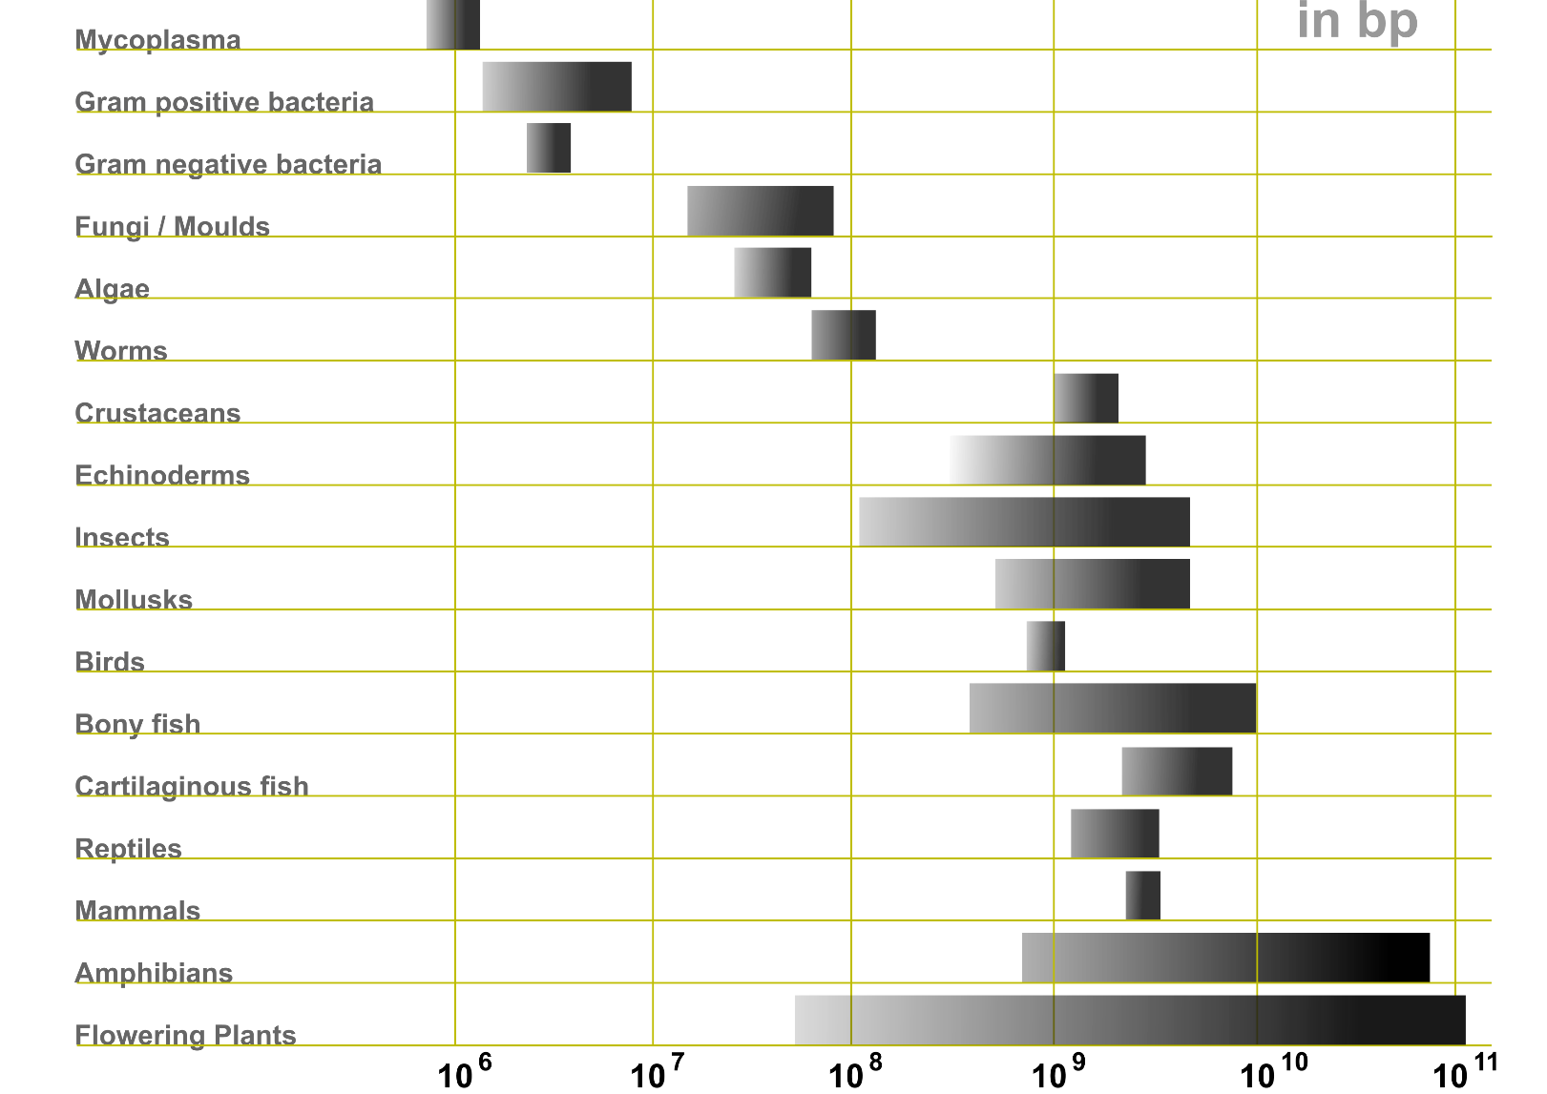
de novo genome assembly
Genome size / bp
Haploid human genome size = 3.2 billion bases

Slide 19
Why are mammalian and plant genomes difficult to assemble?

Slide 20


Slide 21
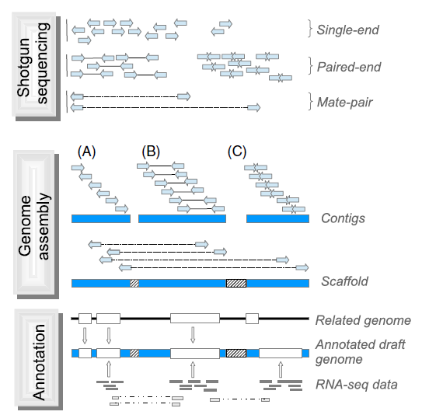
de novo assembly
Or nowadays long
read sequence:
PacBio
Nanopore
Ekblom & Wolf (2014) A field guide to whole-genome sequencing, assembly and annotation. Evolutionary Applications 7: 1026-1042.

Slide 22
agp (a Golden path) file
Describes the assembly of a larger sequence object from smaller objects.
The large object can be a contig, a scaffold (supercontig), or a chromosome.
chr1 1 73148 1 D Hmel201001 1 73148 + # unoriented 0.000 cM
chr1 73149 73248 2 N 100 fragment no
chr1 73249 2694103 3 D Hmel201002 1 2620855 + # anchored 0.000 1.450 2.899 4.349 5.799 7.248 8.698 10.148 11.597 13.047 14.497 15.946 17.396 18.846 20.296 cM
chr1 2694104 2694203 4 N 100 fragment no
chr1 2694204 2757786 5 D Hmel201003 1 63583 + # unordered 20.296 cM
chr1 2757787 2757886 6 N 100 fragment no
chr1 2757887 2773154 7 D Hmel201004 1 15268 + # unordered 20.296 cM
chr1 2773155 2773254 8 N 100 fragment no
chr1 2773255 3691781 9 D Hmel201005 1 918527 + # anchored 20.296 21.745 23.195 24.645 cM
chr1 3691782 3691881 10 N 100 fragment no
chr1 3691882 3852055 11 D Hmel201006 1 160174 + # unoriented 24.645 cM
chr1 3852056 3852155 12 N 100 fragment no
chr1 3852156 5787889 13 D Hmel201007 1 1935734 + # anchored 24.645 26.094 27.544 28.994 30.443 31.893 33.343 cM
chr1 5787890 5787989 14 N 100 fragment no
chr1 5787990 5863997 15 D Hmel201008 1 76008 + # unoriented 33.343 cM
https://www.ncbi.nlm.nih.gov/assembly/agp/AGP_Specification/

Slide 23
General feature format file (gff)
Describes the annotation of a genome: positions of genes, introns/exons, pseudogenes etc
Hmel200001 HGC gene 1917 3952 . - . ID=HMEL015204
Hmel200001 HGC mRNA 1917 3952 . - . ID=HMEL015204-RA;Parent=HMEL015204
Hmel200001 HGC exon 3827 3952 . - . ID=HMEL015204-RA-E1AAAA;Parent=HMEL015204-RA
Hmel200001 HGC exon 2744 2878 . - . ID=HMEL015204-RA-E2AAAA;Parent=HMEL015204-RA
Hmel200001 HGC exon 1917 1976 . - . ID=HMEL015204-RA-E3AAAA;Parent=HMEL015204-RA
Hmel200001 HGC CDS 3827 3952 . - 0 Parent=HMEL015204-RA
Hmel200001 HGC CDS 2744 2878 . - 0 Parent=HMEL015204-RA
Hmel200001 HGC CDS 1917 1976 . - 0 Parent=HMEL015204-RA
Hmel200004 HGC gene 2916 9864 . + . ID=HMEL013922
Hmel200004 HGC mRNA 2916 9864 . + . ID=HMEL013922-RA;Parent=HMEL013922;Dbxref=goslim_goa:GO:0003674
Hmel200004 HGC exon 2916 3063 . + . ID=HMEL013922-RA-E1AAAA;Parent=HMEL013922-RA
Hmel200004 HGC exon 3349 3440 . + . ID=HMEL013922-RA-E2AAAA;Parent=HMEL013922-RA
Hmel200004 HGC exon 3811 4033 . + . ID=HMEL013922-RA-E3AAAA;Parent=HMEL013922-RA
Hmel200004 HGC exon 4330 4525 . + . ID=HMEL013922-RA-E4AAAA;Parent=HMEL013922-RA
Hmel200004 HGC exon 4803 4895 . + . ID=HMEL013922-RA-E5AAAA;Parent=HMEL013922-RA
Hmel200004 HGC exon 6560 6749 . + . ID=HMEL013922-RA-E6AAAA;Parent=HMEL013922-RA
Hmel200004 HGC exon 8334 9864 . + . ID=HMEL013922-RA-E7AAAA;Parent=HMEL013922-RA
Hmel200004 HGC CDS 2918 3063 . + 0 Parent=HMEL013922-RA
Hmel200004 HGC CDS 3349 3440 . + 1 Parent=HMEL013922-RA
Hmel200004 HGC CDS 3811 4033 . + 2 Parent=HMEL013922-RA
Hmel200004 HGC CDS 4330 4525 . + 1 Parent=HMEL013922-RA
Hmel200004 HGC CDS 4803 4895 . + 0 Parent=HMEL013922-RA
Hmel200004 HGC CDS 6560 6749 . + 0 Parent=HMEL013922-RA
Hmel200004 HGC CDS 8334 8335 . + 2 Parent=HMEL013922-RA
http://gmod.org/wiki/GFF3
https://github.com/The-Sequence-Ontology/Specifications/blob/master/gff3.md

