Slide 1
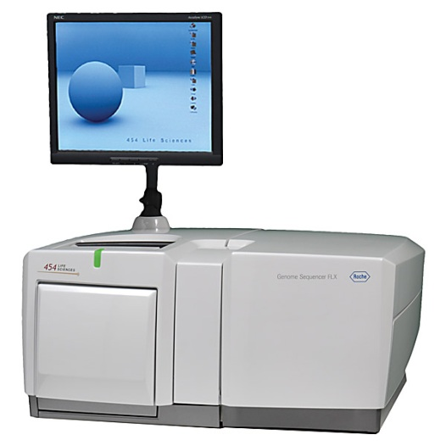
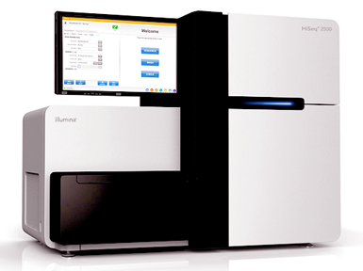
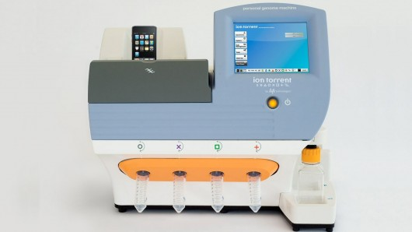
BIO00076H: Sequence Analysis Lecture 2 High-throughput sequencing Part 1
Kanchon Dasmahapatra
kanchon.dasmahapatra@york.ac.uk
Room J101

Slide 2
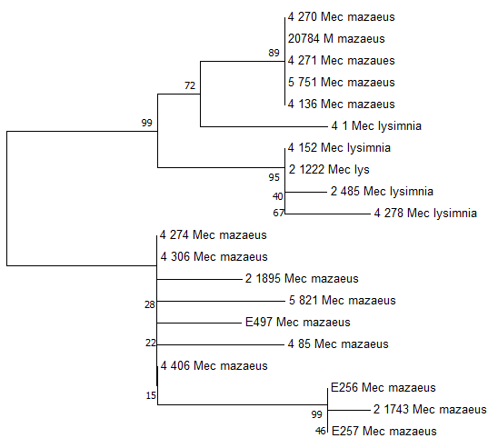
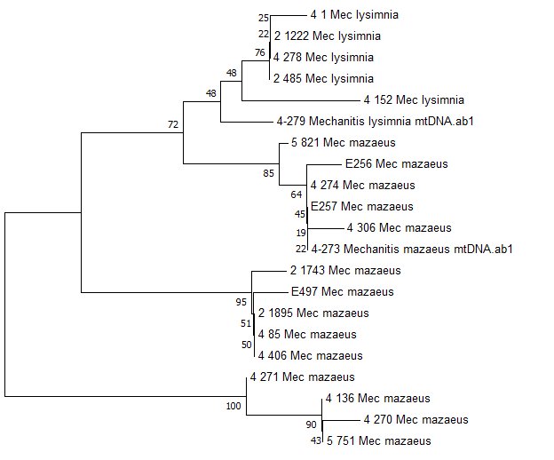
Workshop 1 trees
a) Are there differences between the mtDNA and nuclear trees?
b) Why might there be differences between these trees
c) Is there any evidence for cryptic species? If so, how many cryptic species do you think there are?
d) What evidence would you need to determine whether or not these were truly different species?
mtDNA NJ tree
TPI NJ tree

Slide 3
L2 + W2: Learning objectives
Be aware of the current main Next Generation Sequencing technologies
Be aware of the advantages and disadvantages of each technologies
Understand the FastQ sequence output from these technologies
Know how to quality check and clean FastQ files
Have a understanding of de novo assembly
Have a understanding of resequencing genomes

Slide 4
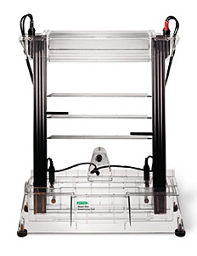
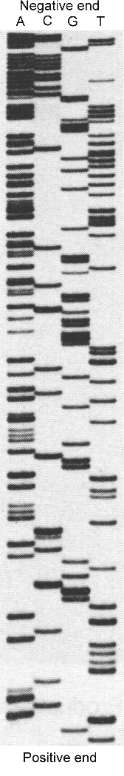
A brief history of sequencing: 1977-1988
A
C
G
T
G
T
T
A
T
C
A
G
T
A
C
A
T
A
C
G
T
Sanger sequencing
(radioactive chain-termination)

Slide 5
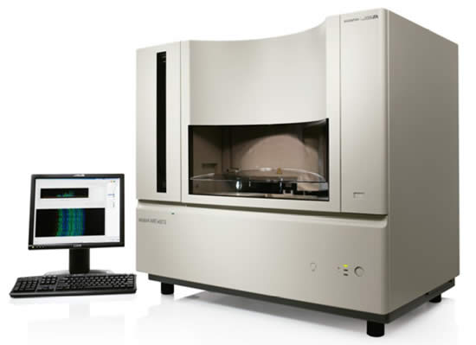
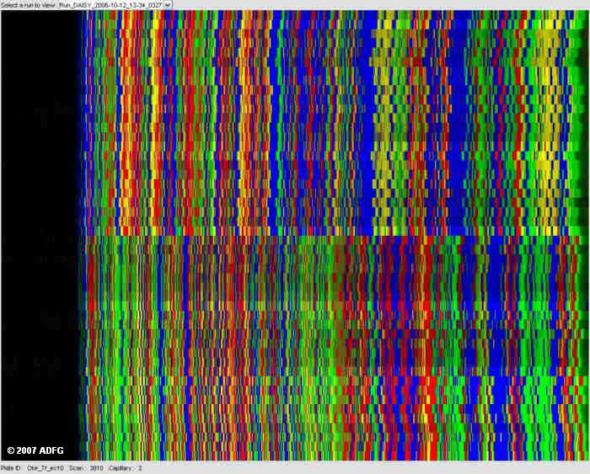
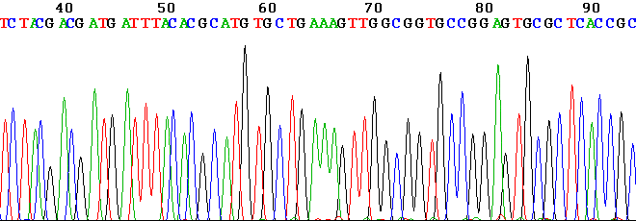
A brief history of sequencing: 1988-2002
Sanger sequencing
(fluorescent chain-termination)
3 hours for 100kb

Slide 6
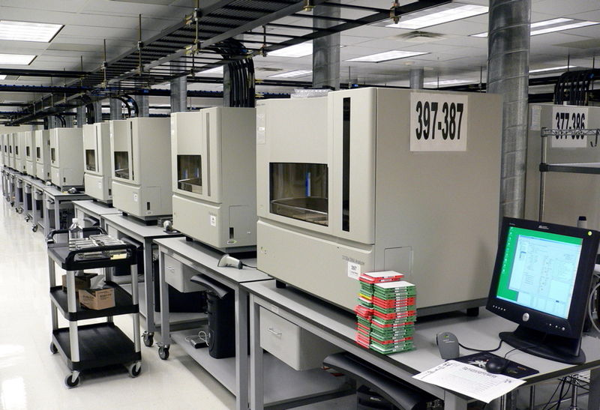

Slide 7
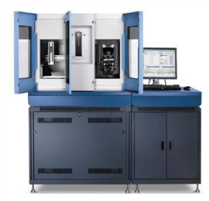

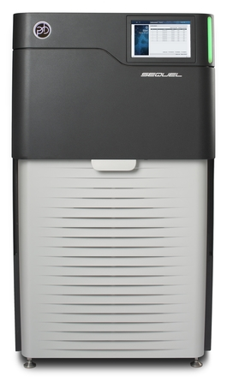


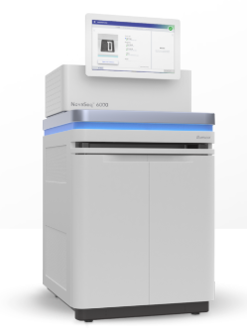
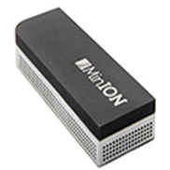


A brief history of sequencing: 2002-2019
ABI SOLiD
NovaSeq

Slide 8
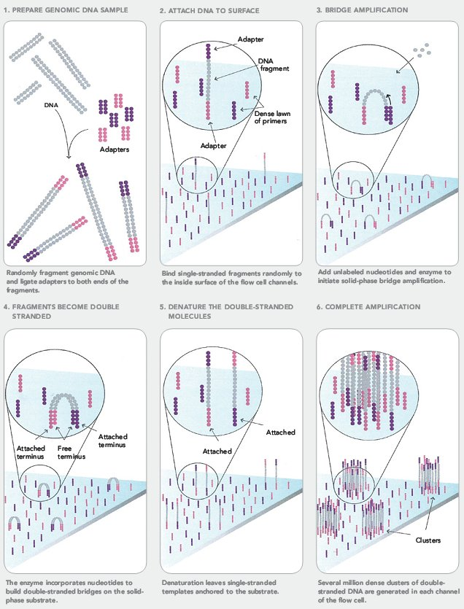
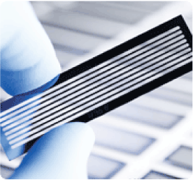
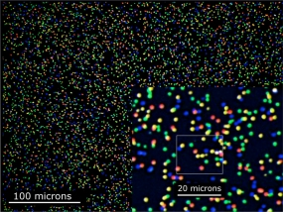
Illumina sequencing
https://www.youtube.com/watch?v=fCd6B5HRaZ8

Slide 9
Illumina sequencing
Illumina sequencing is currently the workhorse of most genomic and functional genomic projects.
Advantages
Very cheap per bp
Huge output: 600Gb/day
Low error rate
Disadvantages
Short read lengths: 2 x 150bp
Sequencer machine is very expensive
Main uses:
Re-sequencing genomes of populations (people, mice, bacteria, viruses, yeast, fish, fruit flies, Plasmodium, Leishmania*)
de novo assembly of small genomes (bacteria etc)
polishing (correcting) long-read assemblies (PACBIO, ONT)
Many other uses in functional genomics: RNAseq, ChipSeq, 3C, BarSeq, TnSeq
Metagenomics
* You will get your hands on some Leishmania data

Slide 10
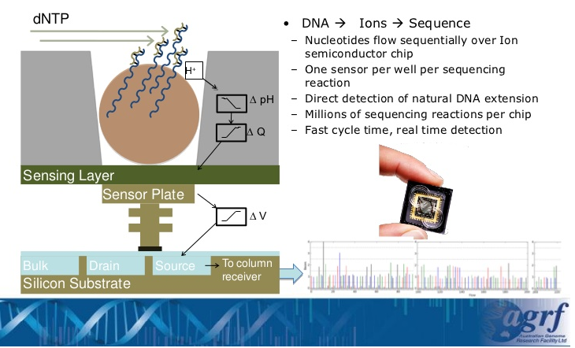
IonTorrent
IonTorrent works by detecting the voltage (pH) change in wells as bases are sequentially washed over immobilised fragments, and then incorporated into a complementary DNA strand. It is similar to Illumina, and old-school Sanger sequencing in that it uses ‘sequencing by synthesis’

Slide 11
IonTorrent
Ion Torrent is seldom used now
(I have never used it).
But the market changes all the time.
Advantages
Sequencer relatively cheap
Relatively fast (4-7 hrs)
Disadvantages
Homopolymer errors
400bp sequence length
1.2 – 2 Gb
Main uses: Small sequencing projects. Microbial genome sequencing. Metagenomics
How IonTorrent works:
https://www.youtube.com/watch?v=WYBzbxIfuKs

Slide 12
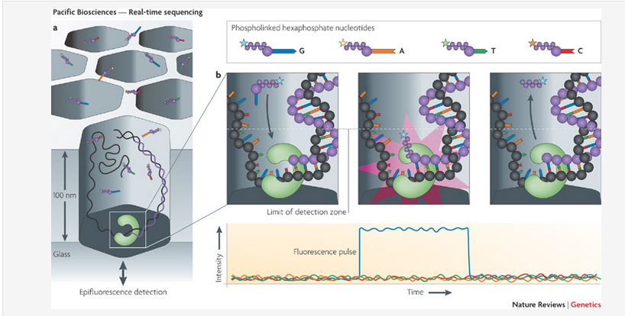
PacBio sequencing
PacBio sequencing works by incorporating modified, fluorescently labelled, DNA bases in un-fragmented DNA, and detecting the flash of light.
See an advert from Pacific Biosciences: https://www.youtube.com/watch?v=v8p4ph2MAvI

Slide 13
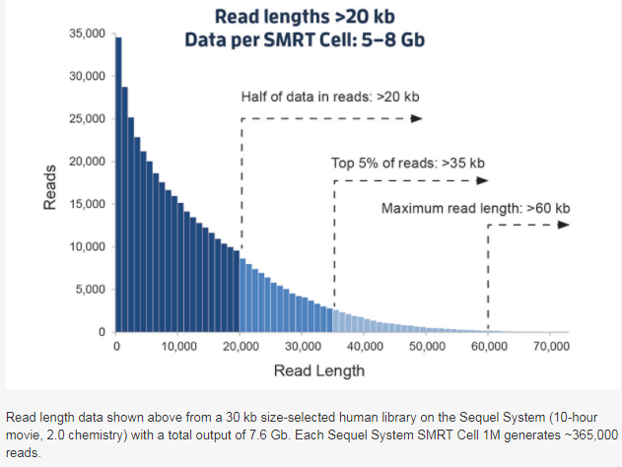
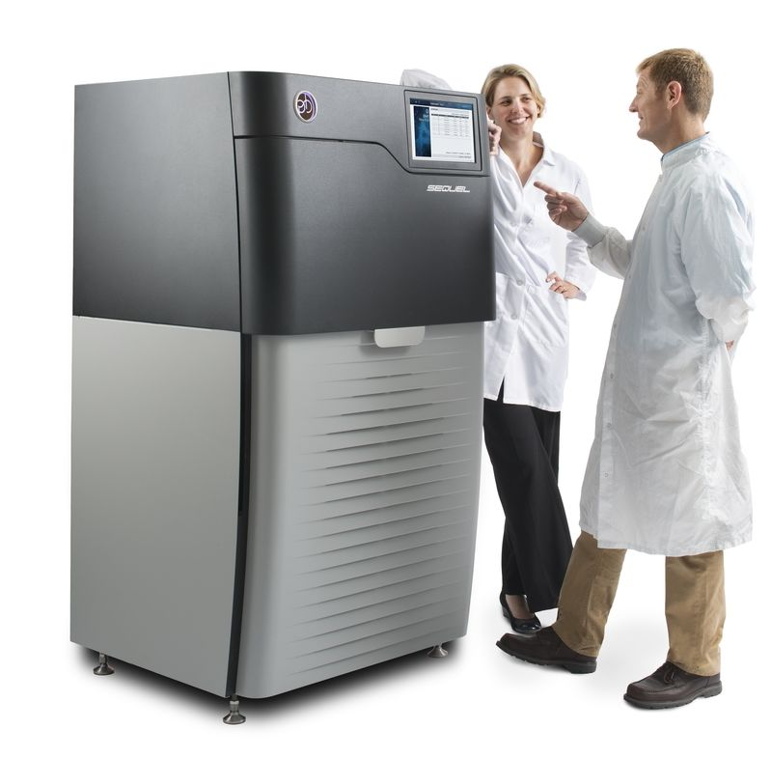
PacBio sequencing
Advantages
Long read lengths
10-15 kb; 40 kb
Disadvantages
High error rates: 1.7%
Sequencer is expensive
Modest sequence output
Main uses: Genome assembly, transcriptomes

Slide 14
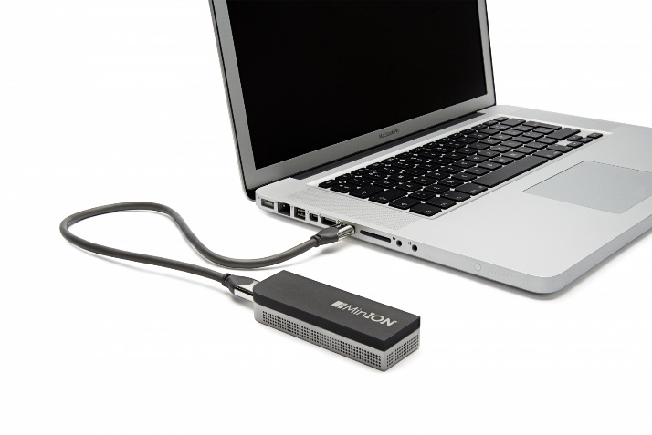
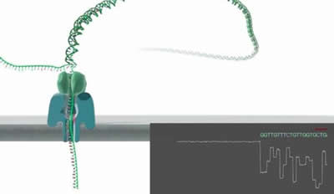
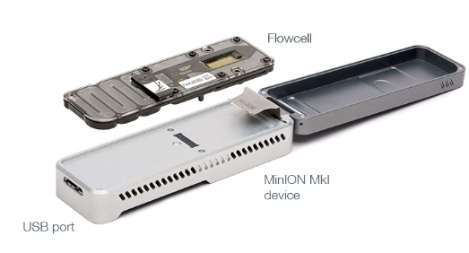
Nanopore sequencing
Oxford Nanopore Technology
See: https://nanoporetech.com/how-it-works

Slide 15
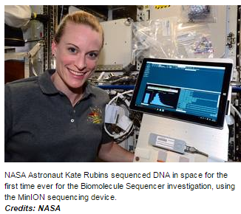
Nanopore sequencing
Oxford Nanopore Technology (ONT) is in very rapid development right now. Sequencing is being transformed (again!).
Advantages
Very long read lengths
3 kb; 28 kb (2015)
7.5 kb; 117 kb (2016)
Portable (has been used in caves)
Sequencer is cheap
In rapid development now
Disadvantages
High error rates: 2-13%
Expensive per bp of sequence (but coming down, close to Illumina)
Main uses: Microbial genomics
Genome assemblies
Transcriptomes

Slide 16
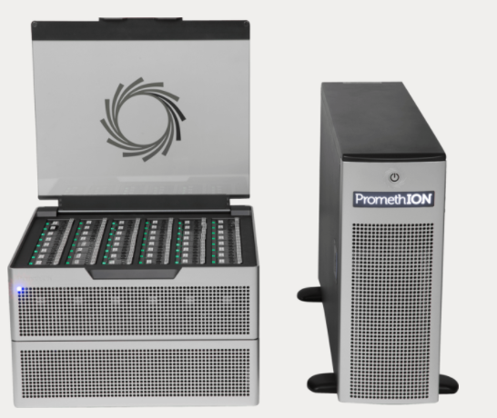
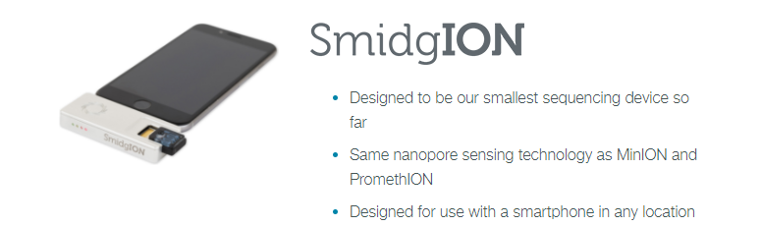
Nanopore sequencing. What next?
The PromethION machine
48 flow cells
3000 nanopores per flow cell
Huge output promised, almost delivering.
Weirather et al. (2017) Comprehensive comparison of Pacific Biosciences and Oxford Nanopore Technologies and their applications to transcriptome analysis. F1000Research, 6:100.
At the moment Nanopore technology is developing very fast.
Output is increasing, error rates decreasing.

Slide 17

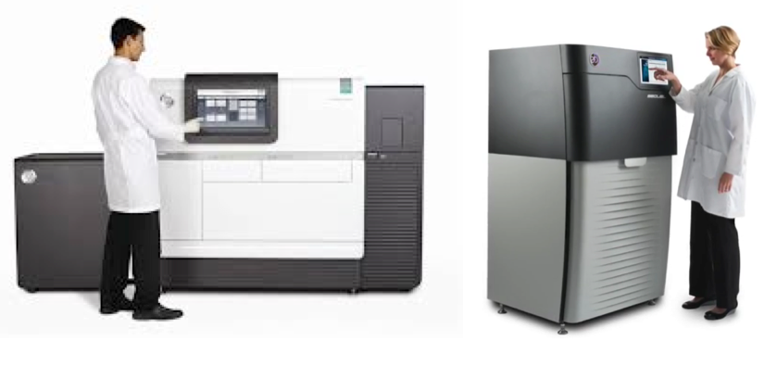
Sequencing now
At this point in time this is what we do:
Sanger sequencing Using ABI machines.
Technology of choice for low- to medium output sequencing
Eg: checking plasmids, small-scale population surveys
Illumina:
Technology of choice for genome re-sequencing (of populations)
Widely used for small de novo genome assemblies, RNA-seq (sequencing transcriptomes), chip-seq, 3C, metagenomics
Pacific BioSciences (PACBIO)
One technology of choice for genome assemblies.
Produces fairly long, fairly accurate reads
Oxford Nanopore
One of the technologies of choice for genome assemblies.
Produces the longest reads
Has the worst error rate
Is developing very fast
Next year this slide will be different!

Slide 18
Read more.
Read more about the ultra-competitive world of NGS here: https://labiotech.eu/medical/ngs-dna-sequencing-illumina-qiagen/
And about long read sequencing here: https://doi.org/10.1016/j.tig.2018.05.008 (Also in the Paperpile collection, see the VLE)

Slide 19
Fastq files and FastQC
Next/3rd gen sequence produce ‘fastq’ files
Bases and a measure of the quality of each base
Quality scores enable users to check the quality their reads, and get rid of bad quality data

Slide 20
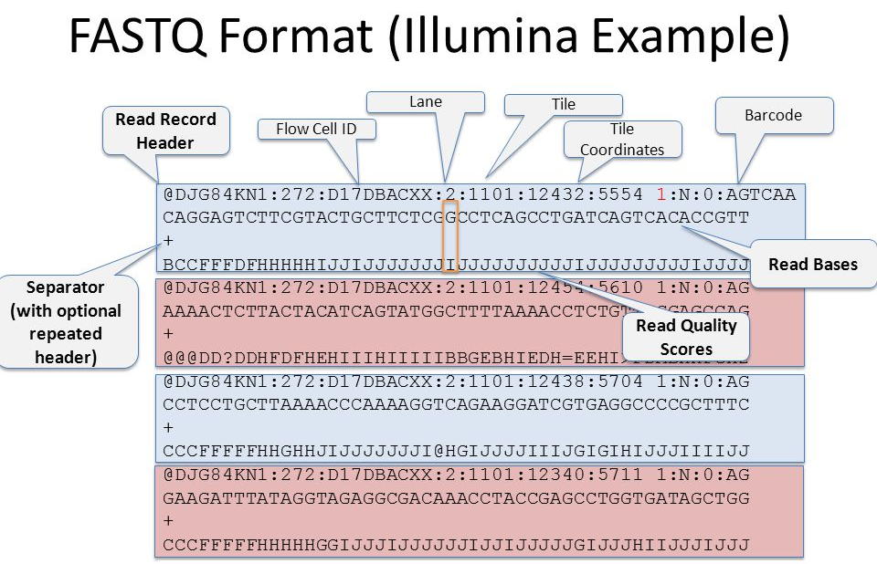
Fastq file ‘anatomy’
Information about the fastq format and Phred-scores at:
http://en.wikipedia.org/wiki/FASTQ_format
http://en.wikipedia.org/wiki/Phred_quality_score

Slide 21
40 billion bases….what do I do with them?
Clean/trim
sequences cutadapt, Reaper, Trimmotomatic
Check average
quality statistics
FastQC
Fastq files
(reads)
de novo assembly
SGA
Velvet, CLCbio, and many others
Compare to other sequences/genomes
BLAST, Cactus Genome-alignment
Annotate (locate and mark up the genes)
Augustus
Align to a
reference genome or
transcriptome
BWA
NextGenMap
Novoalign
Structural variant ‘calling’
Delly, GenomeSTRiP, Lumpy
Remove
PCR
Duplicates
Picardtools
Samtools
SNP and indel ‘calling’
GATK, Samtools, Freebayes
Make vcf files (variant call format)
VCF filtering
bcftools,
vcftools, GATK
Biological analysis
vcftools, Admixture
Many, many others

Slide 22
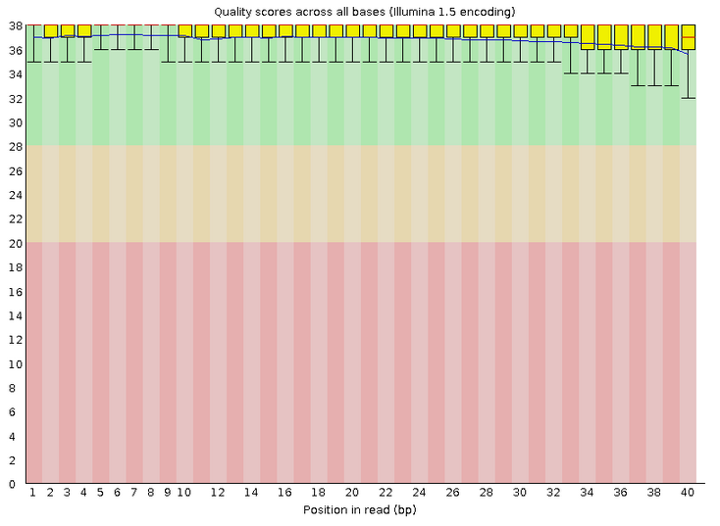
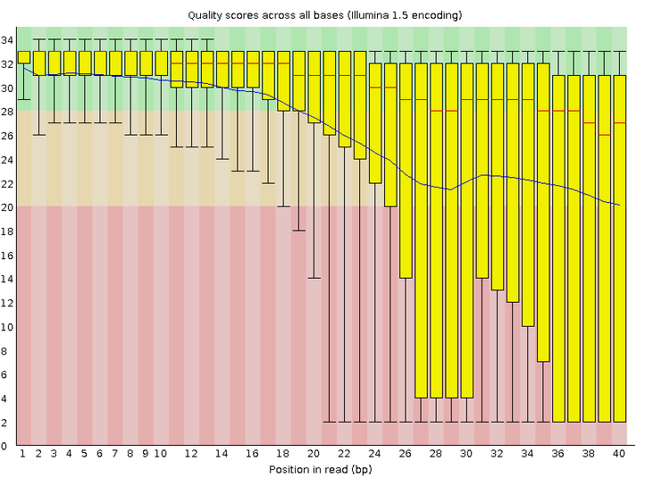
FastQC: quality filtering
GOOD SEQUENCES BAD SEQUENCES

Slide 23
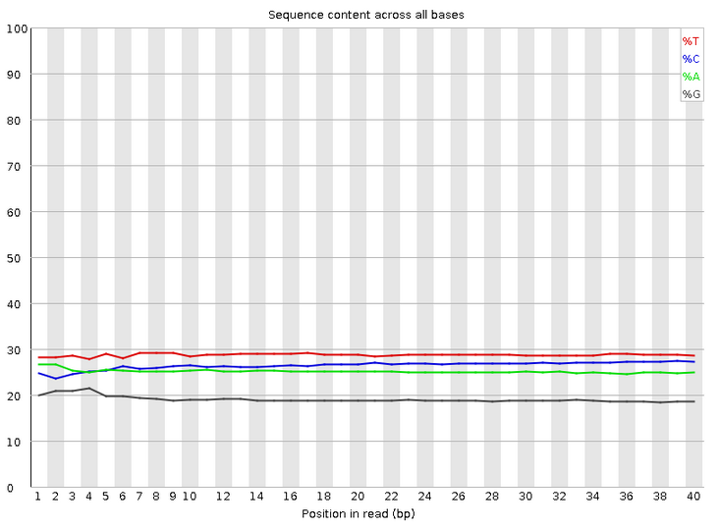
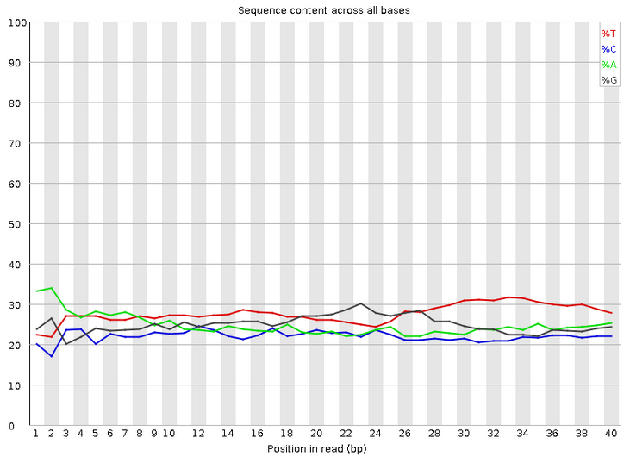
FastQC: quality filtering
GOOD SEQUENCES BAD SEQUENCES

Slide 24
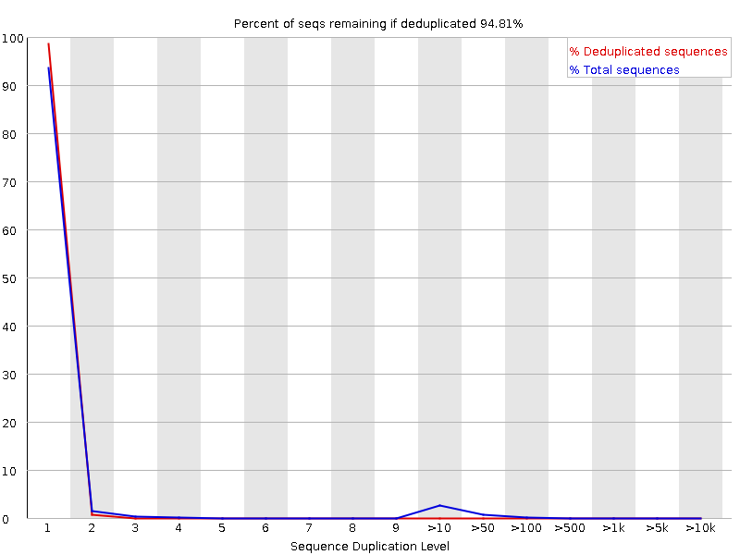
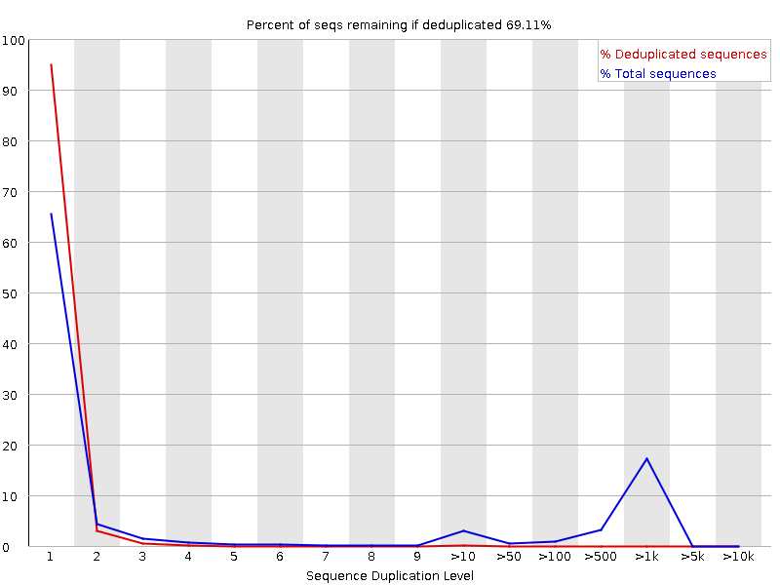
FastQC: quality filtering
GOOD SEQUENCES BAD SEQUENCES
http://www.bioinformatics.babraham.ac.uk/projects/fastqc/Help/3%20Analysis%20Modules/

Slide 25
Cleaning the data
Cutadapt
Trimmotomatic
These programs allow you to trim away poor quality sequence, and remove adapter contamination

Slide 26
40 billion bases….what do I do with them?
Clean/trim
sequences cutadapt, Reaper, Trimmotomatic
Check average
quality statistics
FastQC
Fastq files
(reads)
de novo assembly
SGA
Velvet, CLCbio, and many others
Compare to other sequences/genomes
BLAST, Cactus Genome-alignment
Annotate (locate and mark up the genes)
Augustus
Align to a
reference genome or
transcriptome
BWA
NextGenMap
Novoalign
Structural variant ‘calling’
Delly, GenomeSTRiP, Lumpy
Remove
PCR
Duplicates
Picardtools
Samtools
SNP and indel ‘calling’
GATK, Samtools, Freebayes
Make vcf files (variant call format)
VCF filtering
bcftools,
vcftools, GATK
Biological analysis
vcftools, Admixture
Many, many others

Slide 27
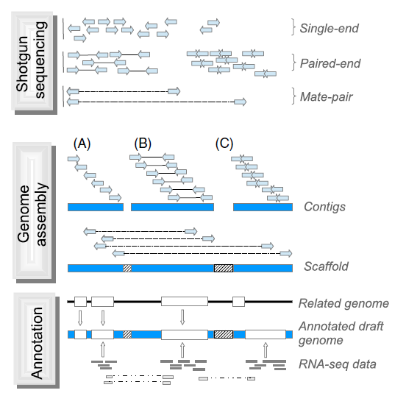
de novo assembly
Ekblom & Wolf (2014) A field guide to whole-genome sequencing, assembly and annotation. Evolutionary Applications 7: 1026-1042.

Slide 28


Slide 29
Whole genome ‘resequencing’
Usually used to collect information about diversity within a species (other uses also possible)
Mapping/aligning to an existing reference genome
Computationally easier than de novo assembly
Much cheaper than de novo assembly
These projects can have impressive scales: The 100,000 Genomes Project has sequenced 100,000 genomes from around 70,000 people. Participants are NHS patients with a rare disease, plus their families, and patients with cancer. See: https://www.genomicsengland.co.uk/the-100000-genomes-project/
In workshops and group projects we will use some population sequencing data from the parasite Leishmania infantum.
This data is unpublished – please do not share it.
Read about this species here: https://en.wikipedia.org/wiki/Leishmania_infantum

Slide 30
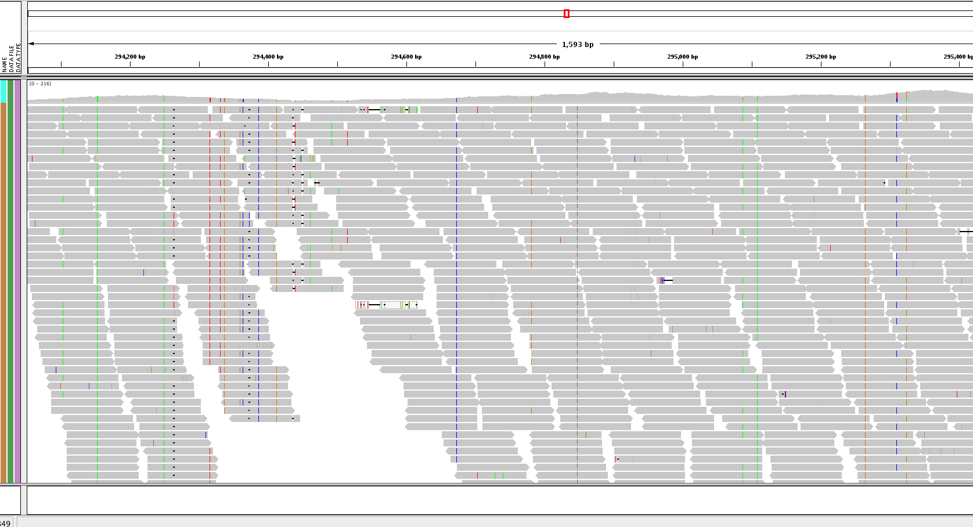
Whole-genome resequencing

Slide 31
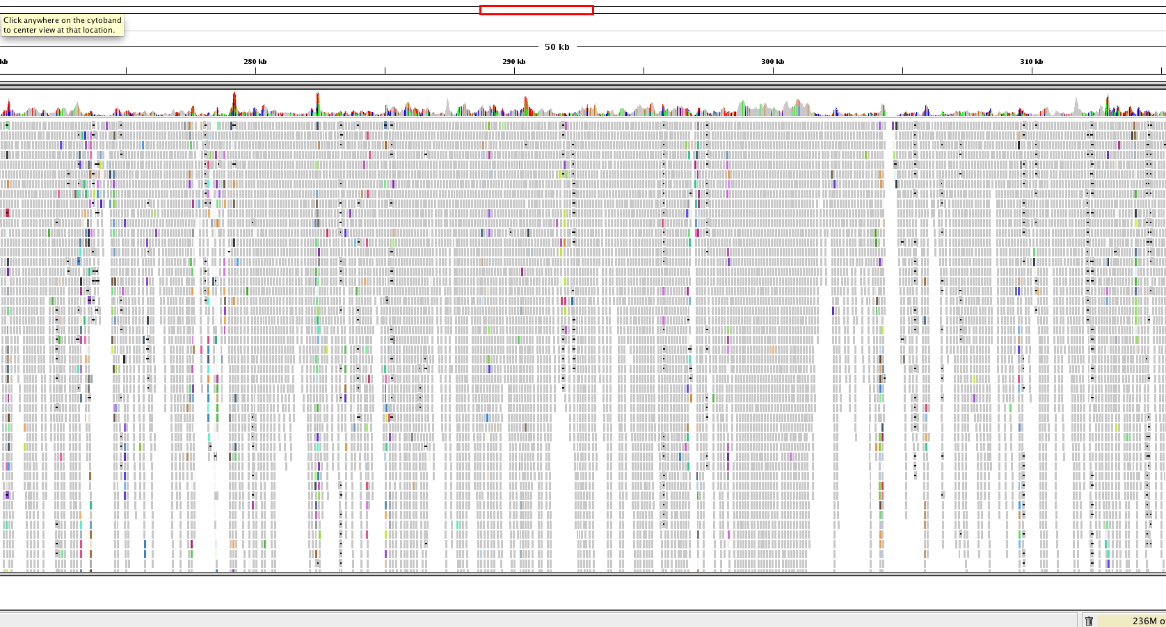
Whole-genome resequencing

Slide 32
Aligning to a reference genome
Different aligners available
BWA: for less divergent sequences (fast)
NextGenMap: for more divergent sequences (slow)
SAM: Sequence Alignment/Map format (https://samtools.github.io/hts-specs/SAMv1.pdf)
BAM is a compressed SAM file

Slide 33
@SQ SN:chr1 LN:278268
@SQ SN:chr2 LN:356299
@SQ SN:chr3 LN:389660
@SQ SN:chr4 LN:466506
@SQ SN:chr5 LN:467711
@SQ SN:chr6 LN:525234
@SQ SN:chr7 LN:592865
@SQ SN:chr8 LN:515744
@SQ SN:chr9 LN:581921
@SQ SN:chr10 LN:588571
@SQ SN:chr11 LN:568610
@SQ SN:chr12 LN:593479
@SQ SN:chr13 LN:659809
@SQ SN:chr14 LN:656122
@SQ SN:chr15 LN:650312
@SQ SN:chr16 LN:688194
@SQ SN:chr17 LN:690898
@SQ SN:chr18 LN:720421
@SQ SN:chr19 LN:706116
@SQ SN:chr20 LN:731246
@SQ SN:chr21 LN:764851
@SQ SN:chr22 LN:782138
@SQ SN:chr23 LN:786675
@SQ SN:chr24 LN:863800
@SQ SN:chr25 LN:895070
@SQ SN:chr26 LN:1055294
@SQ SN:chr27 LN:1175405
@SQ SN:chr28 LN:1205018
@SQ SN:chr29 LN:1272412
@SQ SN:chr30 LN:1353282
@SQ SN:chr31 LN:1529233
@SQ SN:chr32 LN:1544753
@SQ SN:chr33 LN:1532280
@SQ SN:chr34 LN:1852060
@SQ SN:chr35 LN:2019666
@SQ SN:chr36 LN:2743046
@RG ID:S3 SM: S3 PL:Illumina
@PG ID:bwa PN:bwa VN:0.7.17-r1188 CL:bwa mem -t 2 -R @RG\tID:S3\tSM: S3\tPL:Illumina LinJ_cbm_v1.fasta Sample3_R1_fastq.q20.gz Sample3_R2_fastq.q20.gz
J00125:7:HJ772BBXX:5:1101:3437:1332 83 chr31 361505 0 151M = 361476 -180 TCACCCACGACGCCACACCGCATCGCGTCCACTCGGTAGGAAGAGGGAGAGACGCAAGGGGGAGGGGGGAGGCGGCGAGGAAGGGAGGACACCGGGCGCAAGAGACGACGCAGAAGATAAGCCACAAACAAGAGGGAGAGAGGAGGAGNAG 7AJAF<FFFJJJFJJJ<JJJJJJJJJJJJFFAFJJFJJJJJJJJJFJJJJJJJJJJJJJJJJJJJJJJJJFJJJAFJJJAJJJJJJJJJAJJJJJJFF<JJJJJJJJJJJJJJJJJJJJJJJJJJJJJJJJJJJJJJJJFFF7JFJFF#AA NM:i:1 MD:Z:148G2 MC:Z:151M AS:i:149 XS:i:149 RG:Z:S3 XA:Z:chr31,-353856,151M,1;chr31,-369151,151M,1;
J00125:7:HJ772BBXX:5:1101:3437:1332 163 chr31 361476 0 151M = 361505 180 CTCGGCGTGATTGCGTTTGCTCCGTCCCTTCACCCACGACGCCACACCGCATCGCGTCCACTCGGTAGGAAGAGGGAGAGACGCAAGGGGGAGGGGGGAGGCGGCGAGGAAGGGAGGACACCGGGCGCAAGAGACGACGCAGAAGATAAGC AAFFFJ<AJJJJJJJJJJJJJJJJJJFJJJJJJJJJJJJJJJJJJJJJJJJJJJJJJJJJJJJJJJJJJJJFFJ-FJFFJJJFFJJJ7F<FAFAJF-<A<JFFAAAJJJJ<FJ<AA-AAJAAF--<-<JJJJ-F-AF7-7AAAFJJ<FJ-7 NM:i:0 MD:Z:151 MC:Z:151M AS:i:151 XS:i:151 RG:Z:S3 XA:Z:chr31,+353827,151M,0;chr31,+369122,151M,0;
J00125:7:HJ772BBXX:5:1101:5203:1332 99 chr22 572045 60 150M = 572202 307 AANCCGGAAGGCAGTGTATGGACGAAGCACCTGAGCTGTCGAGTAGGTACAGAGAAAGACAGACACACAGAGGGCGGAGGGAAGGGGGAGGCACGCGCGTGCTGTTGCTGATTATACCGCCTTTGTTTTCTGGCTTCTCTTATTCGCTTT AA#FFJJJJJJJJJJJJJJJJJJJJJJJJJJJJJJJJJJJJJJJJJJJJJJJJJJJJJJJJJJJJJJJJJJJJJJJFJJJJJJJJJFFJJJJJJFFJJJJJJJJJJJJJJJJJJJFJAAFFFFJJJJJJJJAAA7FJFFFFJFFA<F7<F NM:i:1 MD:Z:2G147 MC:Z:150M AS:i:148 XS:i:0 RG:Z:S3
J00125:7:HJ772BBXX:5:1101:5203:1332 147 chr22 572202 60 150M = 572045 -307 GTTGTTTGATGTGCGTGTGTGCTTGTGCGGCTCCCGGCATGTGCCACCGTGATAATGGTGGTGGTAGTGGTGGTACGTGCGAAGAGCAGCACCGACGAACGTGTACGGATGTCAAGAGGGCAAGAAAAGGGAAGCGATGGAGGGGATAGG 7JJJFAJA-)JFFAJFFA-<A-F-A-7))<AF<FJJFJFJJF<)))FFJAJJJJJJJJJJJFFJJJJJJJJJJJJJJJJJJJJJJJJJJ<JJJJJFJJJFJJJJJJJJJJJJJJJJJJJJFJJJJJJJJJJJJJJJJJJJJJJJJFFFAA NM:i:0 MD:Z:150 MC:Z:150M AS:i:150 XS:i:20 RG:Z:S3
J00125:7:HJ772BBXX:5:1101:30492:1332 99 chr10 189007 0 72M79S = 189006 75 GANCGGCCCGCTCGCGGATGCCGGGAAGCCGCAGATCAGCATCTTCGTGTCTGCCGCGCTGCAGGCCATCACATGAGATCGGAAGAGCACACGTCTGAACTCCAGTCACATTCAGAAATCTCGTATGCCGTCTTCTGCTTGAAAAAAAAAA <A#FFJAFJJJJAAJJF<JJJJJJJJJJJJJJJJFJJJJJF7FFAJJJJFAAJ<JJJJJJJFAJFFJ-<FAJ-AJJ<--FJJFAF7JJJJFJFJJFFF<F7<AAFFFFJJ<<JFJF<A-AAA<AFF<F-7)A)-77AJ--<F-7<A----< NM:i:1 MD:Z:2A69 MC:Z:75S76M AS:i:70 XS:i:70 RG:Z:S3 XA:Z:chr10,+182916,72M79S,1;chr10,+168748,72M79S,1;chr10,+174884,72M79S,1;chr10,+162463,64M87S,1;
J00125:7:HJ772BBXX:5:1101:30492:1332 147 chr10 189006 0 75S76M = 189007 -75 TTTTTTAATGATCCGGCGACCACCGAGATCTACACCCTATCCTACACTCTTTCCCTACACGACGCTCTTCCGATCTGAACGGCCCGCTCGCGGATGCCGGGAAGCCGCAGATCAGCATCTTCGTGTCTGCCGCGCTGCAGGCCATCACCTG JJFFA--JFA7))7-)A77FA)7A-7A<<--<7<FFA7-FAFA7--F7FFA<FAF7JA-A77JJFAJA<FAFJFFFFF-F7AJJJ7JJJJJJJAFJF<JJAFJJJJJAF<<FJJJJJJJFJJJJJ<JJJJJJJJJJJJJAJJFAF7-FAAA NM:i:0 MD:Z:76 MC:Z:72M79S AS:i:76 XS:i:76 RG:Z:S3 XA:Z:chr10,-182915,75S76M,0;chr10,-168747,75S76M,0;chr10,-174883,75S76M,0;chr10,-162462,75S76M,2;
J00125:7:HJ772BBXX:5:1101:1783:1349 83 chr36 331249 60 11S140M = 331249 -140 TCTTCCGATCTCAGCGCAGAAGTCTGCCAATGCACCAGGCACGGGAGGAGCTGGTGAAGCTCATTCGCGACAATCGCGTGGTGATCATTGTGGGTGAGACCGGATCGGGCAAGACGACGCAGCTGCTTCAGTATCTCTATGAGGAGGGCTT <FFAJF<<7<JA--AFJFAJJFFJAFJFF7)JFJJJJJJFJJJJJJJJAAFFFFFJJJJJJJFFJJJAFFFFJFAAJAJAJFAAJJJFJJJFJJJJ<A-JJJ<JJJJFJJJJA<<FFFFJAF<JJJJJJJFJFFJJ7JJJFJJJJAFFFAA NM:i:0 MD:Z:140 MC:Z:140M11S AS:i:140 XS:i:0 RG:Z:S3

Slide 34
@SQ SN:chr1 LN:278268
@SQ SN:chr2 LN:356299
@SQ SN:chr3 LN:389660
@SQ SN:chr4 LN:466506
@SQ SN:chr5 LN:467711
@SQ SN:chr6 LN:525234
@SQ SN:chr7 LN:592865
@SQ SN:chr8 LN:515744
@SQ SN:chr9 LN:581921
@SQ SN:chr10 LN:588571
@SQ SN:chr11 LN:568610
@SQ SN:chr12 LN:593479
@SQ SN:chr13 LN:659809
@SQ SN:chr14 LN:656122
@SQ SN:chr15 LN:650312
@SQ SN:chr16 LN:688194
@SQ SN:chr17 LN:690898
@SQ SN:chr18 LN:720421
@SQ SN:chr19 LN:706116
@SQ SN:chr20 LN:731246
@SQ SN:chr21 LN:764851
@SQ SN:chr22 LN:782138
@SQ SN:chr23 LN:786675
@SQ SN:chr24 LN:863800
@SQ SN:chr25 LN:895070
@SQ SN:chr26 LN:1055294
@SQ SN:chr27 LN:1175405
@SQ SN:chr28 LN:1205018
@SQ SN:chr29 LN:1272412
@SQ SN:chr30 LN:1353282
@SQ SN:chr31 LN:1529233
@SQ SN:chr32 LN:1544753
@SQ SN:chr33 LN:1532280
@SQ SN:chr34 LN:1852060
@SQ SN:chr35 LN:2019666
@SQ SN:chr36 LN:2743046
@RG ID:S3 SM: S3 PL:Illumina
@PG ID:bwa PN:bwa VN:0.7.17-r1188 CL:bwa mem -t 2 -R @RG\tID:S3\tSM: S3\tPL:Illumina LinJ_cbm_v1.fasta Sample3_R1_fastq.q20.gz Sample3_R2_fastq.q20.gz
J00125:7:HJ772BBXX:5:1101:3437:1332 83 chr31 361505 0 151M = 361476 -180 TCACCCACGACGCCACACCGCATCGCGTCCACTCGGTAGGAAGAGGGAGAGACGCAAGGGGGAGGGGGGAGGCGGCGAGGAAGGGAGGACACCGGGCGCAAGAGACGACGCAGAAGATAAGCCACAAACAAGAGGGAGAGAGGAGGAGNAG 7AJAF<FFFJJJFJJJ<JJJJJJJJJJJJFFAFJJFJJJJJJJJJFJJJJJJJJJJJJJJJJJJJJJJJJFJJJAFJJJAJJJJJJJJJAJJJJJJFF<JJJJJJJJJJJJJJJJJJJJJJJJJJJJJJJJJJJJJJJJFFF7JFJFF#AA NM:i:1 MD:Z:148G2 MC:Z:151M AS:i:149 XS:i:149 RG:Z:S3 XA:Z:chr31,-353856,151M,1;chr31,-369151,151M,1;
J00125:7:HJ772BBXX:5:1101:3437:1332 163 chr31 361476 0 151M = 361505 180 CTCGGCGTGATTGCGTTTGCTCCGTCCCTTCACCCACGACGCCACACCGCATCGCGTCCACTCGGTAGGAAGAGGGAGAGACGCAAGGGGGAGGGGGGAGGCGGCGAGGAAGGGAGGACACCGGGCGCAAGAGACGACGCAGAAGATAAGC AAFFFJ<AJJJJJJJJJJJJJJJJJJFJJJJJJJJJJJJJJJJJJJJJJJJJJJJJJJJJJJJJJJJJJJJFFJ-FJFFJJJFFJJJ7F<FAFAJF-<A<JFFAAAJJJJ<FJ<AA-AAJAAF--<-<JJJJ-F-AF7-7AAAFJJ<FJ-7 NM:i:0 MD:Z:151 MC:Z:151M AS:i:151 XS:i:151 RG:Z:S3 XA:Z:chr31,+353827,151M,0;chr31,+369122,151M,0;
J00125:7:HJ772BBXX:5:1101:5203:1332 99 chr22 572045 60 150M = 572202 307 AANCCGGAAGGCAGTGTATGGACGAAGCACCTGAGCTGTCGAGTAGGTACAGAGAAAGACAGACACACAGAGGGCGGAGGGAAGGGGGAGGCACGCGCGTGCTGTTGCTGATTATACCGCCTTTGTTTTCTGGCTTCTCTTATTCGCTTT AA#FFJJJJJJJJJJJJJJJJJJJJJJJJJJJJJJJJJJJJJJJJJJJJJJJJJJJJJJJJJJJJJJJJJJJJJJJFJJJJJJJJJFFJJJJJJFFJJJJJJJJJJJJJJJJJJJFJAAFFFFJJJJJJJJAAA7FJFFFFJFFA<F7<F NM:i:1 MD:Z:2G147 MC:Z:150M AS:i:148 XS:i:0 RG:Z:S3
J00125:7:HJ772BBXX:5:1101:5203:1332 147 chr22 572202 60 150M = 572045 -307 GTTGTTTGATGTGCGTGTGTGCTTGTGCGGCTCCCGGCATGTGCCACCGTGATAATGGTGGTGGTAGTGGTGGTACGTGCGAAGAGCAGCACCGACGAACGTGTACGGATGTCAAGAGGGCAAGAAAAGGGAAGCGATGGAGGGGATAGG 7JJJFAJA-)JFFAJFFA-<A-F-A-7))<AF<FJJFJFJJF<)))FFJAJJJJJJJJJJJFFJJJJJJJJJJJJJJJJJJJJJJJJJJ<JJJJJFJJJFJJJJJJJJJJJJJJJJJJJJFJJJJJJJJJJJJJJJJJJJJJJJJFFFAA NM:i:0 MD:Z:150 MC:Z:150M AS:i:150 XS:i:20 RG:Z:S3
J00125:7:HJ772BBXX:5:1101:30492:1332 99 chr10 189007 0 72M79S = 189006 75 GANCGGCCCGCTCGCGGATGCCGGGAAGCCGCAGATCAGCATCTTCGTGTCTGCCGCGCTGCAGGCCATCACATGAGATCGGAAGAGCACACGTCTGAACTCCAGTCACATTCAGAAATCTCGTATGCCGTCTTCTGCTTGAAAAAAAAAA <A#FFJAFJJJJAAJJF<JJJJJJJJJJJJJJJJFJJJJJF7FFAJJJJFAAJ<JJJJJJJFAJFFJ-<FAJ-AJJ<--FJJFAF7JJJJFJFJJFFF<F7<AAFFFFJJ<<JFJF<A-AAA<AFF<F-7)A)-77AJ--<F-7<A----< NM:i:1 MD:Z:2A69 MC:Z:75S76M AS:i:70 XS:i:70 RG:Z:S3 XA:Z:chr10,+182916,72M79S,1;chr10,+168748,72M79S,1;chr10,+174884,72M79S,1;chr10,+162463,64M87S,1;
J00125:7:HJ772BBXX:5:1101:30492:1332 147 chr10 189006 0 75S76M = 189007 -75 TTTTTTAATGATCCGGCGACCACCGAGATCTACACCCTATCCTACACTCTTTCCCTACACGACGCTCTTCCGATCTGAACGGCCCGCTCGCGGATGCCGGGAAGCCGCAGATCAGCATCTTCGTGTCTGCCGCGCTGCAGGCCATCACCTG JJFFA--JFA7))7-)A77FA)7A-7A<<--<7<FFA7-FAFA7--F7FFA<FAF7JA-A77JJFAJA<FAFJFFFFF-F7AJJJ7JJJJJJJAFJF<JJAFJJJJJAF<<FJJJJJJJFJJJJJ<JJJJJJJJJJJJJAJJFAF7-FAAA NM:i:0 MD:Z:76 MC:Z:72M79S AS:i:76 XS:i:76 RG:Z:S3 XA:Z:chr10,-182915,75S76M,0;chr10,-168747,75S76M,0;chr10,-174883,75S76M,0;chr10,-162462,75S76M,2;
J00125:7:HJ772BBXX:5:1101:1783:1349 83 chr36 331249 60 11S140M = 331249 -140 TCTTCCGATCTCAGCGCAGAAGTCTGCCAATGCACCAGGCACGGGAGGAGCTGGTGAAGCTCATTCGCGACAATCGCGTGGTGATCATTGTGGGTGAGACCGGATCGGGCAAGACGACGCAGCTGCTTCAGTATCTCTATGAGGAGGGCTT <FFAJF<<7<JA--AFJFAJJFFJAFJFF7)JFJJJJJJFJJJJJJJJAAFFFFFJJJJJJJFFJJJAFFFFJFAAJAJAJFAAJJJFJJJFJJJJ<A-JJJ<JJJJFJJJJA<<FFFFJAF<JJJJJJJFJFFJJ7JJJFJJJJAFFFAA NM:i:0 MD:Z:140 MC:Z:140M11S AS:i:140 XS:i:0 RG:Z:S3
General information about the mapping proceedure

Slide 35
@SQ SN:chr1 LN:278268
@SQ SN:chr2 LN:356299
@SQ SN:chr3 LN:389660
@SQ SN:chr4 LN:466506
@SQ SN:chr5 LN:467711
@SQ SN:chr6 LN:525234
@SQ SN:chr7 LN:592865
@SQ SN:chr8 LN:515744
@SQ SN:chr9 LN:581921
@SQ SN:chr10 LN:588571
@SQ SN:chr11 LN:568610
@SQ SN:chr12 LN:593479
@SQ SN:chr13 LN:659809
@SQ SN:chr14 LN:656122
@SQ SN:chr15 LN:650312
@SQ SN:chr16 LN:688194
@SQ SN:chr17 LN:690898
@SQ SN:chr18 LN:720421
@SQ SN:chr19 LN:706116
@SQ SN:chr20 LN:731246
@SQ SN:chr21 LN:764851
@SQ SN:chr22 LN:782138
@SQ SN:chr23 LN:786675
@SQ SN:chr24 LN:863800
@SQ SN:chr25 LN:895070
@SQ SN:chr26 LN:1055294
@SQ SN:chr27 LN:1175405
@SQ SN:chr28 LN:1205018
@SQ SN:chr29 LN:1272412
@SQ SN:chr30 LN:1353282
@SQ SN:chr31 LN:1529233
@SQ SN:chr32 LN:1544753
@SQ SN:chr33 LN:1532280
@SQ SN:chr34 LN:1852060
@SQ SN:chr35 LN:2019666
@SQ SN:chr36 LN:2743046
@RG ID:S3 SM: S3 PL:Illumina
@PG ID:bwa PN:bwa VN:0.7.17-r1188 CL:bwa mem -t 2 -R @RG\tID:S3\tSM: S3\tPL:Illumina LinJ_cbm_v1.fasta Sample3_R1_fastq.q20.gz Sample3_R2_fastq.q20.gz
J00125:7:HJ772BBXX:5:1101:3437:1332 83 chr31 361505 0 151M = 361476 -180 TCACCCACGACGCCACACCGCATCGCGTCCACTCGGTAGGAAGAGGGAGAGACGCAAGGGGGAGGGGGGAGGCGGCGAGGAAGGGAGGACACCGGGCGCAAGAGACGACGCAGAAGATAAGCCACAAACAAGAGGGAGAGAGGAGGAGNAG 7AJAF<FFFJJJFJJJ<JJJJJJJJJJJJFFAFJJFJJJJJJJJJFJJJJJJJJJJJJJJJJJJJJJJJJFJJJAFJJJAJJJJJJJJJAJJJJJJFF<JJJJJJJJJJJJJJJJJJJJJJJJJJJJJJJJJJJJJJJJFFF7JFJFF#AA NM:i:1 MD:Z:148G2 MC:Z:151M AS:i:149 XS:i:149 RG:Z:S3 XA:Z:chr31,-353856,151M,1;chr31,-369151,151M,1;
J00125:7:HJ772BBXX:5:1101:3437:1332 163 chr31 361476 0 151M = 361505 180 CTCGGCGTGATTGCGTTTGCTCCGTCCCTTCACCCACGACGCCACACCGCATCGCGTCCACTCGGTAGGAAGAGGGAGAGACGCAAGGGGGAGGGGGGAGGCGGCGAGGAAGGGAGGACACCGGGCGCAAGAGACGACGCAGAAGATAAGC AAFFFJ<AJJJJJJJJJJJJJJJJJJFJJJJJJJJJJJJJJJJJJJJJJJJJJJJJJJJJJJJJJJJJJJJFFJ-FJFFJJJFFJJJ7F<FAFAJF-<A<JFFAAAJJJJ<FJ<AA-AAJAAF--<-<JJJJ-F-AF7-7AAAFJJ<FJ-7 NM:i:0 MD:Z:151 MC:Z:151M AS:i:151 XS:i:151 RG:Z:S3 XA:Z:chr31,+353827,151M,0;chr31,+369122,151M,0;
J00125:7:HJ772BBXX:5:1101:5203:1332 99 chr22 572045 60 150M = 572202 307 AANCCGGAAGGCAGTGTATGGACGAAGCACCTGAGCTGTCGAGTAGGTACAGAGAAAGACAGACACACAGAGGGCGGAGGGAAGGGGGAGGCACGCGCGTGCTGTTGCTGATTATACCGCCTTTGTTTTCTGGCTTCTCTTATTCGCTTT AA#FFJJJJJJJJJJJJJJJJJJJJJJJJJJJJJJJJJJJJJJJJJJJJJJJJJJJJJJJJJJJJJJJJJJJJJJJFJJJJJJJJJFFJJJJJJFFJJJJJJJJJJJJJJJJJJJFJAAFFFFJJJJJJJJAAA7FJFFFFJFFA<F7<F NM:i:1 MD:Z:2G147 MC:Z:150M AS:i:148 XS:i:0 RG:Z:S3
J00125:7:HJ772BBXX:5:1101:5203:1332 147 chr22 572202 60 150M = 572045 -307 GTTGTTTGATGTGCGTGTGTGCTTGTGCGGCTCCCGGCATGTGCCACCGTGATAATGGTGGTGGTAGTGGTGGTACGTGCGAAGAGCAGCACCGACGAACGTGTACGGATGTCAAGAGGGCAAGAAAAGGGAAGCGATGGAGGGGATAGG 7JJJFAJA-)JFFAJFFA-<A-F-A-7))<AF<FJJFJFJJF<)))FFJAJJJJJJJJJJJFFJJJJJJJJJJJJJJJJJJJJJJJJJJ<JJJJJFJJJFJJJJJJJJJJJJJJJJJJJJFJJJJJJJJJJJJJJJJJJJJJJJJFFFAA NM:i:0 MD:Z:150 MC:Z:150M AS:i:150 XS:i:20 RG:Z:S3
J00125:7:HJ772BBXX:5:1101:30492:1332 99 chr10 189007 0 72M79S = 189006 75 GANCGGCCCGCTCGCGGATGCCGGGAAGCCGCAGATCAGCATCTTCGTGTCTGCCGCGCTGCAGGCCATCACATGAGATCGGAAGAGCACACGTCTGAACTCCAGTCACATTCAGAAATCTCGTATGCCGTCTTCTGCTTGAAAAAAAAAA <A#FFJAFJJJJAAJJF<JJJJJJJJJJJJJJJJFJJJJJF7FFAJJJJFAAJ<JJJJJJJFAJFFJ-<FAJ-AJJ<--FJJFAF7JJJJFJFJJFFF<F7<AAFFFFJJ<<JFJF<A-AAA<AFF<F-7)A)-77AJ--<F-7<A----< NM:i:1 MD:Z:2A69 MC:Z:75S76M AS:i:70 XS:i:70 RG:Z:S3 XA:Z:chr10,+182916,72M79S,1;chr10,+168748,72M79S,1;chr10,+174884,72M79S,1;chr10,+162463,64M87S,1;
J00125:7:HJ772BBXX:5:1101:30492:1332 147 chr10 189006 0 75S76M = 189007 -75 TTTTTTAATGATCCGGCGACCACCGAGATCTACACCCTATCCTACACTCTTTCCCTACACGACGCTCTTCCGATCTGAACGGCCCGCTCGCGGATGCCGGGAAGCCGCAGATCAGCATCTTCGTGTCTGCCGCGCTGCAGGCCATCACCTG JJFFA--JFA7))7-)A77FA)7A-7A<<--<7<FFA7-FAFA7--F7FFA<FAF7JA-A77JJFAJA<FAFJFFFFF-F7AJJJ7JJJJJJJAFJF<JJAFJJJJJAF<<FJJJJJJJFJJJJJ<JJJJJJJJJJJJJAJJFAF7-FAAA NM:i:0 MD:Z:76 MC:Z:72M79S AS:i:76 XS:i:76 RG:Z:S3 XA:Z:chr10,-182915,75S76M,0;chr10,-168747,75S76M,0;chr10,-174883,75S76M,0;chr10,-162462,75S76M,2;
J00125:7:HJ772BBXX:5:1101:1783:1349 83 chr36 331249 60 11S140M = 331249 -140 TCTTCCGATCTCAGCGCAGAAGTCTGCCAATGCACCAGGCACGGGAGGAGCTGGTGAAGCTCATTCGCGACAATCGCGTGGTGATCATTGTGGGTGAGACCGGATCGGGCAAGACGACGCAGCTGCTTCAGTATCTCTATGAGGAGGGCTT <FFAJF<<7<JA--AFJFAJJFFJAFJFF7)JFJJJJJJFJJJJJJJJAAFFFFFJJJJJJJFFJJJAFFFFJFAAJAJAJFAAJJJFJJJFJJJJ<A-JJJ<JJJJFJJJJA<<FFFFJAF<JJJJJJJFJFFJJ7JJJFJJJJAFFFAA NM:i:0 MD:Z:140 MC:Z:140M11S AS:i:140 XS:i:0 RG:Z:S3
Information one read’s mapping

Slide 36
@SQ SN:chr1 LN:278268
@SQ SN:chr2 LN:356299
@SQ SN:chr3 LN:389660
@SQ SN:chr4 LN:466506
@SQ SN:chr5 LN:467711
@SQ SN:chr6 LN:525234
@SQ SN:chr7 LN:592865
@SQ SN:chr8 LN:515744
@SQ SN:chr9 LN:581921
@SQ SN:chr10 LN:588571
@SQ SN:chr11 LN:568610
@SQ SN:chr12 LN:593479
@SQ SN:chr13 LN:659809
@SQ SN:chr14 LN:656122
@SQ SN:chr15 LN:650312
@SQ SN:chr16 LN:688194
@SQ SN:chr17 LN:690898
@SQ SN:chr18 LN:720421
@SQ SN:chr19 LN:706116
@SQ SN:chr20 LN:731246
@SQ SN:chr21 LN:764851
@SQ SN:chr22 LN:782138
@SQ SN:chr23 LN:786675
@SQ SN:chr24 LN:863800
@SQ SN:chr25 LN:895070
@SQ SN:chr26 LN:1055294
@SQ SN:chr27 LN:1175405
@SQ SN:chr28 LN:1205018
@SQ SN:chr29 LN:1272412
@SQ SN:chr30 LN:1353282
@SQ SN:chr31 LN:1529233
@SQ SN:chr32 LN:1544753
@SQ SN:chr33 LN:1532280
@SQ SN:chr34 LN:1852060
@SQ SN:chr35 LN:2019666
@SQ SN:chr36 LN:2743046
@RG ID:S3 SM: S3 PL:Illumina
@PG ID:bwa PN:bwa VN:0.7.17-r1188 CL:bwa mem -t 2 -R @RG\tID:S3\tSM: S3\tPL:Illumina LinJ_cbm_v1.fasta Sample3_R1_fastq.q20.gz Sample3_R2_fastq.q20.gz
J00125:7:HJ772BBXX:5:1101:3437:1332 83 chr31 361505 0 151M = 361476 -180 TCACCCACGACGCCACACCGCATCGCGTCCACTCGGTAGGAAGAGGGAGAGACGCAAGGGGGAGGGGGGAGGCGGCGAGGAAGGGAGGACACCGGGCGCAAGAGACGACGCAGAAGATAAGCCACAAACAAGAGGGAGAGAGGAGGAGNAG 7AJAF<FFFJJJFJJJ<JJJJJJJJJJJJFFAFJJFJJJJJJJJJFJJJJJJJJJJJJJJJJJJJJJJJJFJJJAFJJJAJJJJJJJJJAJJJJJJFF<JJJJJJJJJJJJJJJJJJJJJJJJJJJJJJJJJJJJJJJJFFF7JFJFF#AA NM:i:1 MD:Z:148G2 MC:Z:151M AS:i:149 XS:i:149 RG:Z:S3 XA:Z:chr31,-353856,151M,1;chr31,-369151,151M,1;
J00125:7:HJ772BBXX:5:1101:3437:1332 163 chr31 361476 0 151M = 361505 180 CTCGGCGTGATTGCGTTTGCTCCGTCCCTTCACCCACGACGCCACACCGCATCGCGTCCACTCGGTAGGAAGAGGGAGAGACGCAAGGGGGAGGGGGGAGGCGGCGAGGAAGGGAGGACACCGGGCGCAAGAGACGACGCAGAAGATAAGC AAFFFJ<AJJJJJJJJJJJJJJJJJJFJJJJJJJJJJJJJJJJJJJJJJJJJJJJJJJJJJJJJJJJJJJJFFJ-FJFFJJJFFJJJ7F<FAFAJF-<A<JFFAAAJJJJ<FJ<AA-AAJAAF--<-<JJJJ-F-AF7-7AAAFJJ<FJ-7 NM:i:0 MD:Z:151 MC:Z:151M AS:i:151 XS:i:151 RG:Z:S3 XA:Z:chr31,+353827,151M,0;chr31,+369122,151M,0;
J00125:7:HJ772BBXX:5:1101:5203:1332 99 chr22 572045 60 150M = 572202 307 AANCCGGAAGGCAGTGTATGGACGAAGCACCTGAGCTGTCGAGTAGGTACAGAGAAAGACAGACACACAGAGGGCGGAGGGAAGGGGGAGGCACGCGCGTGCTGTTGCTGATTATACCGCCTTTGTTTTCTGGCTTCTCTTATTCGCTTT AA#FFJJJJJJJJJJJJJJJJJJJJJJJJJJJJJJJJJJJJJJJJJJJJJJJJJJJJJJJJJJJJJJJJJJJJJJJFJJJJJJJJJFFJJJJJJFFJJJJJJJJJJJJJJJJJJJFJAAFFFFJJJJJJJJAAA7FJFFFFJFFA<F7<F NM:i:1 MD:Z:2G147 MC:Z:150M AS:i:148 XS:i:0 RG:Z:S3
J00125:7:HJ772BBXX:5:1101:5203:1332 147 chr22 572202 60 150M = 572045 -307 GTTGTTTGATGTGCGTGTGTGCTTGTGCGGCTCCCGGCATGTGCCACCGTGATAATGGTGGTGGTAGTGGTGGTACGTGCGAAGAGCAGCACCGACGAACGTGTACGGATGTCAAGAGGGCAAGAAAAGGGAAGCGATGGAGGGGATAGG 7JJJFAJA-)JFFAJFFA-<A-F-A-7))<AF<FJJFJFJJF<)))FFJAJJJJJJJJJJJFFJJJJJJJJJJJJJJJJJJJJJJJJJJ<JJJJJFJJJFJJJJJJJJJJJJJJJJJJJJFJJJJJJJJJJJJJJJJJJJJJJJJFFFAA NM:i:0 MD:Z:150 MC:Z:150M AS:i:150 XS:i:20 RG:Z:S3
J00125:7:HJ772BBXX:5:1101:30492:1332 99 chr10 189007 0 72M79S = 189006 75 GANCGGCCCGCTCGCGGATGCCGGGAAGCCGCAGATCAGCATCTTCGTGTCTGCCGCGCTGCAGGCCATCACATGAGATCGGAAGAGCACACGTCTGAACTCCAGTCACATTCAGAAATCTCGTATGCCGTCTTCTGCTTGAAAAAAAAAA <A#FFJAFJJJJAAJJF<JJJJJJJJJJJJJJJJFJJJJJF7FFAJJJJFAAJ<JJJJJJJFAJFFJ-<FAJ-AJJ<--FJJFAF7JJJJFJFJJFFF<F7<AAFFFFJJ<<JFJF<A-AAA<AFF<F-7)A)-77AJ--<F-7<A----< NM:i:1 MD:Z:2A69 MC:Z:75S76M AS:i:70 XS:i:70 RG:Z:S3 XA:Z:chr10,+182916,72M79S,1;chr10,+168748,72M79S,1;chr10,+174884,72M79S,1;chr10,+162463,64M87S,1;
J00125:7:HJ772BBXX:5:1101:30492:1332 147 chr10 189006 0 75S76M = 189007 -75 TTTTTTAATGATCCGGCGACCACCGAGATCTACACCCTATCCTACACTCTTTCCCTACACGACGCTCTTCCGATCTGAACGGCCCGCTCGCGGATGCCGGGAAGCCGCAGATCAGCATCTTCGTGTCTGCCGCGCTGCAGGCCATCACCTG JJFFA--JFA7))7-)A77FA)7A-7A<<--<7<FFA7-FAFA7--F7FFA<FAF7JA-A77JJFAJA<FAFJFFFFF-F7AJJJ7JJJJJJJAFJF<JJAFJJJJJAF<<FJJJJJJJFJJJJJ<JJJJJJJJJJJJJAJJFAF7-FAAA NM:i:0 MD:Z:76 MC:Z:72M79S AS:i:76 XS:i:76 RG:Z:S3 XA:Z:chr10,-182915,75S76M,0;chr10,-168747,75S76M,0;chr10,-174883,75S76M,0;chr10,-162462,75S76M,2;
J00125:7:HJ772BBXX:5:1101:1783:1349 83 chr36 331249 60 11S140M = 331249 -140 TCTTCCGATCTCAGCGCAGAAGTCTGCCAATGCACCAGGCACGGGAGGAGCTGGTGAAGCTCATTCGCGACAATCGCGTGGTGATCATTGTGGGTGAGACCGGATCGGGCAAGACGACGCAGCTGCTTCAGTATCTCTATGAGGAGGGCTT <FFAJF<<7<JA--AFJFAJJFFJAFJFF7)JFJJJJJJFJJJJJJJJAAFFFFFJJJJJJJFFJJJAFFFFJFAAJAJAJFAAJJJFJJJFJJJJ<A-JJJ<JJJJFJJJJA<<FFFFJAF<JJJJJJJFJFFJJ7JJJFJJJJAFFFAA NM:i:0 MD:Z:140 MC:Z:140M11S AS:i:140 XS:i:0 RG:Z:S3
Mapping score, chromosome, and position that read maps

Slide 37
@SQ SN:chr1 LN:278268
@SQ SN:chr2 LN:356299
@SQ SN:chr3 LN:389660
@SQ SN:chr4 LN:466506
@SQ SN:chr5 LN:467711
@SQ SN:chr6 LN:525234
@SQ SN:chr7 LN:592865
@SQ SN:chr8 LN:515744
@SQ SN:chr9 LN:581921
@SQ SN:chr10 LN:588571
@SQ SN:chr11 LN:568610
@SQ SN:chr12 LN:593479
@SQ SN:chr13 LN:659809
@SQ SN:chr14 LN:656122
@SQ SN:chr15 LN:650312
@SQ SN:chr16 LN:688194
@SQ SN:chr17 LN:690898
@SQ SN:chr18 LN:720421
@SQ SN:chr19 LN:706116
@SQ SN:chr20 LN:731246
@SQ SN:chr21 LN:764851
@SQ SN:chr22 LN:782138
@SQ SN:chr23 LN:786675
@SQ SN:chr24 LN:863800
@SQ SN:chr25 LN:895070
@SQ SN:chr26 LN:1055294
@SQ SN:chr27 LN:1175405
@SQ SN:chr28 LN:1205018
@SQ SN:chr29 LN:1272412
@SQ SN:chr30 LN:1353282
@SQ SN:chr31 LN:1529233
@SQ SN:chr32 LN:1544753
@SQ SN:chr33 LN:1532280
@SQ SN:chr34 LN:1852060
@SQ SN:chr35 LN:2019666
@SQ SN:chr36 LN:2743046
@RG ID:S3 SM: S3 PL:Illumina
@PG ID:bwa PN:bwa VN:0.7.17-r1188 CL:bwa mem -t 2 -R @RG\tID:S3\tSM: S3\tPL:Illumina LinJ_cbm_v1.fasta Sample3_R1_fastq.q20.gz Sample3_R2_fastq.q20.gz
J00125:7:HJ772BBXX:5:1101:3437:1332 83 chr31 361505 0 151M = 361476 -180 TCACCCACGACGCCACACCGCATCGCGTCCACTCGGTAGGAAGAGGGAGAGACGCAAGGGGGAGGGGGGAGGCGGCGAGGAAGGGAGGACACCGGGCGCAAGAGACGACGCAGAAGATAAGCCACAAACAAGAGGGAGAGAGGAGGAGNAG 7AJAF<FFFJJJFJJJ<JJJJJJJJJJJJFFAFJJFJJJJJJJJJFJJJJJJJJJJJJJJJJJJJJJJJJFJJJAFJJJAJJJJJJJJJAJJJJJJFF<JJJJJJJJJJJJJJJJJJJJJJJJJJJJJJJJJJJJJJJJFFF7JFJFF#AA NM:i:1 MD:Z:148G2 MC:Z:151M AS:i:149 XS:i:149 RG:Z:S3 XA:Z:chr31,-353856,151M,1;chr31,-369151,151M,1;
J00125:7:HJ772BBXX:5:1101:3437:1332 163 chr31 361476 0 151M = 361505 180 CTCGGCGTGATTGCGTTTGCTCCGTCCCTTCACCCACGACGCCACACCGCATCGCGTCCACTCGGTAGGAAGAGGGAGAGACGCAAGGGGGAGGGGGGAGGCGGCGAGGAAGGGAGGACACCGGGCGCAAGAGACGACGCAGAAGATAAGC AAFFFJ<AJJJJJJJJJJJJJJJJJJFJJJJJJJJJJJJJJJJJJJJJJJJJJJJJJJJJJJJJJJJJJJJFFJ-FJFFJJJFFJJJ7F<FAFAJF-<A<JFFAAAJJJJ<FJ<AA-AAJAAF--<-<JJJJ-F-AF7-7AAAFJJ<FJ-7 NM:i:0 MD:Z:151 MC:Z:151M AS:i:151 XS:i:151 RG:Z:S3 XA:Z:chr31,+353827,151M,0;chr31,+369122,151M,0;
J00125:7:HJ772BBXX:5:1101:5203:1332 99 chr22 572045 60 150M = 572202 307 AANCCGGAAGGCAGTGTATGGACGAAGCACCTGAGCTGTCGAGTAGGTACAGAGAAAGACAGACACACAGAGGGCGGAGGGAAGGGGGAGGCACGCGCGTGCTGTTGCTGATTATACCGCCTTTGTTTTCTGGCTTCTCTTATTCGCTTT AA#FFJJJJJJJJJJJJJJJJJJJJJJJJJJJJJJJJJJJJJJJJJJJJJJJJJJJJJJJJJJJJJJJJJJJJJJJFJJJJJJJJJFFJJJJJJFFJJJJJJJJJJJJJJJJJJJFJAAFFFFJJJJJJJJAAA7FJFFFFJFFA<F7<F NM:i:1 MD:Z:2G147 MC:Z:150M AS:i:148 XS:i:0 RG:Z:S3
J00125:7:HJ772BBXX:5:1101:5203:1332 147 chr22 572202 60 150M = 572045 -307 GTTGTTTGATGTGCGTGTGTGCTTGTGCGGCTCCCGGCATGTGCCACCGTGATAATGGTGGTGGTAGTGGTGGTACGTGCGAAGAGCAGCACCGACGAACGTGTACGGATGTCAAGAGGGCAAGAAAAGGGAAGCGATGGAGGGGATAGG 7JJJFAJA-)JFFAJFFA-<A-F-A-7))<AF<FJJFJFJJF<)))FFJAJJJJJJJJJJJFFJJJJJJJJJJJJJJJJJJJJJJJJJJ<JJJJJFJJJFJJJJJJJJJJJJJJJJJJJJFJJJJJJJJJJJJJJJJJJJJJJJJFFFAA NM:i:0 MD:Z:150 MC:Z:150M AS:i:150 XS:i:20 RG:Z:S3
J00125:7:HJ772BBXX:5:1101:30492:1332 99 chr10 189007 0 72M79S = 189006 75 GANCGGCCCGCTCGCGGATGCCGGGAAGCCGCAGATCAGCATCTTCGTGTCTGCCGCGCTGCAGGCCATCACATGAGATCGGAAGAGCACACGTCTGAACTCCAGTCACATTCAGAAATCTCGTATGCCGTCTTCTGCTTGAAAAAAAAAA <A#FFJAFJJJJAAJJF<JJJJJJJJJJJJJJJJFJJJJJF7FFAJJJJFAAJ<JJJJJJJFAJFFJ-<FAJ-AJJ<--FJJFAF7JJJJFJFJJFFF<F7<AAFFFFJJ<<JFJF<A-AAA<AFF<F-7)A)-77AJ--<F-7<A----< NM:i:1 MD:Z:2A69 MC:Z:75S76M AS:i:70 XS:i:70 RG:Z:S3 XA:Z:chr10,+182916,72M79S,1;chr10,+168748,72M79S,1;chr10,+174884,72M79S,1;chr10,+162463,64M87S,1;
J00125:7:HJ772BBXX:5:1101:30492:1332 147 chr10 189006 0 75S76M = 189007 -75 TTTTTTAATGATCCGGCGACCACCGAGATCTACACCCTATCCTACACTCTTTCCCTACACGACGCTCTTCCGATCTGAACGGCCCGCTCGCGGATGCCGGGAAGCCGCAGATCAGCATCTTCGTGTCTGCCGCGCTGCAGGCCATCACCTG JJFFA--JFA7))7-)A77FA)7A-7A<<--<7<FFA7-FAFA7--F7FFA<FAF7JA-A77JJFAJA<FAFJFFFFF-F7AJJJ7JJJJJJJAFJF<JJAFJJJJJAF<<FJJJJJJJFJJJJJ<JJJJJJJJJJJJJAJJFAF7-FAAA NM:i:0 MD:Z:76 MC:Z:72M79S AS:i:76 XS:i:76 RG:Z:S3 XA:Z:chr10,-182915,75S76M,0;chr10,-168747,75S76M,0;chr10,-174883,75S76M,0;chr10,-162462,75S76M,2;
J00125:7:HJ772BBXX:5:1101:1783:1349 83 chr36 331249 60 11S140M = 331249 -140 TCTTCCGATCTCAGCGCAGAAGTCTGCCAATGCACCAGGCACGGGAGGAGCTGGTGAAGCTCATTCGCGACAATCGCGTGGTGATCATTGTGGGTGAGACCGGATCGGGCAAGACGACGCAGCTGCTTCAGTATCTCTATGAGGAGGGCTT <FFAJF<<7<JA--AFJFAJJFFJAFJFF7)JFJJJJJJFJJJJJJJJAAFFFFFJJJJJJJFFJJJAFFFFJFAAJAJAJFAAJJJFJJJFJJJJ<A-JJJ<JJJJFJJJJA<<FFFFJAF<JJJJJJJFJFFJJ7JJJFJJJJAFFFAA NM:i:0 MD:Z:140 MC:Z:140M11S AS:i:140 XS:i:0 RG:Z:S3
Sequence of read, quality scores of read, flags (RG, etc)

Slide 38
Ekblom & Wolf (2014) A field guide to whole-genome sequencing, assembly and annotation. Evolutionary Applications 7: 1026-1042.
Sequencing technologies: manufacturers’ websites

