Slide 1
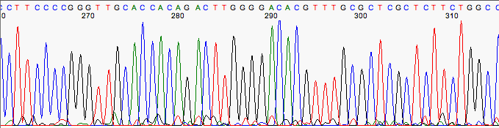
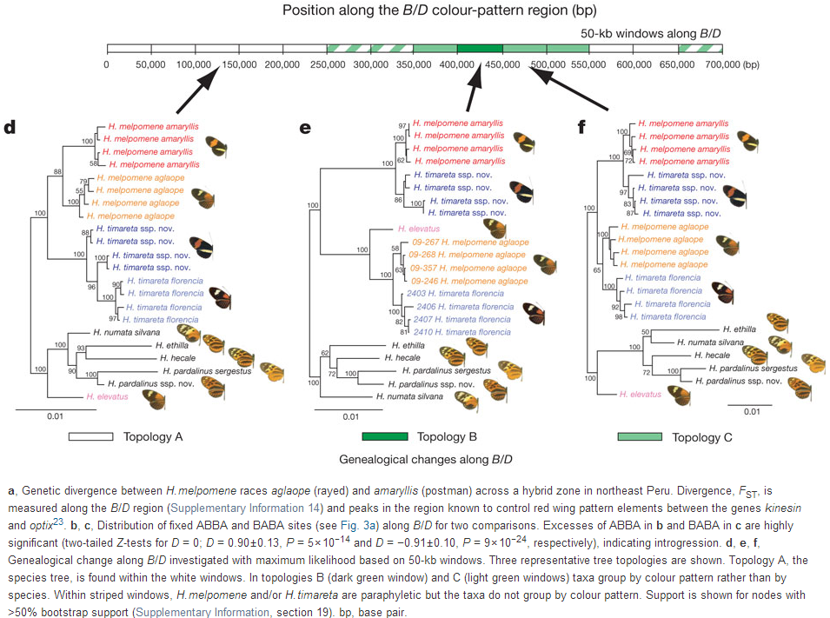
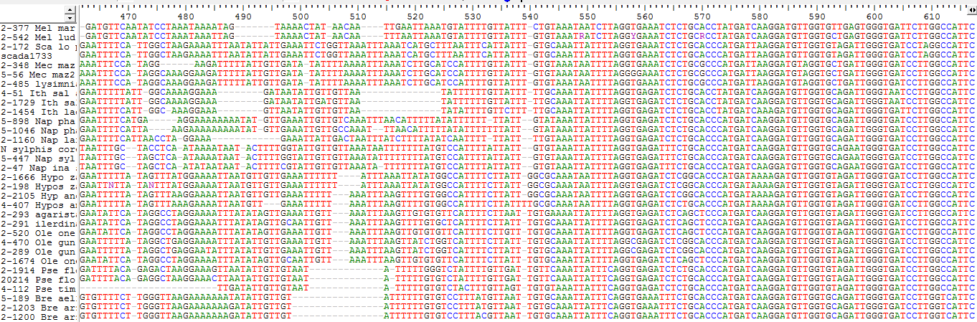
BIO00058M: Sequence Analysis
Lecture 1
Analysis of “low” throughput sequence
Daniel Jeffares

Slide 2
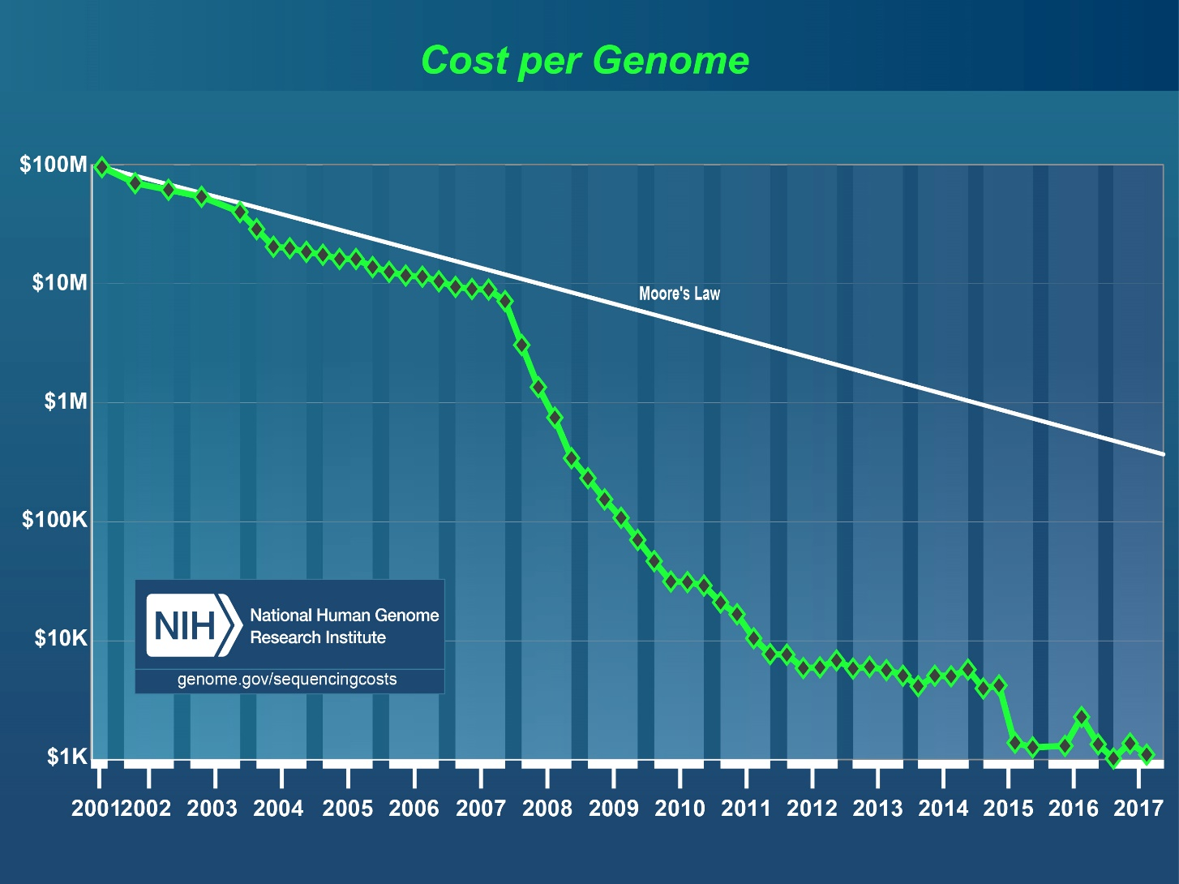
Falling cost of sequencing
The falling costs of sequencing has transformed
genetics, genomics, cell biology, microbiology and evolutionary biology.
Notes:
DNA sequence data is has become much much cheaper over the last ten years. We now measure if in cost/base or cost/human genome.
It has also improved its output vastly. This has transformed genetics and genomics.

Slide 3
Influences of sequence data:
Genomes!
  We can now know the entire gene set of any species.
  This has an enormous effect on molecular biology, medicine, plant biology, microbiology and biotechnology. Many things we now do routinely were challenging, expensive and/or impossible without genomes.
  Eg: knocking out (removing a gene).
Cell biology has been transformed
  Many techniques use next generation sequencing (mainly Illumina) to understand cell and organismal function.
  RNAseq (to examine expression patterns and changes)
  ChipSeq (to tell us where transcription factors bind)
  Chromosome conformation capture (3C) (to analyse the spatial organization of chromatin in a cell)
Evolutionary biology/molecular ecology has been transformed
  Comparative genomics: using all the genomes we have, we can now compare entire genomes, and examine what genes have changed over time, and how fast it has changed.
  Population genomics: by comparing individuals within a species we can locate new events of rapid selection, uncover migrations from the distant past, and do other amazing things – like estimate population sizes backwards though time.
Metagenomics: allows us to characterise the members of entire ecosystems
  Even ecosystems within our bodies (human microbiomes)
Notes:
DNA sequence data is has become much much cheaper over the last ten years. We now measure if in cost/base or cost/human genome.
It has also improved its output vastly. This has transformed genetics and genomics.

Slide 4
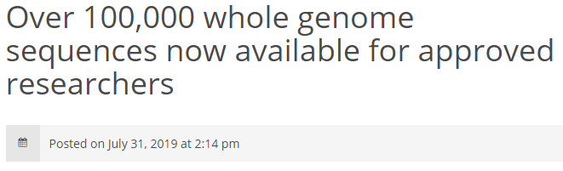


The 100,000 Genome Project
https://www.genomicsengland.co.uk/
Notes:
The 100,000 genome project was established to sequence 100,000 genomes from 85,000 NHS patients affected by rare disease or cancer.

Slide 5
What this option is about
L1 + W1: Analysis of low throughput sequence data
L2 + W2: Introduction to high throughput sequencing. Group projects.
L3 + W3: Aligning sequence to reference genomes. SNP calling.
L4 + W4: Genome browsers and population genetics
L5 + W5: Project plans and help with projects
W6: Extra group projects help session
LINUX LINUX LINUX LINUX LINUX

Slide 6
L1 + W1: Learning objectives
Know how to edit Sanger sequences
How to create an alignment
How to make phylogenies
How to obtain sequences from Genbank

Slide 7
Sanger sequencing

Slide 8
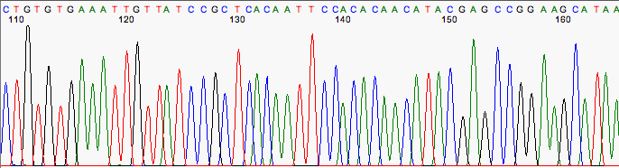
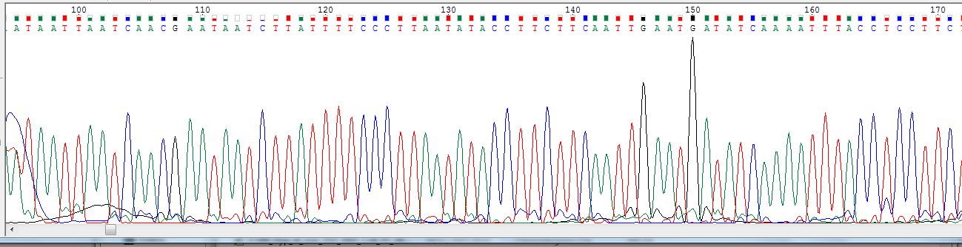
Chromatograms

Slide 9
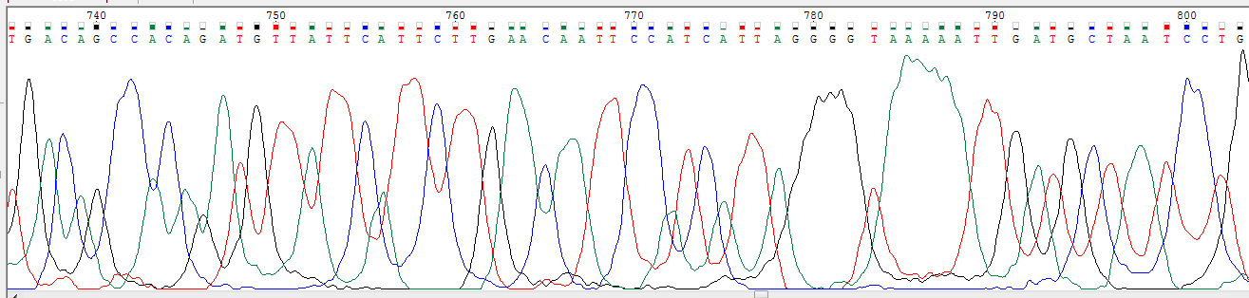
Chromatograms

Slide 10
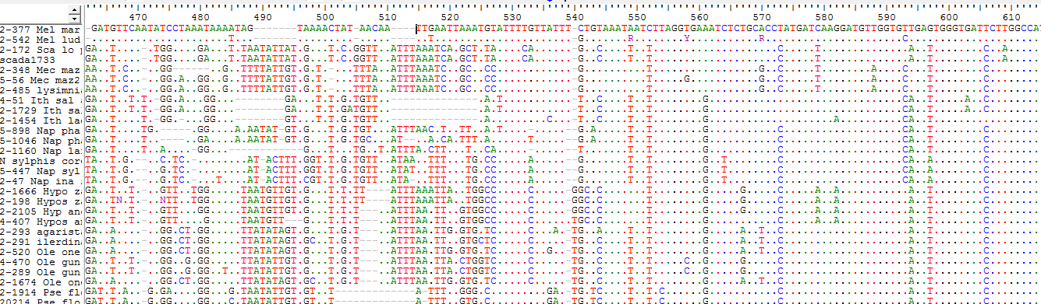
What is a multiple sequence alignment?
Conserved region
A DNA alignment of the Tpi gene from ithomiine butterflies
Notes:
Explaining what is an alignment. Consensus? Indels? Conserved regions. Process of getting from individual sequences to an alignment

Slide 11
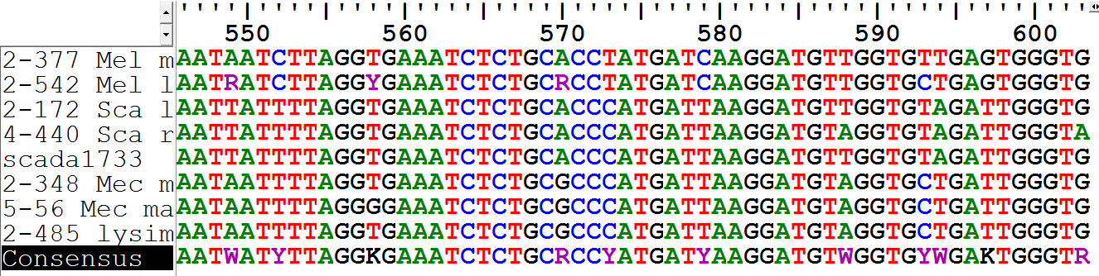
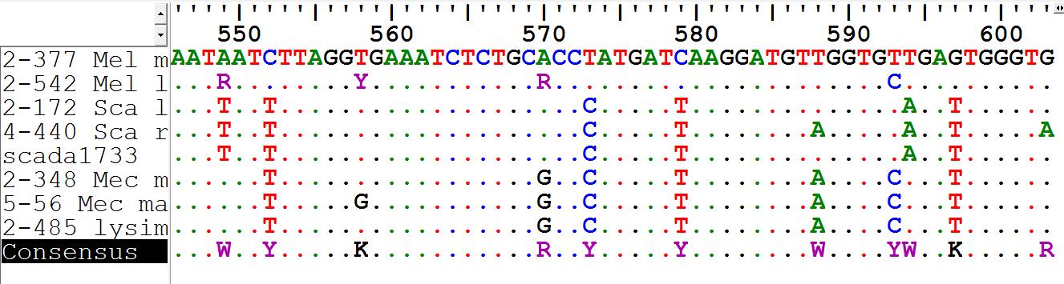
Consensus sequence
A DNA alignment of the Tpi gene from ithomiine butterflies
Notes:
Explaining what is an alignment. Consensus? Indels? Conserved regions. Process of getting from individual sequences to an alignment

Slide 12
Consensus sequence
A DNA alignment of the Tpi gene from ithomiine butterflies
Notes:
Explaining what is an alignment. Consensus? Indels? Conserved regions. Process of getting from individual sequences to an alignment

Slide 13
What is a multiple sequence alignment?
DNA or protein sequences aligned such that positions with same history are aligned with each other
A MSA is based on the hypothesis that all sequences are related, i.e., trace back to same common ancestor
Sequences that trace back to same common ancestor are homologous* alignment = collection of hypotheses
  - every column = an hypothesis, i.e., each residue in each sequence traces to same ancestral residue
* Homology is an important concept in biology see: https://en.wikipedia.org/wiki/Homology_(biology)
Notes:
Hypothesis etc.

Slide 14
Guidelines for evaluating alignments
Modify alignments by eye. You can be better than the computer
Minimise indels (insertion/deletion events), especially in coding sequence
Experiment with gap penalties
For divergent sequences
  Divide into smaller, similar groups first
  Find intermediate sequences
Accept limitations. If more than one solution, test them all.

Slide 15
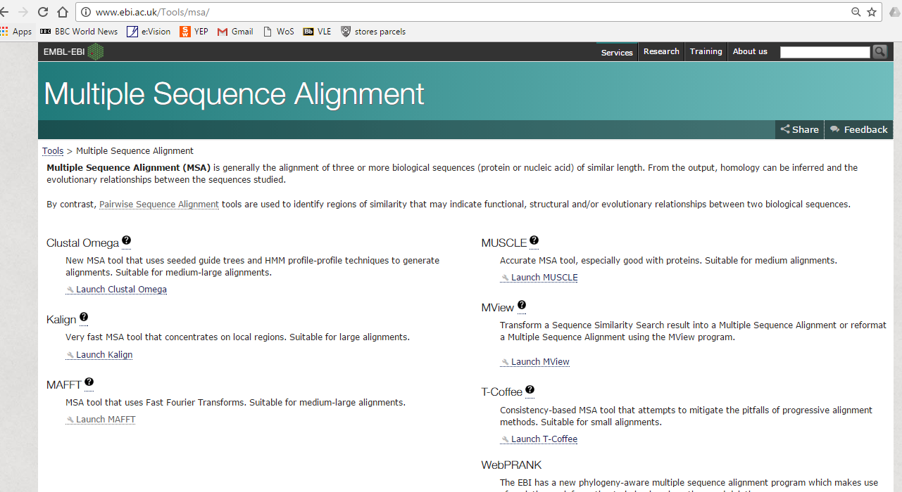
Programs for MSA
See also: https://en.wikipedia.org/wiki/List_of_sequence_alignment_software#Multiple_sequence_alignment

Slide 16
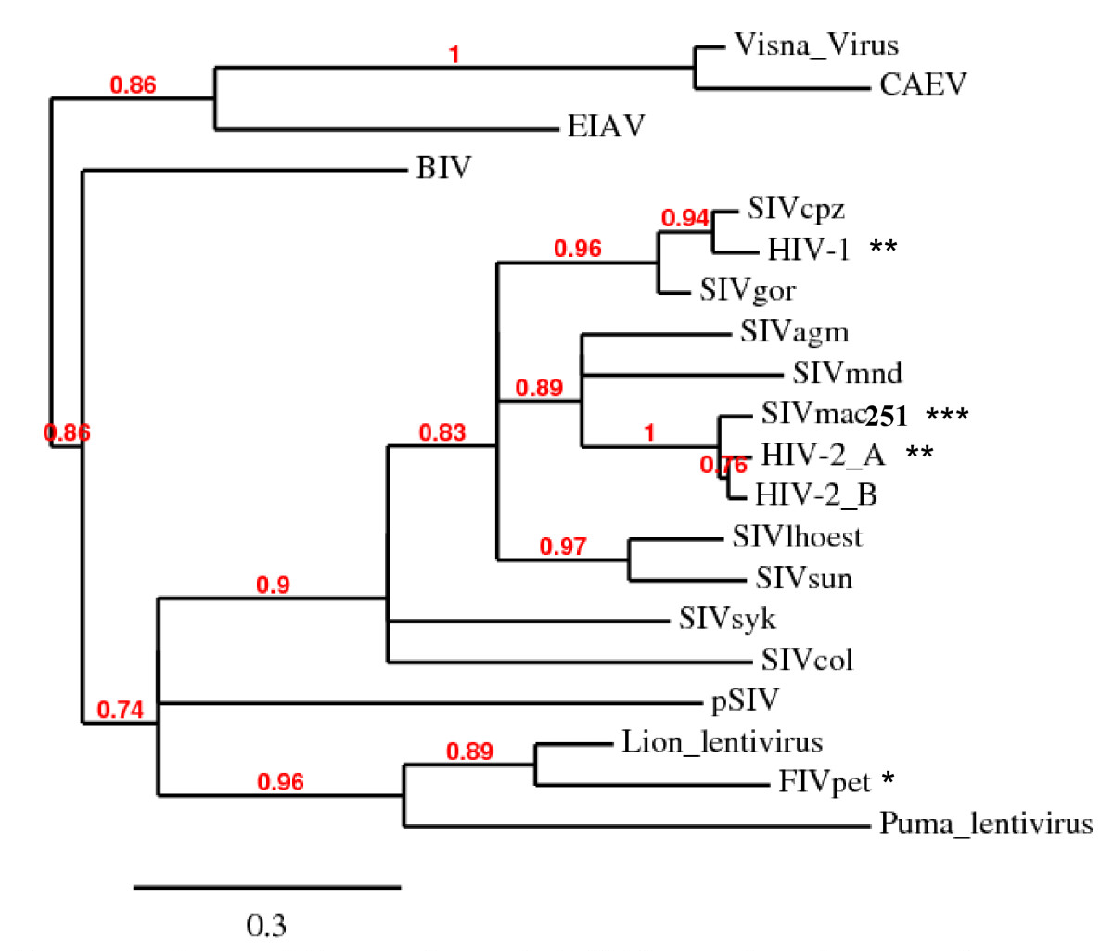
Phylogenetic tree of lentiviruses
Phylogenetic tree of lentiviral integrase core domains
Lewis et al (2010) Retrovirology 7:21.

Slide 17
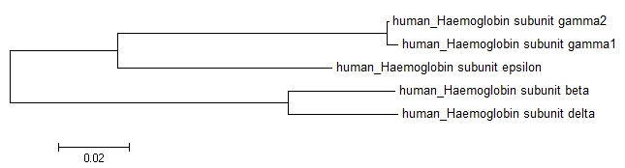
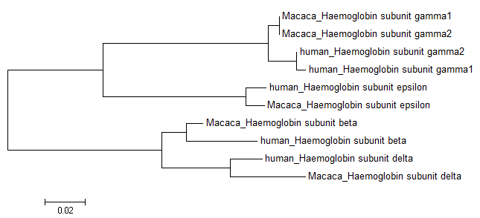
Homologues can be paralogues or orthologues
gene X
Homologous gene sequences have shared ancestry
gene duplication
gene X
gene X’
speciation
gene X
gene X’
gene X
gene X’
species a
species b
human haemoglobin subunit gamma2
Globular proteins comprising haemoglobin
human haemoglobin subunit gamma1
human haemoglobin subunit epsilon
human haemoglobin subunit beta
human haemoglobin subunit delta
human haemoglobin subunit gamma2
macaque haemoglobin subunit gamma2
macaque haemoglobin subunit gamma1
human haemoglobin subunit gamma1
human haemoglobin subunit epsilon
macaque haemoglobin subunit epsilon
macaque haemoglobin subunit beta
human haemoglobin subunit beta
human haemoglobin subunit delta
macaque haemoglobin subunit delta
Notes:
On chromosome 11

Slide 18
Molecular phylogeny step 1 obtain a good alignment
Phylogeny: reconstructing the past based on the present state
  Only meaningful if comparing things with shared ancestry
  i.e. homologous sites in homologous sequences
  Every column in alignment needs to be homologous
NEED A GOOD ALIGNMENT
Evaluate and clean the alignment
  Remove regions where homology is uncertain
  e.g. perhaps regions in and around indels

Slide 19
Distance and discrete phylogenetic methods
Distance methods
  Tree based on pairwise distances between sequences
  Tree produced by clustering method
  One solution only
  Fast, easy and reasonably accurate
  Methods: UPGMA, neighbour-joining (NJ)
Discrete data methods
  Each position in an alignment considered separately
  Look for tree that best fits each position in an alignment
  More detailed and precise. Much slower than distance methods
  Methods: parsimony, maximum likelihood, Bayesian

Slide 20
Bootstrapping: how good is my tree?
How strongly does the data support each branching event?
Bootstrapping
  Create multiple pseudoreplicate datasets from real dataset

Slide 21
Bootstrapping: how good is my tree?
Step 1
a) build bootstrap pseudoreplicate datasets
Original dataset
Bootstrap dataset 1
Bootstrap dataset 2
0123456789
seqA ACCGTTCGGT
seqB ATGGTTCAGA
seqC ATCGATCGGA
15
seqA CT
seqB TT
seqC TT
5539282517
seqA TTGTGGCTCG
seqB TTGAGGGTTA
seqC TTCTCGCTTG
1
seqA C
seqB T
seqC T
seqA
seqB
seqC
1562314951
seqA CTCCGCTTTC
seqB TTCGGTTATT
seqC TTCCGTAATT
b) repeat 1000 times
Step 2
build trees for each
(= 1000 trees)
tree 1
seqA
tree 2
seqA
tree 3
seqA
seqB
seqC
seqB
etc.
seqC
seqB
seqC
Step 3
tabulate results
67%
seqA
seqB
seqC
NJ tree with bootstrap support

Slide 22
Bootstrapping: how good is my tree?
How strongly does the data support each branching event?
Bootstrapping
  Create multiple pseudoreplicate datasets from real dataset
    Randomly sample each position of an alignment
    Repeat random sampling with replacement until alignment complete
    Some positions sampled multiple times, other positions missed out
    Repeat X times to generate X pseudoreplicate datasets (X > 100)
  Compute the phylogenetic tree for each pseudoreplicate dataset
  Calculate what fraction of pseudoreplicate trees support each clade in the original “best” tree, or on a “consensus” tree
A node may have high bootstrap support, but may be completely wrong
Bootstrapping not used for Bayesian trees.

Slide 23
Bootstrapping
Bootstrap gives support for a clade, but NOT relationships within the clade in question
Theoretically, only bootstraps > 95% are significant
Experimental evidence: bootstraps > 70% show strong clade support for molecular data
(Hillis & Bull 1993. Systematic Biology 42: 182-192)
what if BP > 90% for clade of interest, but <50% for others?
  Tree does not have to be fully resolved to be useful
seqA
seqA
seqB
seqB
92%
seqC
92%
seqC
seqD
seqD
seqE
seqE

Slide 24
Displaying phylogenetic trees

Slide 25
Displaying phylogenetic trees
Think who is going to be looking at the figure, and what will help them see what is important
Use real names and not accession numbers
Place bootstrap percentage on branch leading to the relevant clade
Scale bar and what it stands for
Use colours and pictures to clarify and draw attention to interesting parts of the tree
Figure + legend should be stand-alone
Figure title: short and succinct and informative
Figure legend:
  Describe what the tree is (gene, phylogenetic method, taxa)
  Number of bootstrap replicates

Slide 26
Phylogeny programs
Distance methods
  MEGA: user friendly
Likelihood
  MrBayes: Bayesian inference
  BEAST: more for population analyses
  PHYML: fast maximum likelihood
  RAxML: better maximum likelihood
PHYLIP: NJ, parsimony, likelihood
PAUP: NJ, parsimony, likelihood

Slide 27
Further information
Page & Holmes (1998) Molecular evolution: a phylogenetic approach. Blackwell Science
Felsenstein (2004) Inferring phylogenies. Sinauer Associates
Wikipedia + manuals for software
Barry G. Hall (2004) Phylogenetic Trees Made Easy (book). Sinauer Associates.

Slide 28
Linux
Servers running the Linux operating system are used for bioinformatics analyses
Why?
  Large datasets
  Large RAM requirements
  Stable and more secure operating system

Slide 29
Linux Tutorial
You will be using linux command line machines for your workshops and projects.
This will be challenging unless you have a basic knowledge of linux commands.
So, learn about it before you get into the computer lab.
Before workshop 2:
Do this Linux tutorial:
https://www.york.ac.uk/res/dasmahapatra/teaching/MBiol_sequence_analysis/intro_to_linux_2019.html
Further linux help: https://www.york.ac.uk/res/dasmahapatra/teaching/MBiol_sequence_analysis/ sequence_analysis_index.html

Slide 30
Confused?
Here’s what to do
First, check the workshop manuals.
Then use google: bioinformatics problems/solutions are very well documented on the internet (bioinformatics geeks love the internet)
Then, use the discussion board on the VLE:
(called the sequence analysis forum).
  Feel free to reply to comments to help each other out.
  Teaching staff will reply to questions posted here – but NOT 24/7, so please be patient with replies.
Then, email/come and see me: kanchon.dasmahapatra@york.ac.uk

Slide 31
Workshop 1
In workshop 1 (tomorrow) we will learning how to use Sanger ’low throughput’ sequence files.
We will be making alignments and trees.

