Slide 1
Ground Control: Fear and Happiness in cities today
CURB inaugural lecture
11.3.14
Anna Minton

Slide 2
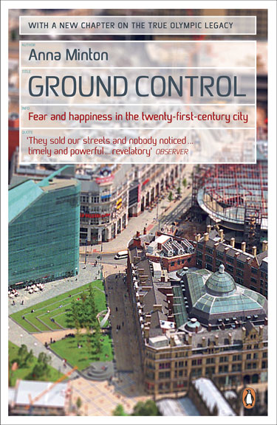

Slide 3
Key Themes
Post industrial change & the new economy
Polarisation & the two speed economy
Regeneration
Identity, homogenisation & sterility
Exclusion & inclusion
Culture of fear and crime complex in contemporary society
Created by lack of trust & cohesion
The economics of happiness, well-being

Slide 4
Context
Context huge post-industrial regeneration opportunities around UK
Level of change not seen since 1950s & 60s
Fuelled by property boom & policy change, particularly in planning & local democracy
What happened not an economic inevitability, led by importing US policies towards the city
Context changed 2008 wt crash

Slide 5
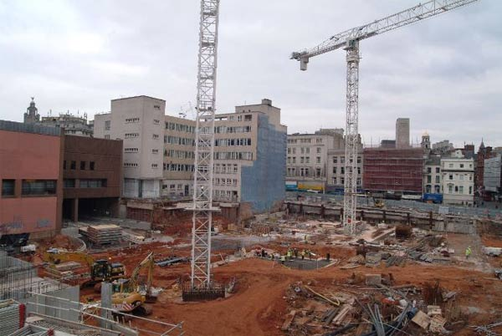

Slide 6
The Privatised City

Slide 7
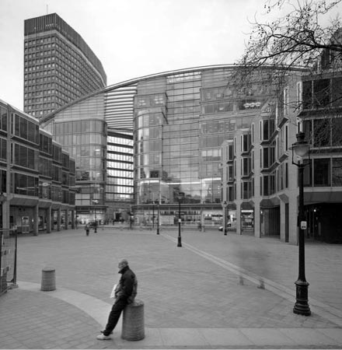

Slide 8
The Privatised City
Two models, which overlap
Privately owned places
Template for all new regeneration on Canary Wharf model
Liverpool One, Highcross in Leicester, Cabot Circus
Privately managed places
Business Improvement Districts on US model
Different idea of the city, place as a product, not democratic, segregates into enclaves
New: only last 10 years. Private investment does not require private ownership of the streets

Slide 9
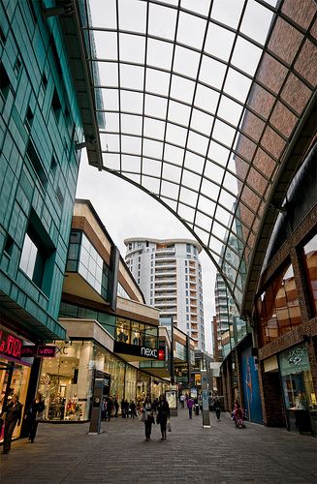

Slide 10
The Economic Model
‘Property-led’ or ‘retail-led’ regeneration
Aims to treat place as a product, create maximum profit from place
Lefebvre: said that each the spaces of each era reflect political culture – the agora
predicted 40 years ago treating place as product mean everywhere look the same – clone towns/non places
‘Malls without walls’ – for BIDS – equally private places
Main aim keep property prices & land values high rather than ‘common good’, ‘public good’ – reflected in planning legislation
Thrived in boom times

Slide 11
Private Places
Virtually all new development
Private security guards, defensible architecture, CCTV over every inch
Rules: no skateboarding, photographs, political demonstrations etc
Creates very different public culture & public life, sterile, fearful & less happy

Slide 12
Policy backdrop: Planning & Compulsory Purchase
Importance powers of land assembly and compulsory purchase
170 acres Stratford City, Liverpool 43 hectares, 34 streets
In US ‘eminent domain’ flashpoints nationwide protest
Supreme court Kelo V London, removed ‘public good’ from legisl led to protestors camping on White House lawn and law revoked many states
Here same change to Planning & Compulsory Purchase Act barely noticed

Slide 13
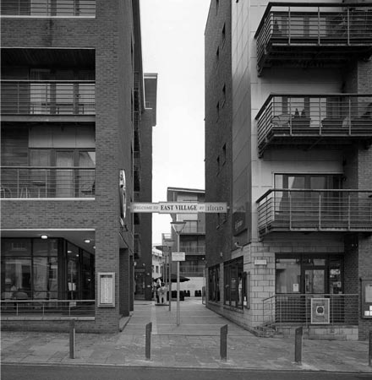

Slide 14
Creating Victorian patterns of landownership
Privatisation of public space is underpinned by changes in patterns of landownership
Last 150 years diverse patchwork of ownership
local authority/private individuals/institutional investors
Shift to individual private landowners owning & managing huge tracts in manner of early Victorian forbears – pre local government
Instead of multitude of ownerships, single landlord
Undermines diversity and democracy

Slide 15
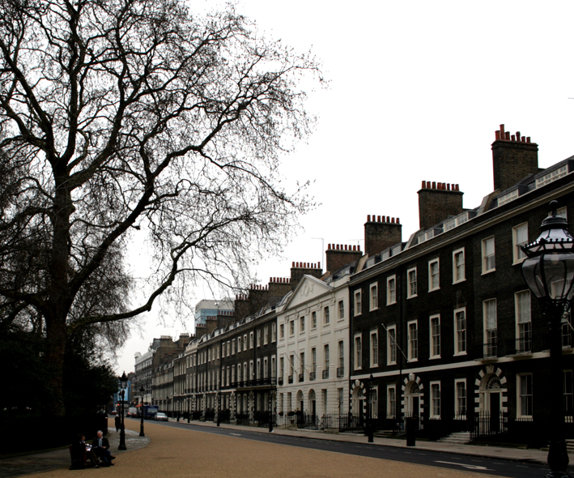

Slide 16
Private control: Management
Business Improvement Districts on US model
Similar level private security, CCTV, rules & regulations & similar feel and culture created
US very controversial, here introduction barely noticed – 174 up and running from New West End Company to CVOne in Coventry, CityCo
US, seen as undermining local democracy, organisation representing local businesses rather than democratically elected representatives

Slide 17
What are BIDS?
Local businesses – retailers – pay tax/service charge to fund the improvements they wish to see
Key principles ‘Clean and safe’
Security & sanitation
Marketing & improving the ‘bottom line’ - shopping
Overlap wt private parts of the city – often manage them

Slide 18
Clean and Safe
Who wouldn’t want the city to be clean and safe?
A good narrative but not so simple
From New York guidelines
Visible, uniformed private security,CCTV
Marketing, branding, ‘importing excitement’
Critics: themed, fake, disneyfied, lack diversity & spontaneity
Pristine cleanliness – ‘to the standards of any office lobby’
Can clean out the people and create soulless feeling
Joseph Rowntree public space research: lingering, doing nothing

Slide 19
Access & behaviour
Range of banned behaviours
No political protest
Occupy LSX & Paternoster Square
Land outside St Paul’s only public land in the City
Not a democratic space

Slide 20
Growth of private security
The ‘wider police family’
Growth private security accompanied by Police Reform Act 2002
Private security can now receive ‘accredited’ status, increases powers
‘Wider police family’ of private security, wardens, rangers, ambassadors etc

Slide 21
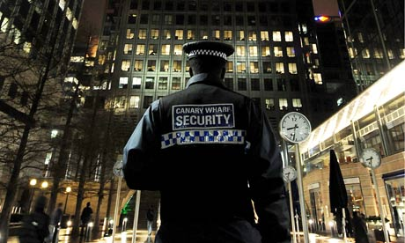

Slide 22
The impact of private security
Adds to sterility
Increases fear
Presence private security enhances fear, constant reminder danger
Conundrum: asked before people say they want it but asked after do not say they feel safer
JRF research shows not deterred by lack of security in genuinely public space

Slide 23
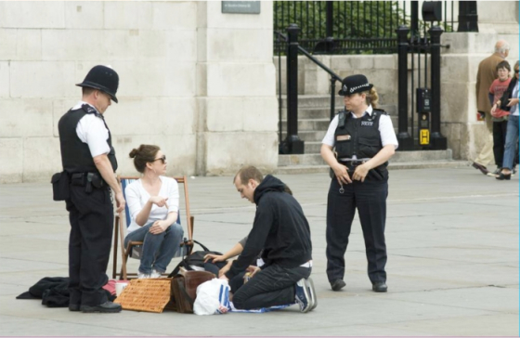

Slide 24
Role of Secured by Design
Oscar Newman & defensible space
‘Crime Prevention thro Environmental Design’ CPTED US version, Secured by Design British version
Alice Coleman
Began late 80s. Funded by security industry
Now planning permission all public buildings depends on SbyD

Slide 25
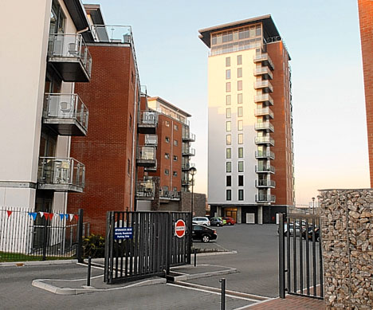

Slide 26
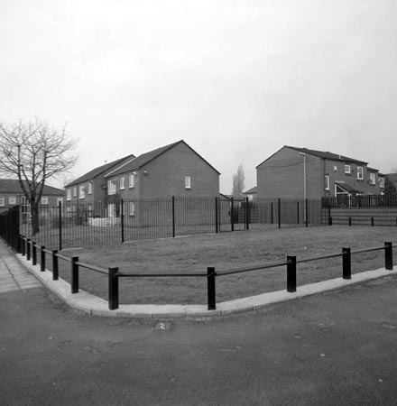

Slide 27
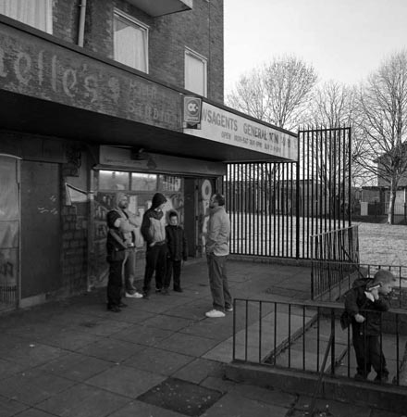

Slide 28
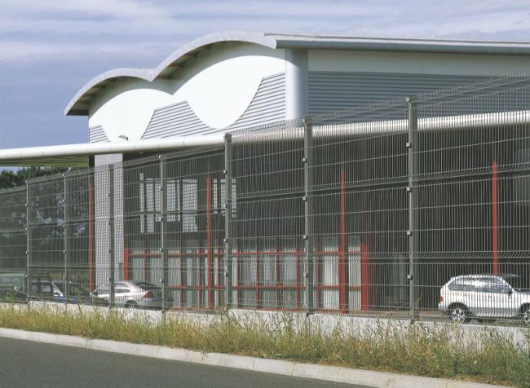

Slide 31
Consequences: Fear and Distrust
New way of looking at city which segregates it even more, not for the ‘benefit’ of place
Not aiming to create a cohesive, inclusive place but enclaves of defended private complexes wt security guards & CCTV
Growing obsession with safety and security that comes with private places & private security actually creates more fearful places
Removes personal and collective responsibility
Undermines ‘natural surveillance’ and dilutes trust
Crime paradox: falling steadily since 1995 but majority believe it is rising

Slide 32
Solutions are part of the problem
Method addressing fear created by this lack of cohesion is even more security
Defensible space in wealthiest and poorest places – gated communities, all social housing, private guards, wardens
4.2 million CCTV cameras, most in all of Europe, growth private security Mosquitos, Drones
‘Respect’ policies & asb agenda – stop & search

Slide 33
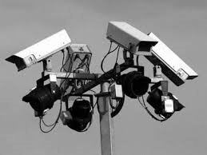

Slide 34
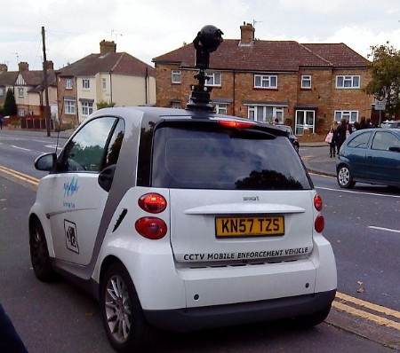

Slide 35
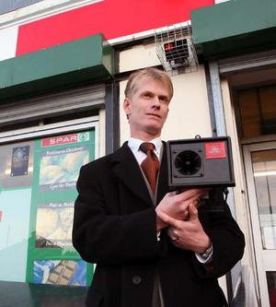

Slide 36
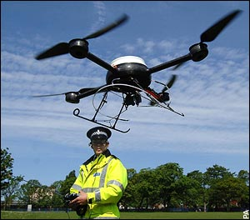

Slide 37
Liverpool
Lpool, one of the most defended places in UK, even cabs have CCTV, drones, private security
also one where paradox starkest
Not a high crime city, tho people believe it is – crime figs lower than Leeds & Mancs – comparable size, perception Merseyside highest crime north west but 2nd lowest
Classic eg. fear of crime rather than crime itself problem

Slide 38
Trust and happiness
Fear of crime does not correlate with actual crime
But does correlate with trust
High security, defensible space, policies towards young people undermine trust and therefore increases fear
Eg Denmark: same levels of crime, shown by European Crime and Safety Survey to be a consequence of urbanisation, large population young people & binge drinking culture
But Denmark also happiest country in the world, low levels of fear
More homogenous, but more equal too, reflected in landscape

Slide 39
Undermining democracy
Places owned & run by private companies, not democratically elected representatives
Votes of companies to set up a BID not residents
Range of behaviours, including political protest, banned
The ‘public good’ substituted for economic benefit

Slide 40
The Future?
Questions about economic viability
Architecture of boom & bust
Opportunity or paralysis?
Further work:
Public life, the public interest & public goods

Slide 41
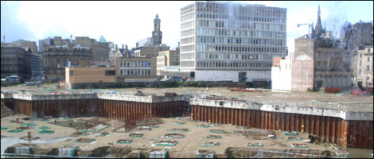

Slide 42
Shared Space
Not just about railings
About interaction between people rather than controls
Same argument applies to security and ‘natural surveillance’

Slide 43
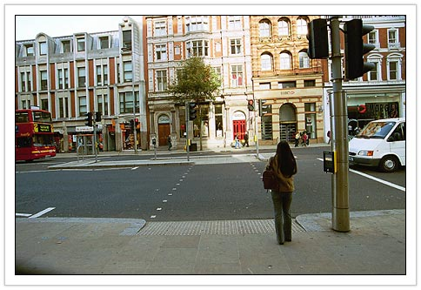

Slide 44
The role of the public good
Is the concept still relevant?
Damaged by top down centralism post war years
Intertwined wt economic benefit
Assaulted from left & right
Still yearned for
Role of ‘common goods’, universal services

Slide 45
Further work on the public good
‘Scaring the living daylights’: The local lobby and the failure of democracy
Published by Spinwatch 2013
Common Good(s): Redefining the public interest and the common good
Published by the Chisenhale Gallery, The Showroom, Studio Voltaire for ‘How to Work Together’ 2013

