Slide 1

The birth of primary health care:
Celebrating 40 years of the
Alma Ata Declaration
Dr Claudia Stein
Director
Division of Information, Evidence, Research and Innovation

Slide 2
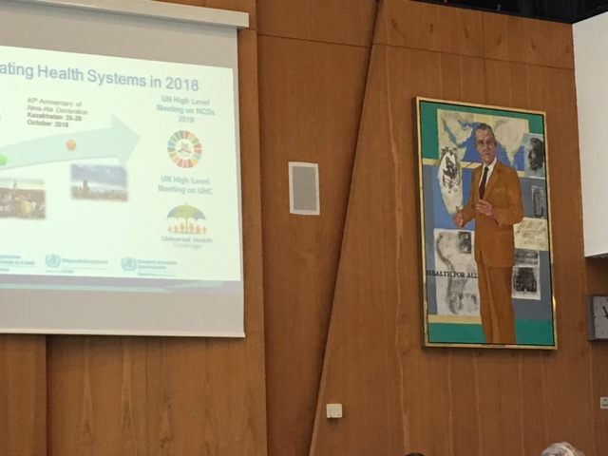
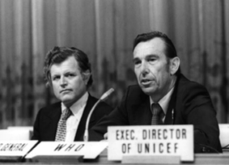
“The goal of economic development is to improve the well-being of people. Health for all is not just a by-product of development. It is a primary lever for initiating the development process itself.”
Halfdan Mahler

Slide 3

Health for All
in the European Region

Slide 4

Now more data and evidence than ever…
Today, we are living in the age of data and evidence

Slide 5
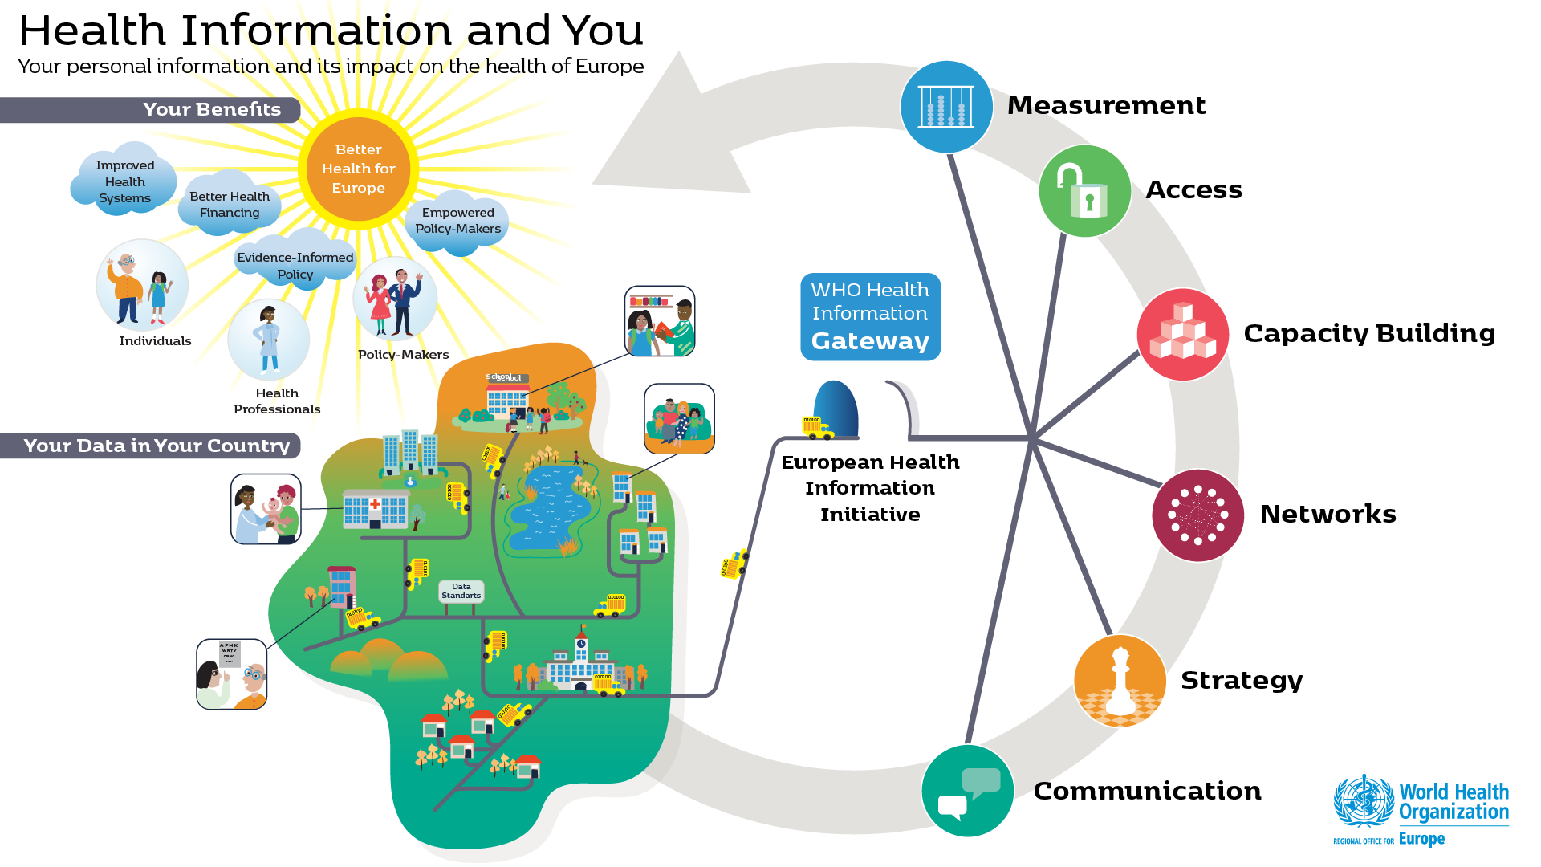

Slide 6
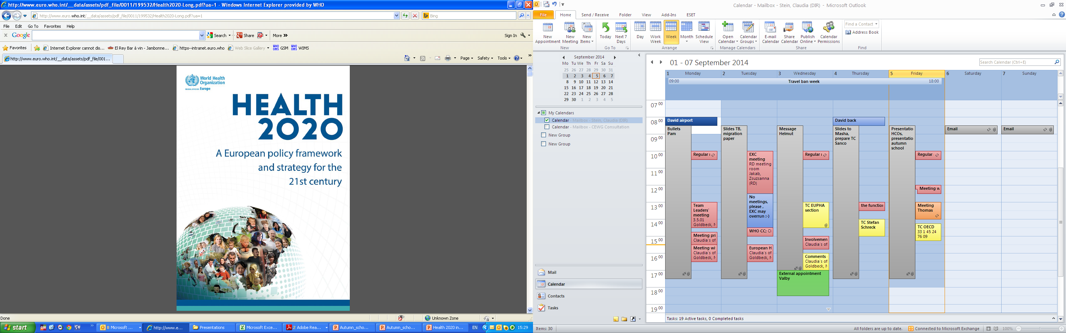
European Health 2020 policy
Emphasis on health and well-being;
The right to health and access to care;
People at the centre;
Addressing the determinants of health;
Whole of society approach;
Whole of government approach;
Importance of partnerships.

Slide 7

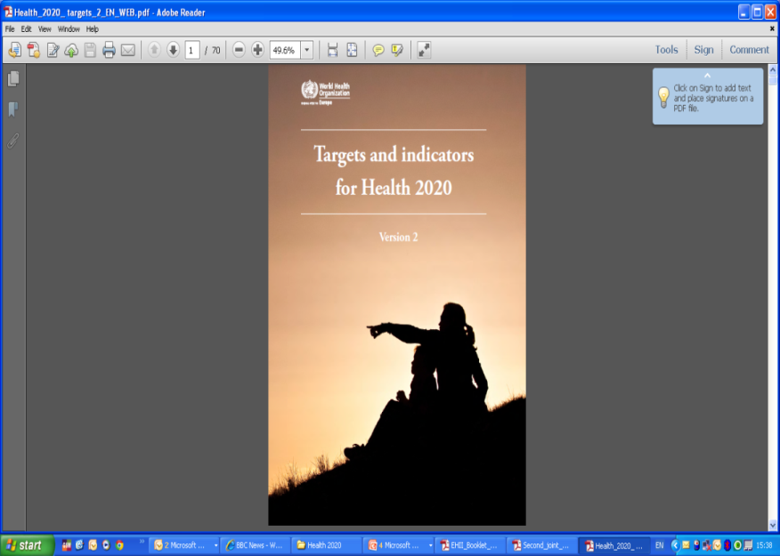
Health 2020 targets
Reduce premature mortality
Increase life expectancy
Reduce inequities
Enhance well-being
Achieve universal health coverage
Establish national targets set by Member States
Notes:
Health 2020, adopted by European Member States in 2012, strongly emphasizes improving health for all and reducing health inequalities, as well as working across sectors and government to improve leadership and participatory governance for health.
Equity, a pillar of Health 2020, is also the cornerstone of the SDGs– reflecting the importance of addressing the needs of poor or disadvantaged groups and leaving no one behind!
The SDGs and Health 2020 are therefore fully aligned, with H2020 being a crucial regional framework for setting the ground and implementing SDGs in the region.

Slide 8
Health 2020 targets
Reduce premature mortality
Increase life expectancy
Reduce inequities
Enhance well-being
Achieve universal health coverage
Establish national targets set by Member States
Notes:
Health 2020, adopted by European Member States in 2012, strongly emphasizes improving health for all and reducing health inequalities, as well as working across sectors and government to improve leadership and participatory governance for health.
Equity, a pillar of Health 2020, is also the cornerstone of the SDGs– reflecting the importance of addressing the needs of poor or disadvantaged groups and leaving no one behind!
The SDGs and Health 2020 are therefore fully aligned, with H2020 being a crucial regional framework for setting the ground and implementing SDGs in the region.

Slide 9
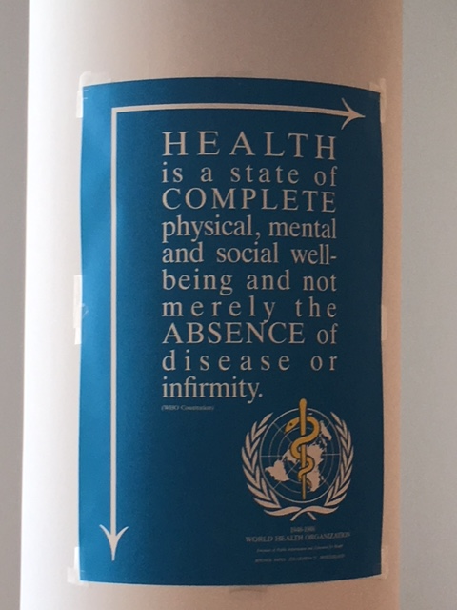
Indicators for objective and subjective well-being in Health 2020

Slide 10
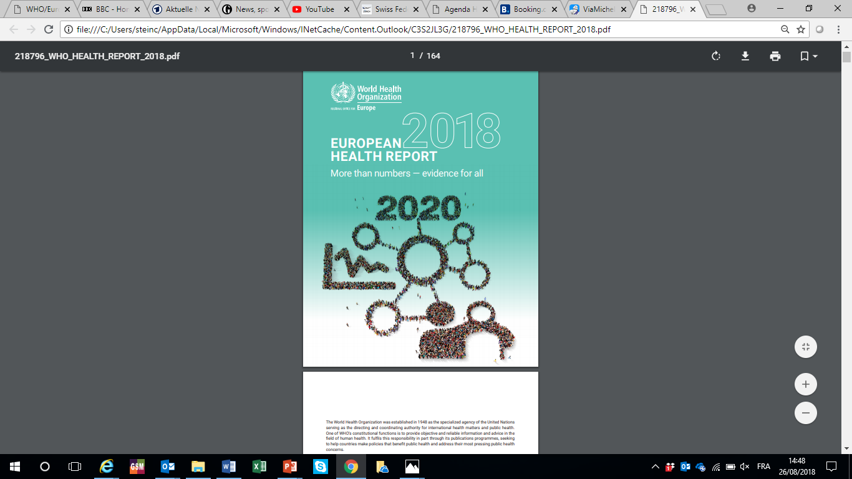
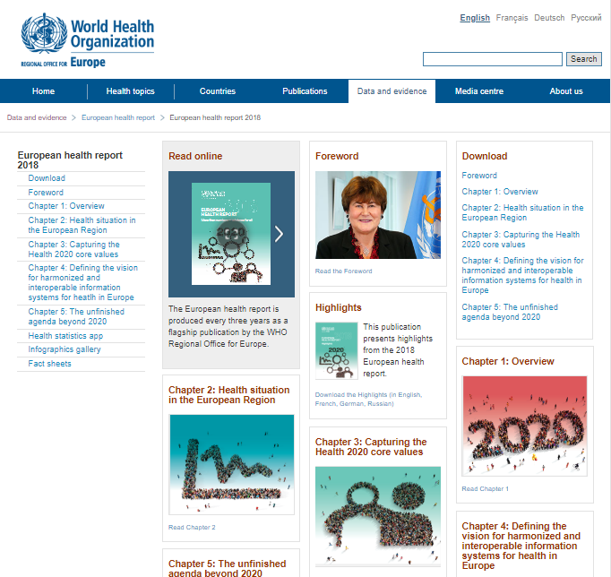
“Evidence for All”
Cultural context of health and well-being
Qualitative & quantitative information as mainstream evidence
“New evidence” for the 21st century

Slide 11
Indicators for objective and subjective well-being in Health 2020
Halfdan Mahler: “There is more to well-being than our definition assumes”

Slide 12
37th World Health Assembly (1984)
Resolution A37.13
INVITES Member States to consider including in their strategies for health for all a spiritual dimension as defined in this resolution in accordance with their social and cultural patterns.

Slide 13
Halfdan Mahler: “There is more to well-being than our definition assumes”
…spiritual?
…other?
What are the implications for the WHO definition of health?

