Slide 1
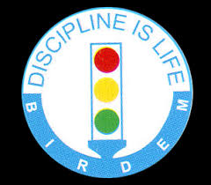
Welcome on behalf of Department of Dental Surgery, BIRDEM General Hospital
Dr. Saeed Hossain Khan
Associate Professor & Head,
Department of Dental Surgery,
BIRDEM General Hospital

Slide 2
National Professor Dr. Mohammad Ibrahim
The founder of Diabetic Association of Bangladesh
and BIRDEM

Slide 3
BIRDEM
Bangladesh Institute of Research and Rehabilitation in Diabetes, Endocrine and Metabolic Disorders
A sister concern of Diabetic Association of Bangladesh

Slide 4
BIRDEM General Hospital
Established in 1956
Located in the center of the capital city of Bangladesh.
Tertiary hospital having more than 650 beds.
Patients all over the country attend here for treatment.
Teaching hospital of Ibrahim Medical College and Ibrahim Medical College Dental Unit

Slide 5
BIRDEM General Hospital (Shahbag)

Slide 6
BIRDEM General Hospital-2 (Women & Children)

Slide 7
Dental Surgery in BIRDEM
Department of Dental Surgery, BIRDEM started working in 1988.
Students of Ibrahim Medical College Dental Unit get their clinical training for Bachelor of Dental Surgery (BDS) degree from this department.
Free treatment is provided to a lot of poor patients, specially diabetic patients.

Slide 8
Department of Dental Surgery, BIRDEM
Clinical services are provided in following disciplines-
1. Periodontology and Oral Medicine
2. Conservative Dentistry & Endodontics
3. Oral and Maxillofacial Surgery
4. Prosthodontics
5. Pedodontics and Dental Public Health
6. Orthodontics

Slide 9
Conservative Dentistry OT

Slide 10
Orthodontic OT

Slide 11
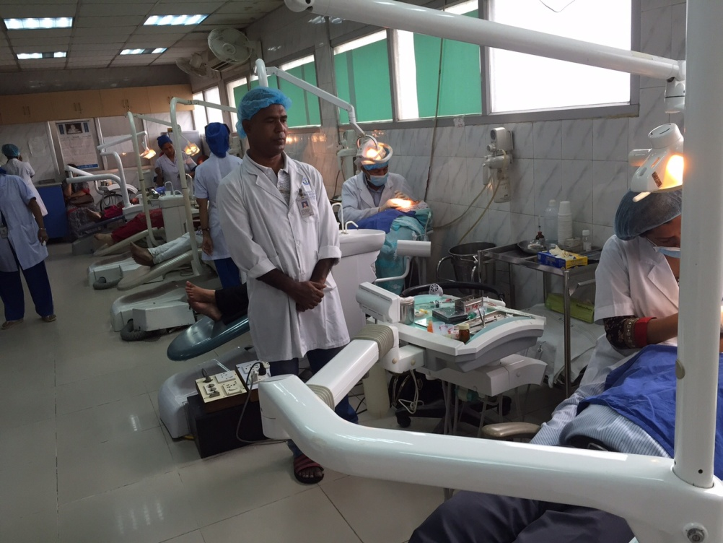
Maxillofacial Surgery OT

Slide 12
Prosthodontic Outdoor and Laboratory

Slide 13
Staffs of Department of Dental Surgery
Type | Name of the Post | Quantity
Teaching Staff | Professor | 1
 | Associate Professor | 2
 | Assistant Professor | 6
 | Senior Medical Officer | 3
 | Registrar | 1
 | Lecturer/ Medical Officer | 13
 | Honorary Medical Officer | 6
Supporting Staff | Dental Technologist | 3
 | X-ray Technologist | 1
 | Nurse | 9
 | Attendent & Cleaner | 11
Total: 56

Slide 14
Number of patients in the Department of Dental Surgery, BIRDEM
Total patients attended in the Department of Dental Surgery, BIRDEM in the year 2019:
25,871
More than 70 patients per day attended in the Department of Dental Surgery, BIRDEM

Slide 15
Publications in Journals & Research Projects
The doctors of the Department of Dental Surgery, BIRDEM have published 9 articles in different national and international scientific journals 2019.
There are 3 research projects running in the Department of Dental Surgery, BIRDEM.

Slide 16
The scope of research in the Department of Dental Surgery, BIRDEM

Slide 17
Fukuda M (2018) Tobacco control and lung cancer, Oncol Res Rev, 2018 doi: 10.15761/ORR.1000106 Volume 1(1): 1-6

Slide 18
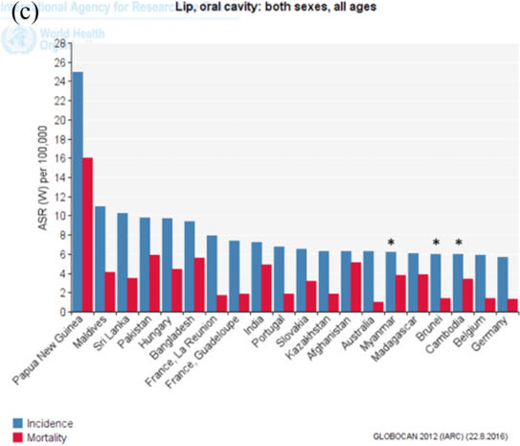

Slide 19
Leading cancers and the prevalence in last 5 years in Bangladesh (males)
Hussain: Cancer scenario of Bangladesh; South Asian Journal of Cancer ; October-December 2013; Volume 2 ,Issue 4

Slide 20
Scope for research/ intervention in the Department of Dental Surgery, BIRDEM
Number of patients attending in the Department of Dental Surgery, BIRDEM (having habit of using tobacco)
periodontal disease and diabetes
diabetic patients(repeated visit) suitable for follow up
Dental Surgeons of BIRDEM having interest in research work
Cooperation from the administrative authority.

Slide 21
Conclusion/ Expectations
Tobacco cessation project can help to reduce the number of cases of malignant and premalignant oral lesions as well as other oral conditions among diabetic patients.
This will have a positive impact in our society.

Slide 22
Thank you

