Slide 1

Best Practice in Early Intervention in 2014
Moggie McGowan 02/05/14
www.iris-initiative.org.uk

Slide 2
Drivers for EIP in UK
Mental Health Policy/Modernisation/Transformation
UK and international research evidence for EI
Problems with TAU/late intervention
New treatments and Guidelines
Costs/Benefits research
Social Movements, campaigning and challenges to dominance of the established paradigm
Outcomes agenda and Performance Management
Austerity?
Notes:
Central to governments modernisation plans for MH services: National plan, NSF, PIG (late 90’s). Originally a target for 06 but extended to 09
Evidence for EI inconclusive at the time but has been demonstrated since
Problems with TAU/late intervention
80% relapse and long term disability
EI ‘movement’ and International Early Psychosis Declaration (WHO)
Schizophrenia had been calculated to cost the NHS in excess of £1 billion per year (Bosanquet, 2000).
Expected to be costly but economic evaluation study is showing the true economic impact of EIP. This study has modelled the costs associated with Early Intervention over a one-year and a three-year period and found that when compared to usual care, the cost for Early Intervention amounts to an annual saving of 53%, which is maintained after three years. (McCrone, Dhanasiri & Knapp)

Slide 3
Drivers for EIP in UK
Mental Health Policy/Modernisation/Transformation
UK and international research evidence for EI
Problems with TAU/late intervention
New treatments and Guidelines
Costs/Benefits research
Social Movements, campaigning and challenges to dominance of the established paradigm
Outcomes agenda and Performance Management
Austerity?
Notes:
3
Central to governments modernisation plans for MH services: National plan, NSF, PIG (late 90’s). Originally a target for 06 but extended to 09
Evidence for EI inconclusive at the time but has been demonstrated since
Problems with TAU/late intervention
80% relapse and long term disability
EI ‘movement’ and International Early Psychosis Declaration (WHO)
Schizophrenia had been calculated to cost the NHS in excess of £1 billion per year (Bosanquet, 2000).
Expected to be costly but economic evaluation study is showing the true economic impact of EIP. This study has modelled the costs associated with Early Intervention over a one-year and a three-year period and found that when compared to usual care, the cost for Early Intervention amounts to an annual saving of 53%, which is maintained after three years. (McCrone, Dhanasiri & Knapp)

Slide 4
The UK policy context
NSF (1999): ‘By 2004 each EI service will have established it’s first team’ - 2006 deadline
National Plan (2000): 50 teams by 2004
PIG (2001): ‘The overall service will be established during the lifespan of the NSF.’
NSF: Five Years On and Ten Years On (2004, 2007)
Darzi Review (2008)
New Horizons (2009)
2010…
No Health without Mental Health (2011)
Closing the Gap: Priorities for essential change in mental health (DH 2014)
Notes:
DOH (NSF) targets
- National Plan: 50 teams (define) by 2004
- PIG: ‘By 2004 each EI service will have established it’s first team’.
‘The overall service will be established during the lifespan of the NSF’
- 2002/3 Priorities and planning framework (2001): ‘By 2004 all young people who develop a serious mental illness will be in receipt of Early Intervention Services’.
- P&P 2003-2006: 2004 DUP target added
- Star ratings (!)

Slide 5
No Health without Mental Health
EIP is prominent within the current MH strategy:
Consolidating development and progress towards comprehensive services
A greater emphasis on prevention and health promotion
Increased focus on recovery and social/occupational outcomes
Expanding the EI paradigm to other MH conditions
Increased emphasis on youth mental health
Performance shift to outcomes
Notes:
QIPP!!
Mental health problems start in adolescence and early adulthood and much of the disability seen in adult MH services is preventable with earlier intervention

Slide 6
Closing the Gap:
Priorities for essential change in mental health (DH 2014)
Increasing access to MH services:
High-quality local MH services should be commissioned in all areas
An information revolution
Clear waiting time limits for MH services
Tackle inequalities around access to MH services
900,000 people pa will benefit from psychological therapies
IAPT for children and young people
The most effective services will get the most funding
Notes:
6
QIPP!!
Mental health problems start in adolescence and early adulthood and much of the disability seen in adult MH services is preventable with earlier intervention

Slide 7
Choices for adults
Radically reduce the use of all restrictive practices and end the use of high risk restraint
Friends and Family Test – including CAMHS
Poor quality services will be identified
Carers will be better supported and more involved
Integrating physical and mental health care
MH care and physical health care will be better integrated at every level
Change the way frontline health services respond to self-harm
No-one experiencing a MH crisis should ever be turned away
Notes:
7
QIPP!!
Mental health problems start in adolescence and early adulthood and much of the disability seen in adult MH services is preventable with earlier intervention

Slide 8
Starting early to promote mental wellbeing and prevent mental health problems
Better support to new mothers with postnatal depression
Schools will be supported to identify MH problems sooner
End the cliff-edge of lost support as children reach the age of 18
Improving the quality of life of people with mental health problems
People with MH problems will live healthier and longer lives.
More people with MH problems will live in homes that support recovery
Notes:
8
QIPP!!
Mental health problems start in adolescence and early adulthood and much of the disability seen in adult MH services is preventable with earlier intervention

Slide 9
Improving the quality of life of people with mental health problems
A national liaison and diversion service for offenders
Service users who are victims of crime will be offered enhanced support
Support employers to help more people remain in or move into work
New approaches to help people move into work
Stamp out discrimination around mental health
Notes:
9
QIPP!!
Mental health problems start in adolescence and early adulthood and much of the disability seen in adult MH services is preventable with earlier intervention

Slide 10
Drivers for EIP in UK
Mental Health Policy/Modernisation/Transformation
UK and international research evidence for EI
Problems with TAU/late intervention
New treatments and Guidelines
Costs/Benefits research
Social Movements, campaigning and challenges to dominance of the established paradigm
Outcomes agenda and Performance Management
Austerity?
Notes:
10
Central to governments modernisation plans for MH services: National plan, NSF, PIG (late 90’s). Originally a target for 06 but extended to 09
Evidence for EI inconclusive at the time but has been demonstrated since
Problems with TAU/late intervention
80% relapse and long term disability
EI ‘movement’ and International Early Psychosis Declaration (WHO)
Schizophrenia had been calculated to cost the NHS in excess of £1 billion per year (Bosanquet, 2000).
Expected to be costly but economic evaluation study is showing the true economic impact of EIP. This study has modelled the costs associated with Early Intervention over a one-year and a three-year period and found that when compared to usual care, the cost for Early Intervention amounts to an annual saving of 53%, which is maintained after three years. (McCrone, Dhanasiri & Knapp)

Slide 11
Research Evidence and EIP
Key Research Findings:
Delayed treatment has serious consequences
Early intervention can reduce long term morbidity
Late intervention and disability is costly
Substantially reduced life expectancy with TAU
Notes:
People with serious mental illnesses die on average 15-20 years earlier

Slide 12
International Research:
Patrick McGorry, Alison Yung (Aus)
Tom McGlashan, Tandy Miller (USA)
TK Larsen, Jan Johannessen (Norway)
Max Birchwood et al (UK)
Nick Tarrier,Tony Morrison, Paul French (UK)
Notes:
12
STARS OF EI RESEARCH

Slide 13
NICE 2009 review of Schizophrenia
“Early intervention can be effective with benefits lasting at least 2 years" (p79)
And went on to say...
"Despite the fact that CMHTs remain the mainstay of community mental health care, there is surprisingly little evidence to show that they are an effective way of organising services" (p336).
http://www.nice.org.uk/nicemedia/pdf/CG82FullGuideline.pdf

Slide 14
NICE 2014 review of Psychosis and Schizophrenia
“EIS more than any other services developed to date, are associated with improvements in a broad range of critical outcomes, including relapse rates, symptoms, quality of life and a better experience for services”. (p551)
http://www.nice.org.uk/guidance/index.jsp?action=download&o=64924

Slide 15
Physical Health
People with serious mental illnesses die on average 20 years earlier
Antipsychotic medications are associated with substantial weight gain. (Journal of Clinical Psychiatry, 2009)
Olanzapine and Aripriprazole induced insulin resistance (Diabetes, July 8 2013 American Diabetes Association)
Children and young people prescribed antipsychotics had an increased risk of type 2 diabetes that increased with cumulative dose (JAMA, August 21 2013)
59% of patients with FEP use tobacco at time of presentation (Journal of Clinical Psychiatry, in press)
Notes:
80% Preventable physical (cardiometabolic) reasons
20% Suicide and injury
McElroy, SL, 2009. Obesity in patients with severe mental illness: overview and management, Journal of Clinical Psychiatry, 70,
Supplement 3:12-21.

Slide 16

Lethal Discrimination
More than 40% of all tobacco is smoked by people with mental illness, but they are less likely to be given support to quit.
Fewer than 30% of people with schizophrenia are being given a basic annual physical health check.
People gain an average of 13lbs in the first two months of taking antipsychotic medication and this continues over the first year.
Despite this, in some areas 70% of people in this group are not having their weight monitored.
Many health professionals are failing to take people with mental illness seriously when they raise concerns about their physical health.
www.rethink.org/lethaldiscrimination

Slide 17
Healthy Active Lives (HeAL) Declaration
Keeping the Body in Mind in Youth with Psychosis
Young people experiencing psychosis have the same life expectancy and expectations of life as their peers who have not experienced psychosis
Young people experiencing psychosis, their family and supporters know how to, and are consistently supported to, maintain physical health and minimize risks associated with their treatment
Concerns expressed by young people experiencing psychosis, their family and supporters, about the adverse effects from the medicines used to treat psychosis are respected and inform treatment decisions
Health care professionals and their organisations work cohesively in a united effort to protect and maintain the physical health of young people experiencing psychosis
Healthy active lives are promoted routinely from the start of treatment, focusing on healthy nutrition and diet, physical and purposeful activity, and reduced tobacco use

Slide 18
Lester UK Adaptation
An intervention framework for patients with psychosis on antipsychotic medication
Positive Cardiometabolic Health Resource
http://www.rcpsych.ac.uk/pdf/RCP_11049_Positive%20Cardiometabolic%20Health%20chart-%20website.pdf

Slide 19
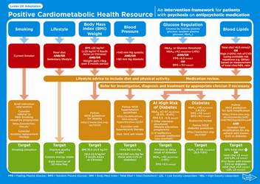

Healthy Active
Lives (HeAL)

Slide 20
Bondi KBIM
Jackie Curtis, Early Psychosis Program, South Eastern Sydney Local Health District
Aim and background
Antipsychotic medication initiation in youth with
first-episode psychosis (FEP) induces rapid
clinically significant weight gain and
metabolic deterioration. This study evaluated the
effectiveness of early lifestyle intervention initiated
within four weeks of antipsychotic medication
commencement, in attenuating weight gain in FEP.
Notes:
Jackie Curtis1,2, Andrew Watkins1, Katherine Samaras3, Megan Kalucy1,2,
Simon Rosenbaum1, Scott Teasdale1, Janelle Abbott1, Julio De La Torre1, Philip Ward2,4
1Early Psychosis Program, South Eastern Sydney Local Health District

Slide 21
Results
Significantly less weight gain at 12 weeks compared to standard care
Prevented gains in BMI and waistline
Prevented deterioration in blood pressure, blood lipid profiles, fasting blood glucose
Clinically significant improvements in aerobic fitness and reduced energy intake
13% of KBIM vs. 75% of standard care participants experienced clinically significant weight gain
Notes:
Intervention
12-week structured, individualised lifestyle coaching
program delivered by specialist clinical staff (nurse
practitioner, dietician and exercise physiologist)
supported by youth peer wellness coaches. The
intervention comprised weekly-individualised dietetic
education & monitoring, including practical sessions
on shopping and cooking. Individualised exercise
prescriptions were provided, with availability of a
supervised on-site gym.

Slide 22
Conclusion
Lifestyle intervention attenuates antipsychotic-induced weight gain in youth with first-episode psychosis
Including a skills-based lifestyle intervention as part of routine care in youth with FEP may prevent the seeding of future disease risk and reduce the life expectancy gap for people living with serious mental illness.
In order to achieve the Healthy Active Lives (HeAL) Declaration target of health parity for youth with psychosis, it is imperative young people with severe mental illness are equipped with lifestyle knowledge and skill sets that will preserve physical health.
Don’t just screen – Intervene!

Slide 23
Drivers for EIP in UK
Mental Health Policy/Modernisation/Transformation
UK and international research evidence for EI
Problems with TAU/late intervention
New treatments (NICE)
Costs/Benefits research
Social Movements, campaigning and challenges to dominance of the established paradigm
Outcomes agenda and Performance Management
Austerity?
Notes:
23
Central to governments modernisation plans for MH services: National plan, NSF, PIG (late 90’s). Originally a target for 06 but extended to 09
Evidence for EI inconclusive at the time but has been demonstrated since
Problems with TAU/late intervention
80% relapse and long term disability
EI ‘movement’ and International Early Psychosis Declaration (WHO)
Schizophrenia had been calculated to cost the NHS in excess of £1 billion per year (Bosanquet, 2000).
Expected to be costly but economic evaluation study is showing the true economic impact of EIP. This study has modelled the costs associated with Early Intervention over a one-year and a three-year period and found that when compared to usual care, the cost for Early Intervention amounts to an annual saving of 53%, which is maintained after three years. (McCrone, Dhanasiri & Knapp)

Slide 24
Consequences of delayed treatment
Interference with psychological and social development
Disruption of study/employment
Loss of self esteem
Substance misuse
Violence/criminal activities
Strain on relationships
Family distress

Slide 25
Increased risk of depression and suicide
Undesirable pathways to care inc. MHA
Unnecessary hospitalisation/IHT
Secondary trauma
Slower/less complete recovery
Treatment resistance
Poorer prognosis
Increased cost of management

Slide 26
Drivers for EIP in UK
Mental Health Policy/Modernisation/Transformation
UK and international research evidence for EI
Problems with TAU/late intervention
New treatments and Guidelines
Costs/Benefits research
Social Movements, campaigning and challenges to dominance of the established paradigm
Outcomes agenda and Performance Management
Austerity?
Notes:
26
Central to governments modernisation plans for MH services: National plan, NSF, PIG (late 90’s). Originally a target for 06 but extended to 09
Evidence for EI inconclusive at the time but has been demonstrated since
Problems with TAU/late intervention
80% relapse and long term disability
EI ‘movement’ and International Early Psychosis Declaration (WHO)
Schizophrenia had been calculated to cost the NHS in excess of £1 billion per year (Bosanquet, 2000).
Expected to be costly but economic evaluation study is showing the true economic impact of EIP. This study has modelled the costs associated with Early Intervention over a one-year and a three-year period and found that when compared to usual care, the cost for Early Intervention amounts to an annual saving of 53%, which is maintained after three years. (McCrone, Dhanasiri & Knapp)

Slide 27
Latest Guidelines
IRIS Guidelines (2012)
Psychosis and Schizophrenia in Children and Young People (2013) NICE Recognition and Management Guideline (CG155)
Psychosis and Schizophrenia in Adults (2014) NICE Treatment and Management Guideline (CG178)
IRIS Guidelines (2014)
Notes:
27
27
NICE 2014
EIP – irrespective of age and DUP
Evidence for late intervention and TAU? It causes long term disability.

Slide 28
Psychosis and
Schizophrenia in Adults
NICE Guideline (CG178, 2014)

Slide 29
Schizophrenia or Psychosis?
Schizophrenia is descriptive
It is a concept
Not a category based on consistent causation
A disease process has not been identified
‘There may be no more biological basis for schizophrenia than there is a biological basis for being Belgian’ (David Yeomans, 2013)
Notes:
David Yeomans, Consultant Psychiatrist, Leeds)
There may be a biological basis for some people whose distress is labelled as Sz (eg GPI)

Slide 30
‘Psychosis’
The term ‘psychosis’ is used in this guideline to refer to the group of psychotic disorders that includes schizophrenia, schizoaffective disorder, schizophreniform disorder and delusional disorder.

Slide 31
What’s in?
Early detection/prevention
CBT for psychosis AND at risk mental states
PTSD-psychosis link
Family interventions
Art Therapy
Supported Employment Programmes
Intensive Case Management (vs AOT)
Best practice prescribing (low dose, choice, coming off)
None?
Proper attention to social, education and developmental needs
Physical healthcare
Relapse prevention
EIP!
Notes:
31
31
NICE 2014
EIP – irrespective of age and DUP
Evidence for late intervention and TAU? It causes long term disability.

Slide 32
What’s out?
Assertive Outreach
14-35
New medicines
Notes:
Intensive Case Management (vs AOT)

Slide 33
NICE 2014 on EI
NICE define EI as ‘Pharmacological, psychological and arts therapies and support for employment provided within an integrated team’.
EI is better than comparators (standard care/CMHT) on a range of outcomes, including reduced relapse rates, reduced hospital stay, improvement in symptoms and quality of life and, importantly, EIS is preferred to standard services
EISs, more than any other services developed to date, are associated with improvements in a broad range of critical outcomes, including relapse rates, symptoms, quality of life and a better experience for service users
The inclusion of evidence based psychological and pharmacological treatments is the most likely explanation for the success of EIS.
The impact of EIS can be lost within 12 months of discharge to CMHTs and other community services
Therefore, to maintain benefits, service users should either remain within EIS for longer periods of time or community teams for people with established psychosis (CMHT, ACT) will need to provide the same evidence based treatments as EIS

Slide 34

IRIS Guidelines Update September 2012
Revision of the original 1998 IRIS Guidelines
www.iris-initiative.org.uk
Notes:
34
Who is IRIS?
[Cut to Guidelines…]

Slide 35

‘The IRIS initiative was the inspiration behind the ground breaking reforms scaled up across England over the past decade which has seen early intervention for psychosis become a standard feature of mental health care; the most systematic demonstration of the value of early intervention in psychiatry to date’
Patrick McGorry
Professor of Youth Mental Health, University of
Melbourne, Clinical Director of the ORYGEN
Research Centre
Notes:
35
35
NICE 2014
EIP – irrespective of age and DUP
Evidence for late intervention and TAU? It causes long term disability.

Slide 36
IRIS Guidelines Update
September 2012
Captures and condenses the wisdom and experience gleaned from a decade of English and international experience with this new model of care
Aimed at commissioners, service providers and clinicians
Written and endorsed by experts in the field
Lessons for the rest of the mental health field.
Web based
Clear, concise and user-friendly
Direct in style – prescriptive where the evidence base is strong
Interactive – web links to key related documents and websites
Fully referenced
Notes:
36
36
NICE 2014
EIP – irrespective of age and DUP
Evidence for late intervention and TAU? It causes long term disability.

Slide 37

Geraldine Strathdee,
National Clinical Director for Mental Health, NHS England
‘The problem is not a lack of guidance!’
(National Psychosis Summit, 10th April 2014)

Slide 38
Drivers for EIP in UK
Mental Health Policy/Modernisation/Transformation
UK and international research evidence for EI
Problems with TAU/late intervention
New treatments and Guidelines
Costs/Benefits research
Social Movements, campaigning and challenges to dominance of the established paradigm
Outcomes agenda and Performance Management
Austerity?
Notes:
38
Central to governments modernisation plans for MH services: National plan, NSF, PIG (late 90’s). Originally a target for 06 but extended to 09
Evidence for EI inconclusive at the time but has been demonstrated since
Problems with TAU/late intervention
80% relapse and long term disability
EI ‘movement’ and International Early Psychosis Declaration (WHO)
Schizophrenia had been calculated to cost the NHS in excess of £1 billion per year (Bosanquet, 2000).
Expected to be costly but economic evaluation study is showing the true economic impact of EIP. This study has modelled the costs associated with Early Intervention over a one-year and a three-year period and found that when compared to usual care, the cost for Early Intervention amounts to an annual saving of 53%, which is maintained after three years. (McCrone, Dhanasiri & Knapp)

Slide 39
Cost Effectiveness
Health economic evidence has accrued over the past decade
Direct and indirect costs
Over three years the cost-per-case was calculated at £26,568 for EIP and £40,816 for CMHT care, a saving of £14,248 per case (McCrone, 2009 and 2010).
Notes:
39
39
NICE 2014
EIP – irrespective of age and DUP
Evidence for late intervention and TAU? It causes long term disability.

Slide 40
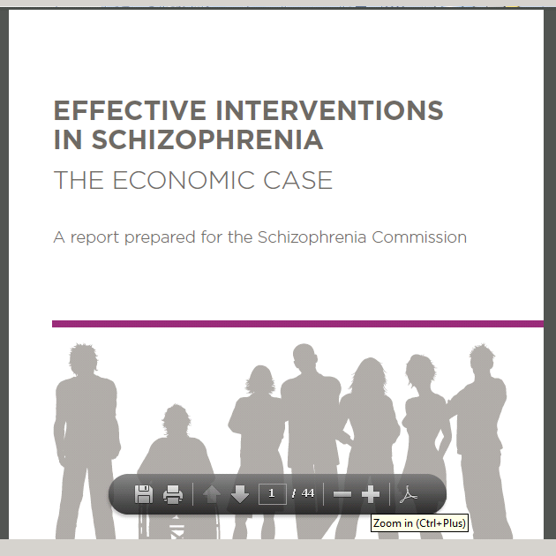
Notes:
LSE Martin Knapp and Paul McCrone
40

Slide 41
Cost drivers in psychosis
Direct cost to the public sector - Use of mental health services - in particular inpatient time; suicide.
Other public services: criminal justice, welfare
Wider societal costs: Employment - earnings and taxation
Family members employment earnings and taxation
Notes:
41
41
NICE 2014
EIP – irrespective of age and DUP
Evidence for late intervention and TAU? It causes long term disability.

Slide 42
£12,198 per admission
Curtis, 2011; Hospital Episode Statistics online, 2011
Notes:
42
The average cost of a night in a mental
health inpatient bed in England is £321 (Curtis
2011). Hospital Episode Statistics (HESonline
2011) show that the median length of admission
is 38 days, translating into an estimated cost of
£12,198 per admission.3 Typically, compulsory
(or formal) admissions under the Mental Health
Act are longer than this, and thus translate
into higher costs than voluntary admissions. taxation

Slide 43
Early Intervention Services reduce the probability of a compulsory admission under the Mental Health Act:
From 13% to 6%
From 44% to 23%
First 2 months
In each 2 month period thereafter

Slide 44
Savings 2010/11 prices
£15,742 per service-user
£5,493 per service-user
Or
In the first year of psychosis
For the first 3 years of psychosis
www.rethink.org
Notes:
44
44

Slide 45
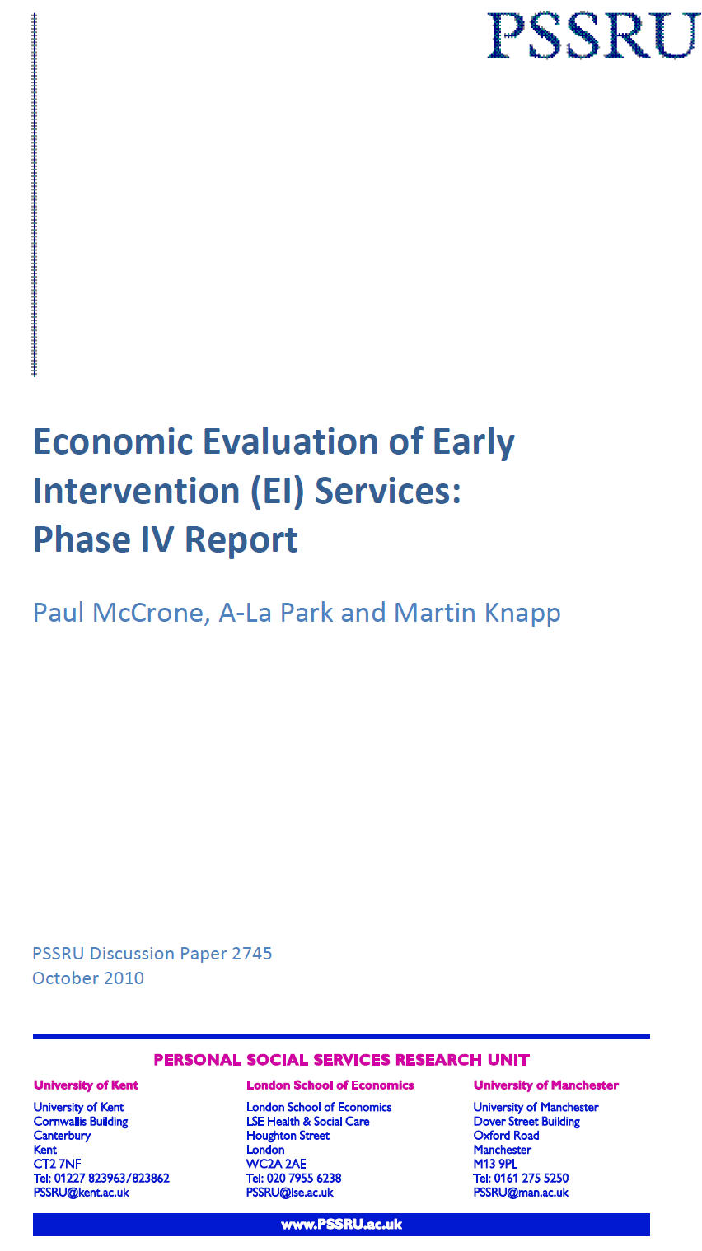
Conclusions
Early Intervention in Psychosis (EIP) services in mental health are able to save up to £65 million a year
This 'invest to save' approach can begin to release savings even within the first year of service provision.
http://www.pssru.ac.uk/pdf/dp2745.pdf
Notes:
45

Slide 46
MH promotion and mental illness prevention: The economic case
The economic and social costs of MH problems in England are £105 billion p.a.
15 forms of prevention and early intervention in mental health reviewed to gauge their economic value
Many of these interventions are ‘outstandingly good value for money’
Early Intervention in Psychosis teams save the economy a total of £18 for every pound spent on them
Low in cost, saving public expenditure as well as radically improving the quality of people's lives.
Department of Health/Centre for MH, 2011
Notes:
46
46
NICE 2014
EIP – irrespective of age and DUP
Evidence for late intervention and TAU? It causes long term disability.

Slide 47
Early Intervention
IN PSYCHIATRY
Early Intervention in Psychiatry, 3, 266-273 November 2009
McCrone P, Knapp M & Dhanasiri S.
Economic impact of services for first-episode psychosis: a decision
model approach.
BME data
McCrone P., Knapp M., & Dhanasiri S
unpublished 2007
Notes:
47
47

Slide 48


Investing in Recovery
Making the business case for effective interventions for people with schizophrenia and psychosis.
Supported by DH

Slide 49
The most up-to-date economic evidence to support the business case for investment in effective, recovery-focused services:
Early Detection (ED) services
Early Intervention (EI) teams
Individual Placement and Support (IPS)
Family therapy
Criminal justice liaison and diversion
Physical health promotion, including health behaviours
Supported housing
Crisis Resolution and Home Treatment (CRHT) teams
Crisis houses
Peer support
Self-management
Cognitive Behavioural Therapy (CBT)
Anti-stigma and discrimination campaigns
Personal Budgets (PBs)
Welfare advice

Slide 50
There is particularly clear evidence for interventions such as EI teams, IPS for employment, CBT and CRHT teams
Examples
Early Intervention: net savings of £6,780 per person after four years. Over a ten-year period, £15 in costs can be avoided for every £1 invested.
Smoking cessation: £1,255 to gain an extra Quality-Adjusted Life Year (QALY), which lies well below the upper threshold of £30,000 recommended by National Institute for Health and Care Excellence (NICE).
Peer support: £4.76 can be gained for every £1 invested.
CBT: Cost per QALY gained of £27,373 for CBT compared to usual care, which is below the upper threshold used by NICE.
http://www.centreformentalhealth.org.uk/publications/investing_in_recovery.aspx?ID=704

Slide 51
Drivers for EIP in UK
Mental Health Policy/Modernisation/Transformation
UK and international research evidence for EI
Problems with TAU/late intervention
New treatments and Guidelines
Costs/Benefits research
Social Movements, campaigning and challenges to dominance of the established paradigm
Outcomes agenda and Performance Management
Austerity?
Notes:
51
Central to governments modernisation plans for MH services: National plan, NSF, PIG (late 90’s). Originally a target for 06 but extended to 09
Evidence for EI inconclusive at the time but has been demonstrated since
Problems with TAU/late intervention
80% relapse and long term disability
EI ‘movement’ and International Early Psychosis Declaration (WHO)
Schizophrenia had been calculated to cost the NHS in excess of £1 billion per year (Bosanquet, 2000).
Expected to be costly but economic evaluation study is showing the true economic impact of EIP. This study has modelled the costs associated with Early Intervention over a one-year and a three-year period and found that when compared to usual care, the cost for Early Intervention amounts to an annual saving of 53%, which is maintained after three years. (McCrone, Dhanasiri & Knapp)

Slide 52
‘Recovery is on the agenda, not clinical, or social recovery, but personal recovery. The responsibility for recovery lies with us all; professionals, users and carers and we can only achieve it by working together. We can only achieve it by talking and listening to each other. We can only achieve it through shifting the paradigm from one of biological reductionism to one of societal and personal development.
Until we succeed, people will still be locked away from society because they hear voices or have different beliefs. Until we succeed, people will still be treated against their will. Until we succeed society will still fear madness and until we succeed civilisation will remain uncivilised. Recovery is our common goal, it is achievable now - let us not lose the moment. Let us work together to make it happen. Let us go forward to Recovery’
(Ron Coleman, 1999).

Slide 53
International Early
Psychosis Declaration (WHO)
Respect of the right to recovery and social inclusion and support to the importance of personal, social, educational and employment outcomes.
Respect of the strengths and qualities of young people with a psychosis, their families and communities, encouraging ordinary lives and expectations.
Services that actively partner young people, their families and friends to place them at the centre of care and service delivery, at the same time sensitive to age, phase of illness, gender, sexuality and cultural background.
Use of cost-effective interventions.
Respect of the right for family and friends to participate and feel fully involved.
Notes:
Values
Vision:
Challenge stigmatising and discriminatory attitudes so that young people are not disadvantaged by their experiences and are truly included in their local communities.
Generate optimism and expectations of positive outcomes and recovery so that all young people with psychosis and their families achieve ordinary lives.
Raise wider societal awareness about psychosis and the importance of early intervention.
Attract and encourage practitioners from a wide range of health, social, non-governmental agencies (e.g. charitable, voluntary and youth), educational and employment services to reflect on how they can better contribute to supporting young people with psychosis, their families and their friends.

Slide 54
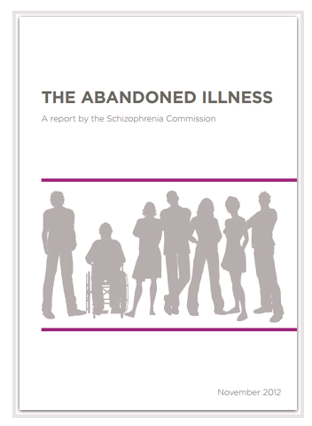
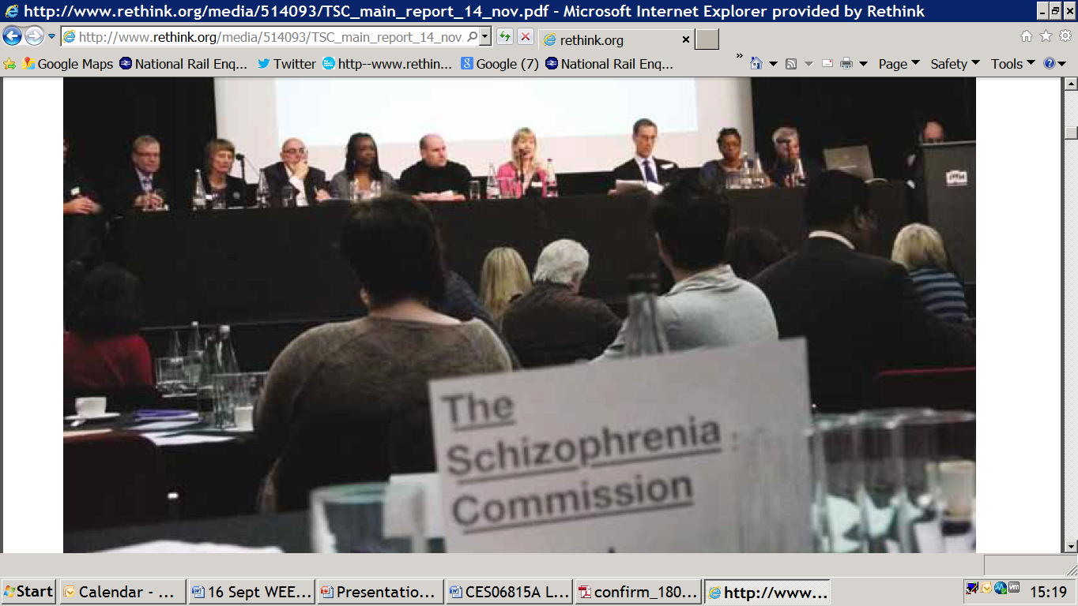
The Schizophrenia Commission
www.rethink.org
Notes:
54
Our current campaigns are based on the schizophrenia commission
. In 2012 there was an independent commission into the care of people with psychosis, hosted by Rethink Mental Illness. The commission heard 2,500 people with lived experience of psychosis, carers and professionals and it also looked at the economic case.
The results of this commission...
54

Slide 55
Early Intervention Services
“the great innovation of the last 10 years”
“the most positive development in mental health services since the
beginning of community care.”
www.rethink.org
Notes:
55
55

Slide 56
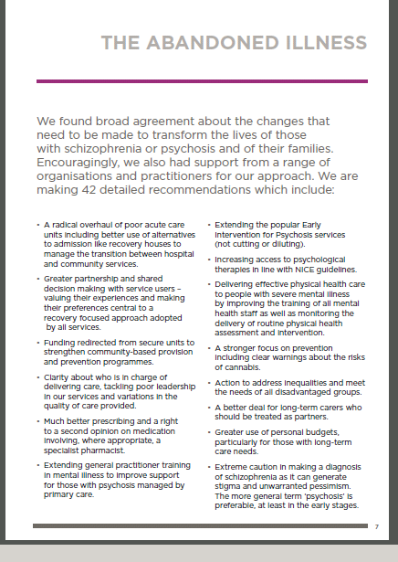
42 recommendations
22.
We recommend that all Clinical
Commissioning Groups commission Early
Intervention in Psychosis services with sufficient resources to provide fidelity to the service model.
www.rethink.org
Notes:
56

Slide 57
Wednesday 12 March 2014
“The recent decision by NHS England and the health regulator Monitor to recommend cutting funding for mental health services by 20% more than that for acute hospitals completely contravenes the government's promise to put mental and physical healthcare on an equal footing and will put lives at risk.
Mental health is chronically underfunded. It accounts for 28% of the disease burden, but gets just 13% of the NHS budget. Mental health services are straining at the seams and these new cuts will mean support is slashed in response to instructions from NHS England. This decision will cost much more in the long term as it will drive up admissions to A&E and the number of people reaching crisis and needing expensive hospital care”.
Sean Duggan Chief executive, Centre for Mental Health, Jenny Edwards CEO, Mental Health Foundation, Stephen Dalton Chief executive, Mental Health Network, Paul Farmer CEO, Mind, Mark Winstanley CEO, Rethink Mental Illness, Professor Sue Bailey President of the Royal College of Psychiatrists

Slide 58
Lost Generation
Why young people with psychosis are being left behind and what needs to change.
http://www.rethink.org/media/973932/LOST%20GENERATION%20-%20Rethink%20Mental%20Illness%20report.pdf
Notes:
From December 2013 – January 2014, Rethink Mental Illness and the IRIS
Network conducted a comprehensive survey of Early Intervention in Psychosis
(EIP) services across England to investigate how economic and political
pressures are impacting on them.29 More than 75% of EIP services and teams
completed the survey.

Slide 59
Lost Generation
Budgets are being squeezed in half of all EIP services:
50% of services say their budget has decreased in the past year.
17% say their budget has been reduced by 6-10%.
11% say they have faced cuts of 11-20% in the last year.
No services say that their budget has increased in the last year.
58% of services say they have lost staff in the past year.
53% of services say the quality of their service has decreased in the past year.
Notes:
From December 2013 – January 2014, Rethink Mental Illness and the IRIS
Network conducted a comprehensive survey of Early Intervention in Psychosis
(EIP) services across England to investigate how economic and political
pressures are impacting on them.29 More than 75% of EIP services and teams
completed the survey.

Slide 60
Recommendations
Young people experiencing psychosis need guaranteed access to EIP support. The Government must introduce a maximum waiting time for accessing EIP services.
NHS England must make provision of EIP services a key priority for commissioners. To achieve this, it should design CQUINs and other incentives to ensure local commissioners reward good quality EIP services.
Clinical commissioning groups must ensure that they commission the full EIP model, including specialist employment and physical health care support.

Slide 61
Drivers for EIP in UK
Mental Health Policy/Modernisation/Transformation
UK and international research evidence for EI
Problems with TAU/late intervention
New treatments and Guidelines
Costs/Benefits research
Social Movements, campaigning and challenges to dominance of the established paradigm
Outcomes agenda and Performance Management
Austerity?
Notes:
61
Central to governments modernisation plans for MH services: National plan, NSF, PIG (late 90’s). Originally a target for 06 but extended to 09
Evidence for EI inconclusive at the time but has been demonstrated since
Problems with TAU/late intervention
80% relapse and long term disability
EI ‘movement’ and International Early Psychosis Declaration (WHO)
Schizophrenia had been calculated to cost the NHS in excess of £1 billion per year (Bosanquet, 2000).
Expected to be costly but economic evaluation study is showing the true economic impact of EIP. This study has modelled the costs associated with Early Intervention over a one-year and a three-year period and found that when compared to usual care, the cost for Early Intervention amounts to an annual saving of 53%, which is maintained after three years. (McCrone, Dhanasiri & Knapp)

Slide 62
UK Performance management
SHAs - weighted population
No.s teams
No.s clients
2006 deadline (and subsequent ‘refresh’)
DUP target…
Fidelity?
Outcomes?
Notes:
NB Pathways and packages

Slide 63
IRIS outcome objectives
Duration of untreated psychosis (delay)
Use of MHA
Admission/ Readmission rates
Occupation rates (employment and education)
Recovery Rates
Suicide rates
Physical Health
Satisfaction
[Coverage inc. ARMS]
[Fidelity]
Notes:
63
Outcome Measure
Standard
Duration of untreated psychosis (DUP and DUEIS)
100% < 6 months Median: < 3 months
Use of MHA
The use of involuntary treatments in the first engagement is less than 25%
Readmission rates
Reduction in admission/readmission bed days: 30% from baseline
Occupation rates (employment and education)
Two years after diagnosis 50% of affected individuals are in employment, education or training (not NEET)
Recovery Rates
80% of clients discharged to primary care at the end of Early Intervention
Physical Health
See HEAL
Suicide rates
Suicide rates will be less than 1%
90% of clients and carers report high levels of satisfaction with pathways to care, the service received and their involvement (F&F test)

Slide 64
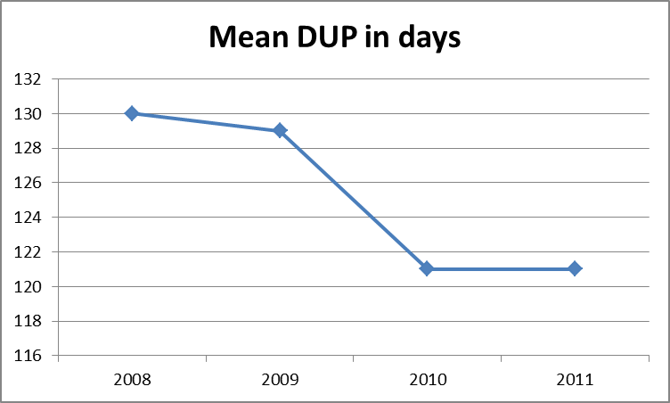
DUP change over time
Median DUP <1 month (2011)
Notes:
64
Bradford data 2011
Can we reduce delay?

Slide 65
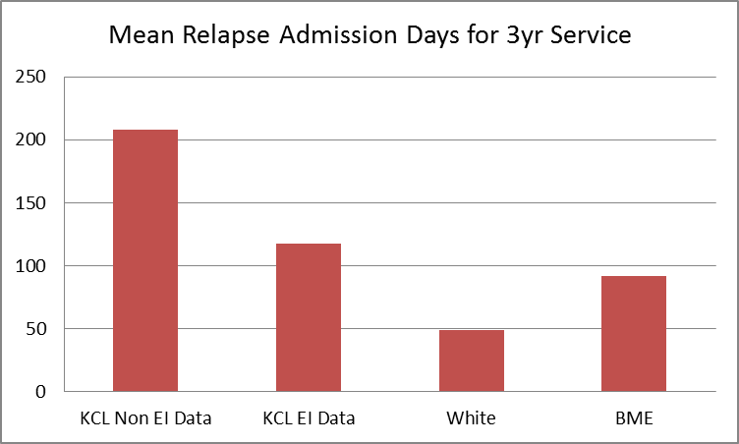
Admissions within EI service
Combined mean admission days for Bradford is 70 (2010)
Notes:
65
Can we reduce admissions?
<118 days for cost savings
2012: 52 days
Local Target: Reduction in admission bed days: 30% from baseline
Non-EI data: 1yr 86 days, 2yr 147 days, 3yr 208 days
EI data: 1yr 50 days, 2yr 84 days, 3yr 118 days
(Paul McCrone’s KCL data)
Average of two relapses per service user
Mean admission relapse days for full 3yr service: 52days
80% <208 days
White clients have a mean of 49 days
BME clients have a mean of 92 days
Paul McCrone’s KCL data suggests 118 days for full 3yr service

Slide 66
Admission Days under MHA section
(involuntary admissions in first engagement)
17% of White service users MHA admission
36% of BME service users MHA admission
EPD objective: The use of involuntary treatments in the first engagement is less than 25%
Notes:
66
Can we reduce use of MHA?
EPD: The use of involuntary treatments in the first engagement is less than 25%

Slide 67
Suicide Risk
Notes:
67
Can we reduce suicide risk?
Suicide rates
Suicide rates will be less than 1%
Suicide risk 1:15 (5 in 3 years for Bradford)
Completed suicide rate for Bradford is 3 over previous 4 years (Average <1%)

Slide 68
Occupation at Referral to EI
Notes:
68
Can we improve occupational outcomes?

Slide 69
Occupation at Discharge from EI
Notes:
69
We can still do better

Slide 70
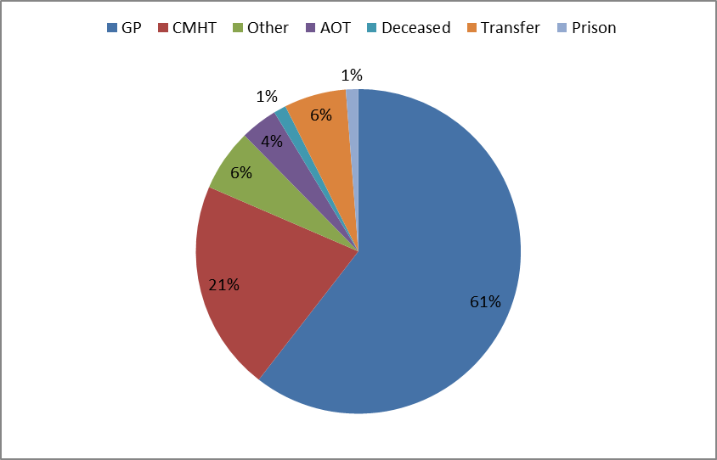
Destination at Discharge 2010/11
Notes:
70
Do more people get better?

Slide 71
I HAVE FELT VALUED AND RESPECTED

Slide 72
I KNOW WHAT MY CARE
PLAN IS

Slide 73
MY FAMILY / CARERS / FRIENDS WERE GIVEN ENOUGH HELP AND SUPPORT IN RELATION TO MY PROBLEMS

Slide 74
I HAVE BEEN OFFERED TALKING TREATMENTS e.g. PSYCHOTHERAPY, COUNSELLING, CBT

Slide 75
I HAVE BEEN PROVIDED WITH GOOD OPTIONS FOR IF I AM IN CRISIS, WHICH HELPS ME AVOID HOSPITAL ADMISSION

Slide 76
I HAVE BEEN OFFERED HELP IN RETURNING TO WORK, COLLEGE OR UNIVERSITY AND BEING A SUCCESSFUL EMPLOYEE / STUDENT

Slide 77
WOULD YOU BE HAPPY TO RECOMMEND THIS SERVICE TO ANYONE YOU KNOW WHO IS GOING THROUGH A SIMILAR EXPERIENCE?

Slide 78
I HAVE BEEN OFFERED A
PHYSICAL HEALTH CHECK
(BLOOD PRESSURE, BLOOD TESTS etc)

Slide 79

Professor Louis Appleby, National Director of Mental Health, reflecting on the achievements of the National Service Framework, described EIP as the:
“Jewel in the crown of the NHS mental health reform because service users like it; people get better; it saves money ”
Policies and Practice for Europe
(DH/WHO Europe conference
attended by 35 European Countries,
2009)

Slide 80
But….

Slide 81
Drivers for EIP in UK
Mental Health Policy/Modernisation/Transformation
UK and international research evidence for EI
Problems with TAU/late intervention
New treatments and Guidelines
Costs/Benefits research
Social Movements, campaigning and challenges to dominance of the established paradigm
Outcomes agenda and Performance Management
Austerity?
Notes:
81
Central to governments modernisation plans for MH services: National plan, NSF, PIG (late 90’s). Originally a target for 06 but extended to 09
Evidence for EI inconclusive at the time but has been demonstrated since
Problems with TAU/late intervention
80% relapse and long term disability
EI ‘movement’ and International Early Psychosis Declaration (WHO)
Schizophrenia had been calculated to cost the NHS in excess of £1 billion per year (Bosanquet, 2000).
Expected to be costly but economic evaluation study is showing the true economic impact of EIP. This study has modelled the costs associated with Early Intervention over a one-year and a three-year period and found that when compared to usual care, the cost for Early Intervention amounts to an annual saving of 53%, which is maintained after three years. (McCrone, Dhanasiri & Knapp)

Slide 82
AUSTERITY!
While NHS funding remains stable across the board, mental health trusts in England have had their funding cut by more than 2% in real terms over the past two years (£21bn)
Local council cuts: 30% cuts 2008-2015
NHS England and the health regulator Monitor recommend cutting funding for mental health services by 20% more than that for acute hospitals in 2014

Slide 83
Better for Less?
QIPP
Cost savings are impacting on service provision
Tough decisions delegated to directorates and teams
Short term cost savings:
- Clumsy efficiency drives
- ‘Salami slicing’
- Loss of leadership
- Dumbing down
Can we afford EIP in the current climate?

Slide 84

‘EIP is one of the keys to improving mental health services and national mental wellbeing. The problem is that in these times of intense spending pressures the incentives to invest in these services risks being crowded out by much shorter term pressures.
Any decision to redesign community MH services must draw on the evidence base and safeguard the important functions and outcomes of EIP teams that make them so effective’.
Steve Shrubb, NHS Confederation, Director of the MH Network, 2011
Notes:
84
These are tough times…

Slide 85
Barriers and threats
Funding (has never been easy)
Recession and cuts to public services
Commissioning changes
Established culture, hidden discourses and professional opposition.
Resistance to change
Business culture (Foundation Trusts)
Risk aversion (clinical and business)
Command and control versus learning systems
Leadership and capacity for managing complex OD
Distrust of the evidence
Notes:
85
Or are these opportunities?

Slide 86
Opportunities
Recession and cuts to public services
Commissioning changes
Genuine Transformation
Become more learning
Expand the evidence base
Filling the OD void
Partnerships
No Health without Mental Health and Closing the Gap
NHS Mandate & Parity of Esteem
Youth MH – expanding the paradigm
Campaigning: Comprehensive, not compromise, services

Slide 87
‘The economic crisis is the biggest driver of change today’
Steve Dahl, Deloitte Consulting

