Slide 1
Chinese “words”
James Myers National Chung Cheng University http://www.ccunix.ccu.edu.tw/~lngmyers/
Beyond the Word, May 7, 2015, University of York

Slide 2
Those without whom...
蔡素娟 (Jane Tsay)、李盈興、柯昱光、阮家慶、楊振宗、黃意晴、鍾育誠、陳泱璉、莊偉強、郭玲汝、楊怡慧、袁家敏、蔡承志、賴薇心、吳玟錚、羅佳雯、洪國銘、歐育辰、林珮琪、呂育安、胥育典、陳元祿、鍾伊玲、楊秋燕、徐家健、許瓊文、徐子平、蘇鈺婷、林育稜、歐姿姍、莊蕙如、王嬿茜、潘家榮、蘇予瀅、王汶鈴、劉曉梅、陳曉君、程涂媛、呂淑美、謝沛諭、黃莉嘉、王建邦、劉慧娟、洪嘉馡、龔書萍、陳宗穎
Grants (1999-2015): NSC-89-2411-H-194-006, NSC-89-2411-H-194-053, NSC-90-2411-H-194-023, NSC-91-2411-H-194-022, NSC-92-2411-H-194-003, NSC-93-2411-H-194-003, NSC 94-2411-H-194-018, NSC 95-2411-H-194-005, NSC 95-2411-H-194-002, NSC 97-2410-H-194-067-MY3, NSC 100-2410-H-194-109-MY3, MOST 103-2410-H-194-119-MY3

Slide 3
Overview
The Chinese word for “word”
Words in speech
Words in reading
Wordlikeness judgments
Words in a second language

Slide 4
Some senses of the word “word”
Sociological words
Morphosyntactic words
Phonological words
Psycholinguistic words

Slide 5
Sociological words
“... that type of unit, intermediate in size between a phoneme and a sentence, which the general, nonlinguistic public is conscious of.... It is the kind of thing ... which a teacher teaches children to read and write in school, which a writer is paid for in so much per thousand, [etc]....” (Chao 1968, p. 136)
[It’s also the thing you look up in a dictionary.]

Slide 6
Chinese characters as “words”
Each Chinese character (typically) represents:
One morpheme: 字 = “character”
Cf. 蝴蝶 húdié “butterfly”
One syllable: 字 = zì
Cf. 兒 (儿) -r “dim. suf.” 卅 “thirty” sà (sānshí 三十)
The largest orthographic unit:
No spaces, no special marks at line breaks
Character strings can go left to right or downward
看字 kàn zì “look at characters; read” (word or phrase?)

Slide 7
Morphosyntactic words
Characters can’t be the largest lexical units
Homographs disambiguated only in compounds
銀行 yínháng“ bank” vs. 行人 xíngrén “pedestrian”
Compounds don’t act like phrases
Noun-noun compounds are common, but not consistent (?) with Chinese syntax
Adjective-noun compounds can’t be modified:
(*很)高山 (*hěn) gāoshān “(*very) high-mountain”
(很)高的山 (hěn) gāo de shān “(very) high DE mountain”

Slide 8
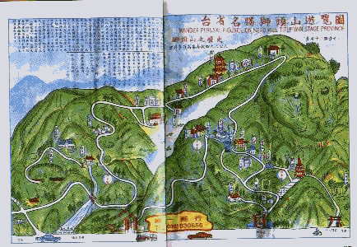
Sociological vs. morphosyntactic words

Slide 9
The phonology of words
Many homophonous morphemes
Only 1300 syllables, even taking tone into account
Compounds much less likely to be homophonous
This makes it easier to access spoken words than morphemes (Packard, 1999; Myers, forthcoming; cf. Zhou & Marslen-Wilson, 1994)
Mandarin words tend to be disyllabic
Around 60% of lexicon used in speech
Around 40% of lexicon used in writing
(More below...)

Slide 10
The special role of disyllabic feet
True in all Sinitic languages (“Chinese dialects”)
Mandarin, Southern Min (“Taiwanese”), ...
Disyllabicity is ancient, and not motivated by homophone avoidance (Duanmu & Dong, 2015)
Productive “elasticity” (Duanmu & Dong, 2015)
Stretching up to disyllables:
“elephant” 象 xiàng 大象 dàxiàng (dà = “big”)
Shrinking down to disyllables (Myers, 2012):
“Portuguese (lng.)” 葡萄牙語言 Pútáoyá yǔyán
葡語 Pú yǔ

Slide 11
Psycholinguistic words
“... a portion of language at roughly the ‘word’ level ... that is (albeit perhaps not consciously) salient and highly relevant to the operation of the language processor... for example ... the type of information that is ‘most active’ at a given, fixed point in the time course of language production....” (Packard 2000, pp. 13-4)
[So wordhood depends on the processes involved: e.g. speaking vs. reading...]

Slide 12
Words in speech
Priming of elastic words (Perry & Zhuang, 2005)
A picture of an elephant is usually called 象 xiàng
But if shown with “non-elastic” di/trisyllabic objects, it’s more likely to be called 大象 dàxiàng
This raises a lemma dilemma:
Phonology should only be processed after a morphosyntactic word is chosen (Levelt et al., 1999)
Solution(?): Elastic word variants may share a single abstract lemma (Myers, 2012)

Slide 13
Words in spontaneous speech
Southern Min (virtually never written)
CCU Taiwanese Spoken Corpus (Tsay & Myers, 2015; Ruan et al., 2012)
Almost a million morphosyntactic word tokens
Mandarin speech
Academia Sinica Balanced Corpus (spoken part) (Huang et al., 1997)
Over half a million spoken word tokens
Cf. Mandarin writing (also from Sinica Corpus)
Around 10 million written word tokens

Slide 14
Elastic words in spontaneous speech
Is there prosodic priming?
Other (e.g., discourse) factors yet to be tested
Test in Southern Min corpus (Myers & Tsay, 2015)
53 elastic noun pairs (“lemmas”) with both variants in the corpus (228 word tokens)
Mixed-effects logistic regression (lemmas as random variable)
Dependent variable: disyllable vs. monosyllable
Predictor: log ratio of disyllables / monosyllables in preceding 10 Southern Min words

Slide 15
Priming of elastic words in S. Min
Speakers increasingly more likely to produce the disyllabic variant in contexts with increasingly more disyllables
But priming inconsistent when the lemma itself repeated

Slide 16
The productivity of disyllables
Productivity as coinage rate (Baayen & Renouf, 1996)
Hapax legomena (words that appear only once in a corpus) may include novel coinages
P*_{N,c} : Productivity P of word class c as proportion of hapax legomena of class c, relative to all hapax legomena in corpus of N tokens
Productivity can also be visualized as the slope of growth curves
Types vs. tokens as more of corpus is sampled
Steep slopes suggest word types still being added

Slide 17
Productivity in Southern Min
P*_{N,2syl} = .50:
Half of all hapax legomena are disyllabic
P*_{N,3syl} = .30
P*_{N,1syl} = .10
P*_{N,4syl} = .07

Slide 18
Productivity in spoken Mandarin
P*_{N,2syl} = .54
P*_{N,3syl} = .25
P*_{N,1syl} = .04
P*_{N,4syl} = .11

Slide 19
Productivity in written Mandarin
P*_{N,2char} = .30
P*_{N,3char} = .37:
Slightly more productive than disyllables!
P*_{N,4char} = .11
P*_{N,1char} = .01

Slide 20
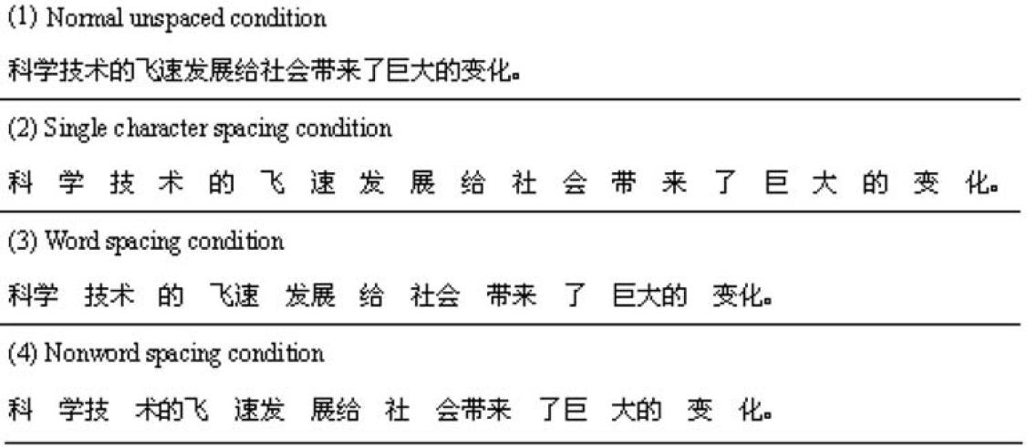
Words in reading
Chinese readers mentally segment their text
US cell: (555) 555-5555 (chunk sizes 7±2; Miller, 1956)
Taiwan cell: 0912345678 (a block of 10 digits!)
If you do segment, do it by words (Bai et al., 2008)
Total reading time
5.2 seconds
5.7 seconds
5.2 seconds
5.9 seconds

Slide 21
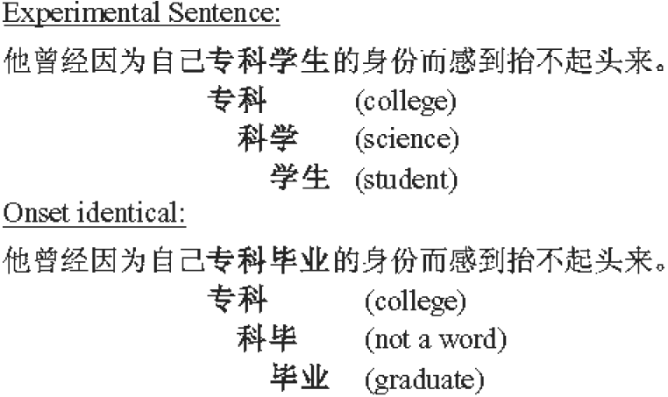
Natural word segmentation
Character recognition is faster in real words, even in sentence context (Chen, 1999)
Parse ambiguity slows reading (Inhoff & Wu, 2005)
Total viewing duration
690 ms
577 ms

Slide 22
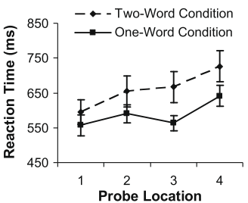
Word segmentation strategies
Segment serially
Though some look-ahead (Inhoff & Wu, 2005)
Maximize word size
E.g. in a probe-detection task with 80 ms display (Li et al., 2009)

Slide 23
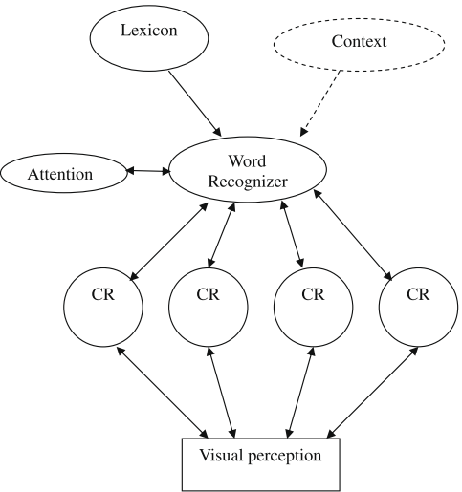
Modeling probe detection
Connectionist model (Li et al., 2009)
(Bayesian-ish evaluation)
(left to right)
(character recognition)

Slide 24
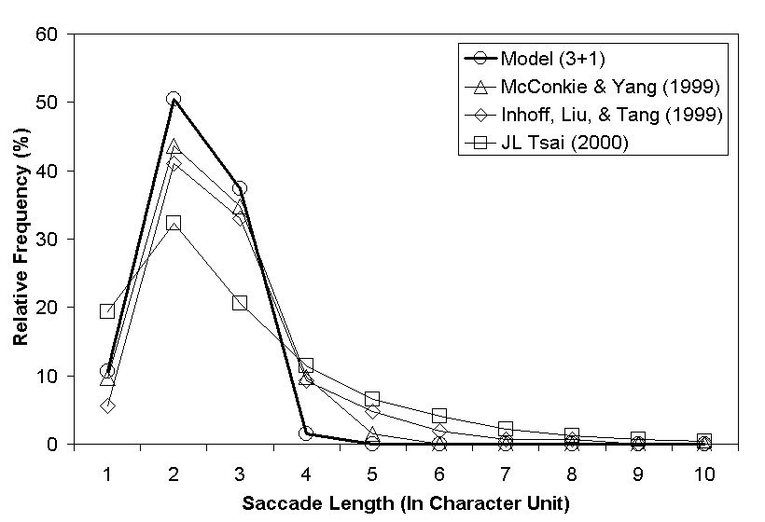
Modeling eye movements
Model explicitly implementing serial segmentation and maximization (Tsai, 2001)

Slide 25
Wordlikeness judgments
What do Mandarin speakers want in a word?
Just ask them (Myers, 2014)
Show nonlexical two-character strings to native speakers to rate as like/unlike Mandarin
A megastudy (Balota et al., 2012): 3000 test items, 51 participants, mixed-effects logistic regression
Some factors that matter
Syntactic categories of component characters
Family size: number of distinct words containing a test item’s character in the same position

Slide 26
Effect of syntactic category
Effects significant, but not correlated with lexical frequencies

Slide 27
Effects of family size
2nd character has clearer effect
(Lexical NN usually right-headed)
Both effects weaker than in NN, 1st character has clearer effect
(Lexical VV usually coordinative)

Slide 28
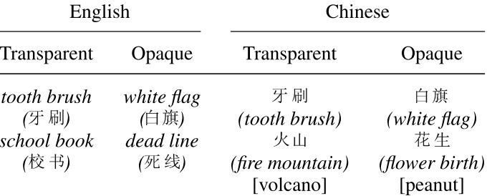
Words in a second language
L1 Chinese / L2 English kids (7-9 yrs): lexical decisions on spoken compounds (Cheng et al., 2011)
L1 = L2
L1 ≠ L2
*
*
*
*

Slide 29
Southern Min cognates in Mandarin wordlikeness judgments
Most (85%) characters in 3000 test items appear in our S. Min corpus (transcribed etymologically)
Cognates help, especially for second character

Slide 30
Conclusions
Words are one of those things that seem to exist despite resisting definition
Wordhood depends on the specific process
In particular for Chinese:
Listeners don’t access words via morphemes
Speakers care a lot about prosodic constituents
Readers access words via characters (& vice versa)
Wordlikeness reflects the lexicon, but not trivially
Morphology modulates cross-language influences

Slide 31
References (1/4)
Baayen, R.H., & Renouf, A. (1996). Chronicling the Times: Productive lexical innovations in an English newspaper. Language, 72, 69-96.
Bai, X., Yan, G., Liversedge, S. P., Zang, C., & Rayner, K. (2008). Reading spaced and unspaced Chinese text: Evidence from eye movements. Journal of Experimental Psychology: Human Perception and Performance, 34(5), 1277-1287.
Balota, D. A., Yap, M. J., Hutchison, K. A., & Cortese, M. J. (2012). Megastudies: What do millions (or so) of trials tell me about lexical processing? In J. S. Adelman (Ed.) Visual word recognition 1: Models and methods, orthography and phonology (pp. 90-115). Hove, England: Psychology Press.
Chao, Y.-R. (1968). A grammar of spoken Chinese. Berkeley: University of California Press.
Chen, J.-Y. (1999). Word recognition during the reading of Chinese sentences: evidence from studying the word superiority effect. In J. Wang, A. W. Inhoff, & H.-C. Chen (Eds.), Reading Chinese script: A cognitive analysis (pp. 239-256). Mahwah, New Jersey: Lawrence Erlbaum Associates.

Slide 32
References (2/4)
Cheng, C., Wang, M., & Perfetti, C. A. (2011). Acquisition of compound words in Chinese–English bilingual children: Decomposition and cross-language activation. Applied Psycholinguistics, 32(03), 583-600.
Duanmu, S., & Dong, Y. (2015). Homophone density and word length in Chinese. In Y. Hsiao & L.-H. Wee (Eds.) Capturing phonological shades within and across languages (pp. 213-242). Cambridge Scholars Publishing.
Huang, C.-R., Chen, K.-J., Chen, F.-Y., & Chang, L.-L. (1997). Segmentation standard for Chinese natural language processing. Computational Linguistics and Chinese Language Processing, 2 (2), 47-62. http://app.sinica.edu.tw/kiwi/mkiwi/
Inhoff, A. W., & Wu, C. (2005). Eye movements and the identification of spatially ambiguous words during Chinese sentence reading. Memory & Cognition, 33(8), 1345-1356.
Levelt, W. J., Roelofs, A., & Meyer, A. S. (1999). A theory of lexical access in speech production. Behavioral and Brain Sciences, 22(1), 1-75.
Li, X., Rayner, K., & Cave, K. R. (2009). On the segmentation of Chinese words during reading. Cognitive Psychology, 58(4), 525-552.

Slide 33
References (3/4)
Miller, G. (1956). The magical number seven: plus or minus two. Some limits on our capacity for processing information. Psychological Review, 9, 81-97.
Myers, J. (2012). Chinese as a natural experiment. In G. Libben, G. Jarema, & C. Westbury (Eds.), Methodological and analytic frontiers in lexical research (pp. 155-169). Amsterdam: John Benjamins.
Myers, J. (2014). Neighborhood effects in wordlikeness judgments of nonlexical Mandarin disyllables. Presented at the Ninth International Conference on the Mental Lexicon, Niagara-on-the-Lake, ON, Canada.
Myers, J. (2015). Trochaic feet in spontaneous spoken Southern Min. Presented at The 27th North American Conference on Chinese Linguistics (NACCL-27), Los Angeles.
Myers, J. (forthcoming). Processing of Chinese compounds. In R. Sybesma, W. Behr, Y. Gu, Z. Handel, C.-T. J. Huang, & J. Myers (Eds.), Encyclopedia of Chinese Language and Linguistics. Leiden, Netherlands: Brill.
.

Slide 34
References (4/4)
Packard, J. L. (1999). Lexical access in Chinese speech comprehension and production. Brain & Language, 68, 89-94.
Packard, J. L. (2000). The morphology of Chinese. Cambridge University Press.
Perry, C., & Zhuang, J. (2005). Prosody and lemma selection. Memory and Cognition, 33, 862-870.
Ruan, J.-C., Hsu, C.-W., Myers, J., & Tsay, J. S. (2012). Development and testing of transcription software for a Southern Min spoken corpus. International Journal of Computational Linguistics and Chinese Language Processing, 17 (1), 1-26.
Tsai, C.-H. (2001). Word identification and eye movements in reading Chinese: A modeling approach. Doctoral dissertation, University of Illinois at Urbana-Champaign.
Tsay, J., & Myers, J. (2015). CCU Taiwanese Spoken Corpus. http://lngproc.ccu.edu.tw/SouthernMinCorpus/
Zhou, X., & Marslen-Wilson, W. (1994). Words, morphemes, and syllables in the Chinese Mental lexicon. Language and Cognitive Processes, 9 (3), 393-422.

