Slide 1

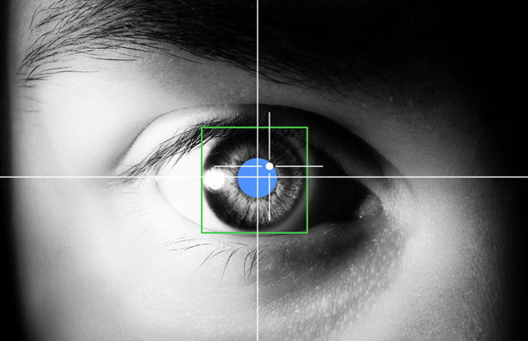
“Thumbing our noses” at the notion of only singles words being words Dr. Kathy Conklin & Gareth Carrol kathy.conklin@nottingham.ac.uk

Slide 2
Definition Of A Word
… for the sake of our discussion, we use a fairly intuitive definition of ‘word’ to mean any sequence of letters that are separated by spaces and that have an accepted pronunciation and meaning in the language. Because the debate about attention allocation in reading has been conducted in the absence of any more formal definition than ours, we contend that – at least for the time being – little if anything is lost by continuing the debate in this manner. Thus, we will not speculate about how attention might be allocated differently in non-alphabetic languages, or how strings of letters in languages like Thai are initially segmented so that individual words can be processed and identified...
(Reichle, Liversedge, Pollatsek, & Rayner, 2009)

Slide 3
Defining Words
‘Spaces’ are a problematic means for establishing what is a word (or not).
Our brain may simply represent/store all frequently used units (words, frequent longer strings).
This should facilitate language comprehension and production.

Slide 4
Words Used Together Wire Together
Relatively small amounts of information (7 ± 2) can be processed in real-time in short-term memory.
Things occurring together frequently in short-term memory - MWUs - will be saved/represented/wired together in long-term memory.
MWUs in long-term memory can be retrieved with-out the need to comprehend individual words.
Leads to less cognitive demand, as MWUs are ‘ready to go’, requiring little additional cognitive processing (i.e. will be read more quickly).

Slide 5
What are MWUs?
Multi-Word Units fall broadly in two categories
Conceptually ‘single choices’
E.g. idioms spill the beans, phrasal verbs get into, and spaced compounds teddy bear
Defined by a high degree of frequency and co-occurrence rather than any unitary conceptual properties or semantic idiomaticity
E.g. lexical bundles/chunks/sentence fragments don’t have to worry, clichés time will tell, non-idiomatic collocations abject poverty, and literal binomials king and queen

Slide 6
Speeded processing indicates MWUs are “wired together”
Idioms (spill the beans)
E.g. Carrol & Conklin, 2014; Carrol & Conklin, in press; Conklin & Schmitt, 2008; Libben & Titone, 2008; Rommers, Dijkstra & Bastiaansen, 2013; Schweigert, 1986, 1991; Schweigert & Moates, 1988; Siyanova-Chanturia, Conklin & Schmitt, 2011; Swinney & Cutler, 1979; Tabossi, Fanari & Wolf, 2009
Spaced Compounds (teddy bear)
E.g. De Cat, Klepousniotou & Baayen, 2015; Cutter, Drieghe and Liversedge, 2014
Phrasal Verbs (get into)
E.g. Blais & Gonnerman, 2013; Cappelle, Shtyrov and Pulvermüller, 2010; Konopka & Bock, 2009; Matlock & Heredia, 2002; Paulmann, Ghareeb-Ali & Felser, 2015
Binomials (fish and chips)
E.g. Arcara, Lacaita, Mattaloni, Passarini, Mondini, Benincà & Semenza, 2012; Siyanova-Chanturia, Conklin & van Heuven, 2011
Highly frequent sentence fragments (don’t have to worry)
E.g. Arnon & Cohen-Priva, 2013; Arnon & Snider, 2010; Bannard & Matthews, 2008; Ellis, Simpson-Vlach & Maynard, 2008; Tremblay & Baayen, 2010; Tremblay, Derwing, Libben & Westbury, 2011

Slide 7
What is “wiring together”?
Idioms are ‘big words’ in the lexicon - single, unanalyzed wholes that are retrieved without compositional analysis of the components (Bobrow & Bell, 1973; Gibbs, 1980; Swinney & Cutler, 1979).
Idioms are distributed entries in the lexicon that are accessed once enough of the idiom has been seen. Once the “key” is reached a literal interpretation is terminated (Cacciari & Tabossi, 1988).
In hybrid models idioms have distributed representations of individual words and are single units (Cutting and Bock, 1997).
Idioms exist as individual words (lemmas) and overall lexical-conceptual entries - ‘superlemmas’ – which encompass phrase-level meaning, syntactic properties, and are reciprocally linked to the component lemmas (Sprenger et al., 2006).
Dual route models hold that frequent forms can be retrieved directly, while novel phrases are computed using a words-and-rules approach (Van Lancker Sidtis, 2012b; Wray, 2002; Wray & Perkins, 2000).

Slide 8
What causes the wiring together?
Is it specific words used in a specific order?
spill the beans not drop the beans
Is it frequency of co-occurrence?
Is it the idiomatic meaning/single conceptual choice?
spill the beans = ‘reveal a secret’
If the configuration that matters, translating an idiom should remove any processing advantage.
If frequency and/or an idiomatic meaning matter a different pattern should be evident for idioms vs. other types of MWUs.

Slide 9
Bilingual idioms processing
An idiom processing advantage is rarely evident in an L2 (e.g. Cieślicka, 2006, 2013; Conklin & Schmitt, 2008; Siyanova-Chanturia, Conklin & Schmitt, 2011).
Attributed to L2 processing being more compositional and literal meanings of words being more salient than figurative, phrase-level ones (Cieślicka, Heredia & Olivares, 2014).
Attributed to frequency of exposure – a direct route may be too slow (Siyanova-Chanturia, Conklin & Schmitt, 2011).
Looking at the processing of idioms translated from the L1 will allow us to address these possibilities.

Slide 10

Eye-tracking MWUs (Carrol & Conklin, 2014)
Eye-tracking has been used extensively to investigate the structure of the mental lexicon and for developing models of ocular-motor control in reading.
Provides online means to examine how words are recognized, processed and integrated into sentence, and to explore factors affecting these processes (e.g. frequency, length, ambiguity) without the need for a secondary task.
Unfortunately, as the length of a region of interest increases, it becomes more difficult to pinpoint the locus of an effect (Clifton, Staub, & Rayner, 2007).
Dutch audio & Dutch subtitles

Slide 11
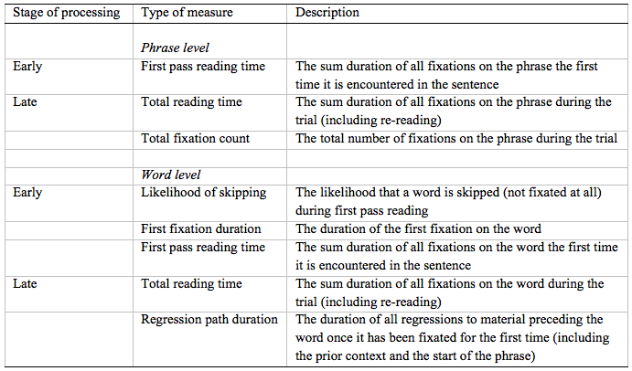
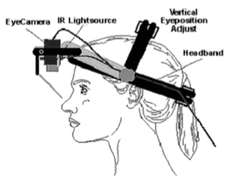
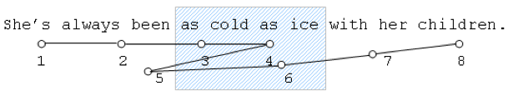
Eye-tracking MWUs (Carrol & Conklin, 2014)
Dutch audio & Dutch subtitles

Slide 12

Experiments Overview
Experiments 1 & 2
Translated Chinese idioms, high-intermediate proficiency participants
Exp 1 – is the final translated word of the idiom predicted
Exp 2 – processing of non-compositional and compositional meaning
Experiment 3
English only idioms, Swedish only idioms, congruent idioms, advanced proficiency participants
Exp 3 – shorter, less predictable idioms, and higher proficiency participants
Experiments 4 & 5
English monolinguals, compare processing of idioms, literal binomials, and collocations
What underpins the processing advantage of the different types?
Dutch audio & Dutch subtitles

Slide 13
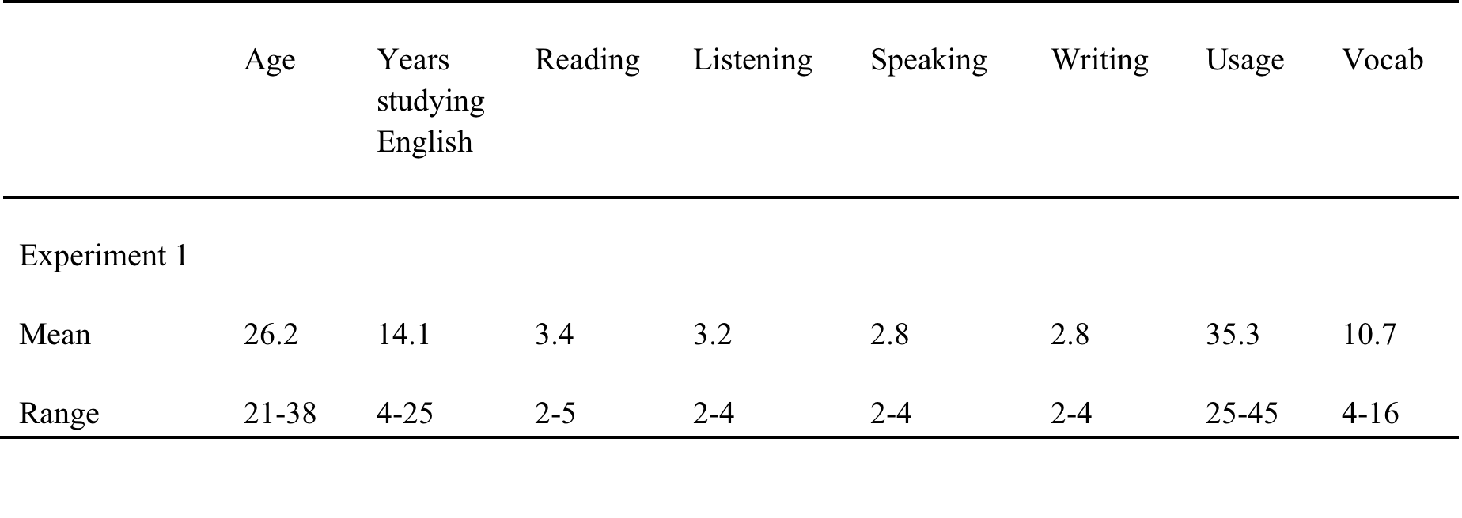
Experiment 1 Carrol & Conklin (2015)
Participants
20 native English speakers, 20 Chinese-English bilinguals
Reading, Listening, Speaking and Writing are self-ratings (1 = Poor, 2 = Basic, 3 = Good, 4 = Very good, 5 = Excellent
Usage is an aggregated estimate of how frequently participants use English in their everyday lives in a variety of contexts (total score out of 50)
Vocab is a modified Vocabulary Size Test with a total score out of 20.

Slide 14
Experiment 1 Carrol & Conklin (2015)
Materials
English idioms/controls spill the beans/chips = “reveal a secret”
Translated Chinese idioms/controls
畫蛇添足 – draw a snake and add feet/hair = “ruin with unnecessary detail”
Embedded in sentence contexts
My wife is terrible at keeping secrets. She loves any opportunity she gets to meet up with her friends and spill the beans/chips about anything they can think to gossip about.”
Idioms normed for familiarity & compositionality and sentences for naturalness
Additional variables for mixed-effects modelling analysis: length in words, final word length in letters and log-transformed final word frequency

Slide 15

Experiment 1 Carrol & Conklin (2015)
Procedure
Participants saw 13 items of each type (English idioms, English controls, Chinese idioms, Chinese controls) and 40 filler items presented across counterbalanced lists
Participants read the passages on a
screen for comprehension while their
eye movements were monitored (Eyelink I version 2.11)
Half of the items had a yes/no comprehension question

Slide 16
Experiment 1 Carrol & Conklin (2015)
Results – final word
Skipping Rates
Reading Times
p<.05
p<.05
p<.001
p<.05
p<.05

Slide 17
Experiment 1 Carrol & Conklin (2015)
Conclusions
English Speakers
Significant facilitation (more skipping, less time reading) final words English idioms.
No effect for Chinese idioms.
Bilinguals
No effect for English idioms, consistent with the literature on non-native speaker idiom processing.
Faster processing of final word of translated Chinese idioms evident in early measures suggests degree of bottom-up facilitation.
Idiom advantage indicates that the L1 idiom was activated, potentially encompassing the figurative meaning. Experiment 2 explores this by manipulating the sentence context.

Slide 18
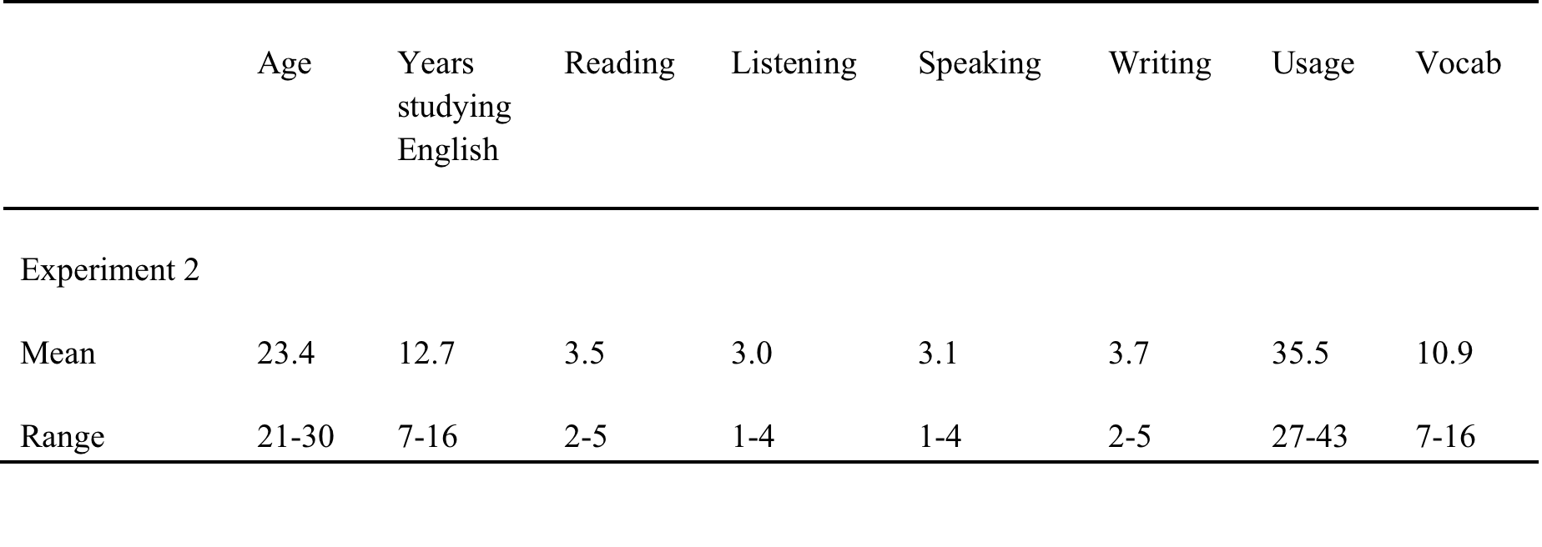
Experiment 2 Carrol & Conklin (2015)
Participants
20 native English speakers, 21 Chinese-English bilinguals
Reading, Listening, Speaking and Writing are self-ratings (1 = Poor, 2 = Basic, 3 = Good, 4 = Very good, 5 = Excellent
Usage is an aggregated estimate of how frequently participants use English in their everyday lives in a variety of contexts (total score out of 50)
Vocab is a modified Vocabulary Size Test with a total score out of 20.

Slide 19
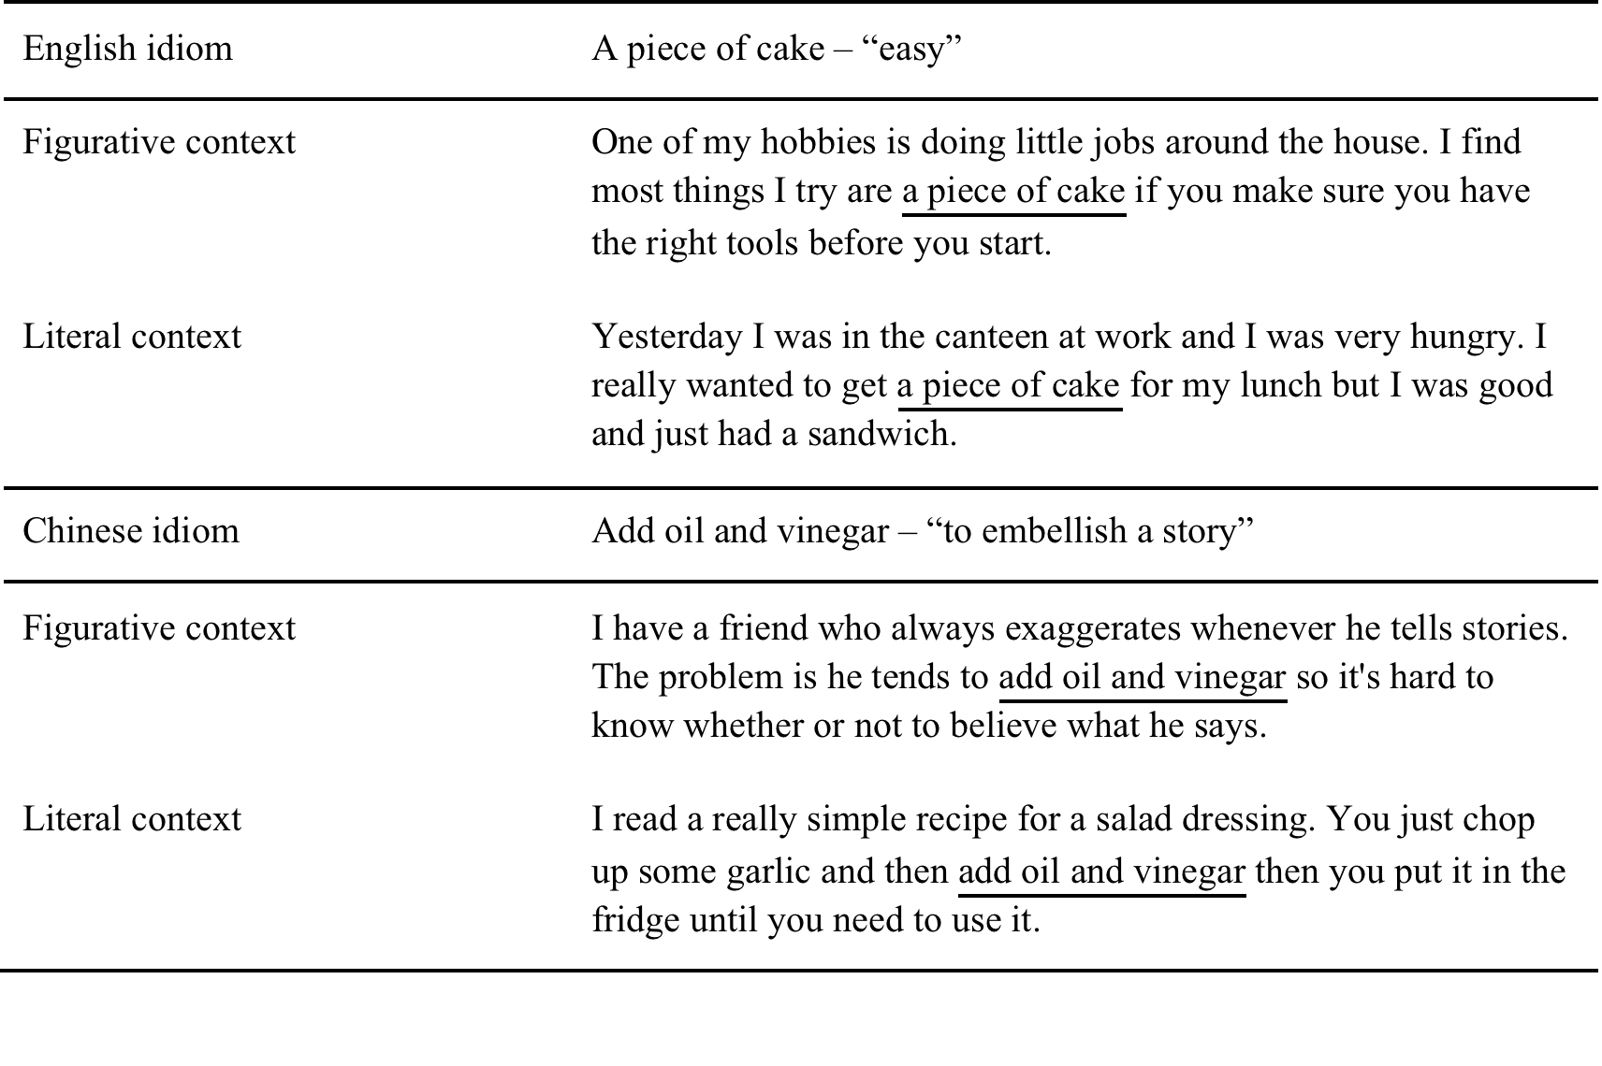
Experiment 2 Carrol & Conklin (2015)
Materials
Idioms normed for: familiarity & compositionality and sentences for naturalness
Additional variables for mixed-effects modelling analyses: length in words, final word length in letters and log-transformed final word frequency

Slide 20
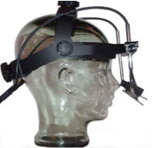
Experiment 2 Carrol & Conklin (2015)
Procedure
Participants saw 10 items of each type (literal English idioms, figurative English idioms, literal Chinese idioms, figurative Chinese idioms) and 40 filler items presented across counterbalanced lists
Participants read the passages on a
screen for comprehension while their
eye movements were monitored (Eyelink I version 2.11)
Half of the items had a yes/no comprehension question

Slide 21
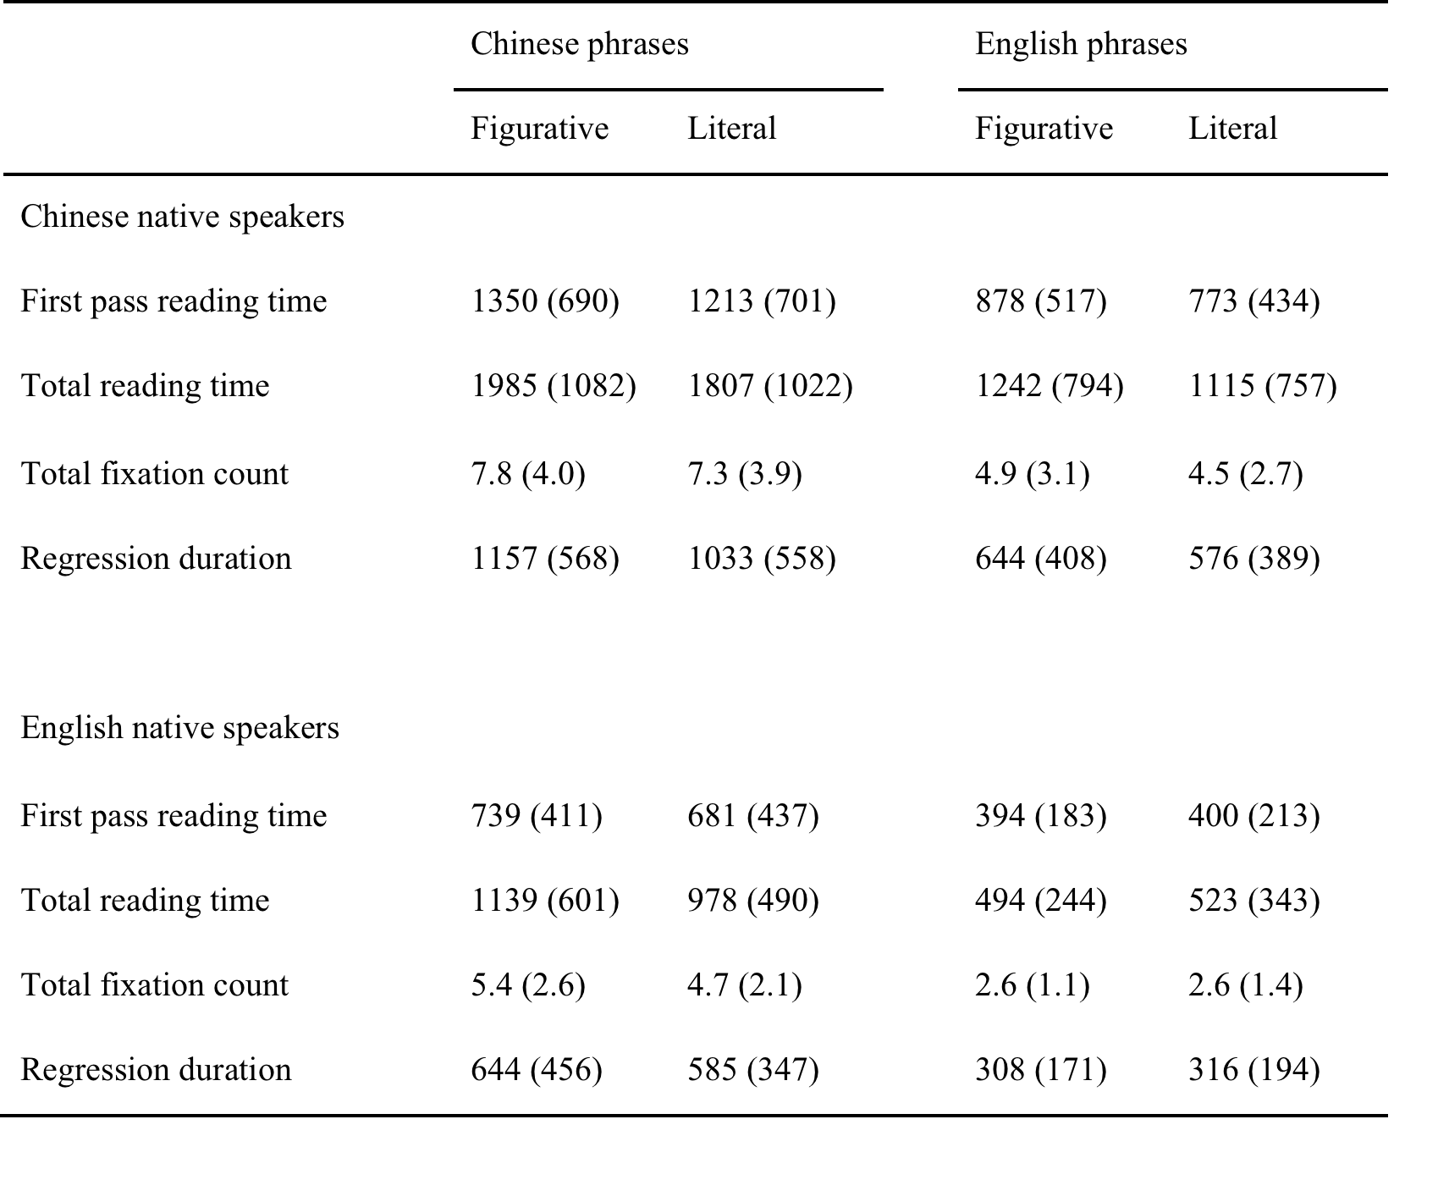
Experiment 2 Carrol & Conklin (2015)
Results
No difference for English idioms used figuratively or literally (ps>.05).
Slower reading for figurative uses of Chinese idioms, evident in TRT & TFC (ps<.01).
Significant main effect of type for all items (ps<.05)
No interactions between language and phrase type, suggesting that literal (compositional) uses were easier to understand than figurative uses of English and Chinese idioms

Slide 22
Experiments 1&2 Carrol & Conklin (2015)
Interim Conclusions
Experiment 1 suggests an idiom’s form is automatically activated, even when translated.
Experiment 2 indicates form activation does not lead to activation of an idiomatic meaning in an L2.
Thus, fast automatic translation may trigger simple lexical priming/spreading activation, thereby facilitating form recognition, but it is not sufficient to activate the ‘holistic’ structure/meaning units of idioms.

Slide 23
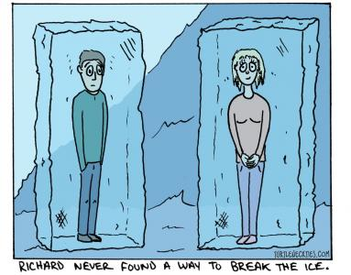
Experiment 3 Carrol, Conklin & Gyllstad (in submission)
The sentences are all neutral to remove any effect of overall discourse context on the prediction of upcoming words.
Introduces the dimension of congruency, to see whether this provides any additional “boost” to idiom activation.
Participants very high proficiency to determine whether this increases idiom activation.
The idioms are all of the same length
and short.

Slide 24
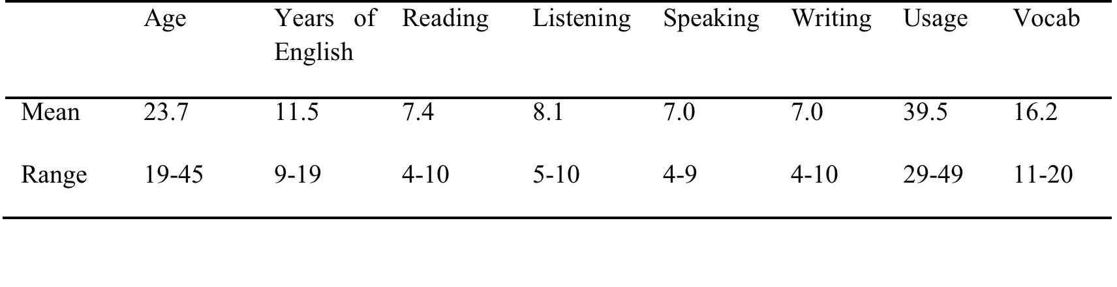
Expriment 3 Carrol & Conklin (in submission)
Experiment 3 Carrol, Conklin & Gyllstad (in submission)
Participants
24 native English speakers, 24 Swedish-English bilinguals
Years of English is years of formal instruction each
Reading, Listening, Speaking and Writing are all self-rated proficiency measures out of 10
Usage is an aggregated estimate of how often participants use English in their everyday lives (10 measures, each estimated out of 5 to give a total score out of 50)
Vocab is the score out of 20 on the modified vocabulary size test

Slide 25
Experiment 3 Carrol, Conklin & Gyllstad (in submission)
Materials
1. English only idioms, 2. Swedish only idioms, and 3. congruent idioms (same/very similar form and meaning)
The key criterion was that each idiom had two concrete lexical items.
The structure X-det-N
X was normally a verb (e.g. kick the bucket)
X was in some cases a noun (neck over head) or preposition (under the ice)
The determiner was sometimes a personal pronoun (e.g. pull your weight), a preposition (fall from grace), or omitted (tread water)

Slide 26
Experiment 3 Carrol, Conklin & Gyllstad (in submission)
Materials
Idioms normed for familiarity & compositionality and sentences for naturalness
Additional variables for mixed-effects modelling analysis: length in words, final word length in letters and log-transformed final word frequency
Idiom sentence: It was hard for him to break the ice when he was at the party last week.
Control sentence: It was hard for him to crack the ice when his locks froze last week.

Slide 27
Experiment 3 Carrol, Conklin & Gyllstad (in submission)
Procedure
Participants saw 10 items of each type presented across counterbalanced lists (English only idioms, English only controls, Swedish only idioms, Swedish only controls, congruent idioms, congruent controls)
Participants read the passages on a
screen for comprehension while their
eye movements were monitored (Eyelink I000)
Half of the items had a yes/no comprehension question

Slide 28
Experiment 3 Carrol, Conklin & Gyllstad (in submission)
Results – final word
No interaction of phrase type for English vs. Congruent items (ps>.05), demonstrating no difference between conditions
Skipped the final word more and spent less time reading (TRT and RPD) English and congruent idioms compared to controls (ps<.05)
Swedish idioms significantly longer TRT and RPD (all ps<.01), indicating integrating them caused difficulty
Likelihood of skipping overall significantly greater for idioms (ps<.01)
Final words skipped more for idioms than controls in Swedish only and congruent conditions (ps<.01), but not English only condition (p>.05)
Other early measures (FFD and FPRT) showed no significant effects
Total reading time showed an overall effect, such that idioms in all conditions were read more quickly than controls (ps<.05)

Slide 29
Experiment 3 Carrol, Conklin & Gyllstad (in submission)
Conclusions
English Speakers
English idioms show facilitation of the form (early measures) and meaning (late measures).
Swedish idioms cause disruption, which is evident in late measures, indicating difficulty integrating meaning.
Bilinguals
Consistent advantage for idiom types over control phrases driven by Swedish only and congruent idioms.
Indicates that known idioms are automatically activated and that familiarity with an idiom underpins the processing advantage.

Slide 30
Experiment 4&5 Carrol & Conklin (in submission)
What underpins the processing advantage for different types of formulaic? Is the exact configuration important?
To answer this, we will examine the processing of MWUs that differ in terms of their semantic and statistical properties.
idioms (spill the beans) - “single meaning unit”, but low frequency
binomials (king and queen) - compositional meaning, strongly semantically associated, high frequency
collocations (abject poverty) - compositional meaning, semantically associated vs. unassociated, less high frequency

Slide 31
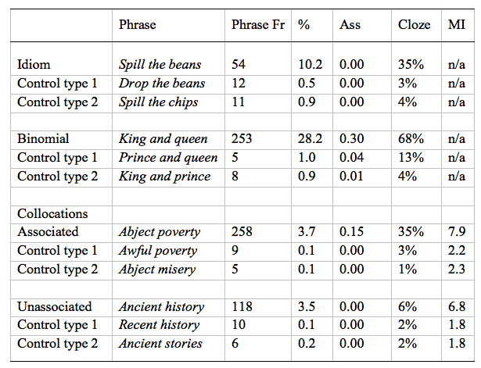
Experiment 4 Carrol & Conklin (in submission)
Participants
24 native English speakers
Materials
Phrase frequency is a raw value from the BNC (per 100 million words)
% is the phrase continuation likelihood
Ass is the strength of association based on EAT scores
Cloze is the mean cloze probability
MI (mutual information) relationship between how many times a particular word combination appears in a corpus, relative to the expected frequency of co-occurrence by chance based on the individual word frequencies and the size of the corpus.

Slide 32
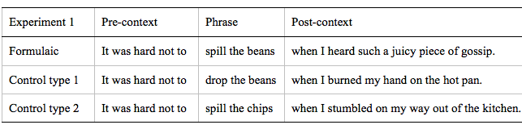
Experiment 4 Carrol & Conklin (in submission)
Materials
Neutral sentences before the MWU
Sentences matched for length
Sentences normed for naturalness

Slide 33
Experiment 4 Carrol & Conklin (in submission)
Procedure
Participants saw 15 items of each type presented across counterbalanced lists (idioms & their controls, binomials & their controls, collocations & their controls)
Participants read the sentences on a
screen for comprehension while their
eye movements were monitored (Eyelink I000)
A third of the items had a yes/no comprehension question

Slide 34
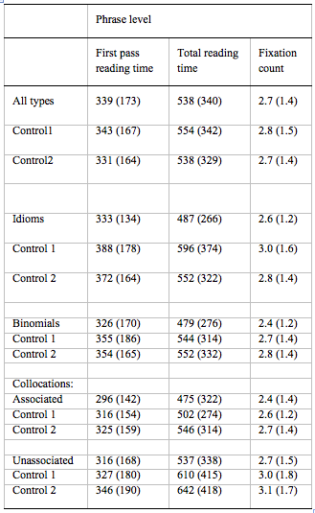
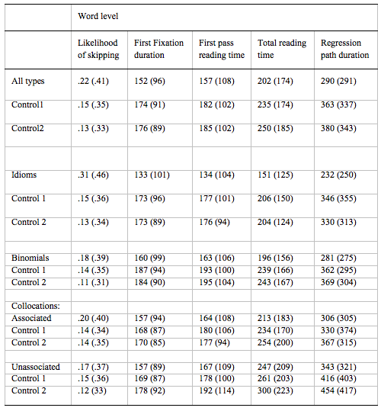
Experiment 4 Carrol & Conklin (in submission)
Results
Clear processing advantage for idioms, binomials, and collocations vs. controls.
Collocations
MI is a significant predictor for the final word and phrase frequency for the phrase
Idioms
cloze probability and predictability significant predictors in early and late measures for the final word and the phrase
Binomials
phrase frequency and cloze probability significant predictors in early and late measures for the final word and the phrase

Slide 35
Experiment 4 Carrol & Conklin (in submission)
Conclusions
Experiment 4 demonstrates clear formulaic processing advantage for idioms, binomials, and collocations.
Final words of idioms have greater tendency to be skipped, despite having lower phrase frequency and cloze probability.
Suggests that their status as single conceptual units may contribute to ‘holistic’ processing, whereas the advantage for compositional units is driven by experience/frequency based processes.
Different features underpin the processing advantage for each.
idioms - cloze probability/predictability
binomials - cloze probability and phrase frequency
collocations - MI in for the final word and phrase frequency for the phrase
Experiment 5 tests whether the “cohesion” of these MWUs is retained when underlying formulaic frames compromised.

Slide 36
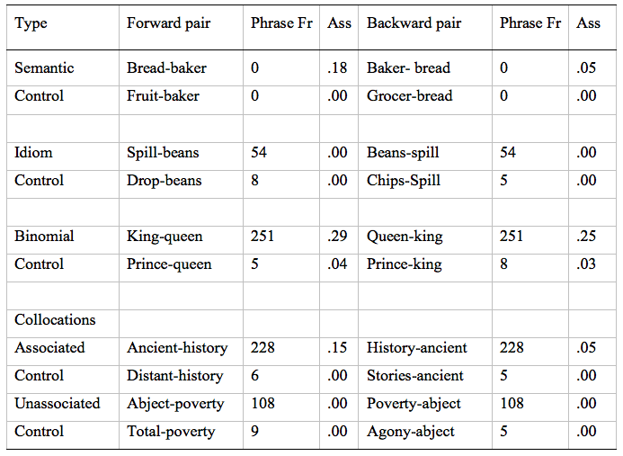
Experiment 5 Carrol & Conklin (in submission)
Participants
24 native English speakers
Materials
Phrase frequency is a raw value from the BNC (per 100 million words), for reversed pairs phrase frequency was considered to be frequency of underlying MWU
Ass is the strength of association based on EAT scores

Slide 37
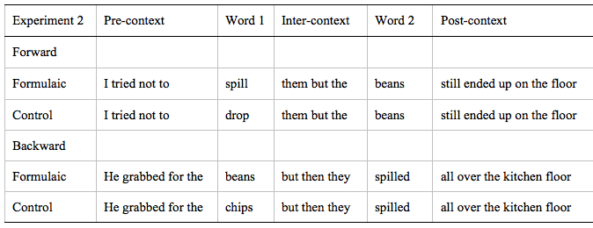
Experiment 5 Carrol & Conklin (in submission)
Materials
Neutral sentences before both components of the MWU
Sentences matched for length
Sentences normed for naturalness

Slide 38
Experiment 5 Carrol & Conklin (in submission)
Procedure
Participants saw 11 items of each type presented across counterbalanced lists (idioms & their controls, binomials & their controls, unassociated collocations & their controls, associated collocations & their controls, semantic associates & their controls)
Participants read the sentences on a
screen for comprehension while their
eye movements were monitored (Eyelink I000)
A third of the items had a yes/no comprehension question

Slide 39
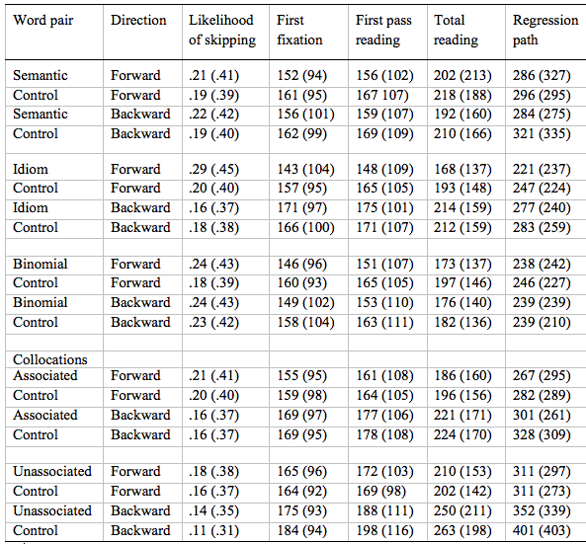
Experiment 5 Carrol & Conklin (in submission)
Results – second word
Semantic Pairs
limited priming
broad classification (close associates bread-baker and schematic relations kettle-steam) may make effects difficult to find, but necessary to distinguish from binomials
Collocations
no skipping for either type of collocation
associated collocations read faster than controls, but unassociated ones only faster in TRT
stronger association strength and higher cloze probability increased reading times, thus disrupting more expected increased reading times
Idioms
skipping and priming in forward directly only, partially accounted for by cloze probability
Binomials
skipping and priming in both directions, accounted for by association strength and phrase frequency
frequency and having ‘core’ semantic relations may underpin priming, while either factor alone may not

Slide 40
Conclusions
Experiments 1-3, on translated idioms show, that the form is “retained” in translation but meaning activation is less apparent.
Thus, familiar lexical combinations are recognised quickly, but understanding non-compositional phrases in an L2 remains problematic even at high levels of proficiency.
Experiments 4 & 5 indicate that different sources of information are implicated in the processing advantage of different types of MWUs.

Slide 41
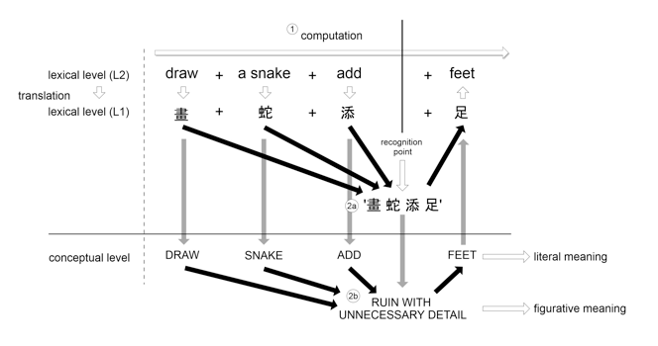
Conclusions
Two routes are available
Analysis and computation of phrase (1).
Direct access via a translation-based route at the lexical level (2a), or via a conceptual route (2b).
In both direct routes a unitary entry is accessible, either as a lexical configuration (2a) or a distinct underlying concept (2b).

Slide 42
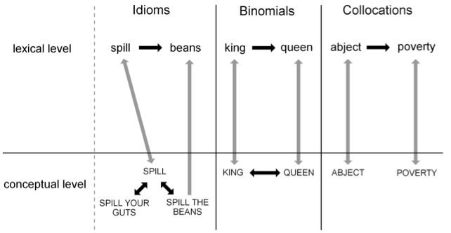
Conclusions
✗
At a conceptual level, only idioms have unique conceptual entries.
Encountering spill activates the lemma SPILL, as well as entries for any idioms of which it is a part (spill the beans, spill your guts, etc.).
The unidirectional arrow from SPILL THE BEANS to beans reflects the forward only priming.
Binomials have strong lexical links due to frequency and strong semantic associations at the conceptual level, which underpins priming.
The bidirectional arrow indicates both forward and backward priming.
The relationship between abject and poverty is schematic and learned and there is no underlying semantic relationship.
Hence priming exists only at a lexical level and is disrupted if the canonical sequence is not presented.

Slide 43
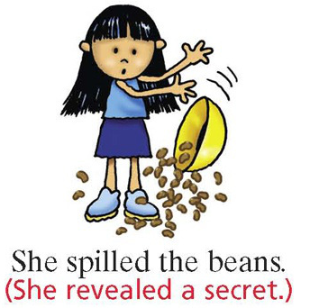

Are MWUs words?
If we take ‘word’ to be any sequence of letters that are separated by spaces and that have an accepted pronunciation and meaning in the language,
and that show effects of properties like frequency/familiarity, cloze probability/predictability, MI, etc.,
then MWUs are words.

Slide 44




Work done with
Gareth Carrol
Dr. Henrik Gyllstad

