Slide 1

Sustainability: which packaging?

Slide 2

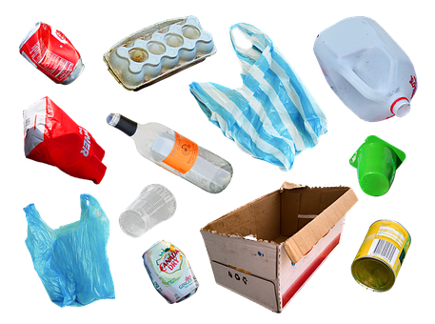
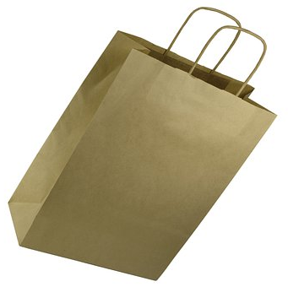
How many different materials can you see here?
Notes:
steel cans (some foods), waxed carton, polyethylene plastic bags, pressed pulp (egg box), polystyrene (yogurt carton), high density polyethylene (milk bottle) aluminium cans (drinks), glass bottle, cardboard box paper bag with string handle.
https://pixabay.com/illustrations/plastic-waste-garbage-recycling-6644673/

Slide 3
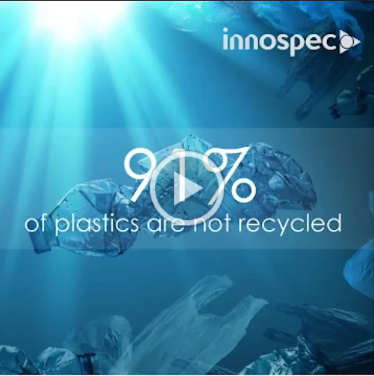

Slide 4
Alice Miles
Senior Applications Chemist
Innospec
Innospec Manufacturing Park
Ellesmere Port
CH65 4EY
Dear Scientists
Following on from the previous work that you have done for us I hoped that you would be able to help us again. We are currently working on a new packaging material for solid products such as soap and shampoo bars.
We need a material that is light so that it does not add to transport costs. It also needs to be flexible enough to wrap around the soap bars and strong enough to protect the soap and to prevent it marking things that it touches. Finally, it would be valuable if the material dissolved the first time that the soap was used so that there was no waste to dispose of.
We have sent you some samples to test and look forward to hearing from you.
Best wishes
Alice Miles

Slide 5


www.ciec.org.uk

