Slide 1

Sustainability:
how much shampoo?

Slide 2



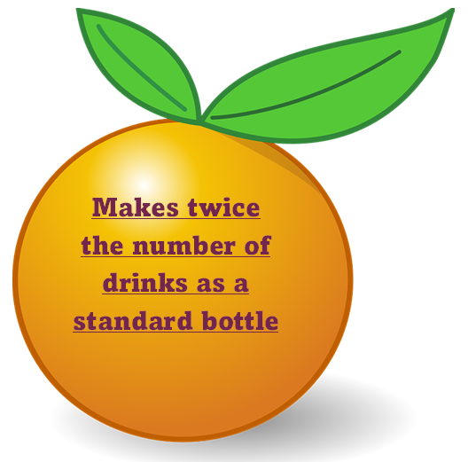

Have you seen labels like these?
What do they mean?
Contains the same amount of shampoo as THREE standard bottles

Slide 3
Alice Miles
Senior Applications Chemist
Innospec
Innospec Manufacturing Park
Ellesmere Port
CH65 4EY
Dear Scientists
We are writing to you from the research department of Innospec. We make personal care products. To reduce the amount of fossil fuels that we use to transport our products we have recently produced concentrated shampoo.
However, we think that some customers are using too much each time and so end up buying twice as much as they need.. This means that we have not reduced the amount of fossil fuels that we use after all.
We think that giving more accurate instructions on the bottle might help people to use the right amount and to stop wasting shampoo. We are recruiting groups of scientists from different parts of the country to find out how much shampoo produces the optimum amount of lather. Since you have been working on this topic we hoped that you would be able to do some tests for us.
Yours sincerely
Alice Miles

Slide 4


www.ciec.org.uk

