Slide 1

Fostering Student Engagement Through Research-Teaching Linkages
Ray Land, University of Strathclyde, Glasgow
University of York Annual Learning and Teaching Conference 25th^{th} May 2011

Slide 2

graduates for the 21st century

Slide 3
3 questions
What are likely to be defining characteristics of “21st century society” in the next two decades?
What (higher order) attributes will our graduates need to thrive (or at least survive) in the 21st century world we have envisaged?
What kind of learning environments or teaching approach are most appropriate to foster the kinds of graduate attributes we identify?

Slide 4
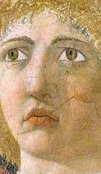
‘A radically unknowable world’
'our ignorance expands in all kinds of directions' (p.250) Need for creative 'knowing-in-situ' and imagination. Mode 3 knowledge where all our knowledge - of the world, of our situations, of ourselves - is contested.
Pedagogy must be founded on openness, mutual disclosure, personal risk and disturbance' (p.258).
  (Barnett 2004: 247-260)

Slide 5
Question 1
What would we envisage as likely to be defining characteristics of 21st century society in the next two decades?

Slide 6

Characteristics of the 21st century
Uncertainty
Speed and acceleration
Complexity
Multiculturalism
Mobility of the population
Conflict (social, military)
Inter-generational tension
Need for ethical citizenship
Information saturation
Proliferation of knowledge
Globalisation
Internationalisation
Private /public sector tension
Increasing panic
Unpredictability
Risk
Need for flexibility and agility
Entitlement v responsibility
Scarcity of resources
Austerity
Sustainability
Need for prudence
Transparency & accountability
Discontinuity and rupture
Shifting paradigms
Poverty v affluence
Outsourcing of jobs
Youthfulness

Slide 7
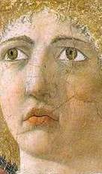
Supercomplexity
Unlike complexity, ‘interactions between the elements are unclear, uncertain and unpredictable’ (p.249) This is symptomatic of professional life with its competing demands, overload and stress. Challenges are never resolved because ‘it produces a multiplication of incompatible differences of interpretation’ (Barnett 2004 p.249)

Slide 8
Intellectual uncertainty
‘Intellectual uncertainty is not necessarily or simply a negative experience, a dead-end sense of not knowing, or of indeterminacy. It is just as well an experience of something open, generative, exhilarating, (the trembling of what remains undecidable). I wish to suggest that ‘intellectual uncertainty’ is ..a crucial dimension of any teaching worthy of the name.’
(Royle 2003 : 52)

Slide 9
Venturing into strange places
The student is perforce required to venture into new places, strange places, anxiety-provoking places . This is part of the point of higher education. If there was no anxiety, it is difficult to believe that we could be in the presence of a higher education.
  (Barnett 2007: 147)

Slide 10

Pedagogies of uncertainty
it's ... insufficient to claim that a combination of theory, practice, and ethics defines a professional's work; it is also characterized by conditions of inherent and unavoidable uncertainty.
(Shulman 2005:1)

Slide 11
Uncertainty in the classroom
... learning to deal with uncertainty in the classroom models one of the most crucial aspects of professionalism, namely, the ability to make judgments under uncertainty.
Lee Shulman, Signature pedagogies in the professions, 2005 p.57

Slide 12
Atmospheres of risk
... uncertainty, visibility, and accountability inevitably raise the emotional stakes of the pedagogical encounters.
Uncertainty produces both excitement and anxiety. These pedagogies create atmospheres of risk taking and foreboding, as well as occasions for exhilaration and excitement.
Lee Shulman, Signature pedagogies in the professions, 2005 p.57

Slide 13
Pedagogies of uncertainty
I would say that without a certain amount of anxiety and risk, there's a limit to how much learning occurs. One must have something at stake. No emotional investment, no intellectual or formational yield.
  (Shulman Pedagogies of Uncertainty, 2005:1)

Slide 14

Speed
supercomplexity
death of geography
issues of democratic space
advent of universal real time
tyranny of the moment
slow and fast time
‘presentified’ history
single gaze of the cyclops
Virilio 2000, Eriksen 2001

Slide 15
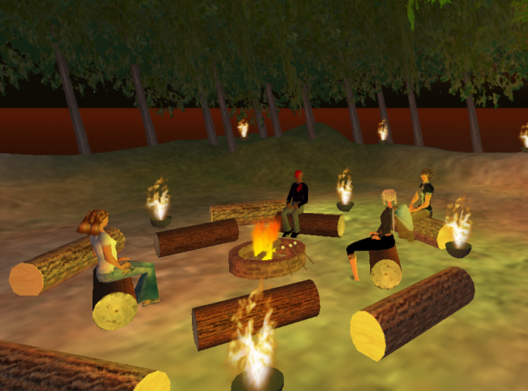
process
fragmentation
exploration
visual
volatility
fast time
consensus
openness
artefact
cohesion
exposition
textual
stability
slow time
authority
containment

Slide 16
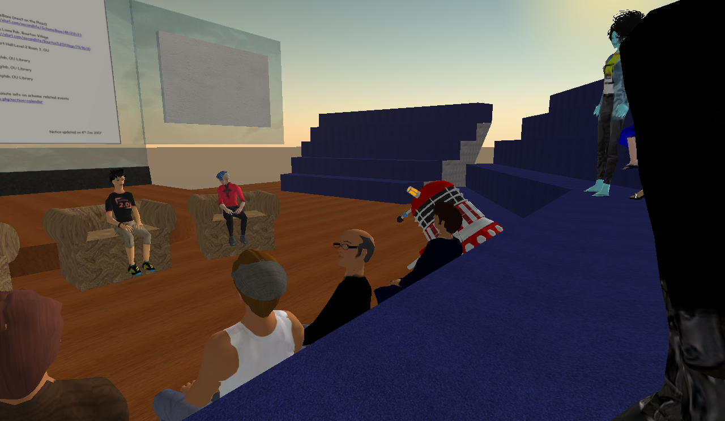

Slide 17

What forms of ‘technoliteracy’ do we need to work in these spaces?
How can assessment regimes be re-crafted for these volatile spaces?
What digital pedagogies work in these environments?
How do these texts and technologies change the way academic knowledge is produced and distributed?

Slide 18
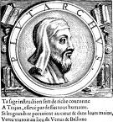
Plutarch’s fire
‘the mind is not a vessel to be filled, but a fire to be lit’.
(Plutarch c46 -127AD).

Slide 19
Plutarch’s Fire
‘Never has the educational philosophy behind this belief been more important: the changing world to be faced by today’s students will demand unprecedented skills of intellectual flexibility, analysis and enquiry.
Teaching students to be enquiring or research-based in their approach is not just a throwback to quaint notions of enlightenment or liberal education but central to the hard-nosed skills required of the future graduate workforce.’
(Hammond 2007:1)

Slide 20
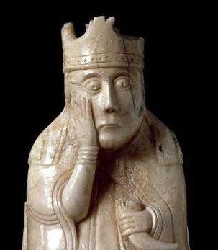
Troublesome knowledge
Perkins 1999

Slide 21
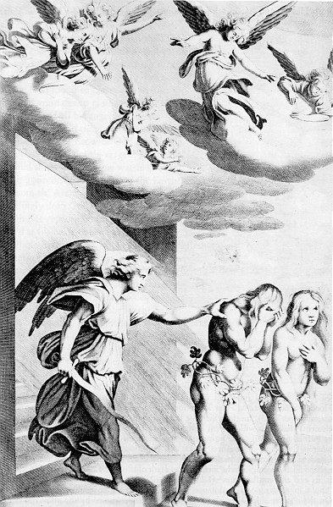
Characteristics of a threshold concept
integrative
transformative
irreversible
bounded
re-constitutive
discursive
troublesome
Meyer & Land 2003

Slide 22
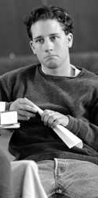
Liminality
a transformative state that engages existing certainties and renders them problematic, and fluid
a suspended state in which understanding can approximate to a kind of mimicry or lack of authenticity
liminality as unsettling – sense of loss

Slide 23
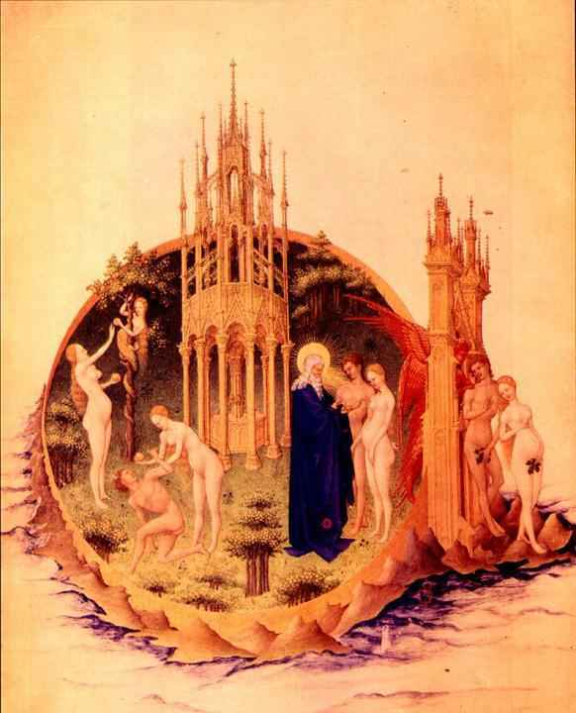
East of Eden through the threshold

Slide 24
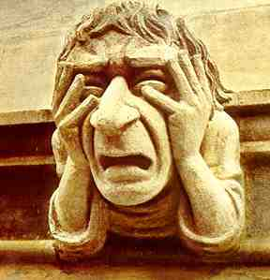
Troublesome knowledge
ritual knowledge
inert knowledge
conceptually difficult knowledge
the defended learner
alien knowledge
tacit knowledge
loaded knowledge
troublesome language

Slide 25
Question 2
What are the higher order attributes that our graduates will need to thrive (or at least survive) in the 21st century world we have envisaged?

Slide 26
Higher order graduate attributes

Slide 27
critical understanding
disciplinary currency
provisionality (knowledge, situations)
contingency (knowledge, situations)
problem formulation
problem analysis and resolution
evaluation
evidence-based solutions
argumentation
deriving meaning from complexity
modes of enquiry
informed judgement
advanced techniques
independence
learner responsibility
creativity
critical values
  ethical
  social
  cultural
  environmental
wider professional conduct
  contextual ‘savviness’
  political astuteness

Slide 28

And at Master’s level
constructing conceptual frameworks
critical evaluation of current research and advanced scholarship
originality in the application of knowledge
reconciling complex issues
forming sound judgments
coping with incomplete data

Slide 29

CIHE international / intercultural GAs
Knowledge
world geography, conditions, issues and events
complexity and interdependence of world events & issues
understanding of historical forces that have shaped the current world system
knowledge of a foreign language, intercultural communication concepts, international business etiquette

Slide 30
CIHE international / intercultural GAs
Attitudes
openness to learning & positive orientation to
new opportunities, ideas and ways of thinking.
tolerance for ambiguity and unfamiliarity.
sensitivity & respect for cultural differences.
empathy or the ability to take multiple
perspectives.
self-awareness and self esteem about one’s own
identity & culture.

Slide 31
CIHE international / intercultural GAs
Skills
research skills to learn about the world
critical and comparative thinking skills
ability to think creatively and integrate knowledge
ability to use another language effectively and
interact with people from other cultures
coping and resiliency skills in unfamiliar and
challenging situations

Slide 32
Question 3
What kind of learning environments or teaching approaches might be most appropriate to foster the kinds of graduate attributes that have been identified?

Slide 33
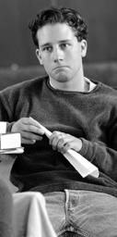
Research could be a strong condition that is aimed at bringing about supercomplexity in the minds of students.
(Barnett 1992 p.623)

Slide 34
Linking research and teaching
“We are all researchers now … Teaching and research are becoming ever more intimately related … In a ‘knowledge society’ all students – certainly all graduates – have to be researchers. Not only are they engaged in the production of knowledge; they must also be educated to cope with the risks and uncertainties generated by the advance of science”
(Scott 2002, 13)
Supercomplexity (Barnett) Risk (Beck)
Uncertainty (Shulman), Speed (Virilio)
Notes:
34
7
3

Slide 35
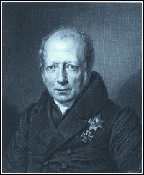
What is distinctive about ‘higher’ learning?
“It is furthermore a peculiarity of the universities that they treat higher learning always in terms of not yet completely solved problems, remaining at all times in a research mode …
Schools, in contrast, treat only closed and settled bodies of knowledge. The relationship between teacher and learner is therefore completely different in higher learning from what it is in schools. ..”
Wilhelm von Humboldt 1810
Notes:
35

Slide 36
What is distinctive about ‘higher’ learning?
“…At the higher level, the teacher is not there for the sake of the student, both have their justification in the service of scholarship.”
Wilhelm von Humboldt 1810
Notes:
36

Slide 37
Idealistic (Humboldtian) approach. (Simons & Elen 2007)
Research a kind of general education.
Academic enquiry, morality (edification) and citizenship are linked.
University different from schools (social needs) as well as from research institutions (govt needs, commercial interests)
Education at the university solely guided by academic enquiry (one submits to the tribunal of reason, the spirit of truth, the force of the better argument.)
Not influenced by pedagogic expertise or didactics, or managerial or moral or economic imperatives.
State and society cannot ask for immediate returns.

Slide 38
successful graduate
responsible citizen
effective employee

Slide 39
potential research-teaching linkages
Learning about the research of others
Learning in research mode – enquiry based
Learning to do research – research methods
Pedagogic research – enquiring and reflecting about learning
Notes:
39

Slide 40
Curriculum design and the research-teaching nexus
STUDENT-FOCUSED
STUDENTS AS PARTICIPANTS
Research-tutored
Curriculum emphasises learning focused on students writing and discussing papers or essays
Research-based
Curriculum emphasises students undertaking inquiry-based learning or low key research
EMPHASIS ON RESEARCH PROCESSES AND PROBLEMS
EMPHASIS ON RESEARCH CONTENT
Research-led
Curriculum is structured around teaching subject content
Research-oriented
Curriculum emphasises teaching processes of knowledge construction in the subject
TEACHER-FOCUSED
STUDENTS AS AUDIENCE
(Healey 2005)
Notes:
40

Slide 41
Curriculum design and the research-teaching nexus
STUDENT-FOCUSED
STUDENTS AS PARTICIPANTS
Research-tutored
Curriculum emphasises learning focused on students writing and discussing papers or essays
Research-based
Curriculum emphasises students undertaking inquiry-based learning or low key research
EMPHASIS ON RESEARCH PROCESSES AND PROBLEMS
EMPHASIS ON RESEARCH CONTENT
Research-led
Curriculum is structured around teaching subject content
Research-oriented
Curriculum emphasises teaching processes of knowledge construction in the subject
TEACHER-FOCUSED
STUDENTS AS AUDIENCE
(Healey 2005)
Notes:
41

Slide 42
Curriculum design and the research-teaching nexus
STUDENT-FOCUSED
STUDENTS AS PARTICIPANTS
Research-tutored
Curriculum emphasises learning focused on students writing and discussing papers or essays
Research-based
Curriculum emphasises students undertaking inquiry-based learning or low key research
EMPHASIS ON RESEARCH PROCESSES AND PROBLEMS
EMPHASIS ON RESEARCH CONTENT
Research-led
Curriculum is structured around teaching subject content
Research-oriented
Curriculum emphasises teaching processes of knowledge construction in the subject
TEACHER-FOCUSED
STUDENTS AS AUDIENCE
(Healey 2005)
Notes:
42

Slide 43

High Impact Activities
First-Year Seminars and Experiences
Common Intellectual Experiences
Learning Communities
Writing-Intensive Courses
Collaborative Assignments and Projects
“Science as Science Is Done”; Undergraduate Research
Diversity/Global Learning
Service Learning, Community-Based Learning
Internships
Capstone Courses and Projects
George Kuh (2008)
Notes:
43
43

Slide 44
Illustrations of practice
Induction week Materials Science – ‘a product in ten years time’
2nd yr Literary Studies – ‘Toni Morrison’s Jazz’
1st yr Mech Eng – ‘dissection of a car’
1st yr Basic Psychology – ‘online peer groups’
2nd yr Chemistry ‘forensic investigation of a (fictitious) death’
‘Exhibitions’ as a research-teaching linkage in a School of Art

Slide 45
‘Beyond Understanding’
Possessive Knowledge
Performative Knowledge
Proactive Knowledge
David Perkins – ‘Beyond Understanding’ in Land. Meyer & Smith Eds) (2008) Threshold Concepts within the Disciplines

Slide 46
From demand culture to opportunity culture
From very other-directed to significantly self-directed
From extrinsic motivation to intrinsic motivation
From cool to hot cognition
From prototypical examples to include diverse and marginal examples and close counterexamples
From ‘learning about’ to ‘learning to do’

Slide 47
From learning the pieces to ‘whole game learning’
From ‘designing to specifications’ to ‘designing the specifications’
From problem solving to problem finding, problem defining
From learning here and there to learning here, there and elsewhere
David Perkins – ‘Beyond Understanding’ (2008) pp 14-15.

Slide 48

Academics for the 21st Century?

Slide 49
Thank you
ray.land@strath.ac.uk
Project information at:
http://www.enhancementthemes.ac.uk/themes/ResearchTeaching/outcomes.asp

