Slide 1
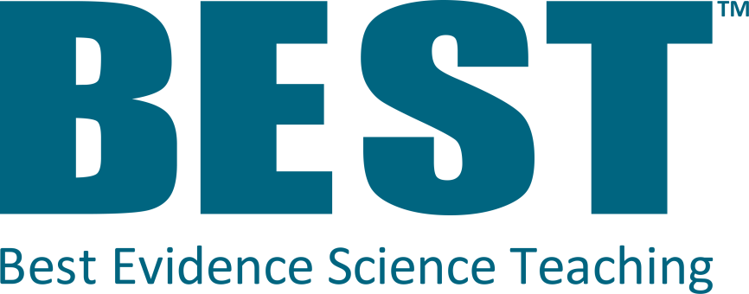
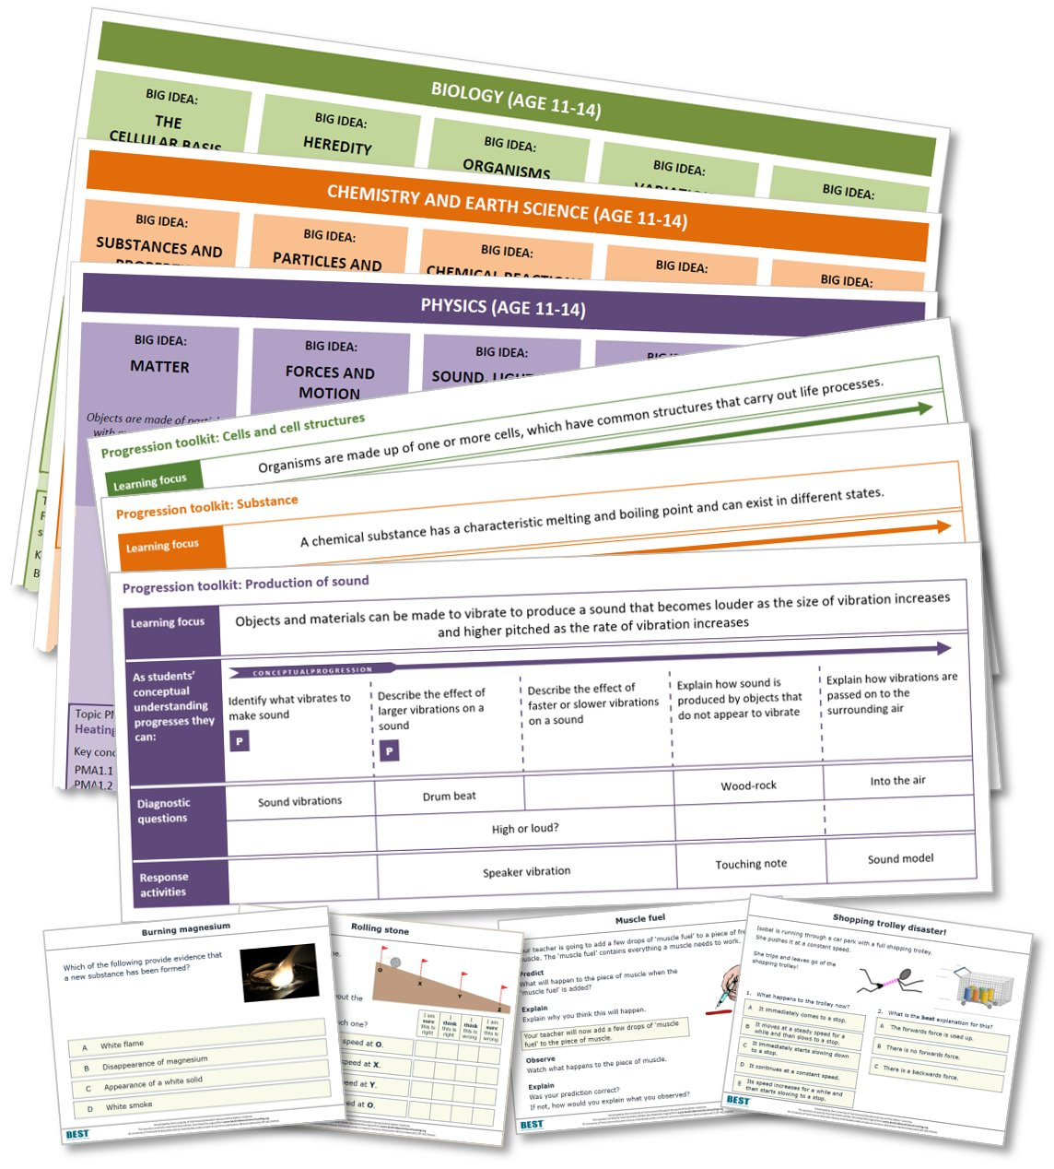






The best teaching
draws on the best evidence
Full introductory
presentation
@BestEvSciTeach
www.BestEvidenceScienceTeaching.org
Notes:
Best Evidence Science Teaching (BEST) provides a large, online collection of FREE research-informed resources to support science teaching in secondary schools (age 11-16). The resources help teachers to test and consolidate students’ understanding of key concepts in science, to facilitate better progression.
The resources have been developed from the best research evidence we can find on:
common misunderstandings in science
effective diagnostic questioning and formative assessment
constructivist approaches to building understanding
effective sequencing of key concepts.

Slide 2

What’s
?

Slide 3
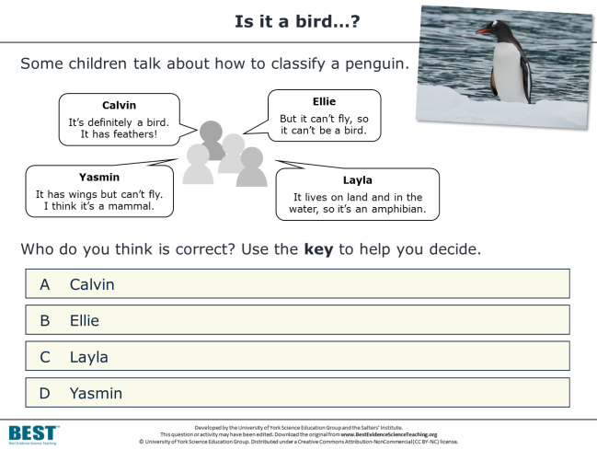
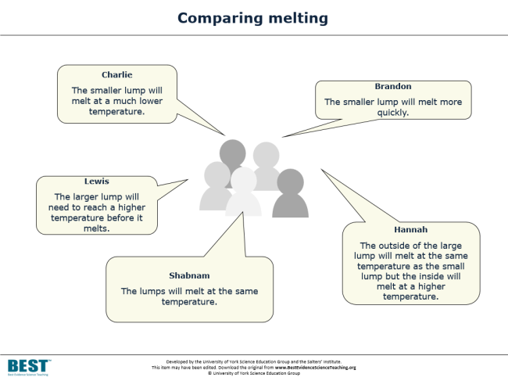
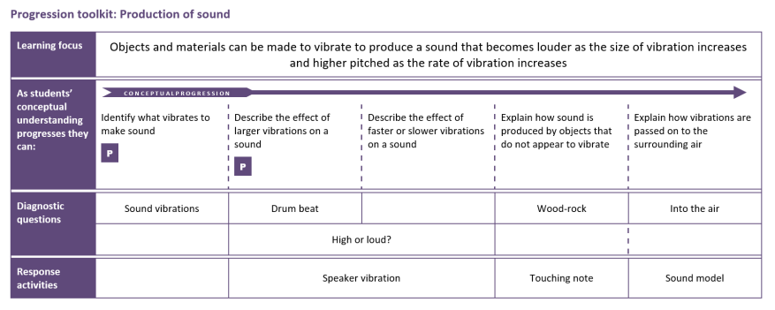
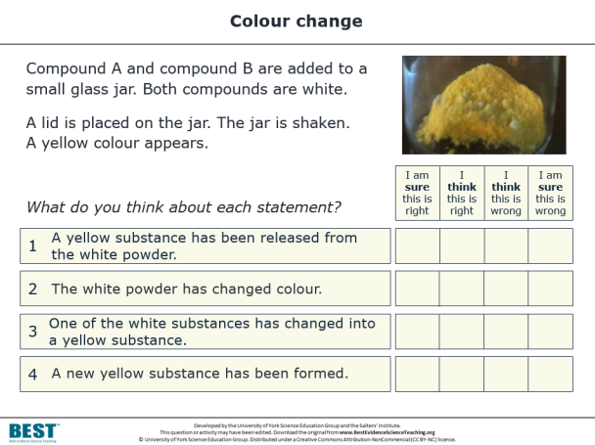
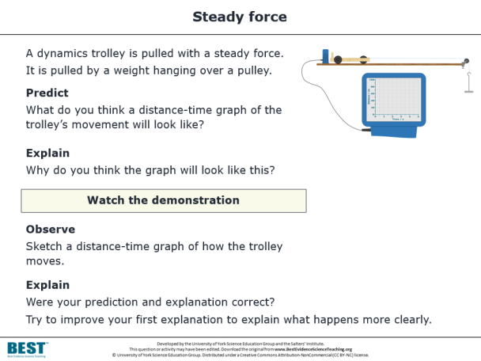
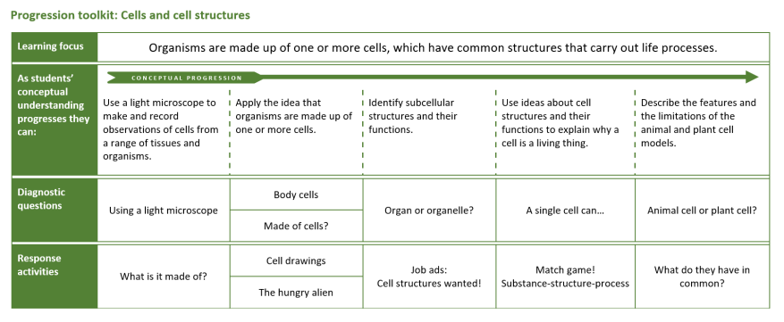
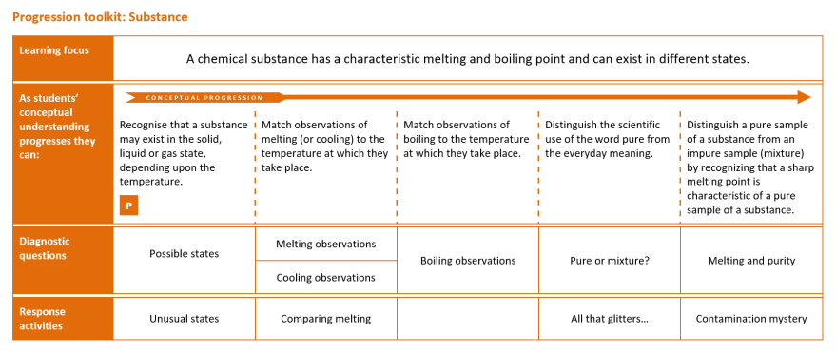
Hundreds
of
resources
All based
on research evidence
ONLINE, OPEN-ACCESS & FREE!
DIAGNOSTIC QUESTIONS
RESPONSE ACTIVITIES
PROGRESSION TOOLKITS
…to help teachers develop evidence-based practices
…to test and consolidate students’ understanding of key concepts in science.
Notes:
In a nutshell, the Best Evidence Science Teaching project provides a large collection of resources for science teachers, all developed from research evidence and all online, open access and completely FREE to use.
There is a vast body of published research into school students’ understanding of science, their preconceptions and common misunderstandings. We’re surveying that research literature systematically for key concepts taught in secondary school science, and turning it into a series of diagnostic questions – short, formative assessment items that teachers can use quickly and easily in lessons to collect evidence of what their students understand and – crucially – what preconceptions and misunderstandings they have.
Often the research will describe ways in which teachers could respond to and challenge these misunderstandings – for example through particular interventions and constructivist approaches that aim to move students’ thinking on towards the kind of scientific understanding we would wish them to have. We’ve used this research to develop response activities, paired up with the diagnostic questions.
And we’ve gone a little further than that. There’s a lot of research into learning progression and effective sequencing of ideas to help build understanding. So we’ve used that to develop a progression toolkit for each key concept, which sets out appropriate learning steps to help move students’ thinking on.
Our aim is to transform research evidence into practice, to help science teachers develop their evidence-based practices in the classroom. Ultimately we hope this will help teachers to help students develop better understanding of key concepts in science.

Slide 4

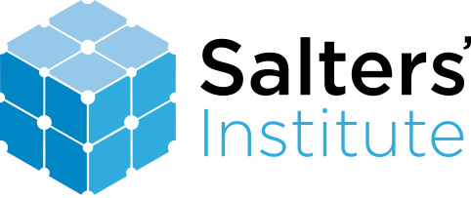



Best Evidence Science Teaching (BEST)
The resources have been developed from the best available research evidence on:
  common misunderstandings in science
  effective diagnostic questioning and formative assessment
  constructivist approaches to building understanding
  sequencing of key concepts.
The resources are developed by the University of York Science Education Group.
The Salters' Institute has been proud to fully fund the BEST project since it began in 2016.
The Institute of Physics is now a co-funder of BEST, having supported the project since 2021.
We are providing FREE online access to the resources in collaboration with STEM Learning to support science teaching.
Notes:
The BEST resources are developed by the University of York Science Education Group (UYSEG), a team of science education researchers and curriculum developers based at the University of York, UK. Since 1983 the group has been engaged in research-informed curriculum development, which means taking the best research evidence we can find and transforming it into resources for science teachers to use in the classroom.
The Salters’ Institute has been proud to fully fund the BEST project since it began in 2016. The Salters’ Institute was founded in 1918, and plays a major role in the support of science teaching and the encouragement of young people to pursue careers in science. The partnership between the Salters’ Institute and UYSEG has endured for over 35 years, and has included some ground-breaking curriculum development projects: the Salters’ A level courses pioneered context-led teaching of science at age 16-18, and Twenty First Century Science led the way in developing students’ scientific literacy at age 14-16. Best Evidence Science Teaching (BEST) is the latest body of work to result from this valuable and productive partnership.
The Institute of Physics is now a co-funder of BEST, having supported the project since 2021.
We are providing free online access to the resources in collaboration with STEM Learning to support science teaching. Download from: www.BestEvidenceScienceTeaching.org

Slide 5
The
resources

Slide 6
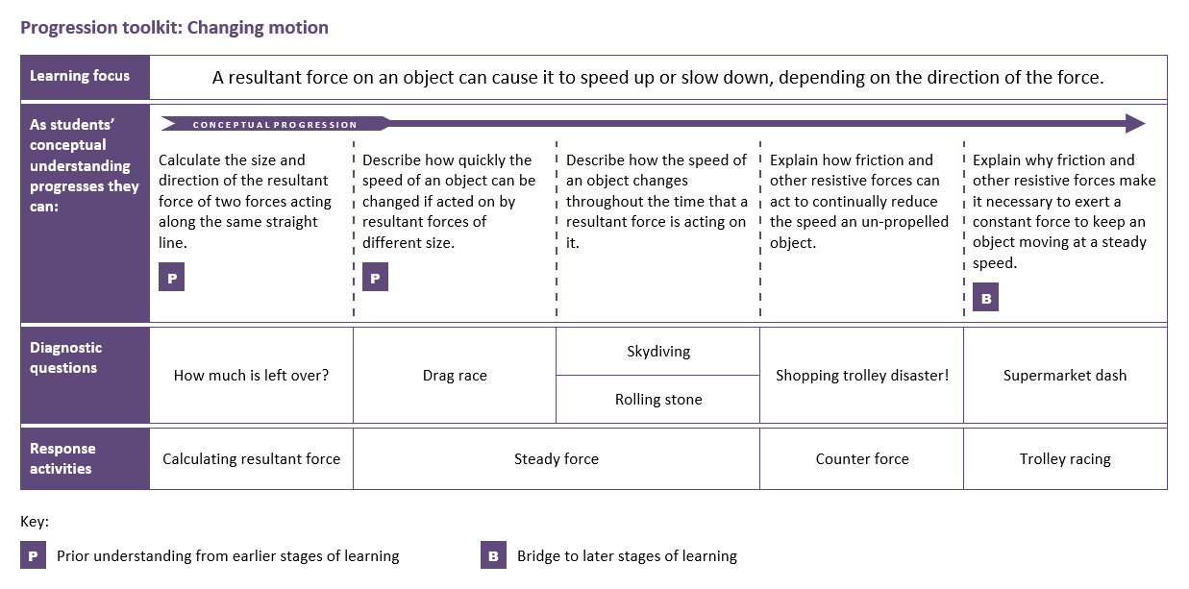

Evidence-informed progression
A progression toolkit helps you to test and consolidate understanding of a key concept in science.
A research-informed progression pathway describes what students should be able to do as their understanding of the concept develops.
Notes:
A progression toolkit sets out a research-informed progression pathway that describes, in appropriate steps, what students should be able to do as their understanding of the concept develops.
The progression pathway is only advisory, but for teachers seeking some guidance on appropriate sequencing of learning steps it may help and is based on our reading of relevant research evidence. We’ve found that trainee teachers, NQTs and teachers who are having to teach outside their specialism find the progression pathways particularly helpful.

Slide 7


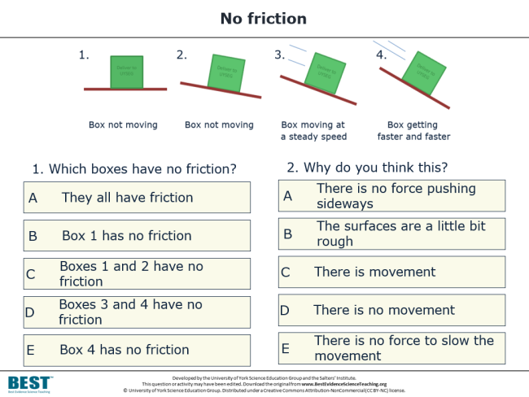
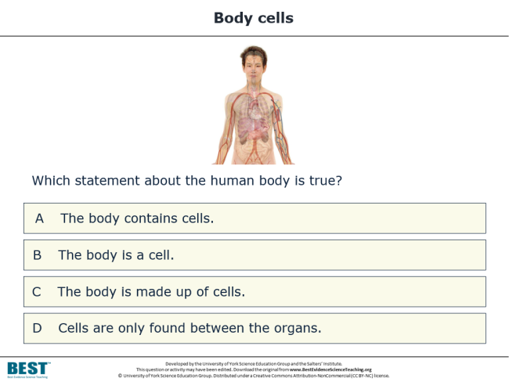
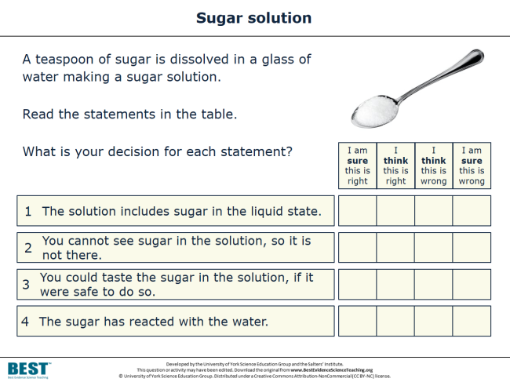
Diagnose misunderstandings
Diagnostic questions help you to collect:
evidence of where your students are in their conceptual progression
evidence of common misunderstandings and preconceptions.
They can be used formatively to decide what to do next.
Notes:
For each step in the learning progression, we provide one or more research-informed diagnostic questions. These provide evidence of where students are in their conceptual progression, and evidence of common misunderstandings and preconceptions that can form barriers to developing scientific understanding.
The diagnostic questions are most effective when they’re used as part of a learning pathway. The evidence they provide can be used formatively to help a teacher decide whether it’s appropriate to move on, or whether there is a need to challenge students’ misunderstandings using one or more response activities.

Slide 8

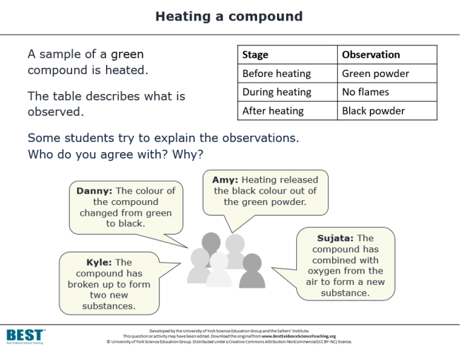
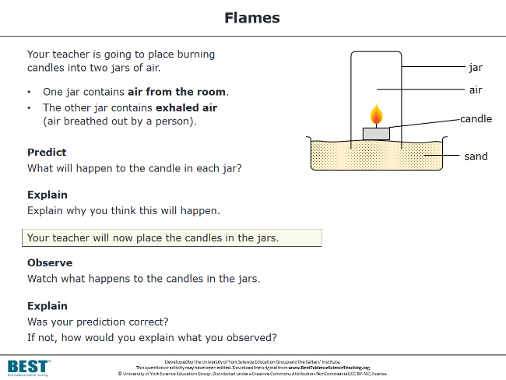
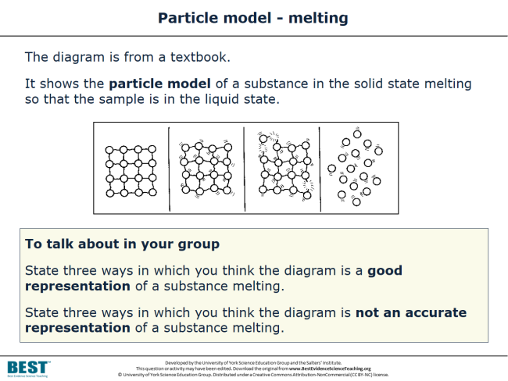
Respond effectively
Response activities:
encourage students to talk and think about what they’re thinking (metacognition)
facilitate purposeful practical work
encourage meaning-making.
They help to challenge misunderstandings and overcome barriers to conceptual development.
Notes:
The diagnostic questions are paired up with response activities that can help students to overcome misunderstandings and move their thinking on by building their scientific understanding. Response activities facilitate metacognition – they challenge students to think and talk critically about what they and their peers are thinking and why. Meaning-making is encouraged through group dialogue and purposeful practical work.

Slide 9

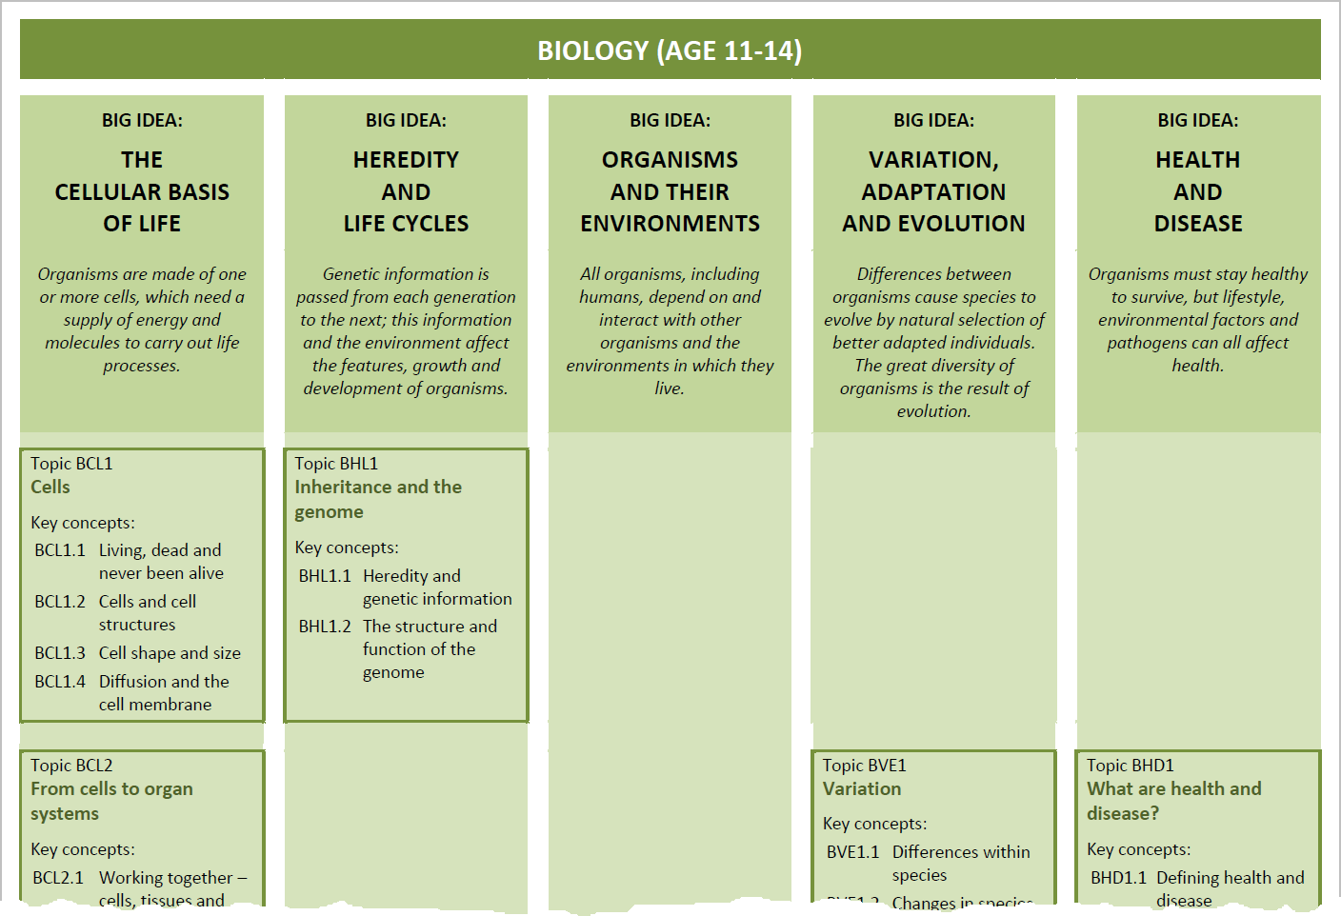

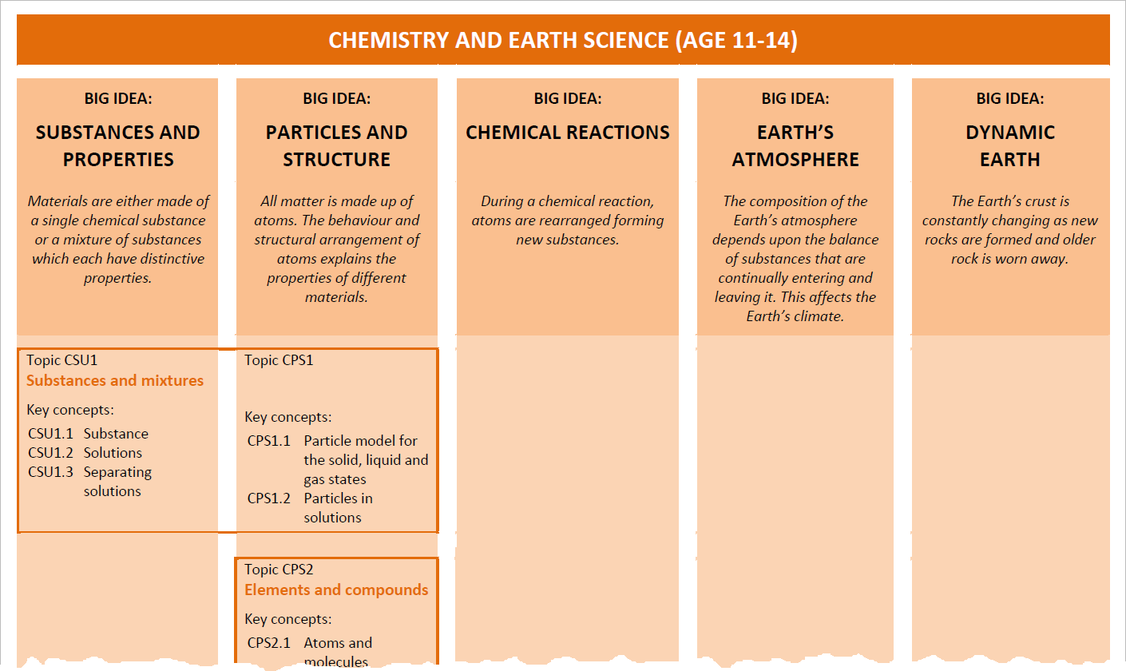

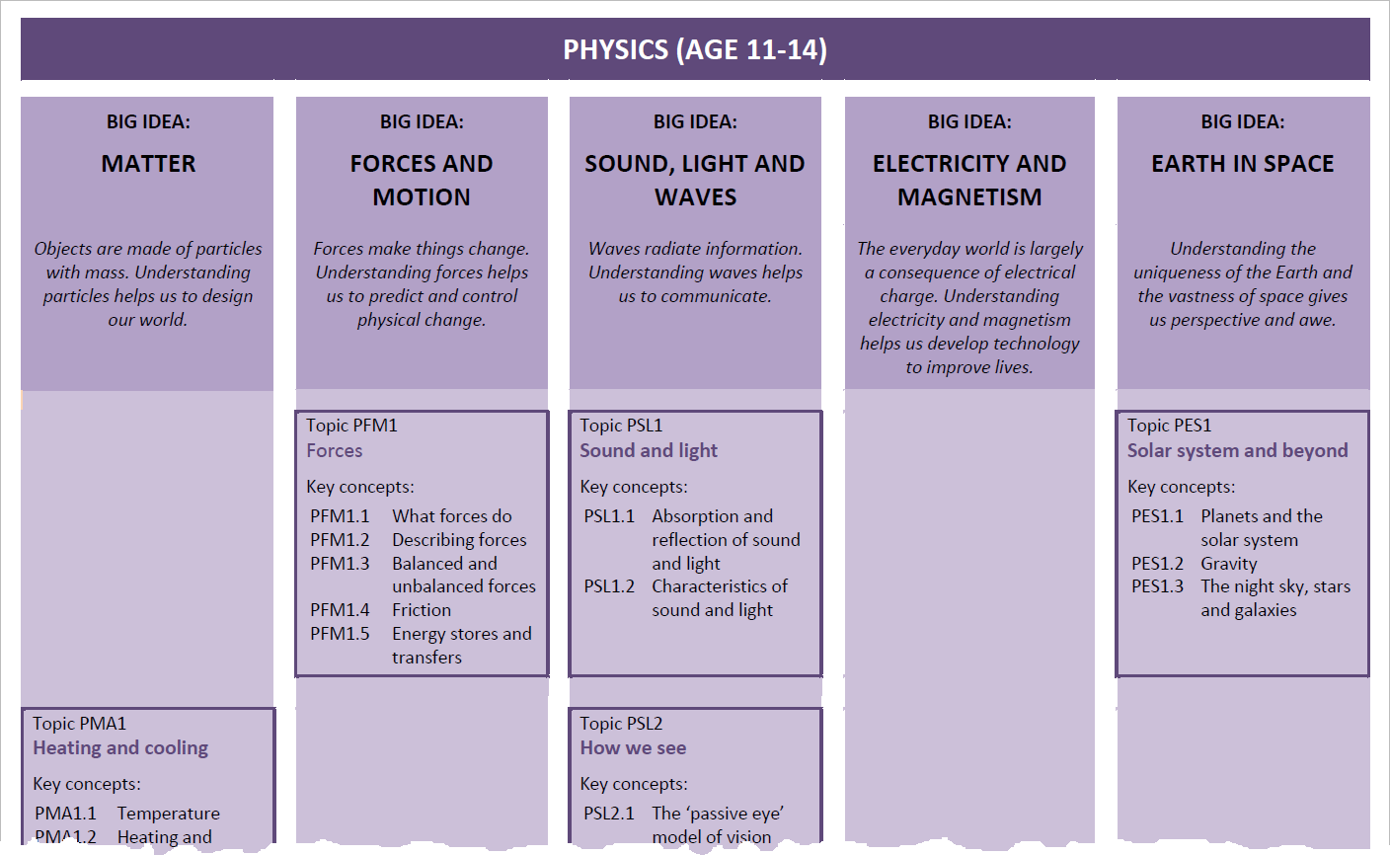
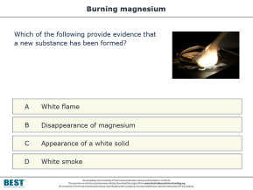
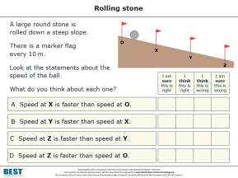
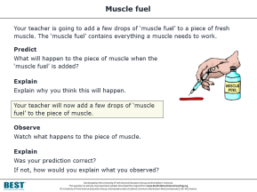
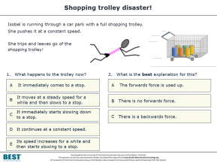
Research-informed curriculum planning
The BEST resources can be incorporated into existing
schemes of learning…
…or use our research-informed maps for curriculum planning. They suggest how
key concepts can be sequenced to build understanding of big ideas of science.
Notes:
We’re surveying the research literature and systematically developing resources for key concepts taught in secondary science. The key concepts are universal, so the resources are not tied to any particular examination board or national curriculum and can be incorporated into teachers’ existing schemes of work – no matter where in the world they’re teaching.
However, for teachers seeking guidance on curriculum planning, we’ve also used research evidence on learning progressions and sequencing of ideas to produce key concept maps. These illustrate how key concepts in science can be sequenced and linked together to build understanding of big ideas of biology, chemistry, Earth science and physics. Teachers who wish, or are required, to re-develop their secondary science curriculum in school may find these helpful.

Slide 10





WEBINAR:
BEST Curriculum Planning for 11-16
Presented in May 2020
This webinar explored how the free, research-informed resources of BEST could help you develop a flexible and responsive science curriculum.
Watch the recording at:
bit.ly/2Nmcbq3
Password:
ASECOVID9
COVID-19 WEBINAR SERIES
Notes:
For more on how the BEST resources can help with secondary science curriculum planning, watch the recording of our BEST Curriculum Planning webinar, presented as part of the ASE’s COVID-19 webinar series in 2020.
Watch the recording at: bit.ly/2Nmcbq3
Password: ASECOVID9

Slide 11
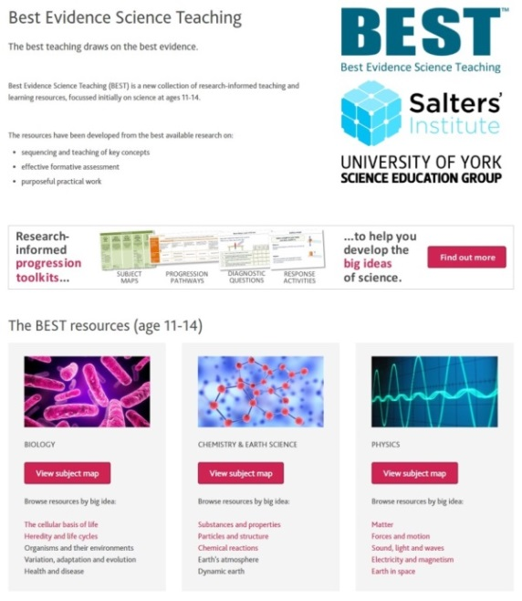

The BEST resources are all FREE to download and use
All resources for ages 11-14 are complete!
Topics:
  Biology
  Cells
  From cells to organ systems
  Inheritance and the genome
  Life cycles
  Reproduction
  Food chains and food webs
  Ecosystems
  Biodiversity and human impacts
  What are health and disease?
  Human lifestyles and health
  Infectious disease
  Plant nutrition and photosynthesis
  Cellular respiration
  Classification
  Variation
  Adaptations
  Evolution by natural selection
  Chemistry
  Substances and mixtures
  Elements and compounds
  Solubility
  Chemical change
  Understanding chemical reactions
  Energy and reactions
  Acids and alkalis
  Periodic table
  Earth science
  Earth’s resources
  Air pollution
  Acid rain
  Water cycle
  Weathering and erosion
  Rock changes
  Physics
  Heating and cooling
  Floating and sinking
  Forces
  Moving by force
  More about force
  Sound and light
  How we see
  Making images
  Waves
  Simple electric circuits
  More electric circuits
  Magnets and electromagnets
  Solar system and beyond
  Earth, Moon and Sun
@BestEvSciTeach
www.BestEvidenceScienceTeaching.org
Notes:
The BEST resources are developed based on careful consideration of the best available research evidence on learning pathways, common student misunderstandings, and effective teaching approaches.
All resources for age 11-14 have now been published. Resources for age 14-16 will be published on a topic-by-topic basis throughout 2021 and 2022.
Follow @BestEvSciTeach on Twitter to find out when new topics have been made available.

Slide 12
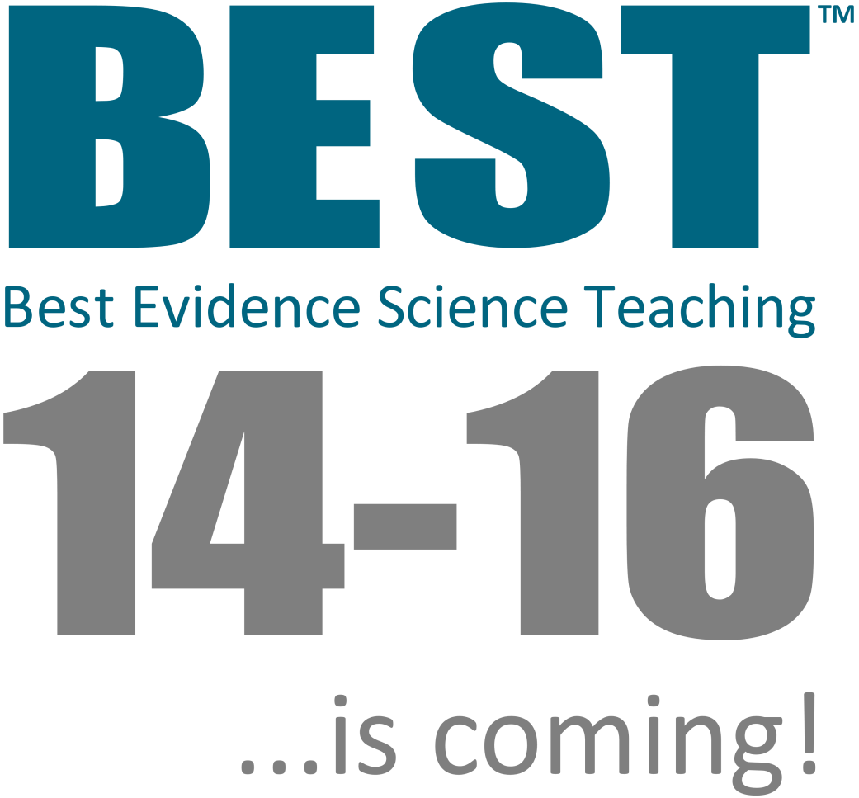



Thanks to the generosity of the Salters’ Institute, we now have funding to expand Best Evidence Science Teaching
to cover the complete 5-year secondary science curriculum from age 11 to 16.
Publication will proceed on a
topic-by-topic basis to the end of 2022.
FUNDED BY
DEVELOPED BY
FREE • ONLINE • OPEN-ACCESS www.BestEvidenceScienceTeaching.org
Notes:
We are delighted to announce that, thanks to the generosity of the Salters’ Institute, we have now secured funding for another three years of development work to extend Best Evidence Science Teaching up to age 16.
Research and development work on BEST 14-16 is already underway, and resources are being published on a topic-by-topic basis through to the end of 2022.
The BEST 14-16 resources will build upon our existing resources for 11-14, to facilitate progression in understanding across the 5-year secondary science curriculum.

Slide 13
Why
?

Slide 14



High-level calls for evidence-based practice
We want a high quality teaching profession which embraces evidence-based practice to drive up standards in schools.
DfE white paper: Educational Excellence Everywhere (2016)
Educational policy and practice should be informed by the best available research evidence. There is increasing recognition of the need for the teaching profession to be research-informed.
The Royal Society & The British Academy, Harnessing Educational Research (2018)
Notes:
There have been high-level calls for teachers to engage in evidence-based practices.
In 2016 the UK Government’s Department for Education published a white paper called Educational Excellence Everywhere, in which they said “We want a high quality teaching profession which embraces evidence-based practice to drive up standards in schools.” In 2018, the Royal Society and the British Academy jointly published a report called Harnessing Educational Research, in which they said that “educational policy and practice should be informed by the best available research evidence.”
I’m sure we’d all agree with that, and in fact this is nothing new. The notion that evidence-based teaching is a good thing is not a new idea. And yet these calls persist – because there are considerable challenges in making it happen. It’s very difficult for teachers to bridge the gap between research evidence and what they do in class.

Slide 15
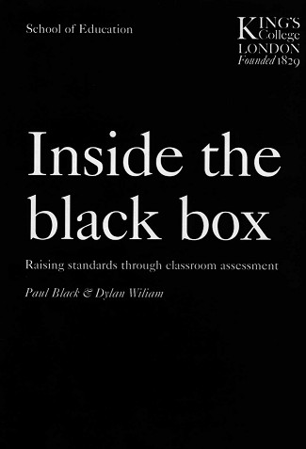

The challenges of transforming evidence into practice
Teachers will not take up attractive-sounding ideas, albeit based on extensive research, if these are presented as general principles... their classroom lives are too busy for this to be possible.
What they need is a variety of living examples of implementation.
Paul Black and Dylan Wiliam,
Inside the Black Box (1998)
Teachers are seeking to develop strategies that make best use of evidence.
Research organisations and intermediary bodies need to transform evidence for practice
[if it is to be effectively utilised by teachers].
NFER, Using Evidence in the Classroom: What Works and Why? (2014)
What they need is a variety of living examples of implementation.
Notes:
In Inside the Black Box, published in 1998, Black & Wiliam highlight one of the main barriers: classroom teachers are just too busy to systematically survey and distil research evidence into something that can be used in a class next week, next term or next year. There are other challenges as well: much of the research is published in academic journals that schools don’t subscribe to, so the papers are hidden behind paywalls and teachers often can’t read more than the title and abstract.
Even if a teacher does have time to engage with science education research, one of the biggest hurdles they are likely to face is the question: where do I start?
Black & Wiliam go on to say that what teachers need is a variety of living examples of implementation. One way to provide that is with ready-made resources that teachers can use, which include information about the underpinning research evidence and data – where available – from classroom trials. From these, teachers can start to work out what might work – and then what does work – in their own classrooms.
In 2014 the NFER suggested that “intermediary bodies need to transform evidence for practice” - and that is exactly what the Best Evidence Science Teaching project is aiming to do. The project is a major undertaking in research-informed curriculum development, aiming to make high-quality, research-evidence informed resources freely and widely available to teachers.

Slide 16
example

Slide 17

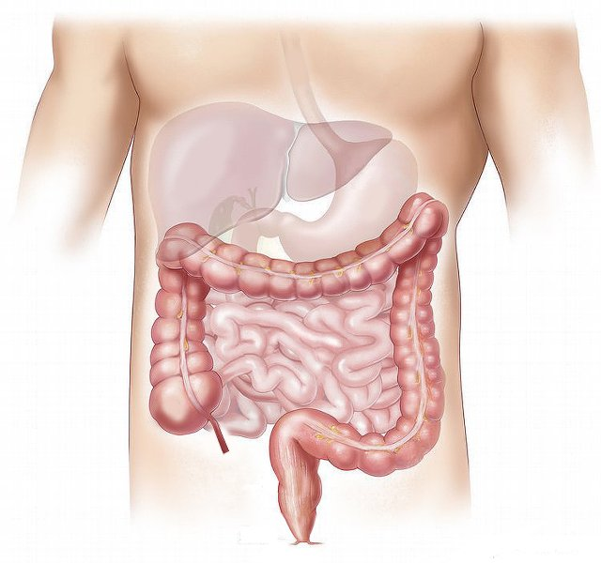
Moving through the digestive system
Food we swallow moves through the digestive system.
What is the main thing that causes food to move through the digestive system?
A
Gravity
B
Contraction of muscles in the digestive system
C
Vibrations from body movements such as walking
D
Swallowing more food pushes it along
Notes:
This is one example of a diagnostic questions, taken from the hundreds of resources published as part of the Best Evidence Science Teaching collection. It’s aimed at lower secondary school students (age 11-14). It assesses understanding of the key concept that muscles are an essential part of organ systems.
The best answer is B – contracting muscles (a.k.a. peristalsis) is what is principally responsible for moving food through the digestive system. The other options, or ‘distracters’ as well call them, are misunderstandings that have been reported in the research literature as being common misunderstandings in children of lower secondary age.

Slide 18
Research evidence
When children up to age 15 were asked to draw what is inside the human body, most drew organs but very few drew muscles, and when muscles were drawn they were commonly only depicted in the limbs.
Reiss, M. J., et al. (2002). An international study of young peoples' drawings of what is inside themselves. Journal of Biological Education, 36(2), 58-64.
Bartoszeck, A. B., Machado, D. Z. and Amann-Gainotti, M. (2011). Graphic representation of organs and organ systems: psychological view and developmental patterns. EURASIA Journal of Mathematics, Science & Technology Education, 7(1), 41-51.
Rosalind Driver’s review of the research literature suggested that there was no evidence that school-age children recognise the involvement of muscles in the digestive, circulatory and respiratory systems.
Driver, R., et al. (1994). Making Sense of Secondary Science: Research into Children's Ideas, London, UK: Routledge.
Several studies have found that children from ages 4 to 10 do not appreciate that food is pushed through the digestive tract by waves of muscle contraction (peristalsis), believing instead that gravity and body movements such as walking and bending are responsible.
Teixeira, F. M. (2000). What happens to the food we eat? Children's conceptions of the structure and function of the digestive system. International Journal of Science Education, 22(5), 507-520.
AHİ, B. (2017). Thinking about digestive system in early childhood: a comparative study about biological knowledge. Cogent Education, 4(1).
Notes:
The question was built from research evidence on common preconceptions and misunderstandings that school-age children have, and you can see some of that summarised here. The research suggests that children tend to be more focussed on organs rather than muscles when thinking about what’s inside them, they don’t tend to think about the presence and roles of muscles in organs systems, and they think that food just moves through the digestive tract because of gravity or because other body movements such as walking help the food to be shuffled along.
To find, and access, this kind of research is often not easy for busy teachers. We’re working to locate this evidence on there behalf, and using it to build good diagnostic questions.

Slide 19
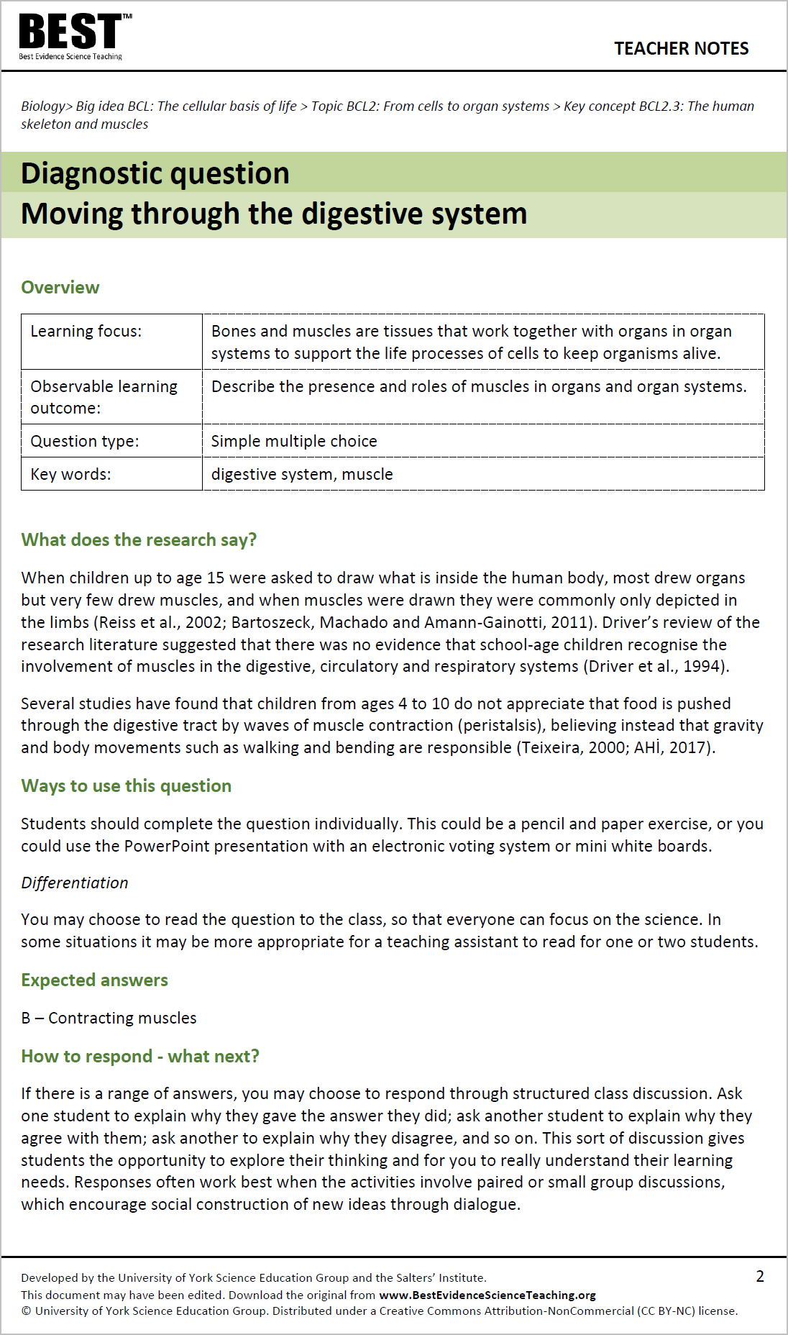
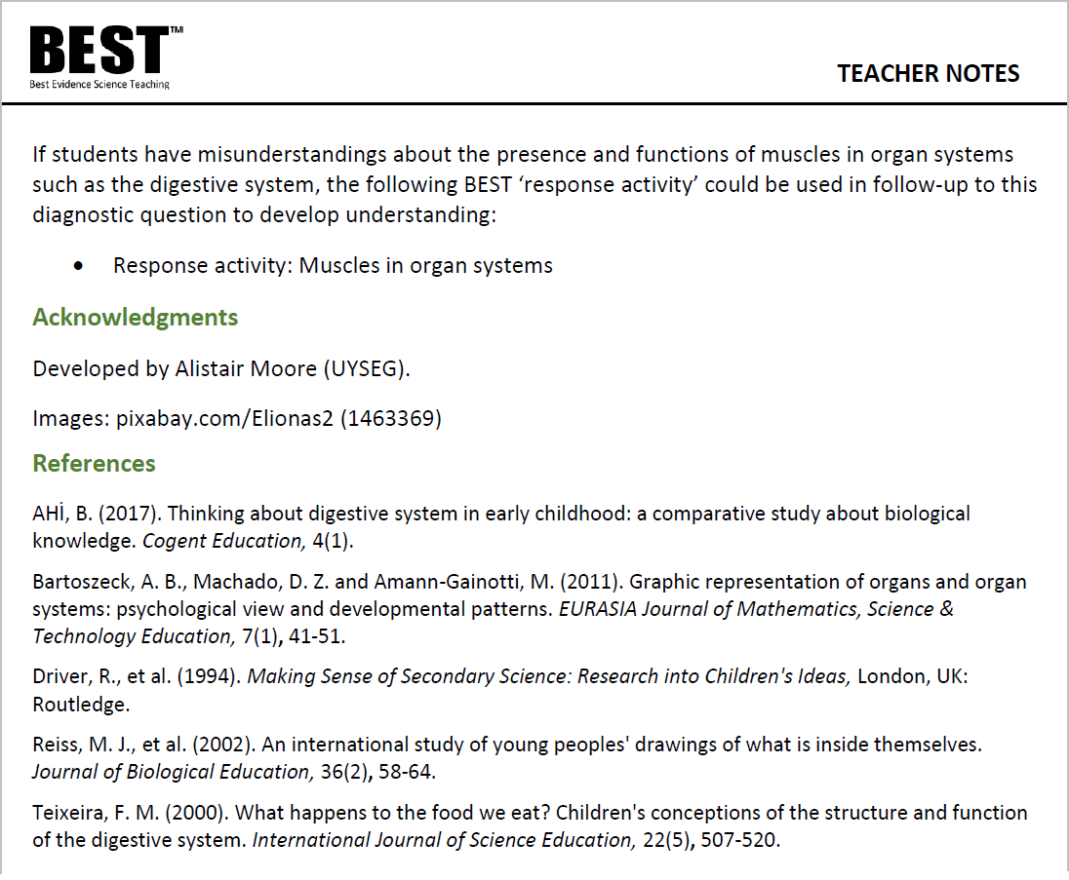

Evidence-informed practice
Teacher notes summarise the research evidence underpinning each resource.
This provides bitesize CPD to help you develop your
evidence-informed practices.
Notes:
Every one of the Best Evidence Science Teaching resources is provided with teacher notes that include a section called “What does the research say?”. That section provides a short summary of the underpinning research and useful teaching approaches. It’s usually just a couple of paragraphs, so it’s quick and easy to read – but gives a teacher insight into some research that they might not otherwise have seen. We also provide a references list for anybody who wishes to read further.
From trials in schools, we have evidence that these research notes can function as bitesize episodes of self-directed professional development, which can lead to small but impactful changes in classroom practices. A paper describing our findings was published in the December 2020 issue of School Science Review*. Free access to the paper is available at:
https://www.ase.org.uk/system/files/SSR_December_2020_055-063_Atkinson.pdf
* Atkinson, L., Dunlop, L., Bennett, J., Fairhurst, P. and Moore, A. (2020) Best Evidence Science Teaching: research evidence in action. School Science Review, 102 (379), 55-63.

Slide 20
Moving through the digestive system
Food we swallow moves through the digestive system.
What is the main thing that causes food to move through the digestive system?
A
Gravity
Editable
resources
B
Contraction of muscles in the digestive system
C
Vibrations from body movements such as walking
D
Swallowing more food pushes it along
Notes:
The answer options in the diagnostic question have been chosen carefully to reflect the common misunderstandings that have been reported in the research literature.
All of the resources are provided in editable formats (Word and PowerPoint), so teachers can tweak the wording to suit their students, and can copy and paste the slides into their own lesson presentations.
Teachers could use various approaches to collect students’ responses to the question, e.g. a show of hands, answers on mini-whiteboards, electronic voting mechanisms (e.g. Plickers app), ask individual students to respond, or even a pen and paper task. The approach they decide to use depends on what they think will provide the most useful information about what their students are thinking.
This is not an exam question – we’re not necessarily simply looking for students to pick the one expected answer. The pattern of responses in a class provides a picture of the landscape of understanding and misconceptions in the room. Students may want to pick more than one answer – they may rightly think that gravity and other body movements will have some effect on the movement of food through parts of the digestive system – and it’s useful to know if this is what students are thinking.
Similarly, teachers can decide when to use this diagnostic question, e.g. at the start of a lesson to check students’ prior understanding, or part-way through a lesson to check whether the class is ready to move on, or at the end of a lesson to find out what the students have understood, to help the teacher plan for the next lesson. Techers should use the question at a time that provides them with useful information about what their students understand, to help them plan more effectively what to do next and how to deal with misunderstandings before moving on.
For instance, the question could be used as the basis for a discussion with students; e.g. why did they pick the answers they did? What do they think are the relative contributions of these factors in moving food through the digestive system? What would their answer be if the question was asked about a person who was lying down, or was motionless because they are asleep, or was an astronaut in space?
The diagnostic questions in Best Evidence Science Teaching are coupled with ‘response activities’ to help teachers respond effectively. When the evidence provided by a diagnostic question is used to decide what happens next, it becomes truly formative. The “E” in Best Evidence Science Teaching works in two ways – we’re using research evidence to develop the resources, and they provide you with the evidence you need about your students’ knowledge and understanding to help them make progress.

Slide 21
diagnostic questions
Notes:
There are some common formats of diagnostic questions that we have used – not exclusively – but repeatedly throughout the Best Evidence Science Teaching resources, because they are powerfully diagnostic; that is, they provide very useful evidence about what students are thinking (what they understand, and what their misconceptions are), and why they are thinking it.
The following slides show examples of some of these useful formats of diagnostic questions.

Slide 22
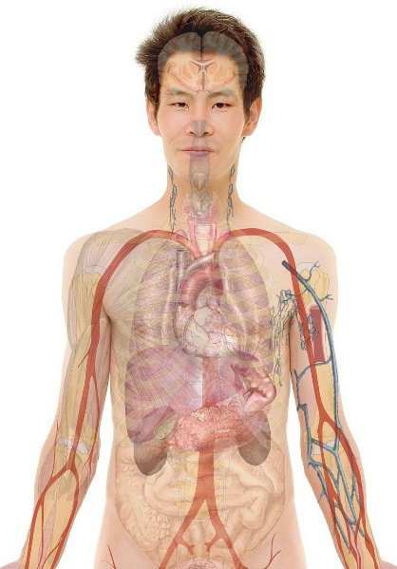
Body cells
Simple
multiple
choice
Which statement about the human body is true?
A
The body contains cells.
B
The body is a cell.
C
The body is made up of cells.
D
Cells are only found between the organs.
Notes:
Simple multiple choice
The answer options can be presented as words, numbers, pictures, graphs, equations... etc.
This type of diagnostic question provides a quick way to gather evidence of learning. It could be completed individually, in small groups to encourage discussion, or with a whole class using a voting system. Students could vote on the answer options using a show of hands, mini whiteboards, apps (e.g. Plickers), and so on.
The ‘distractors’ (the incorrect options) are developed from research on common misunderstandings, to reveal whether students hold these ideas. They are not obviously wrong to a student who holds these misconceptions; the question is more powerfully diagnostic (and testing) because the distractors are strong (i.e. tempting).

Slide 23
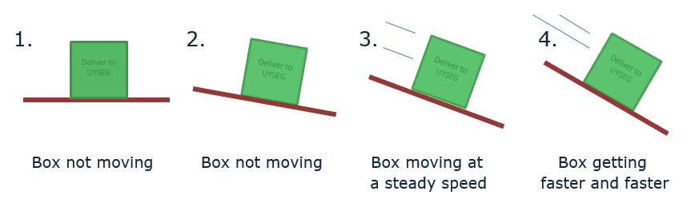
No friction
Two-tier
multiple
choice
1. Which boxes have no friction?
2. Why do you think this?
Intro
Intro
A
They all have friction
A
There is no force pushing sideways
B
Box 1 has no friction
B
The surfaces are a little bit rough
C
Boxes 1 and 2 have no friction
C
There is movement
D
Boxes 3 and 4 have no friction
D
There is no movement
E
Box 4 has no friction
E
There is no force to slow the movement
Notes:
Two-tier multiple choice
This format is commonly used in the science education research literature.
It provides more information about students’ thinking than a simple multiple choice question - it’s more powerfully diagnostic.
In the first tier, students must select what they think is the correct or best answer. In the second tier, students must select the correct or best explanation for the answer they chose in the first tier.

Slide 24
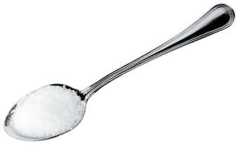
Sugar solution
Confidence
grid
A teaspoon of sugar is dissolved in a glass of water making a sugar solution.
Read the statements in the table.
What is your decision for each statement?
I am sure this is right
I think this is right
I think this is wrong
I am sure this is wrong
1
The solution includes sugar in the liquid state.
2
You cannot see sugar in the solution, so it is not there.
3
You could taste the sugar in the solution, if it were safe to do so.
4
The sugar has reacted with the water.
Notes:
Confidence grid
This formation provides more information about students’ thinking than a simple multiple choice question - it’s more powerfully diagnostic.
Students must evaluate each statement in turn, rather than homing in on the correct answer. For each statement they must indicate their confidence in ruling-in or ruling-out the answer.

Slide 25

Respiration and breathing
Focused
cloze
Respiration is one of the processes carried out by living things.
Complete the sentences in the box.
You should only use respiration or breathing to fill each gap.
Moving air into and out of your lungs is called ………………………… .
Using food as fuel to provide energy is called ………………………… .
………………………… happens in all living things.
………………………… only happens in some living things.
………………………… does not happen in plants.
………………………… provides living things with oxygen for ………………………… .
Notes:
Focussed cloze
A particular type of ‘fill the gaps’ (cloze) activity, in which there are only two words from which the student can choose to fill the gaps.
The words provided to fill the gaps are a pair of words for which there is research evidence that they are commonly confused by students. Because there are lots of gaps but only two words, students really need to understand the difference between the two words to fill all the gaps correctly.

Slide 26
response activities
Notes:
There is a greater variety of formats of response activities in the Best Evidence Science Teaching collection, as many are based on particular activities reported in the research literature. But there are some common general formats of response activities that we have used because they promote meaning-making and social construction of understanding through small group discussion and metacognitive talk, or through purposeful practical work.
The following slides show examples of some of these useful formats of response activities.

Slide 27
What does C represent?
Small
group
discussion
Some children talk about the C in CO₂.
Alex
C is short for the element name carbon.
Arjun
C stands for the substance carbon.
Kyle
C makes me picture a lump of black coal.
Zara
C means one atom of carbon.
Poppy
C is the symbol for the element carbon.
To talk about in your group:
1 Who do you agree with?
2 Who do you disagree with, and why?
3 How would you explain the right ideas to these children?
Notes:
Small group discussion
Small group discussion activities facilitate metacognitive talk and dialogue. Students have to think critically about what they know and understand, and discussion encourages meaning-making through social construction of understanding.

Slide 28
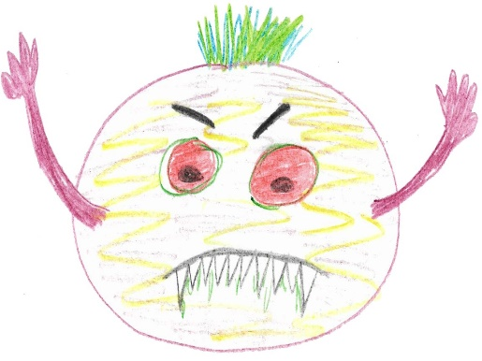
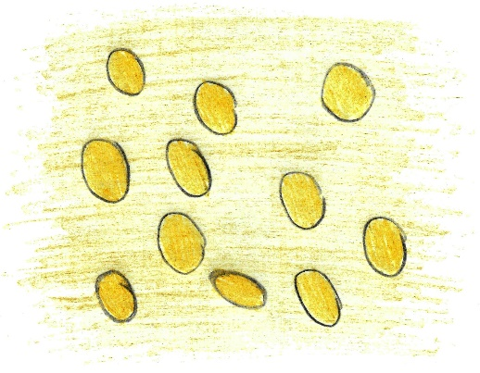
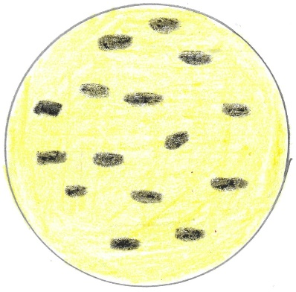
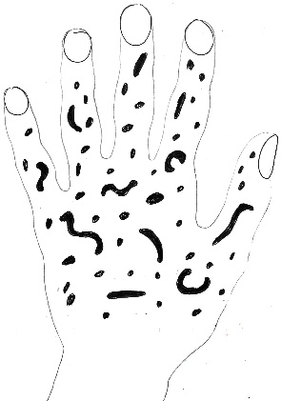
Cell drawings
Critiquing a representation
Some children were asked to draw what they think bacteria cells look like.
A
B
C
D
To talk about in your group:
1 Which is the best drawing of bacteria cells?
2 Why do you think it’s the best?
3 What is wrong with the other three drawings?
Notes:
This is another group discussion activity, this time focussed on critiquing a representation.
Listening in to the conversations of each group will give you insights into what your students are thinking. And careful selection of groups can be helpful: ensure a mix of abilities, and perhaps ask the most confident person to ask as a scribe: tell them they’re not allowed to suggest ideas, but have to write down the main points of the discussion and can ask questions for the rest of the people in the group to answer.

Slide 29
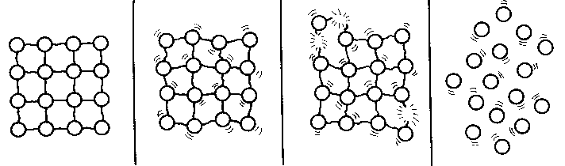
Particle model - melting
Critiquing a model
The diagram is from a textbook.
It shows the particle model of a substance in the solid state melting so that the sample is in the liquid state.
To talk about in your group
State three ways in which you think the diagram is a good representation of a substance melting.
State three ways in which you think the diagram is not an accurate representation of a substance melting.
Notes:
This is another group discussion activity, this time focussed on critiquing a scientific model. This is a way of making scientific models explicit, and to get students to think critically about the uses and limitations of models.
The model is presented in this kind of activity without any indication of whether it’s a good or bad model; students have to talk about what the parts of the model represent, the uses and limitations of the model, and decide for themselves how useful it is.

Slide 30
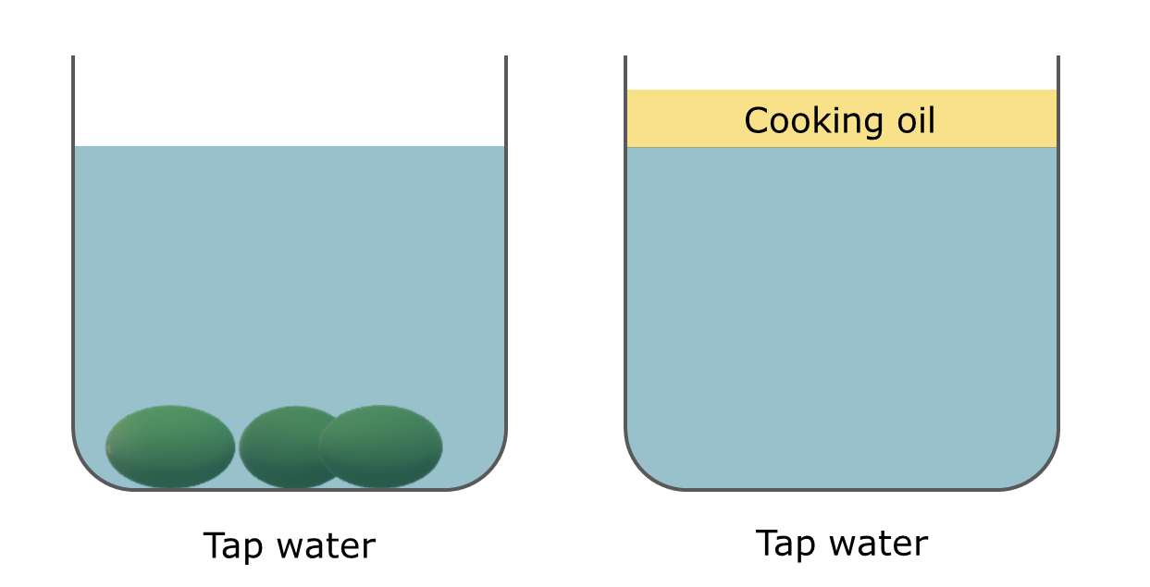
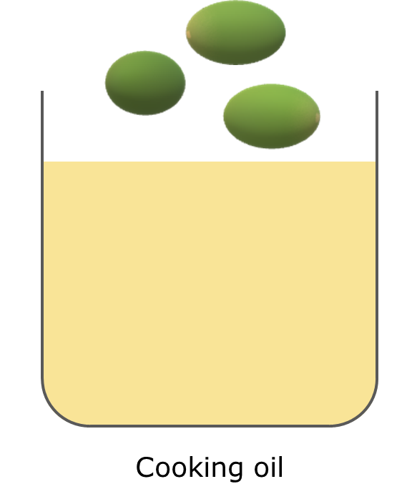
Grape expectations
PEOE
Grapes sink in tap water.
Cooking oil floats on tap water.
Predict
What will happen when grapes are put into cooking oil?
Explain
Explain why you think this will happen.
Watch the demonstration
Observe
Describe what you see.
?
Explain
Were your prediction and explanation correct?
Try to improve your first explanation to explain what happens more clearly.
Notes:
Purposeful practical work
An example of purposeful practical work, in the form of a predict-explain-observe-explain (PEOE) activity. This allows students to apply what they know to make a prediction, challenges their thinking about a phenomenon, and encourages them to build explanations for what they have predicted and what they observe.
The practical work can be very simple, but is powerful because it is used purposefully to develop students’ scientific understanding as part of a learning progression (in this case, a learning progression on density and buoyancy).

Slide 31
The
team

Slide 32

Funding and publication
The Salters’ Institute has been proud to fully fund the BEST project since it began in 2016.
The Institute of Physics is now a co-funder of BEST, having supported the project since 2021.
We are providing FREE online access to the BEST resources in collaboration with STEM Learning.
Notes:
The Salters’ Institute has been proud to fully fund the BEST project since it began in 2016. The Salters’ Institute was founded in 1918, and plays a major role in the support of science teaching and the encouragement of young people to pursue careers in science. The partnership between the Salters’ Institute and UYSEG has endured for over 35 years, and has included some ground-breaking curriculum development projects: the Salters’ A level courses pioneered context-led teaching of science at age 16-18, and Twenty First Century Science led the way in developing students’ scientific literacy at age 14-16. Best Evidence Science Teaching (BEST) is the latest body of work to result from this valuable and productive partnership.
The Institute of Physics is now a co-funder of BEST, having supported the project since 2021.
We are providing free online access to the resources in collaboration with STEM Learning to support science teaching.

Slide 33






Research and development
Department of Education
Project
Director
Biology
Lead
Chemistry
Lead
Physics
Lead
Professor
Judith Bennett
Alistair
Moore
Helen
Harden
Peter
Fairhurst
Notes:
The BEST resources are developed by the University of York Science Education Group (UYSEG), a team of science education researchers and curriculum developers based at the University of York, UK. Since 1983 the group has been engaged in research-informed curriculum development, which means taking the best research evidence we can find and transforming it into resources for science teachers to use in the classroom.
The University of York Science Education Group is part of the Department of Education at York.
The Project Director is Professor Judith Bennett; the project was her brainchild, so without her vision and her persistence Best Evidence Science Teaching would never have existed. The core members of the Best Evidence Science Teaching development team are Alistair Moore (who leads the development of the biology resources), Helen harden (who leads chemistry and Earth science), and Peter Fairhurst (who leads physics). Additional physics development and evaluation work has been undertaken by Simon Carson, and additional biology development work has been undertaken by Elizabeth Lupton. We must also acknowledge and thank two former members of the University of York Science Education Group: Mary Whitehouse, who did a lot of development work on Best Evidence Science Teaching in its early stages, and Professor Robin Millar, whose many years of research into teaching science and diagnostic questions in particular, through projects such as EPSE and York Science, provided foundations upon which Best Evidence Science Teaching was built.

Slide 34
@BestEvSciTeach
www.BestEvidenceScienceTeaching.org
Notes:
Download all resources for FREE from: www.BestEvidenceScienceTeaching.org
Follow @BestEvSciTeach on Twitter for updates on the publication of new topics.

