Slide 1
Fluency in Oral Interaction Workshop
(FLOW)
Zoe Handley, Department of Education, University of York
zoe.handley@york.ac.uk

Slide 2
Programme
Time | Location
10:00 – 12:00 | B/R/012 | Exploring oral fluency using PRAAT (Zoe Handley, Stewart Cooper, Ann-Marie Hunter)
12:30 – 2:00 | Various | Lunch
2:00 – 3:00 | D/L/104 | Challenges in measuring and assessing second language oral frequency (Parvaneh Tavakoli)
3:00 – 3:30 | D/L/104 | Broadening the context for analysing fluency - time and task effects on Mandarin in fluency development during Study Abroad (Clare Wright)
3:30 – 4:45 | Norman Rea Gallery | Coffee and posters
4:45 – 5:15 | D/L/104 | Investigating fluency across multiple languages and tasks (Amanda Huensch)
5:15 – 5:45 | D/L/104 | What is oral fluency? (Zoe Handley)
5:45 – 6:00 | D/L/104 | Summing up

Slide 3
Exploring Oral Fluency Using PRAAT
Zoe Handley, Department of Education, University of York
Stewart Cooper, Department of Education, University of York
Ann-Marie Hunter, St Mary’s University, London

Slide 4
Plan
What is oral fluency?
  Definitions and common measures
What is PRAAT?
  An overview and where to download the software
Measuring fluency using PRAAT
  Automatically coding for fluency
  Hand coding for fluency
  Scripting to extract measures

Slide 5
What is oral fluency?
Broad sense:
  “the highest point on a scale that measures spoken command of a foreign language”
  “oral proficiency”
Narrow sense:
  “speak[s] correctly by not very fluently”
  “native-like rapidity”, “flowingly”
  (Lennon, 1990, p. 389 - 390)
Fluency in the narrow sense
  Perceived fluency: “the inferences listeners make about … cognitive fluency based on their perceptions of utterance fluency”
  Utterance fluency: “the features of utterances that reflect cognitive fluency”
  Cognitive fluency: “efficiency of the operation of the underlying processes”
  (Segalowitz, 2010, p. 165)

Slide 6
Common measures of oral fluency
Type | Measure
Holistic | Pruned speech rate
Speed fluency | Speech rate Articulation rate
Breakdown fluency | Pauses per minute Mean length of pauses Mean length of run Phonation-time-ratio
Repair fluency | Dysfluencies per minute Corrections per minute Repetitions per minute
Measure duration of
Speech
Pauses
AND
Count
Syllables
Pauses
(Kormos & Dènes, 2004; Segalowitz, 2010)

Slide 7
What is PRAAT?
PRAAT is a free computer software package for the scientific analysis of speech in phonetics
PRAAT can also be used to generate synthetic speech, and run perceptual experiments
For more information on the range of functionalities and to download PRAAT:
  http://www.fon.hum.uva.nl/praat/
Referencing PRAAT:
  See Boersma & Weenink (2013)

Slide 8
Measuring fluency using PRAAT
Overview
Automatically coding for fluency
Hand coding for fluency
Extracting fluency measures

Slide 9
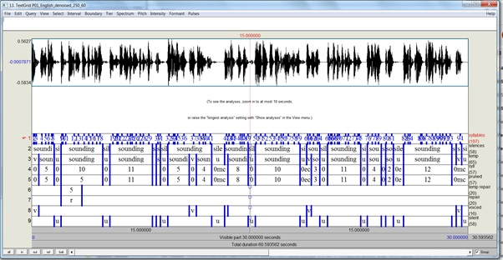
Our approach
Notes:
Explain why the various layers of coding are required
Explain why using automated coding and that have validated for own data
Explain why keeping temporary layers of coding

Slide 10
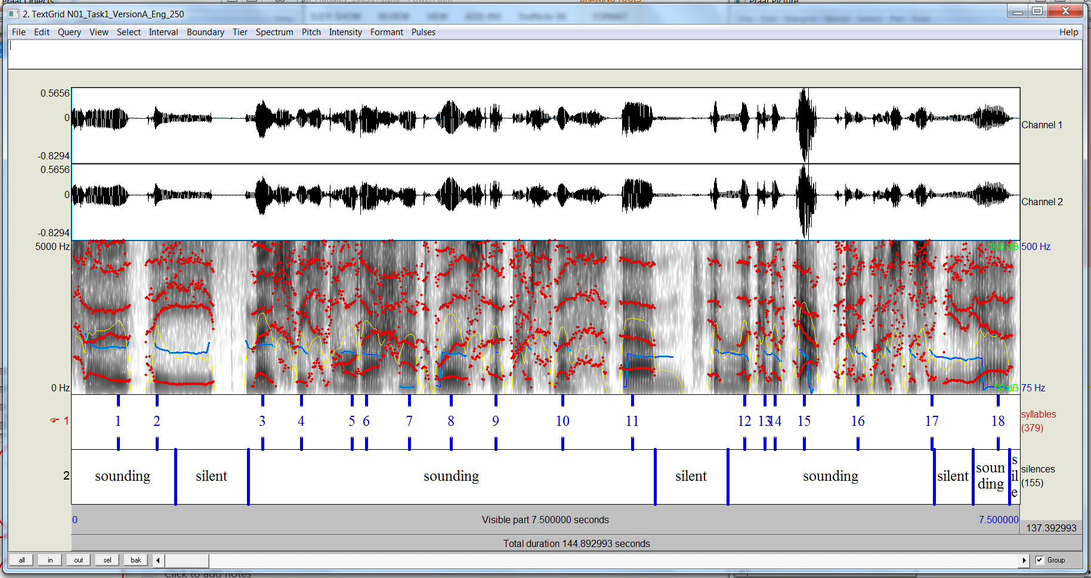
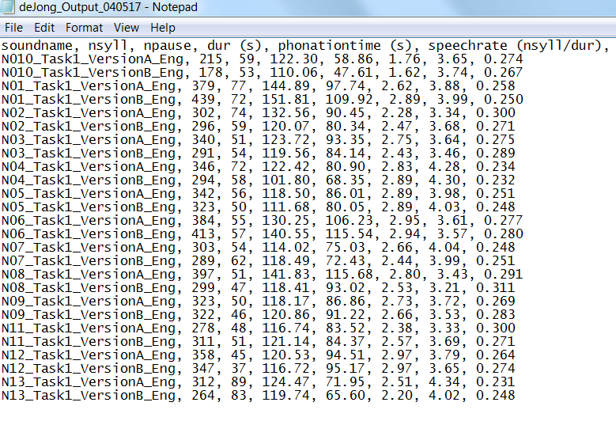
Automatically coding for fluency
De Jong & Wempe (2009)
  Script for calculating speech rate
  Involves detecting silent pauses and syllable nuclei
  Sets an intensity threshold for silence/speech
  Searches for syllable nuclei by looking for peaks in intensity – vowels have higher energy than surrounding sounds

Slide 11
Automatically coding for fluency
Download the script
  https://sites.google.com/site/speechrate/
Instructions
  In PRAAT Objects:
    PRAAT / Open PRAAT Script / select script + Open
  In Script:
    Run / Run
  In Run Script:
    Set parameters
    Set directory for wav files
    OK
Example parameters
  Silence threshold: -20
  Minimum dip between peaks: 4
  Minimum pause duration: 0.25

Slide 12
Discussion
What are the strengths and limitations of automatic coding?

Slide 13
Hand coding for fluency

Slide 14
Hand coding for fluency
Focusing on speed and breakdown fluency
Identify voiced/filled pauses
Code pauses according to location
Code for number of syllables

Slide 15
Hand coding for fluency
Hints and tips
  A basic understanding of acoustic phonetics focusing on how to read waveforms and spectrograms is helpful.
  Recommended reading on acoustics phonetics:
    Ladefoged, P. (2006). A course in phonetics. London: Thomson.
    Ladefoged, P. (2003). Phonetic data analysis: An introduction to fieldwork and instrumental techniques. Oxford: Blackwell
    Ladefoged, P. (2012). Vowels and consonants. Malden, MA: Wiley-Blackwell.
  Some things I look for include … increases and decreases in intensity of the waveform, changes in formant patterns on the spectrogram …
  You, however, should always check your coding by ear

Slide 16
Extracting fluency measures
Write a PRAAT script to
  Calculate speed (speech rate and articulation rate) and breakdown fluency (pause rate and pause duration)
  Calculate duration of the sample, duration of silent pauses and total silence, and phonation time
  Count number of silent and filled pauses and total number of syllables
Approach to scripting
  In PRAAT objects:
    Open / Read from file … / select a text grid to analyse + Open
    PRAAT / New PRAAT script
  In untitled script:
    Write script
    Drawing on existing scripts (e.g. de Jong & Wempe, 2009)
    Clicking on buttons in PRAAT objects window to discover commands
    Checking commands against PRAAT documentation: http://www.fon.hum.uva.nl/praat/

Slide 17
Extracting fluency measures
Sample script
  Measures
    Speech rate, articulation rate, pause rate, and average pause duration
  Generates a comma delimited text file which can be imported to Excel
  Run
  In PRAAT Objects:
    Open / Read from file … / text grids to analyse + Open
    PRAAT / Open PRAAT Script / select script + Open
  In Script:
    Run / Run

Slide 18
References
Lennon (1990). Investigating fluency in EFL: A quantitative approach. Language Learning, 40, 387-412
Segalowitz (2010). Cognitive bases of second language fluency. London: Routledge.
Kormos, J. & Denés, M. (2004). Exploring measures and perceptions of fluency in the speech of second language learners. System, 32(2), 145-164
De Jong, N. H. & Wempe, T. (2009). Praat script to detect syllable nuclei and measure speech rate automatically. Behaviour Research Methods, 41(2), 385-390
Boersma, P. & Weenink, D. (2013): Praat: doing phonetics by computer [Computer program]. Version 5.3.51, retrieved 2 June 2013 from http://www.praat.org/

Slide 19
Thank you!

