Slide 1
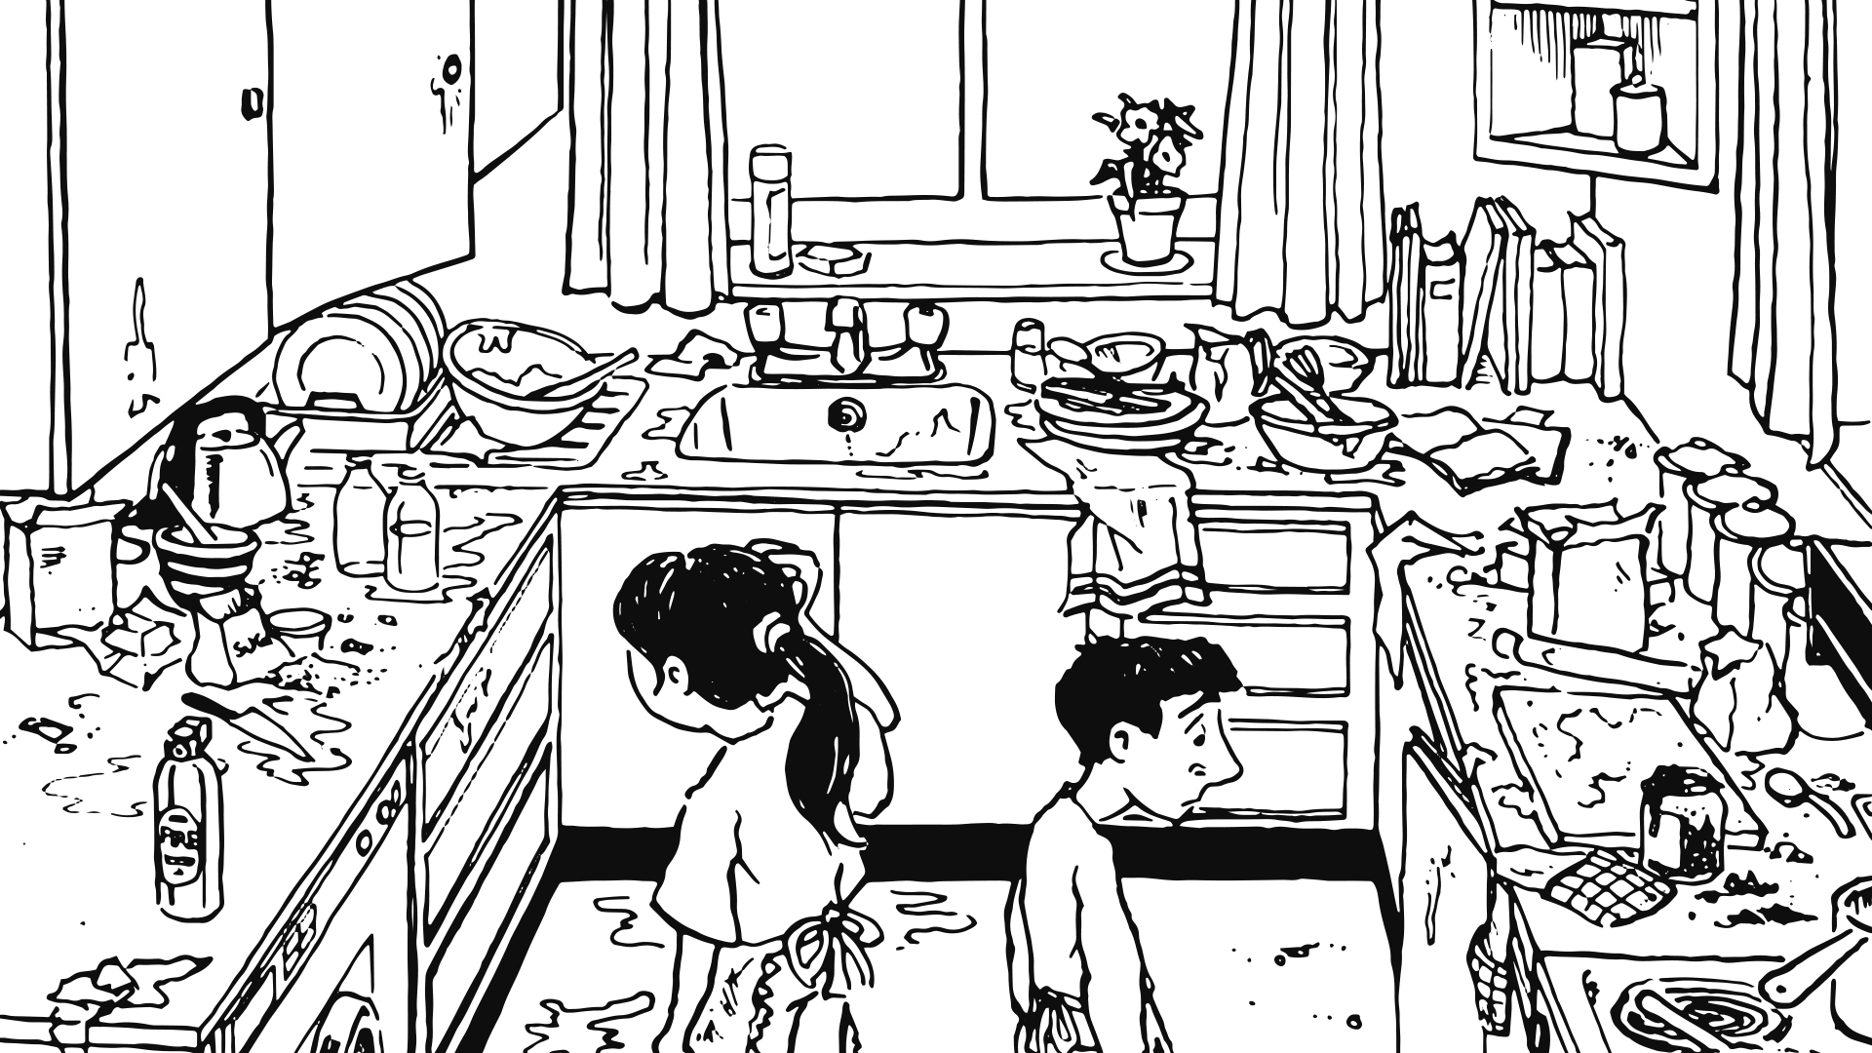
Kitchen Chaos
Written by Joy Parvin
Illustrated by Martin Cottam

Slide 2
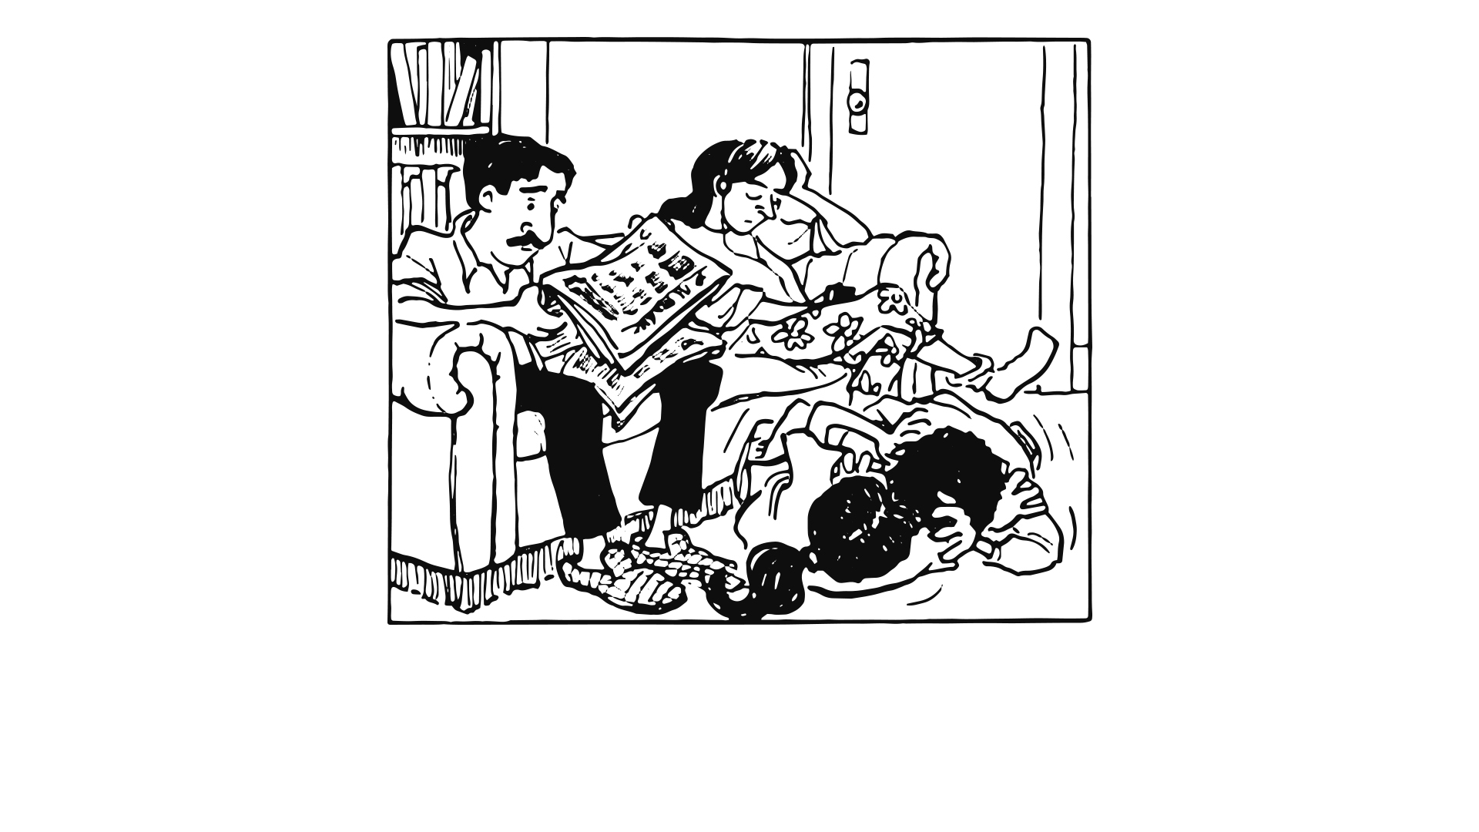
Callum and I were bored…

Slide 3
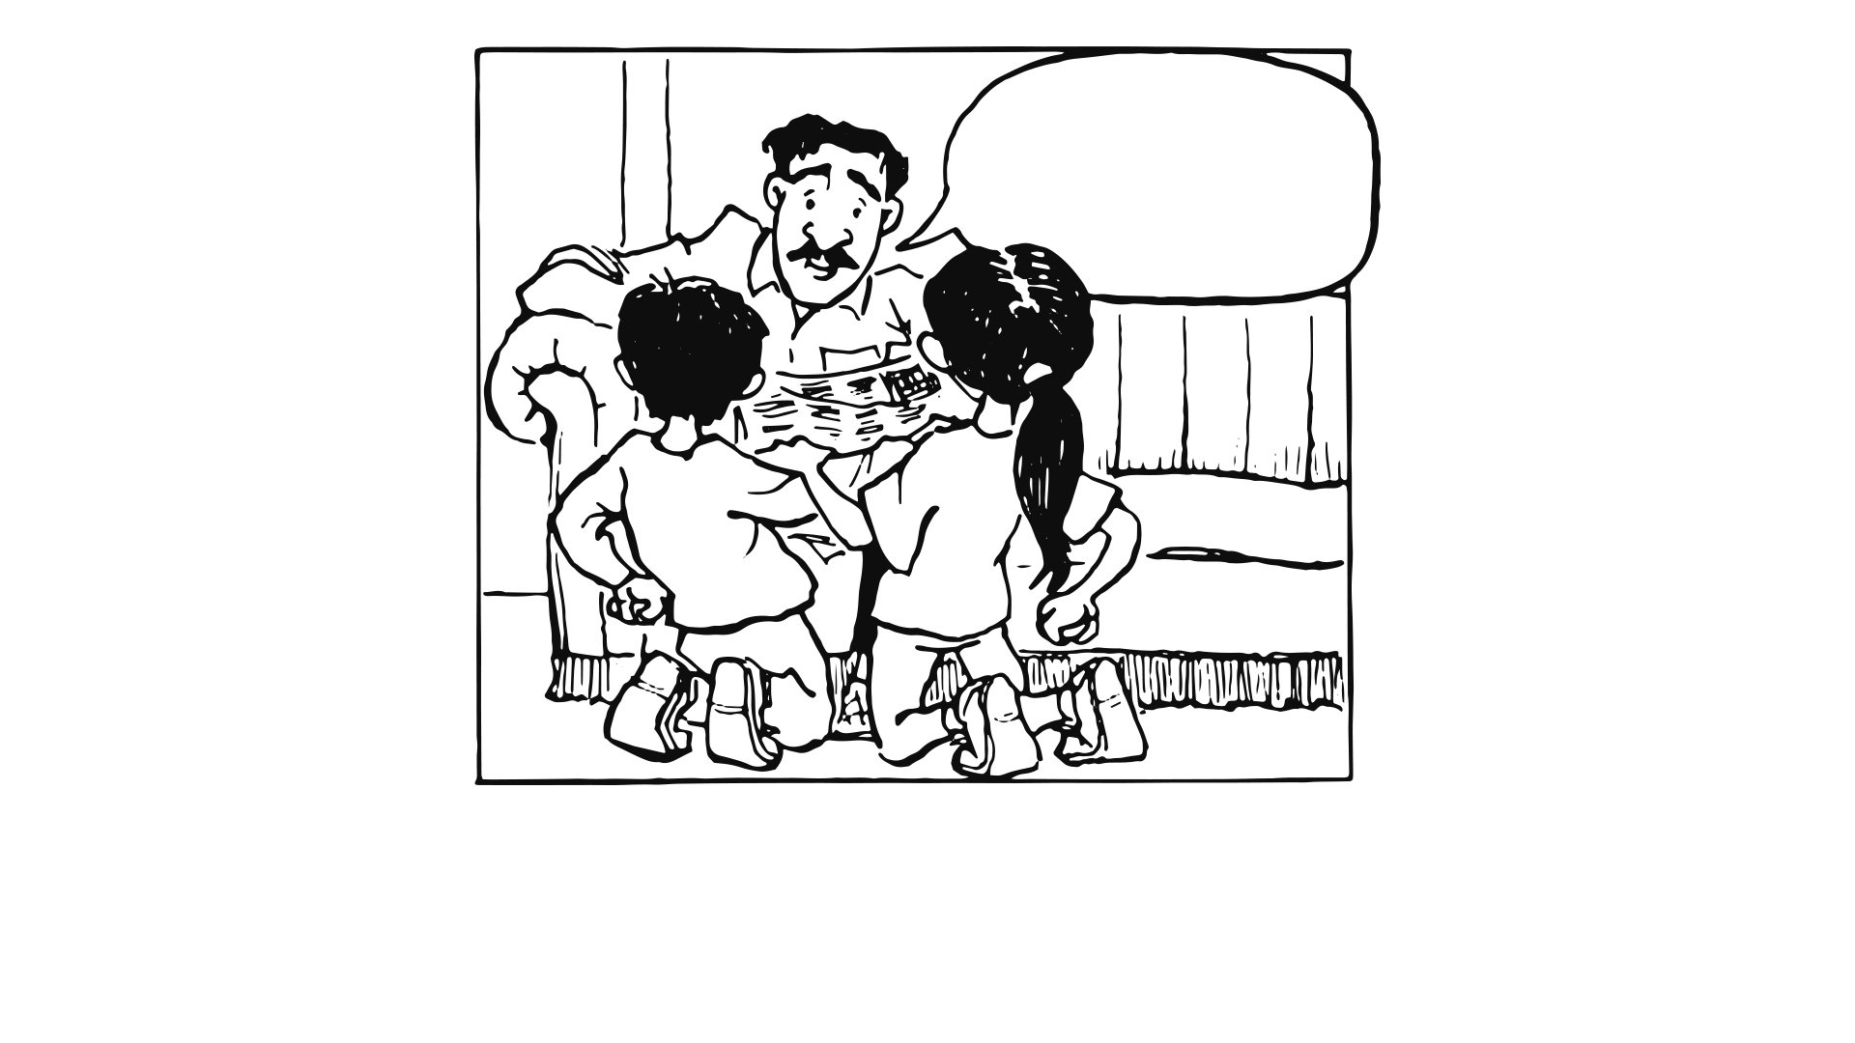
Let’s bake
some mince-pies
for mum
Okay kids!

Slide 4
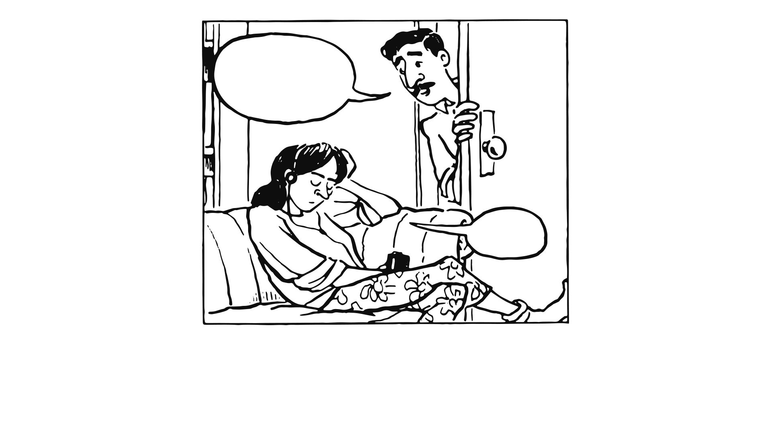
Do you want
to help Sam?
Uh?
Dad should have known that nothing would drag Sam from her music…

Slide 5
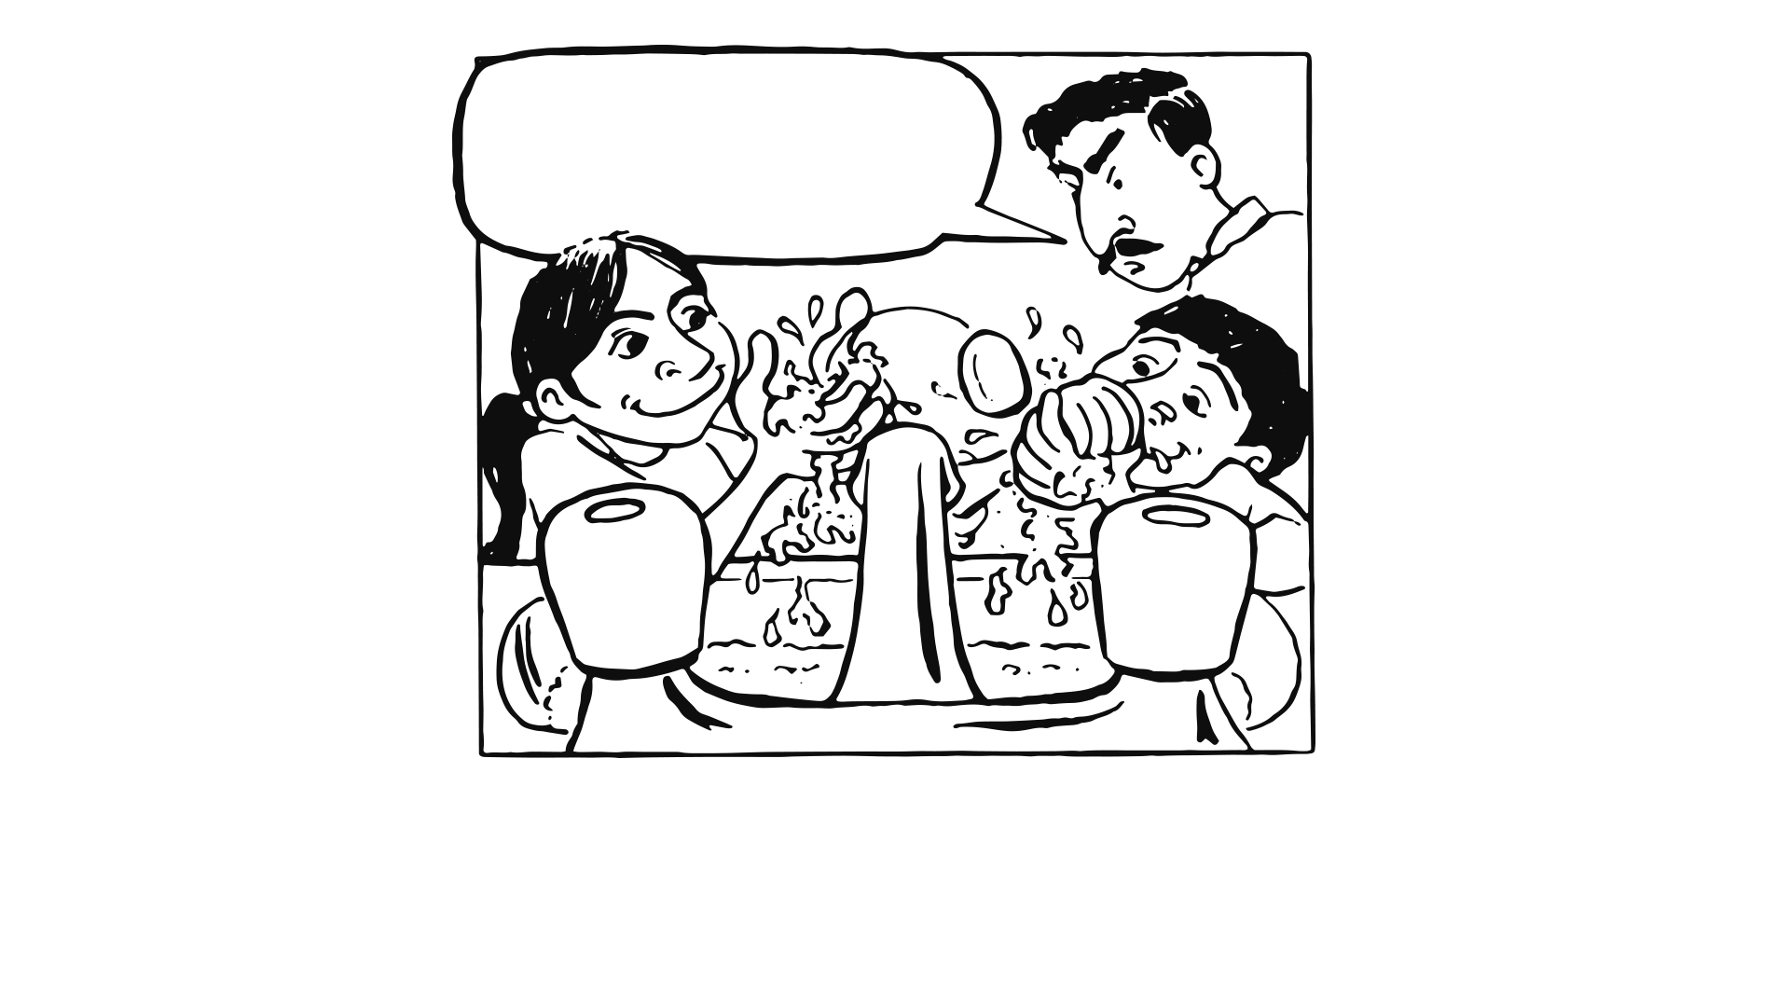
Dry your hands and come and look at the recipe.
Hey, stop it!
Dad let us get away with far more than mum did.
We thought this would be a great day.

Slide 6
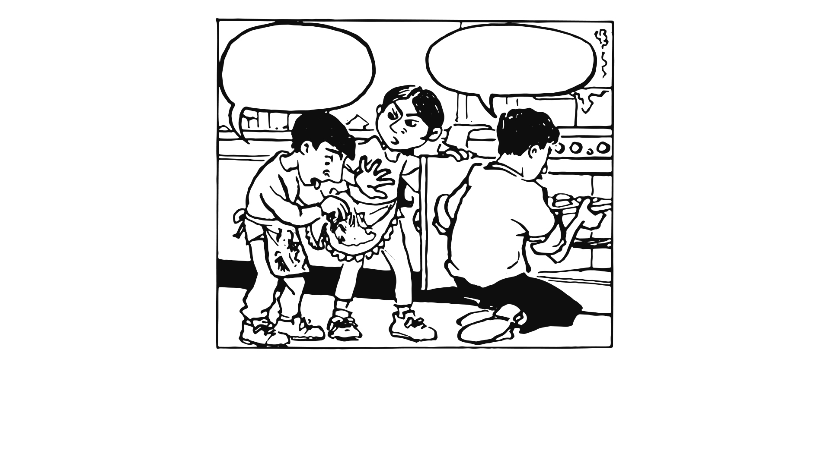
What’s in
that stuff dad?
Close the oven door behind me, Sita.
Yuck!!
It’s really sticky.

Slide 7
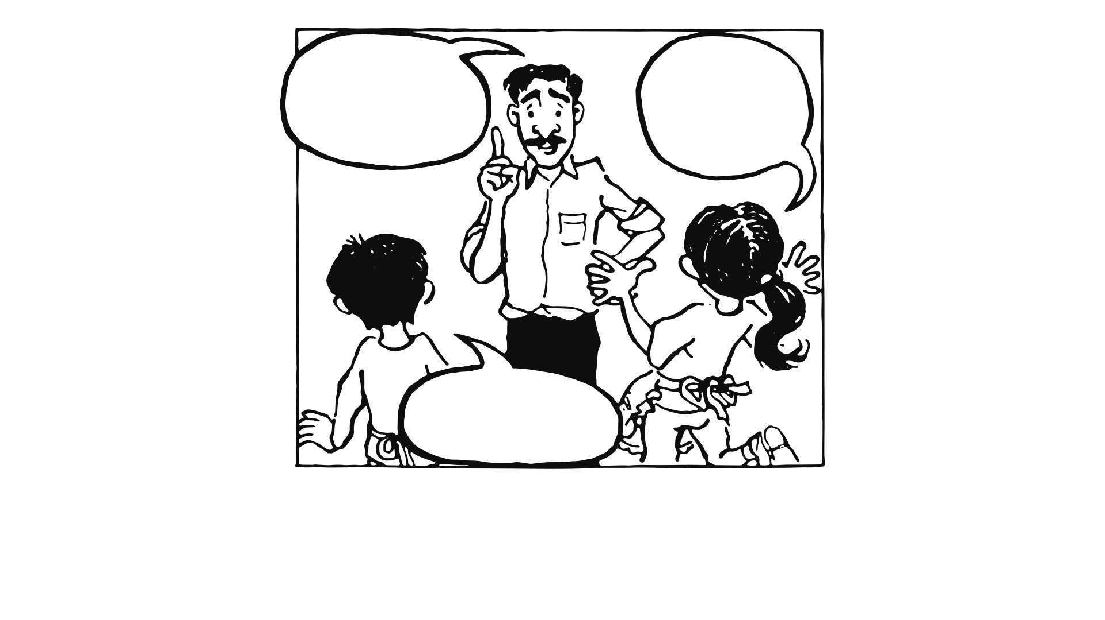
I’ll get some cream to go with the pies.
Get that squirty stuff, it’s ace!
I know!
Oooh!
No, get proper cream.
P L E A S E !

Slide 8
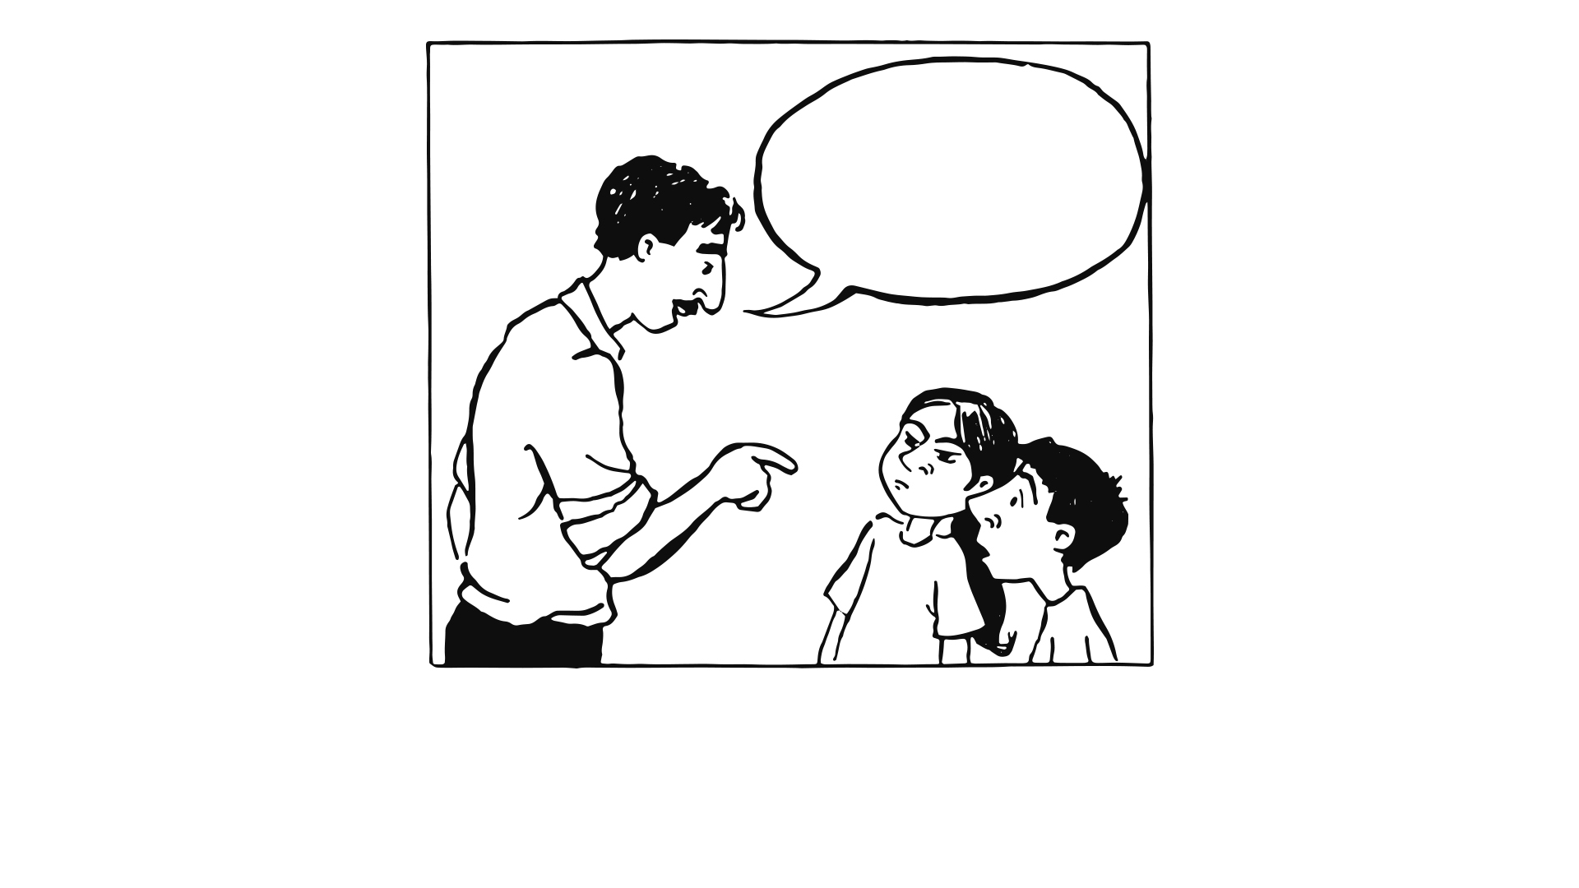
While I’m gone, start tidying up
There had to be a catch…

Slide 9
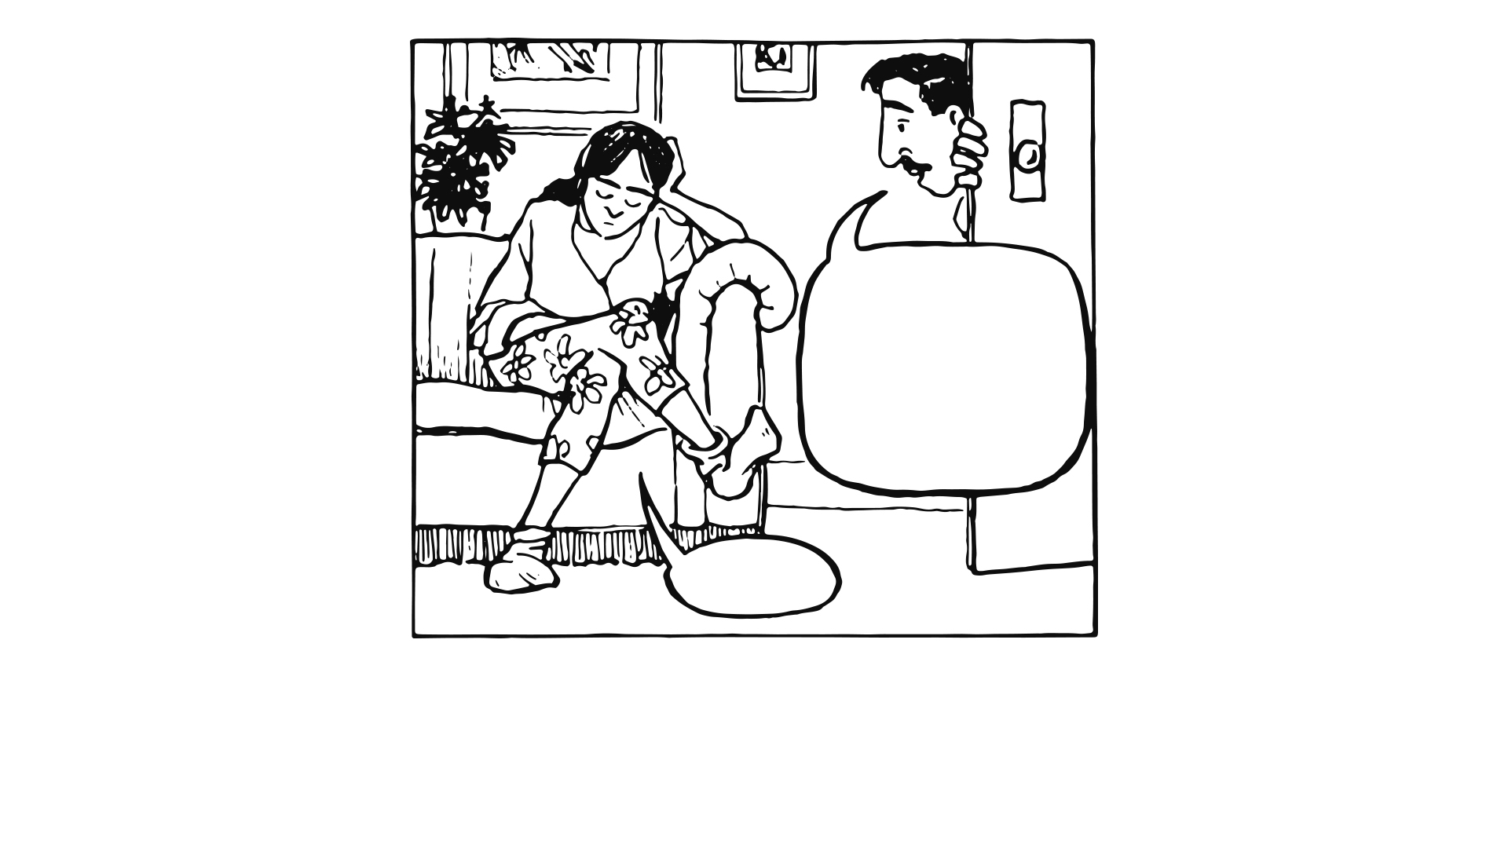
Sam, keep an eye on those two while
I’m out
Okay
At least Sam wouldn’t bother us, but…

Slide 10
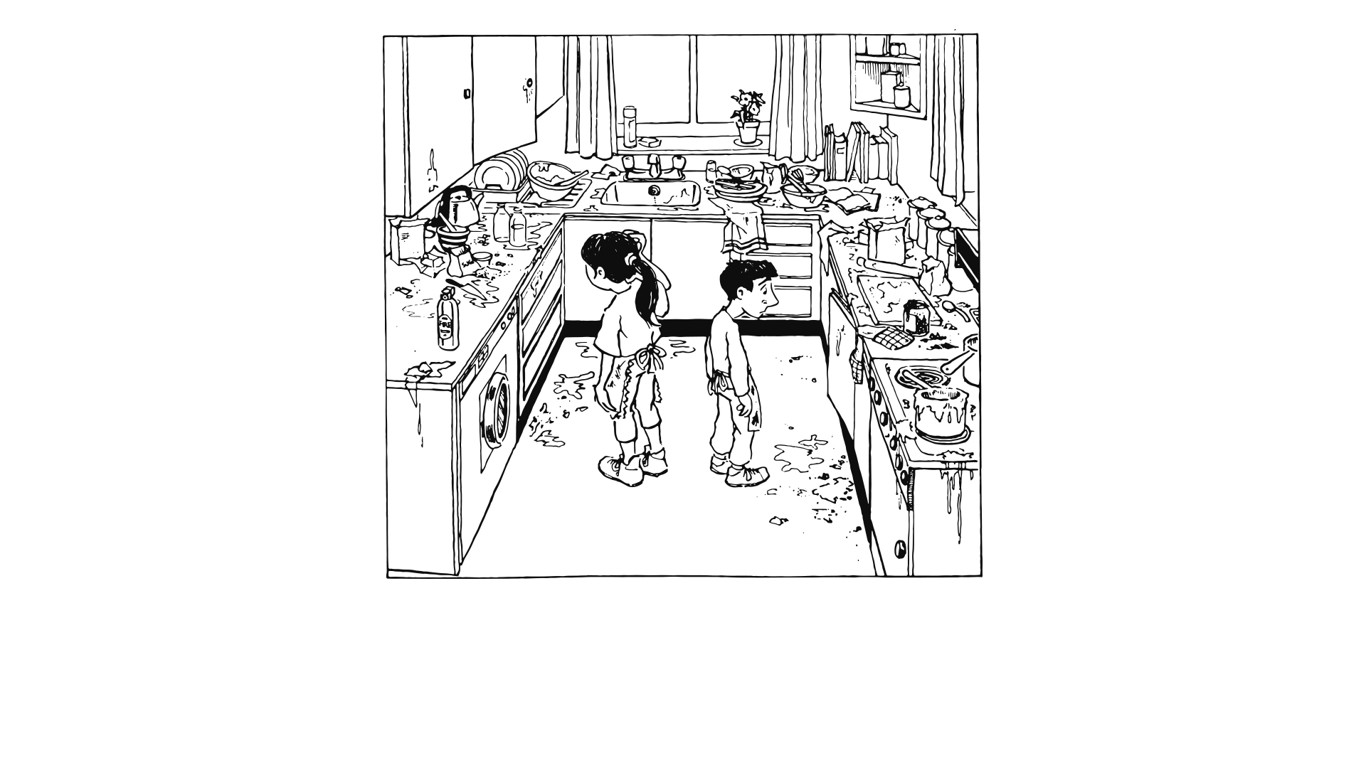
Where would we start?
The kitchen looked like a bomb had hit it.

Slide 11
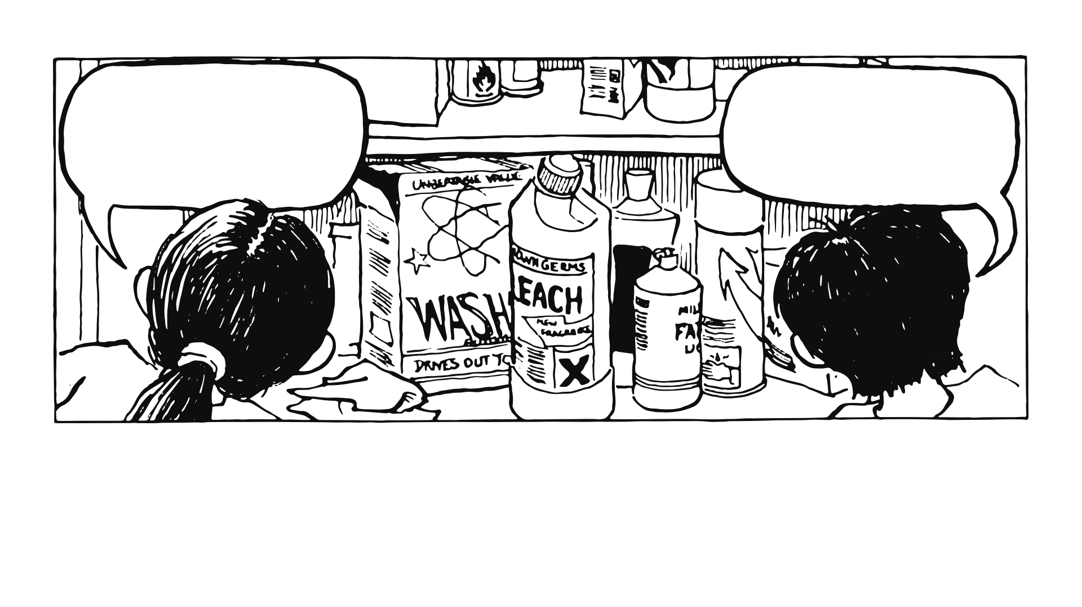
Why do we need so many cleaning things?
We can’t use any with these signs on.
They’re dangerous.
What should we use to clean what?
Washing the dishes was our safest bet, except…

Slide 12
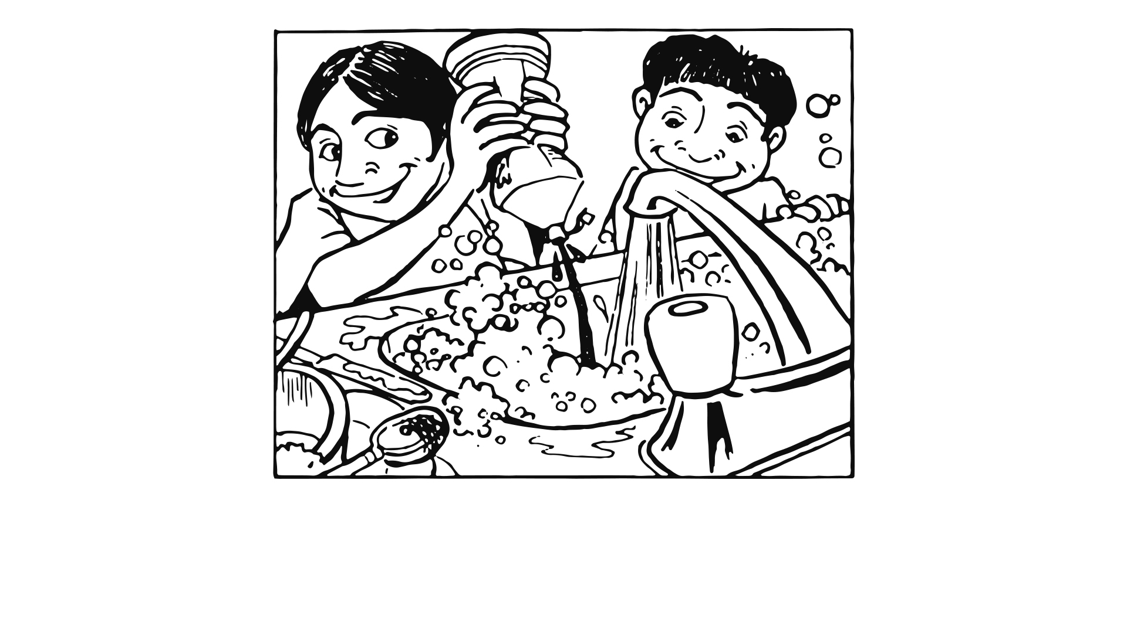
We got carried away squirting the bottle and…

Slide 13
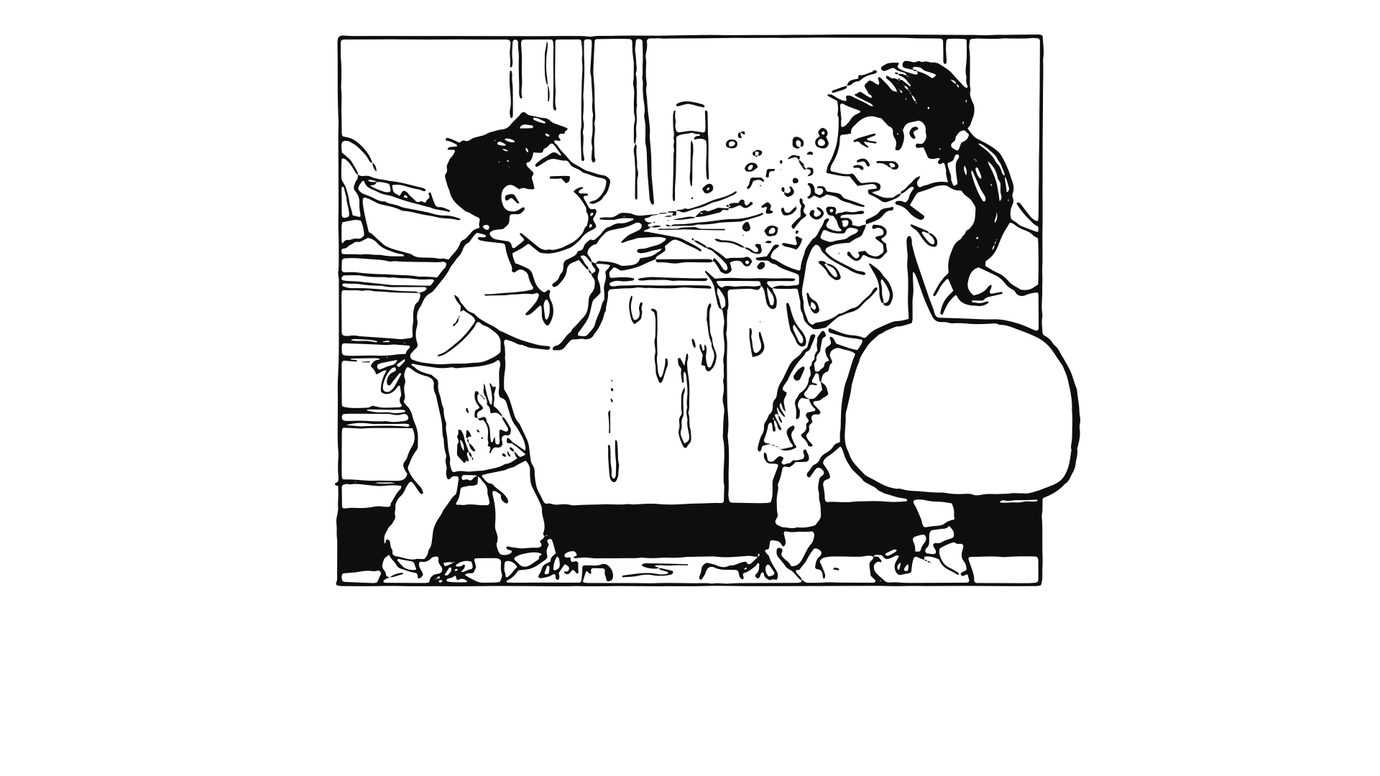
I’m
soaked!
I’m soaked
Aaaghh!!
Aaaghh!!
Stop it!!
Before we knew it there were soap suds everywhere!

Slide 14
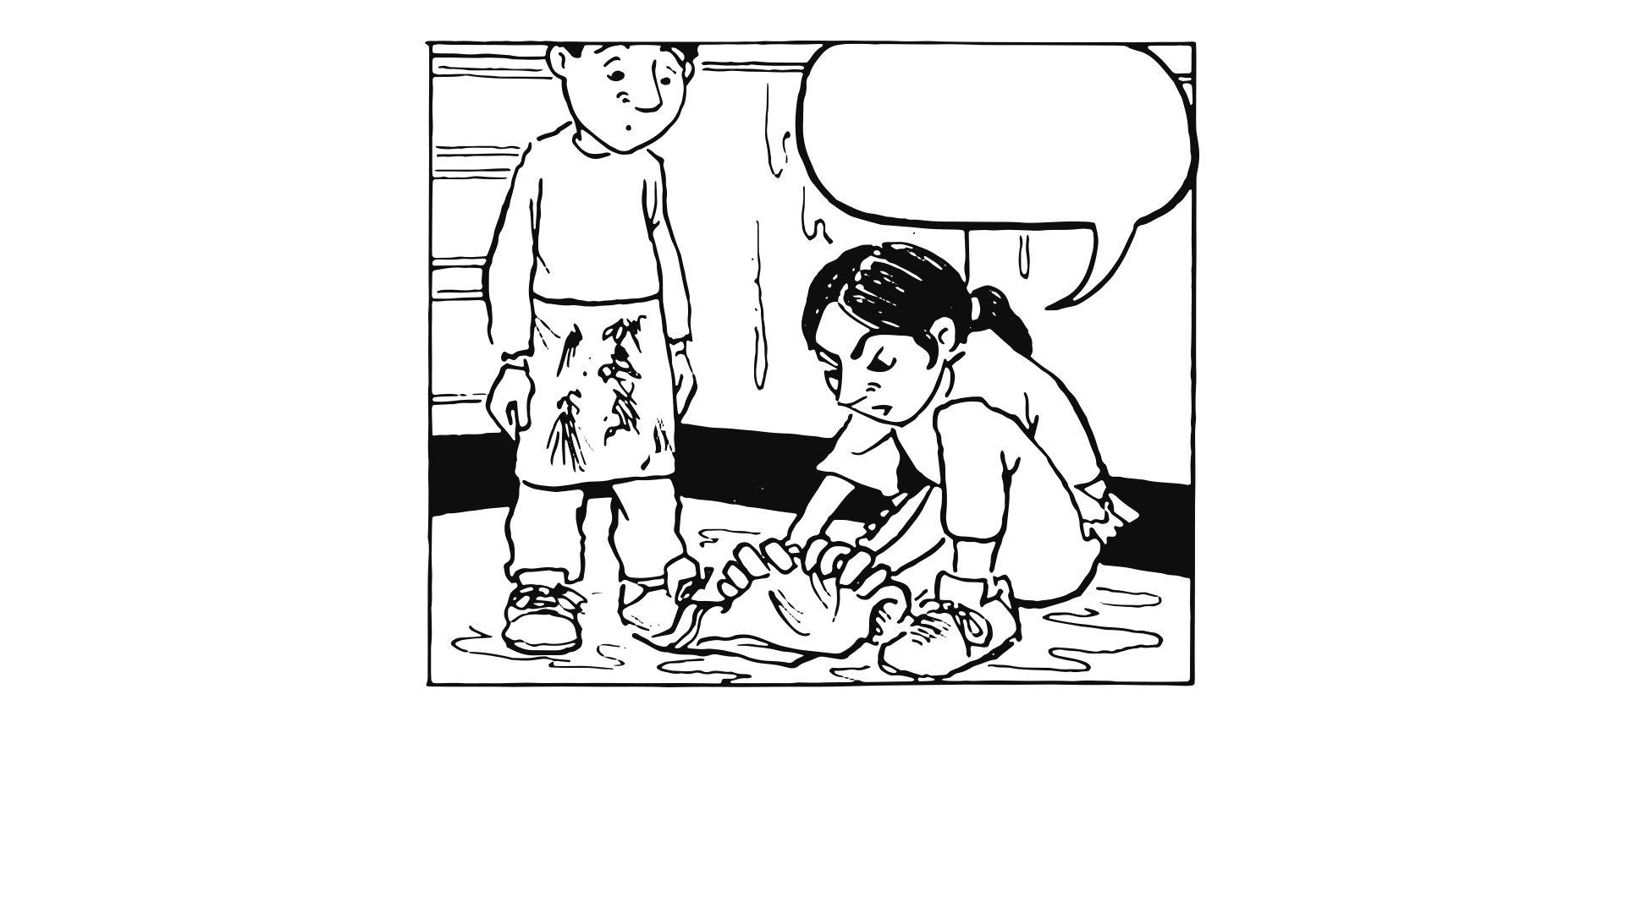
The floor’s soaked now, grab a cloth, quick!
I didn’t mean to use tea towels, I panicked!

Slide 15
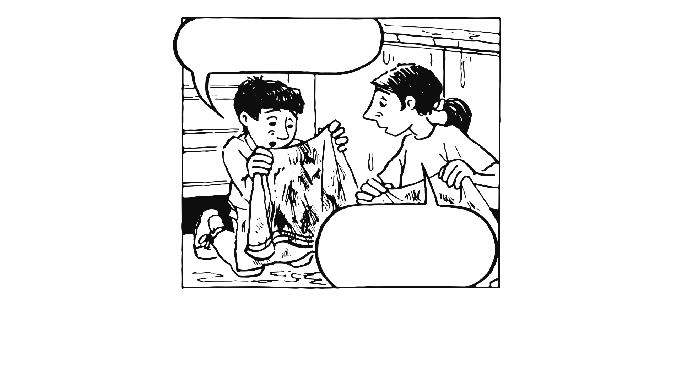
Look at the tea towels, they’re black!
Oh no, Sita!
We’d better put them in the washing machine
We could wash our aprons at the same time

Slide 16
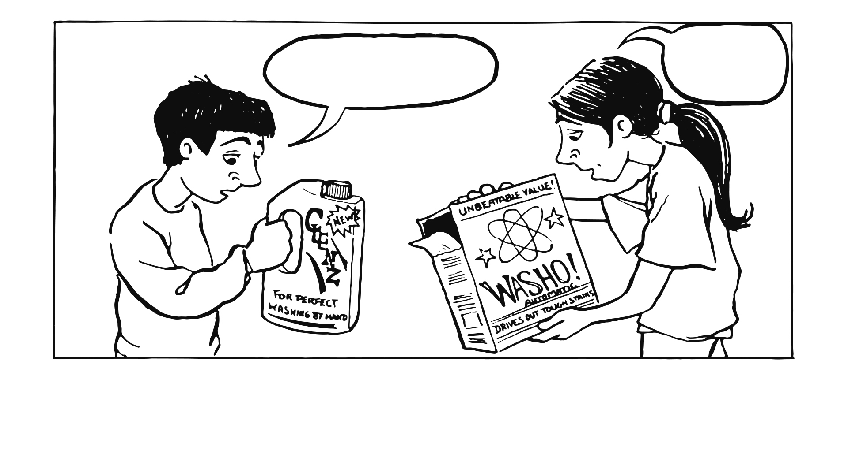
So does this one
This one cleans clothes
What should we use?
The writing on the bottles and the boxes said ‘the best’ – just like on the telly.
So we closed our eyes and picked one – “Clenz”.

Slide 17
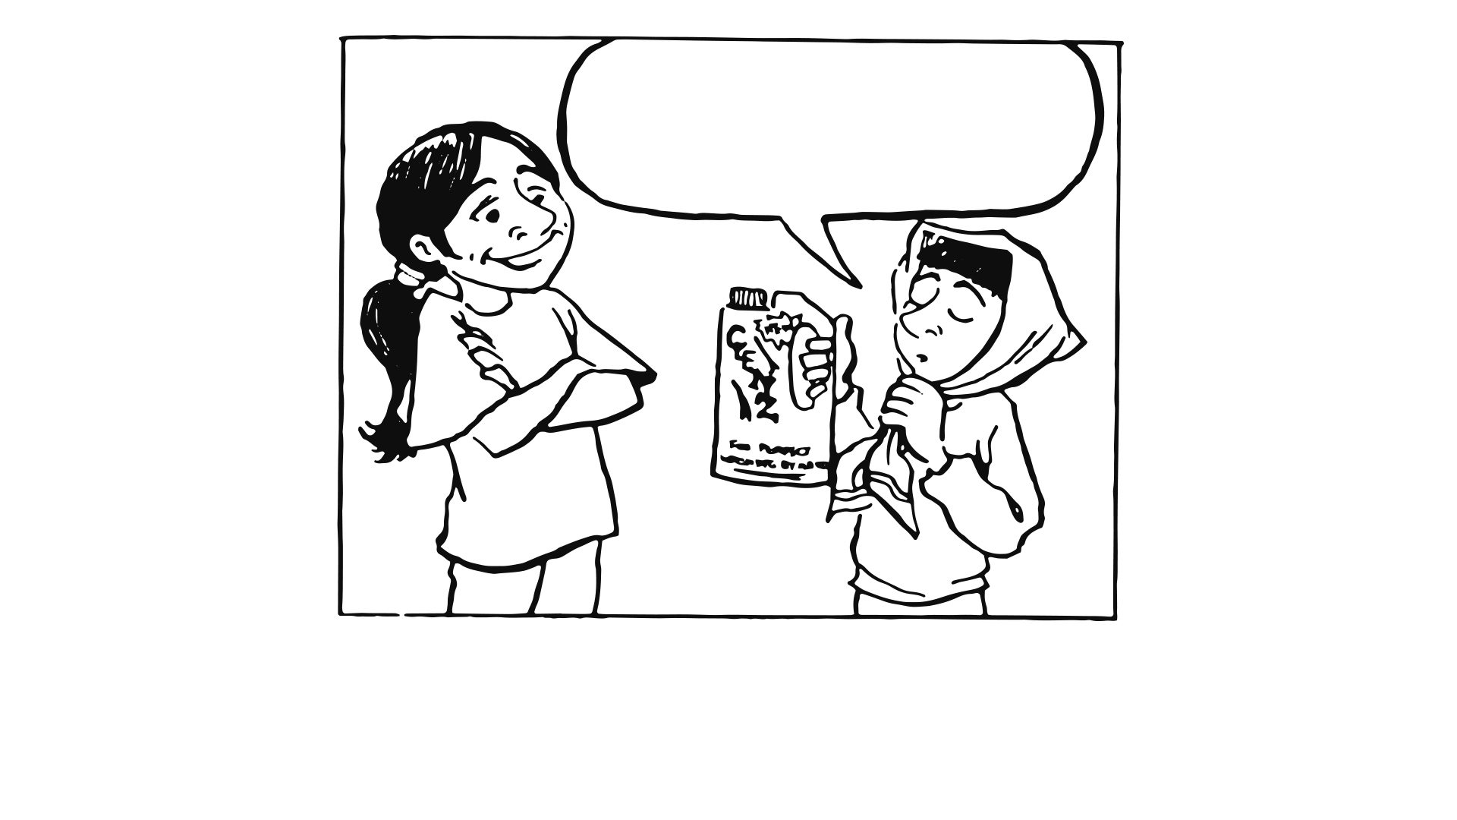
I put one of our Freddie’s shirts in Clenz and one in a leading brand of soap powder…
We’d seen the adverts, and Mum washed our jumpers with Clenz, so it must be okay

Slide 18
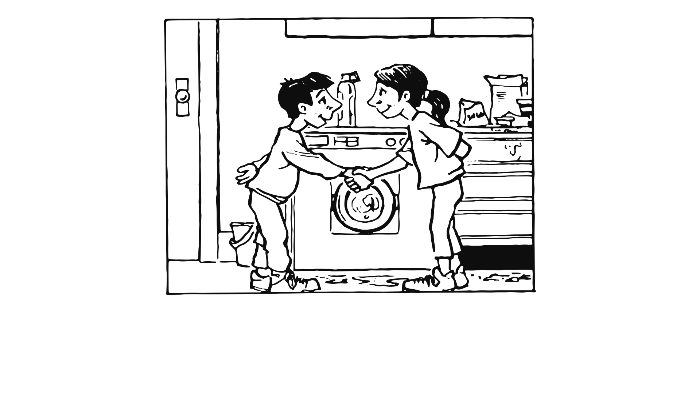
We were pretty pleased with ourselves, we hadn’t needed Sam’s help once!

Slide 19
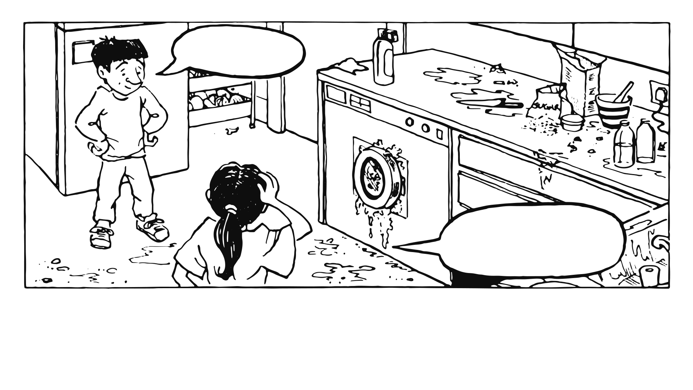
Gadzooks Batwoman!
We’ve no time for jokes Cal, look at this mess!
and the kitchen tops were still covered in flour…
The kitchen floor looked worse than when we started,

Slide 20
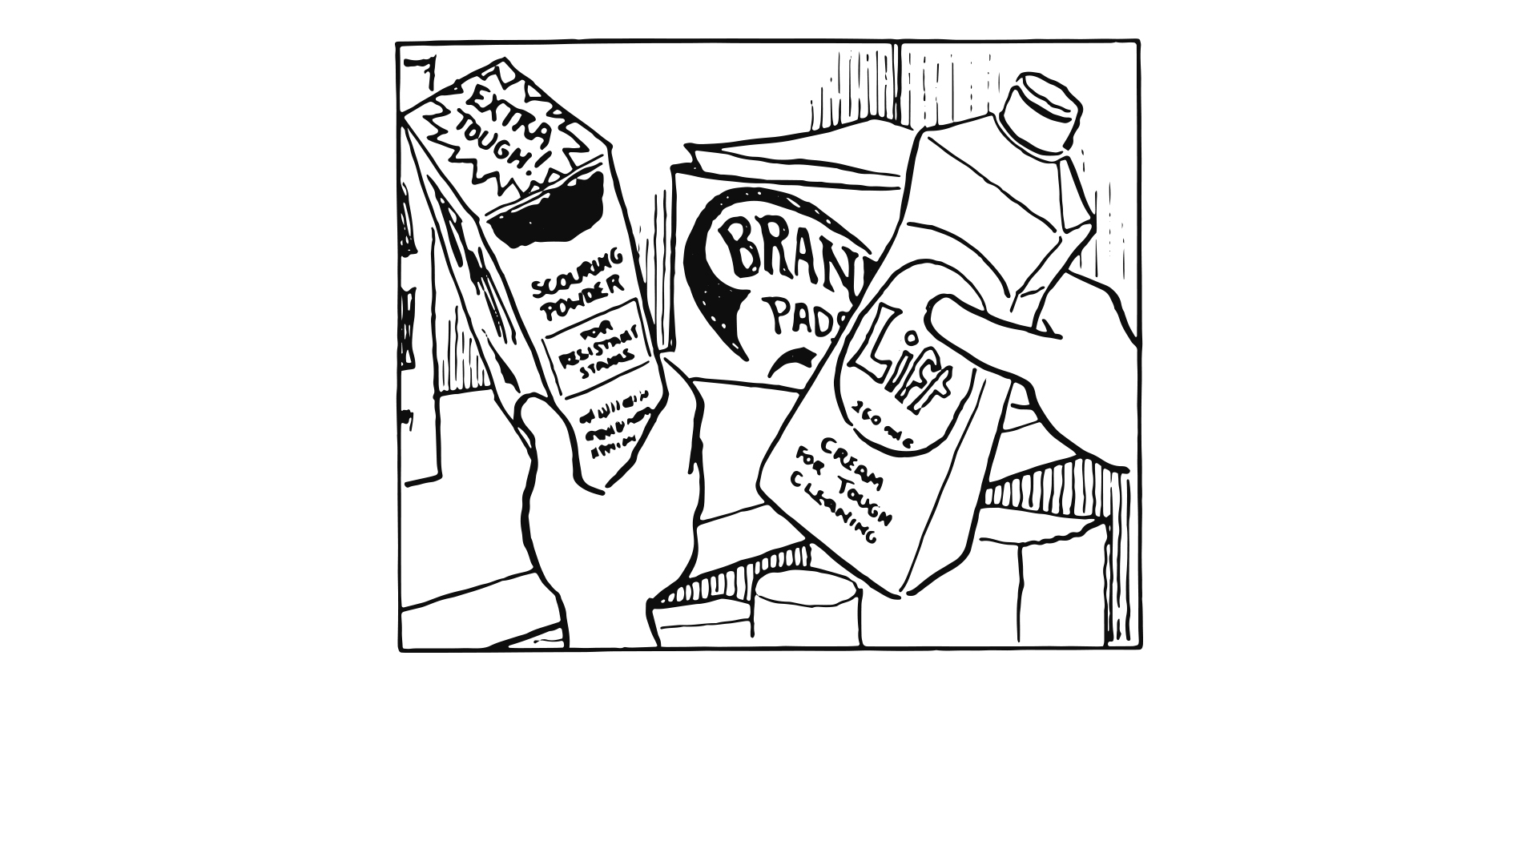
We had to be quick, dad wouldn’t be long

Slide 21
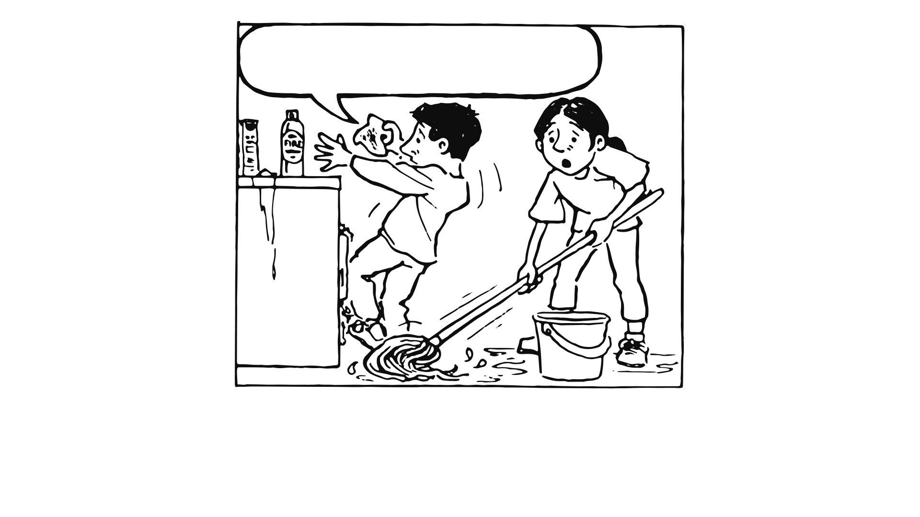
this scouring stuff scratches the…
aaaaagh!
O-oh…
Did Cal have to step back just then?

Slide 22
