Slide 1
save me campaign
In Germany
and in Dresden
Cities as Sanctuary: Improving Protection for Human Rights Defenders and Refugees in Europe
Centre for Applied Human Rights, University of York, 9-10 July 2013
Sebastian Herwig

Slide 2
Structure
Background
What actors are needed to initiate, develop and sustain such initiatives?
How is protection best framed to generate support from the general public?
What research will strengthen the capacity of European cities to provide protection?
Shortcomings in the German protection system

Slide 3
Background: The German resettlement program
2011: decision to adopt a regular UN resettlement program
300 refugees a year for the years 2012 – 14
900 in total
The first group (2012) came from the Shousha camp and from Turkey (Iraqi Christians)
1

Slide 4
Background: The German resettlement program
Shortcomings:
Those with “desirable“ qualification and religion are prioritised instead of the most vulnerable ones.
No refugee status, no permanent residence permit
1
Concept of resettlement …

Slide 5
Background: save me campaign
Before the resettlement programme was adopted, …
1

Slide 6
Background: save me campaign
Before the resettlement programme was adopted, …
51 City Councils
over 7,000 ‘Paten/Patinnen’ (godfathers/-mothers; mentors)
had already said Yes!
'bottom-up' approach
1

Slide 7
What actors are needed to initiate, develop and sustain such initiatives?
Step 1: Initiative
“We want to say yes!“
2

Slide 8
What actors are needed to initiate, develop and sustain such initiatives?
Step 2: Agenda-setting
Mobilising local support
Alliance-building
2
Targets are:
Civil society:
Recruitment of interested people
City councillors: lobbying “open-minded” and influential ones

Slide 9
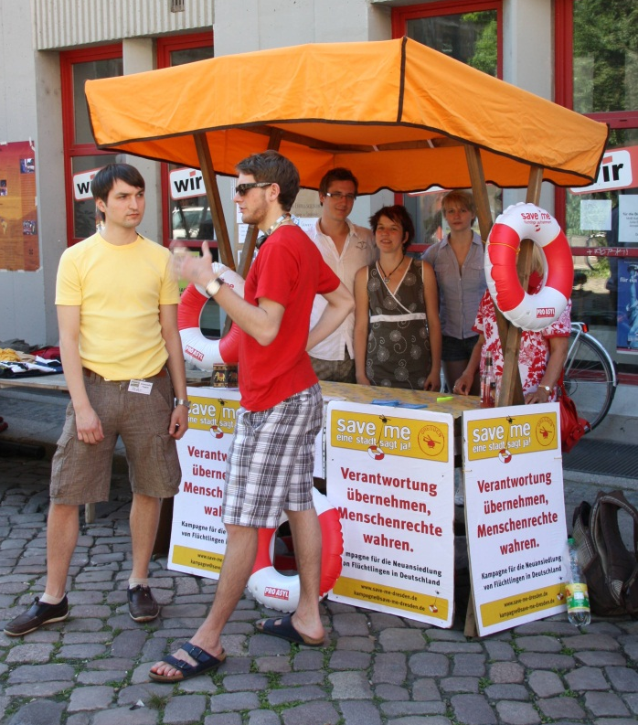
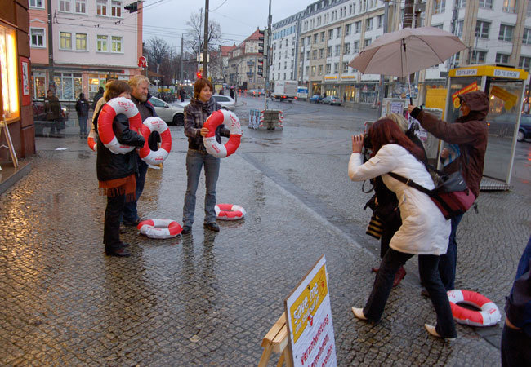
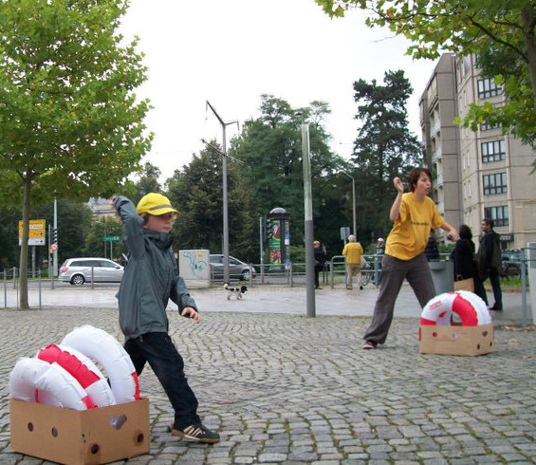
Raising public awareness and garnering support
through events and activities
The Save Me lifebuoys

Slide 10
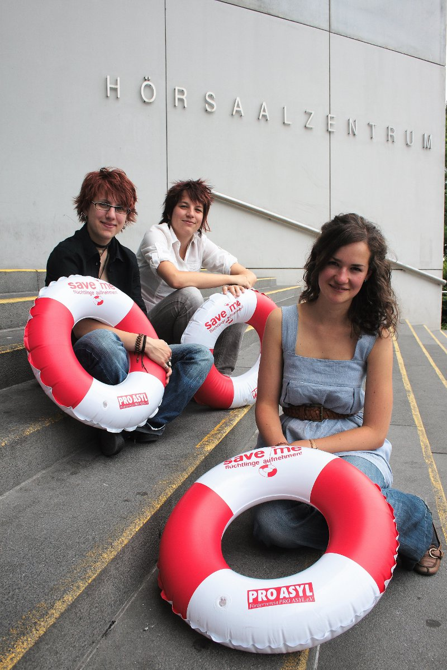
Raising public awareness, garnering support
The Saxony newspaper Sächsische Zeitung and Dresden’s university magazine ran several high profile stories on save me.

Slide 11
What actors are needed to initiate, develop and sustain such initiatives?
Step 3:
Preparation of the reception of refugees
After the city council resolution
Round table
2
Local public authorities:
Commissioner for Foreigners and Integration
Social welfare office (“Sozialamt”)
City council working group
Civil society:
save me representatives, mentors
Organisations in charge of reception and integration of refugees, such as church and welfare organisations, local refugee councils etc.

Slide 12
What actors are needed to initiate, develop and sustain such initiatives?
Step 4:
Reception and integration of the refugees
2
Mentors:
help refugees find their way around their new town
improve their language skills, find housing, complete forms and paperwork, and help children with their homework
<< Expertise (Money) >>
Constant SUPPORT needed

Slide 13
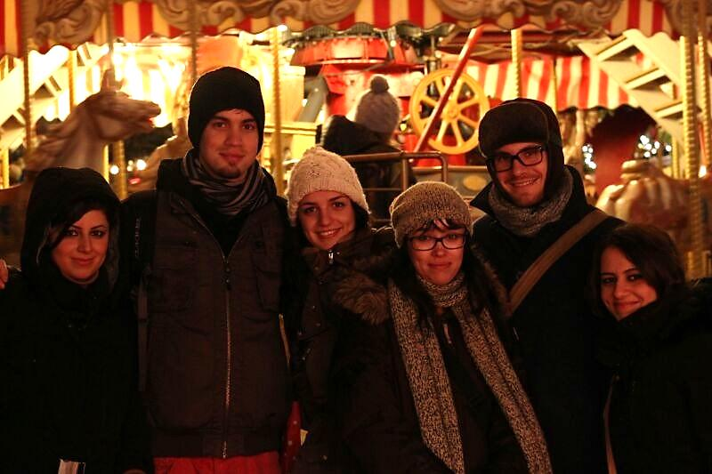

Slide 14
How is protection best framed to generate support from the general public?
Be inclusive!
people ‘like you and me’
‘I join, because… by doing…’
Guidance: training & coordination
Don’t overcharge the mentors
3

Slide 15
What research will strengthen the capacity of European cities to provide protection?
Monitoring the progress of resettled refugees who have been accompanied by mentors.
→ Did they take their place in society more easily and faster compared to those who did not receive this help?
4

Slide 16
Germany: Shortcomings or what has to be done
Reduce the case load of social workers
Hire save me managers
Otherwise, no capacities for ”Patenarbeit” left
Need of information!
Best practice Munich
5
Money & manpower

Slide 17
Germany: Shortcomings or what has to be done
Volunteers are additional to and not a replacement for the local public authorities
Some problems have to be tackled by municipal authorities “from above” and not by NGOs
Social transfers and services such as health care
More efficient mechanism of accommodation provision
5
Clarity of competences & responsibility

Slide 18
Sources
IMAGES
http://www.dw.de/resettlement-gekommen-um-zu-bleiben/a-16294663
http://mein.salzburg.com/forum/lichtblicke/2009/07/burger-dialoge-2010.html
http://staunend.blogspot.hu/2013/06/christliche-partei.html
http://www.infozentrum-dresden.de/site/auslaenderarbeit.php
http://tu-dresden.de/die_tu_dresden/fakultaeten/philosophische_fakultaet/is/mikro/forsch/Kinderstudie/Kinderstudie_Start
http://www.wolkdirekt.com/spannungszeichen-schwarzer-blitz-_-1197281.html
Photos: save me Dresden

Slide 19
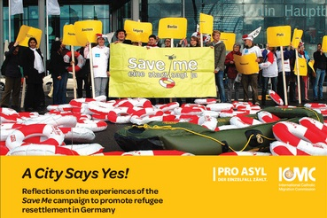
Thank you
for your kind attention!
 kampagne@save-me-dresden.de

Slide 20
Source: UNHCR, Global Trends 2012
“ Resettlement needs continued to exceed the number of places available by a ratio of 1:10.”
United States of America (66,300), Canada (9,600), Australia (5,900), Sweden (1,900), and Norway (1,200).
“The United States of America and Canada together admitted nearly nine out of ten resettled refugees in 2012.”

Slide 21
Hire more staff
case load of a social worker:
Per part-time worker in Germany: 130-200
Per full-time worker in the UK: ca. 30

Slide 22
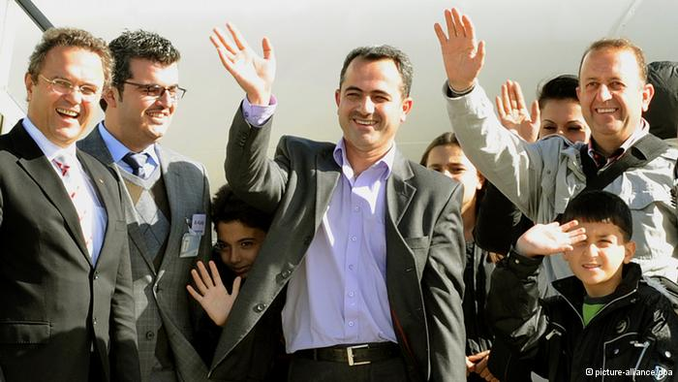

Slide 23
Available at: http://www.resettlement.eu/news/launch-share-pro-asyl-publication-city-says-yes

